Slide 1


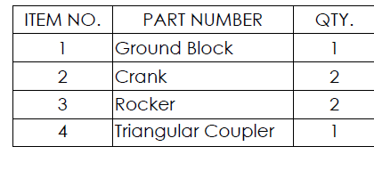
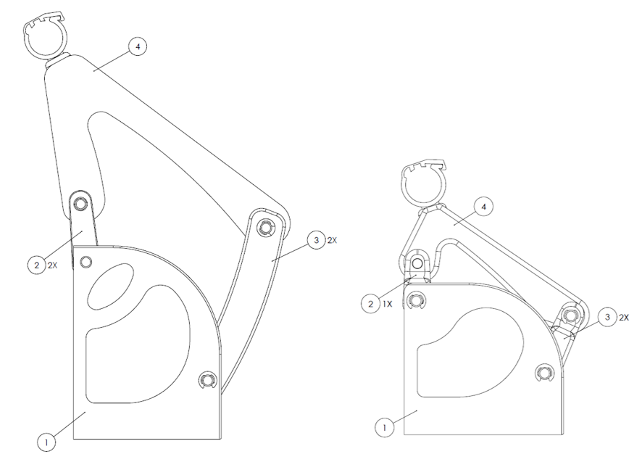
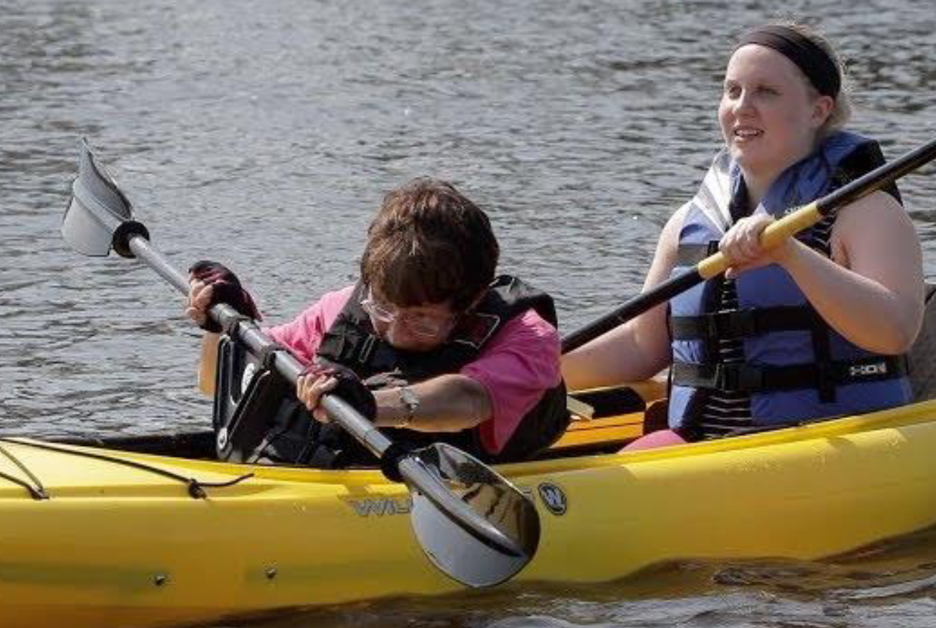
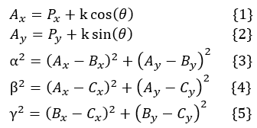
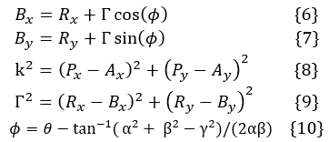
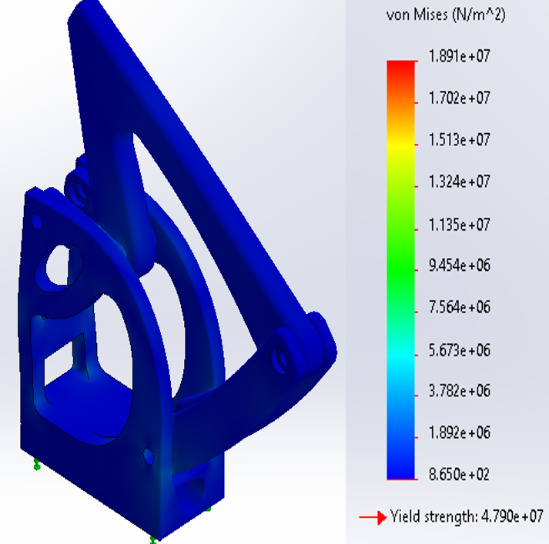
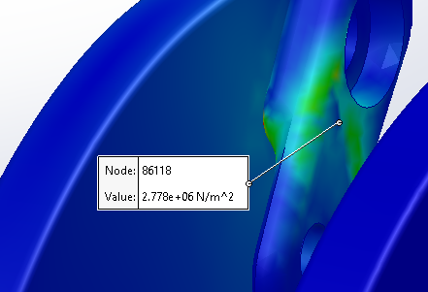
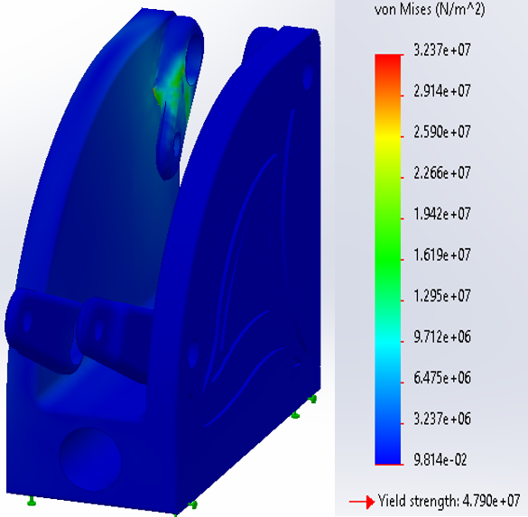
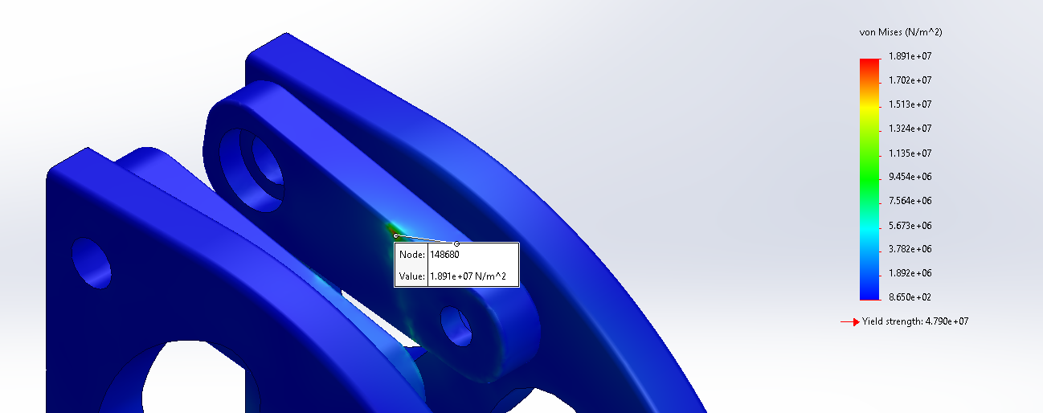
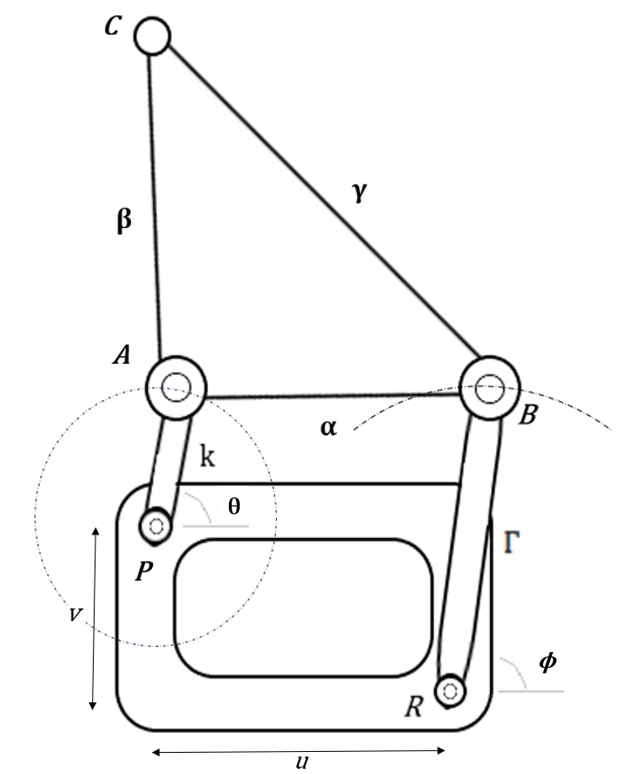
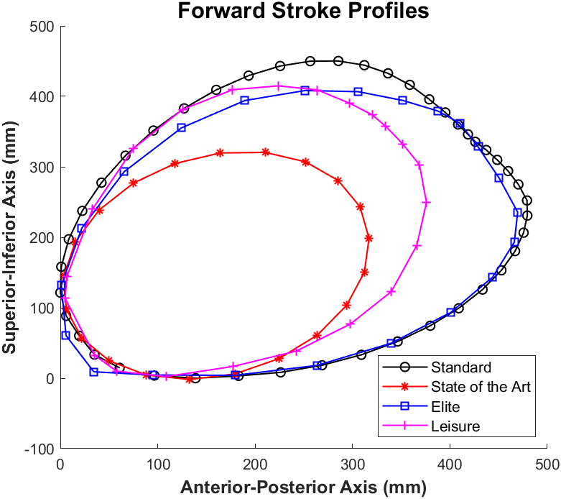
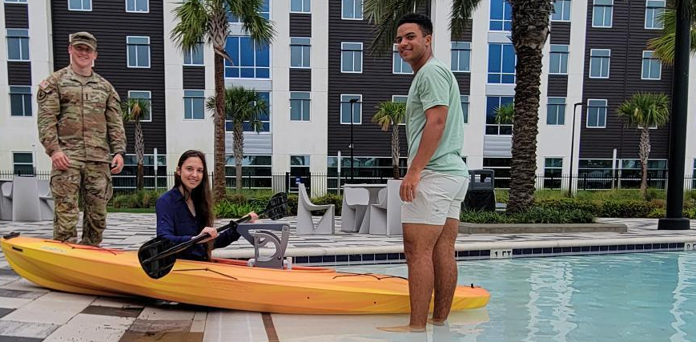
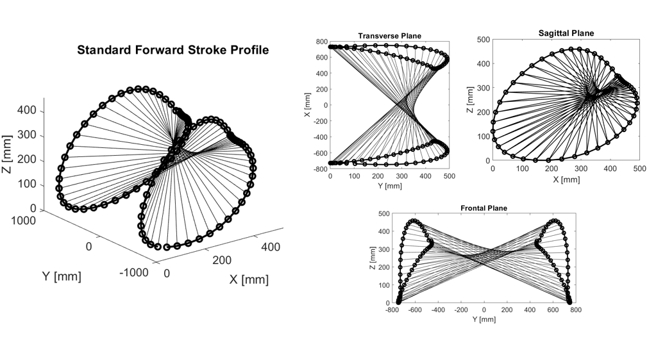
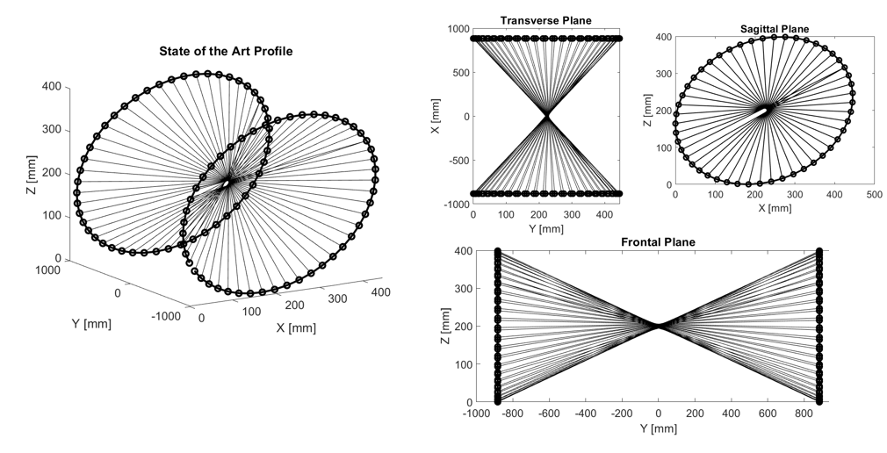
PROJECT FYN: Revolutionizing Adaptive Solutions for Universal Application in Aerospace and Beyond
Megan Parker, Alex Britton, Douglas Wingert
Department of Mechanical Engineering, Embry–Riddle Aeronautical University, Daytona Beach, United States
parkem19@my.erau.edu, brittoa3@my.erau.edu, wingertd@my.erau.edu
Mechanical Engineering
Biomedical Systems
INTRODUCTION
The Biomedical Systems Senior Capstone design team at Embry-Riddle Aeronautical University embarked on Project FYN to convert sub-optimal input into optimal output. With millions of Americans facing mobility impairments, 71% experience stress and isolation, including 150 in our community [1]. Through the lens of para-kayaking, the team aimed to highlight the revolutionary potential of mechanical systems in adaptive technologies to assist The Oceans of Hope Foundation (OOHF).
METHODOLOGY
Crank-rocker mechanism with a rotating crank, oscillating rocker, fixed ground point, and connecting coupler [3]. The end coupler point captures the sagittal plane OSP at “C” where the center point of the paddle is attached (Figure 5). Boots on the lower pin joints provide flexibility in the frontal plane accommodating variations in individual stroke width. The Evans 4-bar triangular coupler linkage was developed using equations 1-10 [2].
DESIGN
State-of-the-art Material(s):
PETG (linkage), PVC (linkage support)
State-of-the-art Dimensions:
Linkage Max. Height: 243.61 [mm]
Device Max. Height: 440.22 [mm]
Final Product Weight: 3.56 kg (~8 lbs.)
RMSE: 272.6478 [mm]
Leisure RMSE: 79.68 [mm]
4-Bar Linkage: 22.0204 [mm]
Currently, the Oceans of Hope Foundation uses the state-of-the-art Gamut Holder, which, due to its limited design, hinders genuine participation and imposes awkward limitations on natural motion for para-kayakers, forcing an unnatural teeter-totter motion, seen in Fig. 1.
Fig. 7 Elite Linkage (left) and Leisure Linkage (right)
LINKAGE SAFETY FACTOR
A MATLAB model optimized linkage dimensions to align point C with the standard stroke profile by rotating crank "k". Two path models, elite and leisure, were developed. The leisure path reduces effort while preserving stroke shape for enhanced accessibility. Accuracy was evaluated using root mean squared error. The relative accuracy of the linkage paths was compared to the standard forward stroke using a root mean squared error, common in the measure in the performance regression optimization metrics [
Fig. 1 OOHF Requiring assistance using the modified Gamut Holder due to reduced stroke profile
The capstone design team was tasked to develop a para-kayaking mount tailored to meet client requirements and optimize the forward stroke profile, turning suboptimal input into optimal outcomes.
BACKGROUND
Utilizing 3D motion profile data from the Micaplex, the team studied the optimal stroke profile, revealing a semi-ellipsoidal low-cut profile requiring translational movement along each primary axis. Paddle endpoints from 15 averaged forward kayak strokes were captured using 3D motion capture technology. From this dataset, an optimal stroke profile (OSP) was extrapolated, defining the paddle's center point path. Key dimensions from the OSP across each axis were determined, as illustrated in Figure 4.
Fig. 8 Elite Linkage (left) and Leisure Linkage (right) Maximum Von Mises Stress Locations
Table 1 Minimum Safety Factor
The Goodman Fatigue failure exceeded theoretical infinite life, with a range from 1.5-4.6 at the highest factor of safety. This matches the standards of general-use sporting equipment on the market today made from polymers and plastics [6].
 | Max Von Mises | Min Factor of Safety
Elite | 19 MPa | 2.2
Recreational | 2.8 MPa | 1.5
Fig. 5 Evans Linkage
Fig. 6 Evans Linkage Optimization
DESIGN
Requirements:
Safety – The final design shall not inhibit the user’s ability to wear an approved non-inflatable wearable personal flotation device, bind to the user’s extremities, or inhibit the user’s line of sight.
Metrics – The final design shall weigh under 10 lbs. (4.5 kg), fit in a standard 28” (711.2 mm) wide kayak, and Meet the MIL-STD-810G standard for saltwater spray resistance and UV resistance compliant with ASTM D4587.
Functionality – The final design shall produce the full ROM for the OSP with maximum dimensions of 768 [mm] (mediolateral axis), 310 [mm] (superior-inferior axis) and 315 [mm] (anterior-posterior axis), take no more than five minutes to assemble, and match the required rotational power of the user up to 80% given 20% minimum by the user.
Fig. 8 Project FYN device developed by the capstone team Douglas Wingert (left), Megan Parker (center), and Alex Britton (right)
ACKNOWLEDGMENTS
Special appreciation goes to the project advisor Dr. Christine Walck, Dr. Charles Reinholtz, Sheridan Perry, James Palmer, & Dutch Holland, for their time and valuable contributions.
REFERENCES
[1] Côté-Leclerc, F., Duchesne, G. B., Bolduc, P. (2017). How does playing adapted sports affect quality of life of people with mobility limitations?
[2] Pickard, J. K., Carretero, J. A., & Merlet, J. (2019). Appropriate analysis of the four-bar linkage. Mechanism and Machine Theory, 139, 237–250.
[3] H., & Reinholtz, C. (1987). Mechanisms and Dynamics of Machinery (4th Edition). Wiley.
[4] Walck, C., Huayamave, V., Garcia, M., Scott, E., & Palmer, J. (2023). Advancements in Assistive Devices for Para-Kayaking Sports.
[5] Li, J. (2015b). The Optimization Design of the Four-bar linkage Based on MATLAB. Advances in Intelligent Systems Research/Advances in Intelligent Systems Research. https://doi.org/10.2991/isrme-15.2015.160
[6] Seol, M. (2019). Perception of safety and usability of powered hand tools. https://doi.org/10.33915/etd.1644
Fig. 3 Motion Capture of Kayak Endpoints
Notes:
NEW POSTER! UPDATE

