Slide 1
Plan
Motivation
Underlying thinking
Setup SSH keys
Workshop!
Cheatsheets

Slide 2
There’s a few kinds of developers…

Slide 3

The one that doesn’t need source control
Big brain
Probably over 3 million IQ
Never makes a mistake
Doesn’t exist

Slide 4

The one that thinks they don’t need source control
Has no backups
Struggles to keep track of changes
Can’t safely experiment
Can’t collaborate
Can’t conveniently share
Notes:
Murphy’s Law: will 100% lose all his code in a freak EMP pulse memory wipe

Slide 5
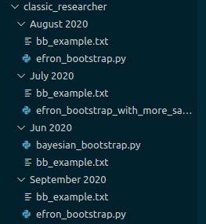
The one that does DIY source control
Good luck convincing a sane human being to work on code you have written like this
I have seen this in the wild – causes a nightmare
Only thing it solves is backups

Slide 6



The one that uses git + GitHub
Has stable searchable backups
Has a sense of chronology in backups – can keep track of changes
Can experiment with multiple features in parallel whilst not affecting the ‘real deal’
Combining all those experiments together at once is easy with merge
Powerful features such as diff comparisons and commit messages
Can easily collaborate with other developers
Reproducible Research
Notes:
Spent a week or so learning a basic workflow

Slide 7
A (little) theory
Before we dive into using the tool it helps to understand the basics of how it works behind the hood

Slide 8
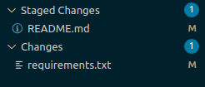
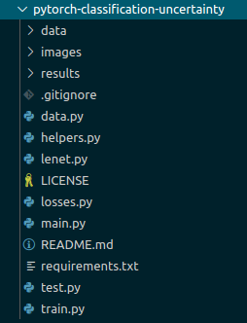
The git way of thinking about version control
git add
git commit
bb5
ad3
master
git init
HEAD

Slide 9
The git way of thinking about version control
git checkout –b some_branch
as7
12a
git add
git commit
some_branch
bb5
ad3
782
7hg
master
git init
HEAD
git merge some_branch
a4d
other_branch

Slide 10
local vs staging vs remote e.g. git vs GitHub
Remote repository
GitHub/GitLab
* Not to be confused with a ‘Pull Request’
git pull *
Local/
Disk
Where you make changes and what is actually shown to you in directory
Can reset this to places in the tree
Staging
A sort of short term ‘save’ of changes
Use this to try keep related changes together
Local Repository
The gremlin’s bag
Permanently saved into repo
git push
git add …
git commit
Notes:
Local/Staging/Repo/Remote

Slide 11
local vs staging vs remote e.g. git vs GitHub
Where we have permission
Someone else's repo
Copy of someone else's repo we can push to
Fork
* Not to be confused with a ‘Pull Request’
git pull *
Local/
Disk
Where you make changes and what is actually shown to you in directory
Can reset this to places in the tree
Staging
A sort of short term ‘save’ of changes
Use this to try keep related changes together
Local Repository
The gremlin’s bag
Permanently saved into repo
git push
git add …
git commit
Notes:
Local/Staging/Repo/Remote

Slide 12
SSH keys
How does Github know what you are allowed to use?

Slide 13
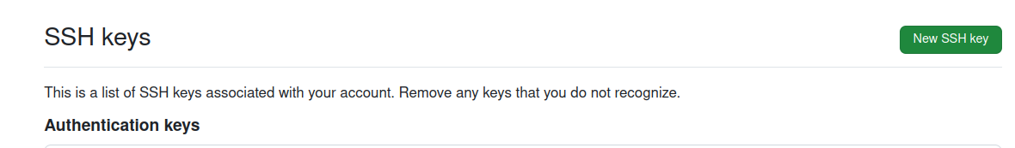
Setting up SSH keys
ssh-keygen -t ed25519 -C "your_email@example.com"
Don't use a password.
Open up generated '.pub' file
Copy the whole text start to finish
Go to Github account settings > SSH and GPG keys
4.

Slide 14
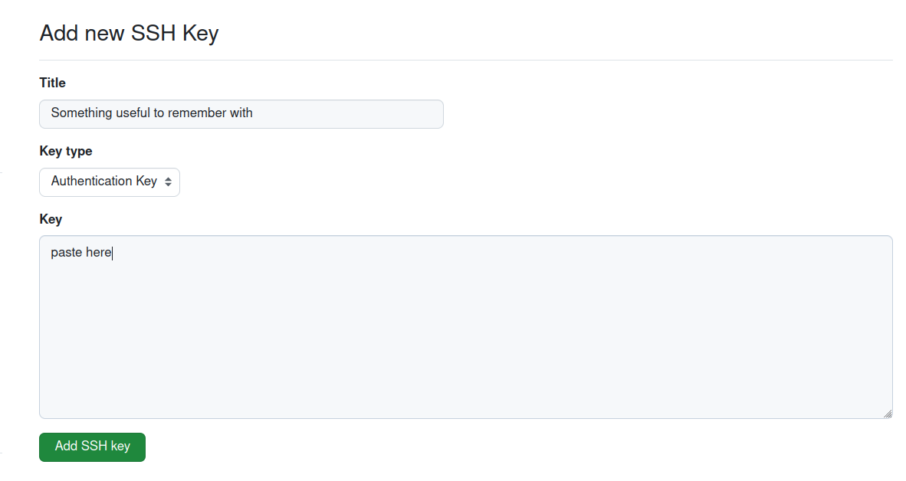
Setting up SSH keys
5.

Slide 15
Setting up SSH keys
6.

Slide 16
Setting up SSH keys
7.

Slide 17

Check it works
1

Slide 18
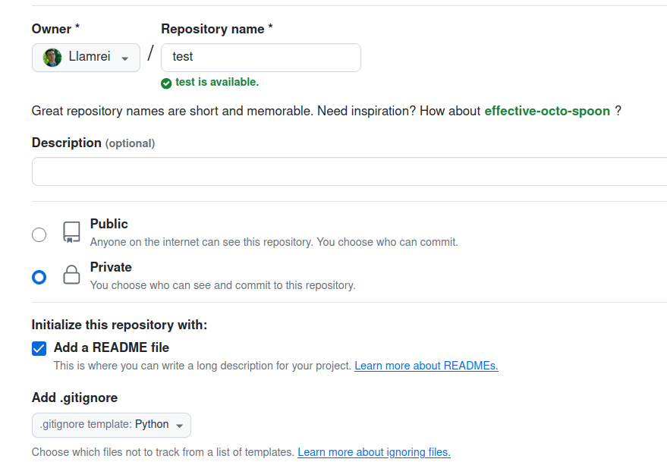
Check it works
2.
3.

Slide 19
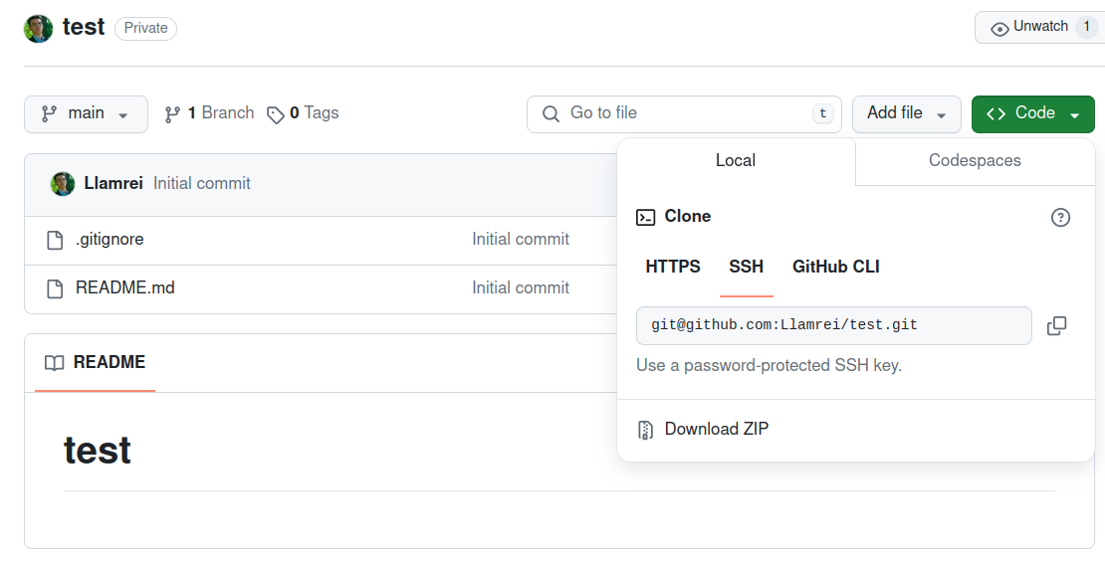
Check it works
1
2

Slide 20
Check it works
git clone <paste>

Slide 21
.gitignore
Magic file that tells the git gremlin to not remember changes to specific files.
Why?
Because some files too darn big.
Also, some files are pointless intermediate crud.
Can supply wildcard patterns
Can copy common gitignore files depending on project
For python: https://github.com/github/gitignore/blob/main/Python.gitignore
For R: https://github.com/github/gitignore/blob/main/R.gitignore

Slide 22
Time for a practical!

Slide 23
Workflow Cheatsheet – on an existing project
Optional: fork the repository​
git clone [url] (once allowed to edit repo)
git status
…
git add [changed files]
…
git commit -m [some message to help you remember what you did]
git push –u origin [new branch name]

Slide 24
Workflow Cheatsheet – starting a project
git init
...
git add [changed files]
…
git commit -m [some message to help you remember what you did]
# Go to GitHub and make a new repository
git remote add origin [repository url]
git push
Notes:
Start a repo – git init
Get a repo from the internet – git clone
Move to staging – git add
Save in repo – git commit
Create a new branch – git checkout –b
Move between branches – git checkout
Check whats up – git status
Undo a commit – git reset –soft
How to get changes from another branch – git pull

Slide 25
Workflow Cheatsheet – on an existing project (better)
Optional: fork the repository
git clone [url] (once allowed to edit repo)
git status
git checkout –b [new branch name]
…
git add [changed files]
…
git commit -m [some message to help you remember what you did]
git push –u origin [new branch name]

Slide 26
Workflow Cheatsheet – combining work
You don’t need to or really should do this in terminal. This is better done as a ‘Pull Request’ on GitHub
Make sure everything you wanted to commit in current_branch is committed
git checkout [branch you want to move changes into]
git pull (this is to make sure we are at the latest version)
git merge current_branch
… this could be a bit messy – practice!
git commit –m [reminder]
git push
Notes:
Start a repo – git init
Get a repo from the internet – git clone
Move to staging – git add
Save in repo – git commit
Create a new branch – git checkout –b
Move between branches – git checkout
Check whats up – git status
Undo a commit – git reset –soft
How to get changes from another branch – git pull

Slide 27
References
For any git related weirdness or questions:
If you want to understand: https://www.atlassian.com/git/tutorials
If you just want this thing to work: https://stackoverflow.com/

