Slide 1
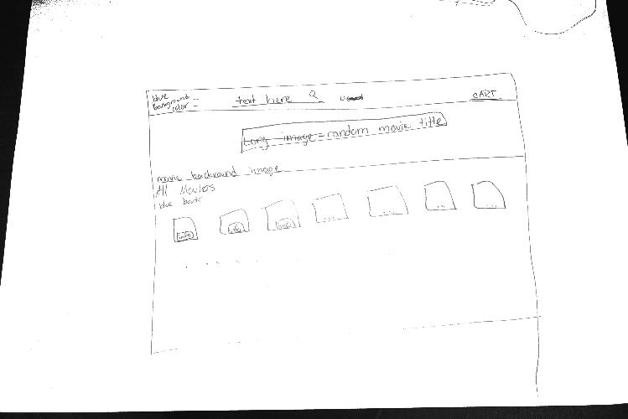
Mock Up
Notes:
In reality, you’d need to know more detailed information about the current checkout process in order to include any restrictions in the system, such as:
Number of equipment a person can checkout
Could someone checkout equipment even if s/he hasn’t returned a previous item?
Are users able to reserve equipment?
What happens if a device is returned in bad conditions (broken, not working, scratched, etc.)

Slide 2
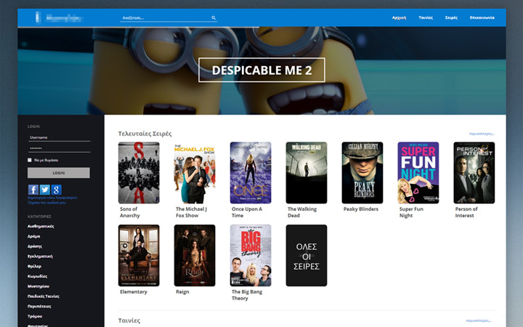
Mock up 2

Slide 3

BlueBox movie rentals
User Story
The project is a movie rental service similar to "RedBox" in which a user may search the database for movies and return results. They will also be able to add movies to their cart and check them out. There will be a set database of movies that can be searched for and will include prices per movie. They will be able to filter by movie name, category(blu ray dvd), or by genre from a dropdown box.

Slide 4
BlueBox Rental
Database Design
Use spreadsheet to identify the “entities”
Apply the First Normal Form to each entity
Check relationships between entities
belongs to
movieId
movieName
genreId
priceId
Movies
1
N
prices
priceValue
priceId
M
1
1
N
N
1
belongs to
1
1
genreId
genreName
genres

