Slide 1
Introduction
Week 0 – Day 1
CS-1064 "Intro to Python"
Austin Cory Bart, Virginia Tech, 2018
Notes:
Instructor lecture notes will go down here.

Slide 2
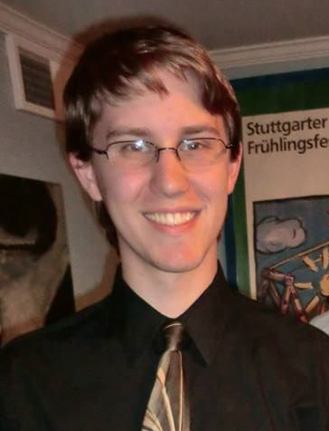
Dr. XXX
<Discipline>
<Teaching Experience>
<Hobbies/Research>
Notes:
This slide is meant to introduce you to the students. You are free to customize it as you see fit. I gave them my title, discipline, research background, and teaching experience. You are free to give whatever information you think is relevant to make you seem more authoritative/approachable/etc.

Slide 3


The Course Staff
Other instructors
GTAs
UTAs
Notes:
This slide is meant to show photos of the other course staff. In particular, you can show photos of the other instructors and teaching assistants, and give their names. You want students to be comfortable approaching the teaching assistants. This information should also be on the course site.

Slide 4
You
~300 students
50% sophomore, 40% juniors and seniors, 10% freshmen
66% male, 33% female
GE, Ind. & Sys. Eng., Mech Eng., Civil Eng, Physics, University Studies, etc.
Notes:
These statistics break down who the students are and give them a sense of who their classmates are. These numbers are accurate for Fall 2017.

Slide 5
Force-Add
I cannot Force-add.
I don't think there are any force adds.
Check department website for more information.
Notes:
You may have a different force-add policy, but this is the current one for the department.

Slide 6

"Intro to Programming in Python"
Notes:
Remind the students that this course is named "Introduction to Programming in Python", and therefore they will be learning to program in Python.
This course has no prerequisites
Although some students have prior experience, it is assumed that you have no prior programming experience
Basic digital literacy is expected – you should know how to use a web-browser

Slide 7
Course Format
Each week is a new module composed of 2-8 lessons
Each lesson is composed of:
Video/Slides/Transcript of material
Canvas quiz
Programming problems
Some modules have a mini-project, survey, or ethics activity
Notes:
This is when you outline the major course format.
You want to explain the weekly module format, and the format of lessons.
Mention that lessons do not necessarily always have a quiz and programming problems, but they will have one of those.
You can speak a little bit about the video lessons – students should check them out, but they can also just read the transcript or skim the slides if they feel confident about the material.
Don't worry about explaining anything too in-depth at this point.

Slide 8

Open/Lock Dates
Module opens all at once Friday before
Module locks two weeks later
No late submissions/penalties
Notes:
All the assignments for a module open the Friday before the module starts
Those assignments will lock two weeks later
Recommend that they complete assignments during their week, rather than waiting till the deadline
Once a module locks, no submissions are possible (don't waver on this – you'll be eaten alive reopening assignments)
But on the plus side, there are no late penalties.

Slide 9
Class Time
Some lecture
Some group work
Some free time to work
Notes:
Depending on how you plan to use classtime, you might modify this.
I tell them that I lecture for about ~20 minutes (some slides, performances, code examples) to reinforce the important bits of lessons.
Then I usually have the rest of classtime open for students to work on problems and ask the staff questions.
If we see you leave, and then you show up in our office hours later, don't expect much sympathy or attention.
Class time is the ideal time to get help.
We'll talk about the groupwork aspect when it becomes relevant.

Slide 10
Finals
Exam
Project
Notes:
Break the bad news that there is a final exam and a final project.
The exam is cumulative, will talk more about it nearer the end of the semester.
Exams are important for assessing their understanding and motivating them to master the material.
There are several mini-projects throughout the course, and then one big final project.
A lot of class-time will be dedicated to working on the final project.

Slide 11
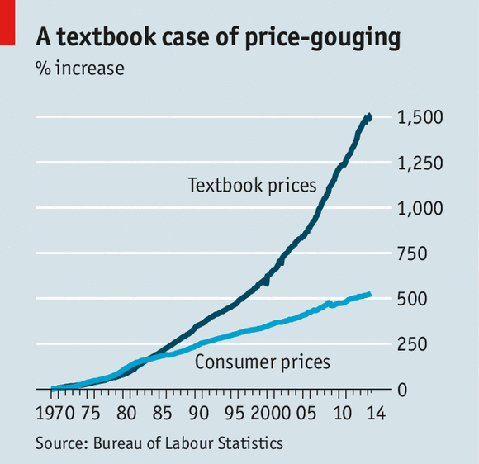
Textbook
NO TEXTBOOK!
Notes:
There is no required textbook for the course.
There are three optional textbooks available, two of which are free online.
Some lessons will have readings highlighted for it.
But again, no one is required to buy any textbooks.

Slide 12
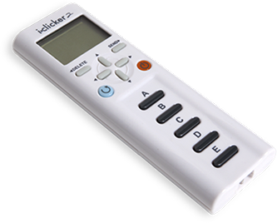
Clicker + Laptop
Need an i>clicker
Also, bring Laptop
Notes:
Clickers are required.
They must be the regular i>clicker – these shouldn't be too expensive, can probably get a used one for cheap.
Laptops are also required.
You'll be doing a lot of work in class.

Slide 13
Canvas Site
Notes:
This is a chance for a demo of the canvas site. You should walk through the following in the Student View:
The navigation tabs on the left
The Module view
What an individual lesson looks like ("#1) Lesson: Introduction")
How to look at the video
How to show the transcript under the video (there's a button for Show/Hide transcript)
How to access the slides
How to access the lesson's assignments
What a quiz looks like
Today's programming assignment (Maze game)
What the Grades menu looks like, how to go to a submission and then the assignment for that submission
Show the syllabus page
Show the Course Staff page
Go to the Piazza, demonstrate how to make a post

Slide 14
Getting Help
Piazza
TAs + Dr. Bart
Textbook
Classmates
Google
Notes:
Let them know the major sources of help.
The piazza is one of the most preferred ways. They need to follow its rules: no posting code publicly (honor code violation).
There are also office hours scheduled, and of course the class time.
They can get help from each other, but need to be careful.

Slide 15
Cheating, Collaboration, Communication
Notes:
They must not take code from anyone besides the course staff.
Doing so is an honor code violation, and we have ways of detecting that (e.g., MOSS).
When you get help from peers, it can only be high level conceptual help or motivational.
You are encouraged to help each other, but do not share code or look at each other's solutions.
All of this is laid out in the Cheating Collaboration Communication Page on Canvas.

Slide 16

Any Questions?
Notes:
I usually let them ask whatever questions they have now.

Slide 17
Lab Time
DO NOT LEAVE
I mean, like, unless you're on fire or something
Work on class assignments!
Notes:
Many will leave, but ask them to stay and work on assignments. You can check to see how many are actually done before class starts, and gauge if too many are leaving. Still, the early material is easy so don’t necessarily need to hold them down.

