Slide 1
Python
Week 0 – Day 2
CS-1064 "Intro to Python"
Austin Cory Bart, Virginia Tech, 2018
Notes:
Instructor lecture notes will go down here.

Slide 2
Notes
GET YOUR CLICKER – Need it by Friday!
No Force/Adds
Notes:
You might have other notes for students, feel free to modify as necessary.

Slide 3
Programming
Makes the world go round
Notes:
You want to begin with a high-level motivation for why we're here. My argument to students is that programming is used everywhere and by everybody. There's probably several hundred computers in the room with the students right now, and they all needed to be programming. It's a relatively modern invention, and it's really changed the world. Probably most of them don't need to be convinced, but a pep talk can't hurt, right?

Slide 4

"Intro to Programming in Python"
Notes:
Time to remind them that this is a class about the Python programming language.

Slide 5
Why Python and not…
Java?
JavaScript?
Swift?
C?
C++?
MatLab?
Notes:
Highlight that there are many other languages in the world, which have their own trade-offs. Python is not the best language for every task – but it is a useful language for many kinds of problems. We aren't here to sell Python too much, but let them know that it's one of the biggest ones out there, on par with Java, C, or JavaScript.

Slide 6
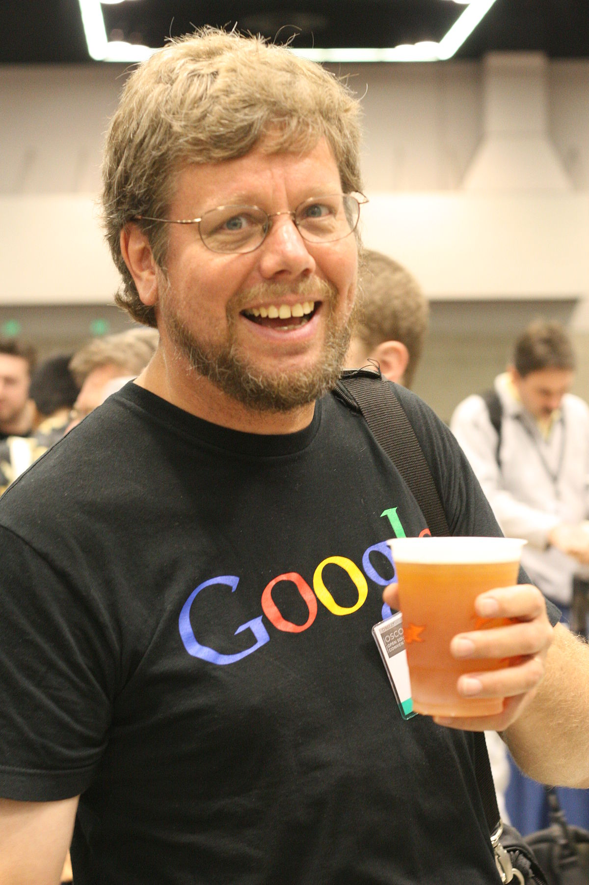
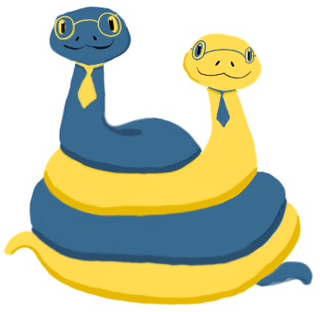

Why is it named "Python"?
Notes:
Some quick history!
Python was created around 1991 (depending on when you consider its first release)
The guy in the photo is named Guido van Rossum (pronounced https://www.howtopronounce.com/guido-van-rossum/), he's the original creator of Python.
But Python is now more of a community effort than the work of one person.
It is not named after the snake, it's named after Monty Python's Flying Circus, a famous British comedy troupe that probably none of your students recognize.
More info: https://en.wikipedia.org/wiki/Python_(programming_language)

Slide 7

What is Anaconda?
Notes:
The main goal of class time today is to have them install Anaconda, which is a distribution of Python that includes many common tools and packages.
Fortunately it's free and pretty easy to install. Instructions for installing it are in lesson #2, which requires them to upload three screenshots to prove that they successfully installed all the software they need.

Slide 8
Installing Anaconda
Notes:
This is where you can demonstrate how to access the Anaconda website, download the installer, and then install things.

Slide 9
IPython
Notes:
You'll want to have installed Anaconda before class so you can show them the IPython application. This is just a REPL for Python, makes it easy to try out commands. Make it clear to them that this is not a place to write longer scripts! This is for trying things out quickly.

Slide 10

Spyder
I promise I'm not making these names up
Notes:
Spyder is the name of the editor most of them should use. It is meant for writing scripts, and should be used for the projects. Open up the application and demonstrate:
Creating a new document
Editing a file
Opening a file, saving a file
Running your code with the green triangle
Interpreting the results of running code

Slide 11
Programmer Text Editor
Windows:
NotePad++
Mac:
Sublime
Linux:
eMacs, VIM
Notes:
The instructions will also demand they install a serious text editor. The built-in ones for mac and windows won't cut it. Some options are listed here. Expected a ton of questions from students about other valid ones, I'm betting.

Slide 12
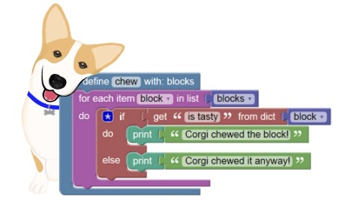
BlockPy
Notes:
Finally, you'll want to demonstrate BlockPy. There's an actual assignment that uses BlockPy in lesson #3. Make sure you're in Student Mode and walk through the interface:
Next/Back buttons (though this assignment only has one question)
Read the prompt in the top-left
Below that is the console where you can print things and make graphs
Next to it is the spot for feedback
Below that is the toolbar, which has the all-important run button.
Write code in first the block interface, then the text interface, then show the Split view to see how they stay in sync.
Recommend they move to the text interface as soon as they are comfortable (students won't need much prompting)
Demonstrate running the code, observing the output, and reading the feedback.

Slide 13

Any questions?
Notes:
Chance to let them ask questions.

Slide 14
Work on assignments
DO NOT LEAVE
Notes:
Recommend they finish all the lessons for this week so they can enjoy the weekend hassle-free.

