Slide 1
Modules
Week 10 – Day 2
CS-1064 "Intro to Python"
Austin Cory Bart, Virginia Tech, 2018

Slide 2
Modules
Organize your code

Slide 3
JSON
Share data easily

Slide 4
Was the file properly closed?
import json
json_data = json.load(open("my_data.json"))
# ... Process the Data
json_data.close()
A) Yes
B) No

Slide 5
Was the file properly closed?
import json
def process_json(path):
json_file = open(path)
json_data = json.load(json_file)
# ... Process the Data
return json_data
json_file.close()
process_json("my_data.json")
A) Yes
B) No

Slide 6
Web Data
Great but volatile

Slide 7
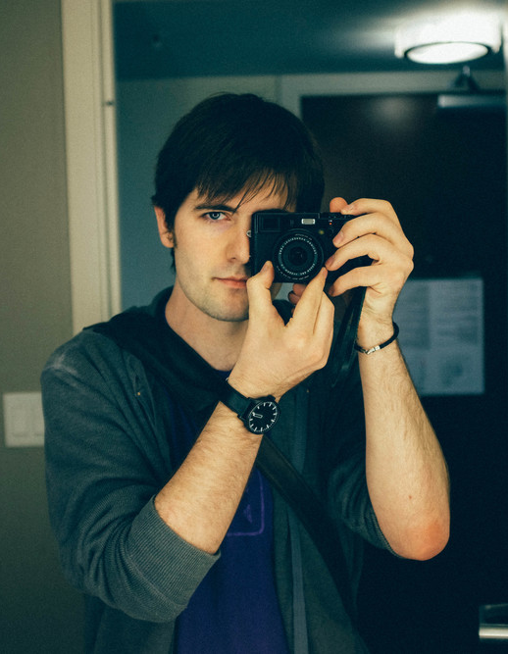
Requests
"HTTP for Humans"
Kenneth Reitz, the creator of Requests

Slide 8
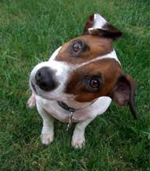
Any questions?

