Slide 1
Plotting
Week 11 – Day 1
CS-1064 "Intro to Python"
Austin Cory Bart, Virginia Tech, 2018

Slide 2
MatPlotLib
Mathematical Plotting Library

Slide 3
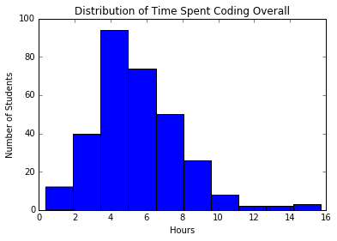
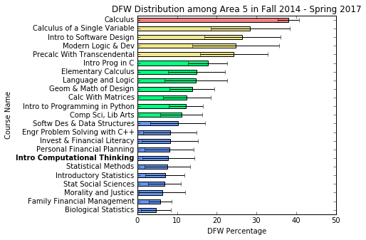
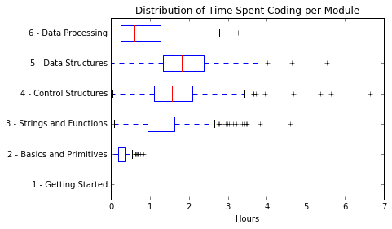

Slide 4
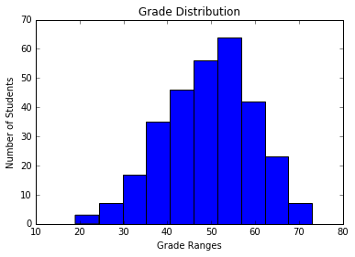
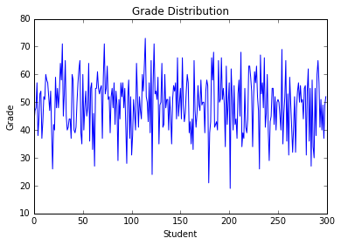
Which Visualization is best for looking at a distribution of Grades?
A)
B)

Slide 5
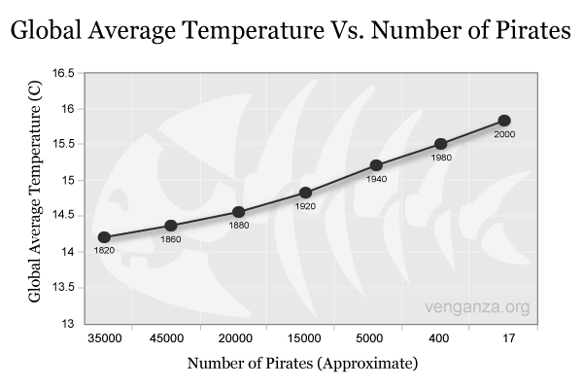
Decreases in pirates has caused global warming:
Probably true
Probably false

Slide 6
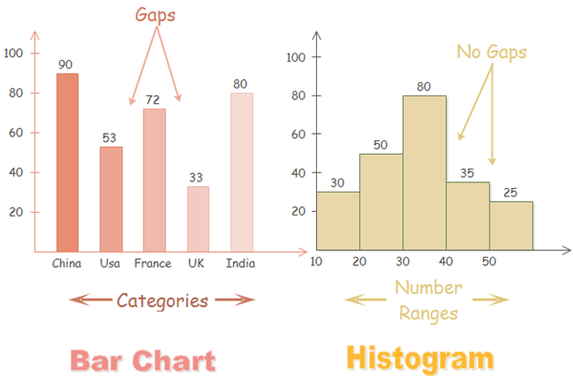
Histograms vs. Bar Charts

Slide 7
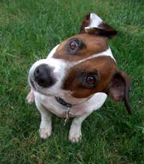
Any questions?

