Slide 1
Data Science
Week 11 – Day 2
CS-1064 "Intro to Python"
Austin Cory Bart, Virginia Tech, 2018

Slide 2
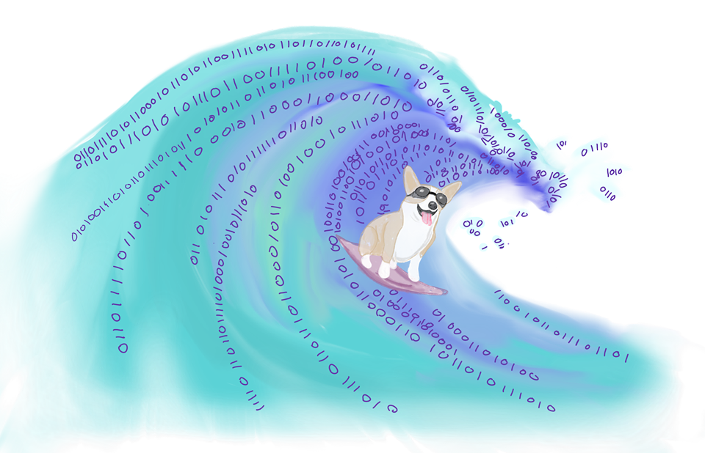
Data is everywhere!

Slide 3


Lists
Dicts
Ints
Abstraction
Floats
Real World
Bools
Strings
Explore Dataset
Make Question
Write Algorithms
Answer Question
Analyze Impacts
Communicate Results

Slide 4
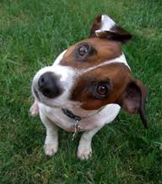
Any questions?

