Slide 1
Defining Functions
Week 3 – Day 1
CS-1064 "Intro to Python"
Austin Cory Bart, Virginia Tech, 2018

Slide 2
Functions
Reusable bits of code
Notes:
Today's lecture is about defining functions your own functions. You want to begin by highlighting the reason why we use functions (to write chunks of code in isolation, making them easier to test and think about, and to reuse them).

Slide 3
Practicing functions
Notes:
Spend some time solving some example questions. Highlight how you read a prompt involving code. Here are some example function questions (probably don't want to do all of them).
Write a function that consumes a string and returns whether the string contains either "hot" or "cold".
def hot_or_cold(a_string):
return "hot" in a_string or "cold" in a_string
Write a function that consumes two numbers and returns them as a mathematical expression. So the arguments 4 and 5 would become "4+5=9".
def make_math(left, right):
return str(left)+"+"+str(right)+"="+str(left+right)
Write a function that consumes a URL (as a string) and returns whether it is secure (starts with "https" instead of "http").
def is_secure(a_url):
return a_url.startswith("https")
Write a function that consumes an integer and gets input from the user, and returns whether that input is the same as the integer (good chance for audience participation, write it without converting the input and ask them why it doesn't work).
def test_input(a_number):
user_number = input("Give me a number:")
return str(a_number) == user_number
Write a function that consumes a message and prints it out twice, and then returns the integer 2.
def print_echo(a_message):
print(a_message)
print(a_message)
return 2

Slide 4
Parameters vs. Arguments
Parameters:
When you define a function, you specify the formal parameters.
Arguments:
When you call a function, you replace the parameters with arguments (values)
calculate_volume(5, 10, 7)
Notes:
Students get tripped on parameters vs. arguments, but it's a vocabulary thing. Going over it in class highlights its importance.
This is a chance to practice writing another function:
def calculate_volume(width, length, height):
return width * length * height

Slide 5
How many arguments will this take?
Create a function that consumes a string and a number and returns the number of times that that number appears in the string.
A) 0
B) 1
C) 2
D) 3
Notes:
After you've asked the question, open up your editor and write a solution.
def number_count(a_number, a_string):
return a_string.count(str(a_number))

Slide 6
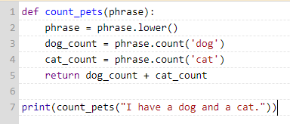
Which line is executed first?
A) 1
B) 2
C) 5
D) 7
Notes:
A tricky idea to get across is that functions are defined before they are used. Their body is not executed until they are called.
The first line of any program is always the first one executed, so this is A.

Slide 7
Which line is executed second?
A) 1
B) 2
C) 5
D) 7
Notes:
Execution then jumps down to 7. This is D.

Slide 8
Which line is executed third?
A) 1
B) 2
C) 5
D) 7
Notes:
But then the execution jumps back up to 2.
You can highlight this in your favorite debugger (e.g., the PythonTutor).

Slide 9
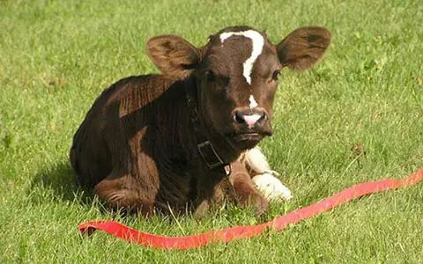
Any questions?

