Slide 1
Lists (and Loops)
Week 5 – Day 2
CS-1064 "Intro to Python"
Austin Cory Bart, Virginia Tech, 2018

Slide 2
Who care about lists?
Notes:
Lists are a powerful tool for collecting related data into the same place. Any noun can be collected – you have a list of students, a list of grades, a list of commands, a list of whatever. Lists are just an ordered representation of some data.

Slide 3
Which of these definitions has a list parameter?
A)
B)
C)
def find_biggest(a_list):
def find_biggest([a_list]):
def find_biggest("a_list"):
Notes:
Around this time, students start getting anxious about types. They'll try and force parameters to have types, especially if they come from a Java/C background. But parameters don’t have types, and they'll make mistakes like B and C. For the record, A is the correct choice.

Slide 4
Lists
Create a function check_animals that will consume a list of strings and returns whether any of them are "cat" or "dog".
Create a function make_extents that consumes a number and returns a list with that number and its negation.
Notes:
You'll want to do some worked examples of working with lists. Here are two example problems.
def check_animals(animals):
return "cat" in animals or "dog" in animals
def make_extents(a_number):
return [-a_number, a_number]

Slide 5
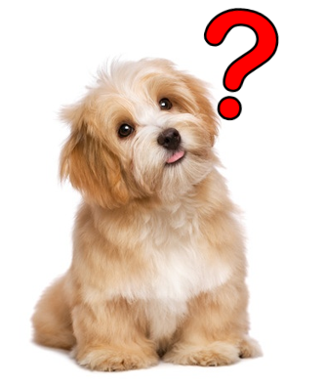
Any questions?

