Slide 1
Project 4: Text Adventure Games
Dr. Bart
CS-1064 "Intro to Python"

Slide 2
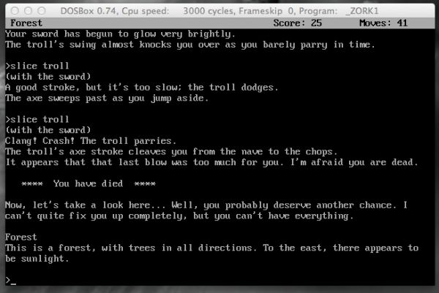
Text-based Adventure Games
Playable examples:
Zork
Spooky House
Finding Adventure

Slide 3
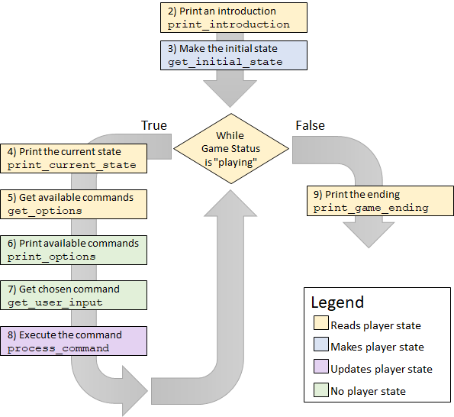
Main Game Loop

Slide 4
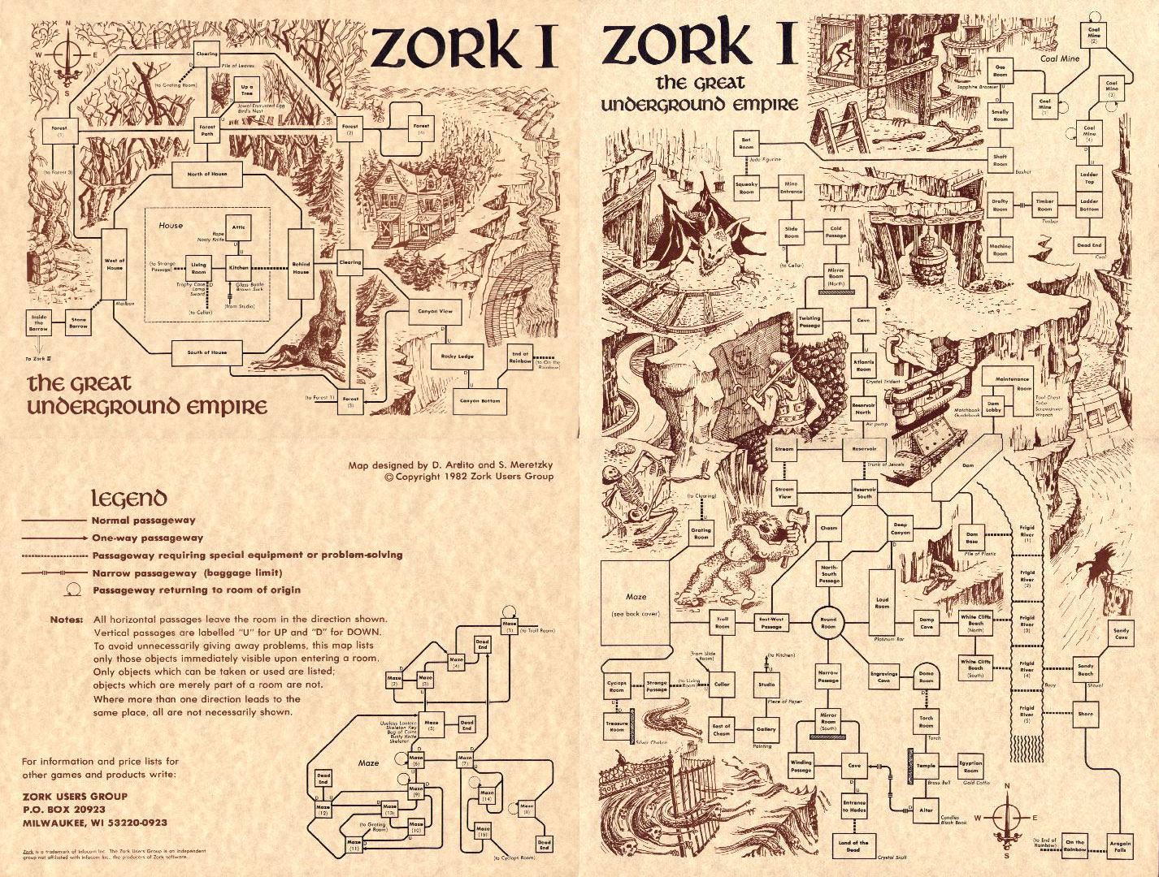
Zork Game Location Diagram

Slide 5
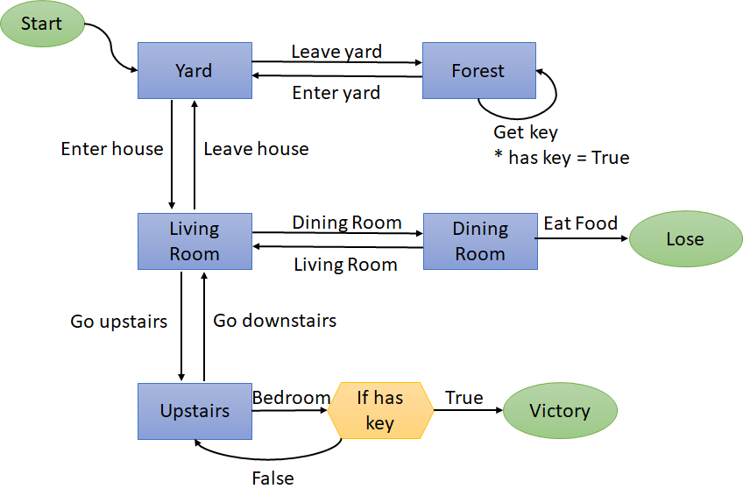
Two Diagrams
Game Location Diagram
Player State Table
Key | Value | Initial | Description
game status | string | "playing" | Whether the game is in progress or has ended
location | string | "Yard" | Where the player is in the world
has key | boolean | False | Whether they have collected the bedroom key

Slide 6
Functional Requirements
Clear, deterministic path to Win and Lose
Able to Quit at any time
At least 4 player fields (2 of which are required)
Every field used
Every field modified
Some creativity and self-expression
Good code organization

Slide 7
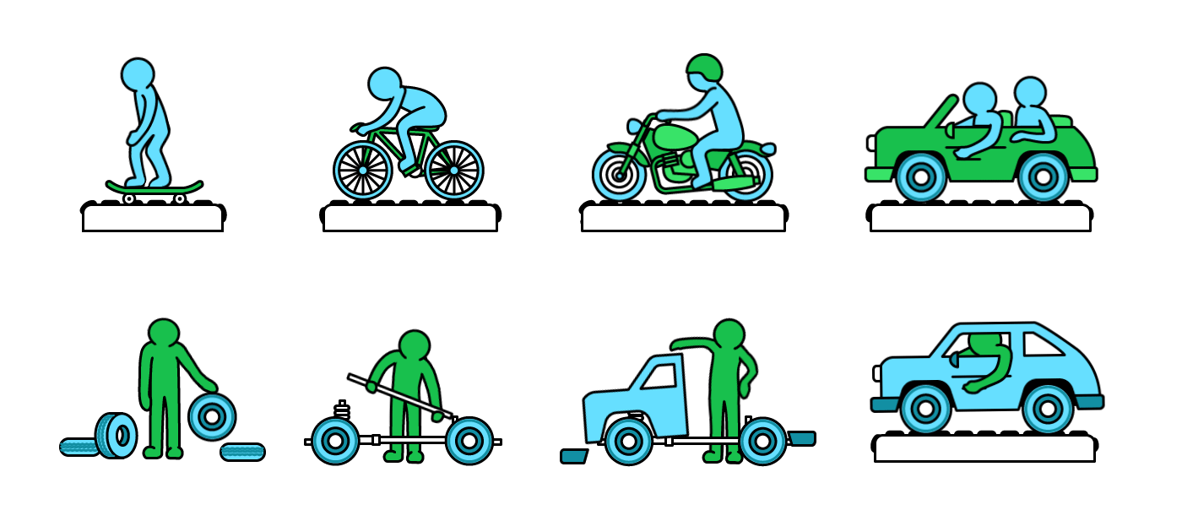
Developing the functions
Sequential Design
Agile Design
Write and test each function, one at a time, after the other
Comment out parts of the engine you aren't ready yet to test
Always have a runnable game, even if it is uninteresting
Slowly add features and complexity
Test incrementally

Slide 8
The Curse of Infinite Loops
If your game gets locked in to an infinite loop, here are ways to escape:
CTRL+C
Breaks out of the program
CTRL+.
Restarts the console
Press the red X on the console tab in spyder
Restarts the console
Close and reopen Spyder
Restarts Spyder

Slide 9

Any questions?

