Slide 1
Modules – Web Data
Week 10 – Day 2
CS-1064 Intro to Python
Dr. Panagiotis Apostolellis, Virginia Tech, 2018

Slide 2
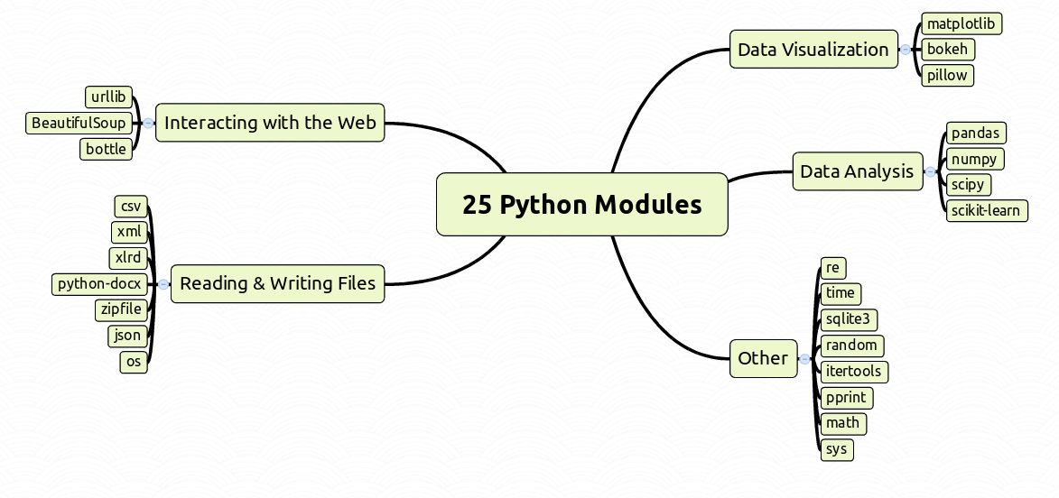
Modules
Organize your code

Slide 3
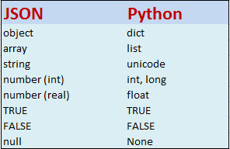
JSON
person.json:
{
"firstName": "Alice",
"lastName": "Hall",
"age": 35
}
salaries.json:
[ {
"year" : 1985,
"teamId" : "ATL",
"leagueId" : "NL",
"playerId" : "barkele01",
"salary" : 870000
}, {
"year" : 1985,
"teamId" : "ATL",
"leagueId" : "NL",
"playerId" : "bedrost01",
"salary" : 550000
} ]
animals.json:
[
"cat",
"dolphin",
35
]
Json to Python conversion table
Share data easily
Notes:
JSON (stands for “JavaScript Object Notation”) is a text-based format which facilitates data interchange between diverse applications. For example, an application written in C++running on Windows can easily exchange JSON data with an application written in python and running on Linux. Its simplicity and flexibility has led to widespread usage in recent years, especially in preference to earlier XML-based formats.

Slide 4

Was the file properly closed?
import json
json_data = json.load(open("my_data.json"))
# ... Process the Data
json_data.close()
Yes
No
Notes:
No, because we are trying to close the loaded json data (e.g., a list or dict) and not the opened file object!

Slide 5
Was the file properly closed?
import json
def process_json(path):
json_file = open(path)
json_data = json.load(json_file)
# ... Process the Data
return json_data
json_file.close()
process_json("my_data.json")
Yes
No
Notes:
No, it wasn’t because the .close() method follows the return so it will never be executed

Slide 6

Web Data
Great but volatile!
Notes:
Web scraping (web harvesting or web data extraction) is data scraping used for extracting data from websites. ... While web scraping can be done manually by a software user, the term typically refers to automated processes implemented using a bot orweb crawler.

Slide 7

Requests
Http for Humans
Kenneth Reitz, the creator of Requests
Notes:
Requests allows you to send organic, grass-fed HTTP/1.1 requests, without the need for manual labor. There's no need to manually add query strings to your URLs, or to form-encode your POST data. Keep-alive and HTTP connection pooling are 100% automatic, thanks to urllib3.
Besides, all the cool kids are doing it. Requests is one of the most downloaded Python packages of all time, pulling in over 11,000,000 downloads every month. You don't want to be left out!

Slide 8
Which is the right way to access the online data?
import requests
import json
json_file = requests.get('http://some.site.com/someData.json')
json_data = json.load(json_file)
B)
import requests
json_file = requests.get('http://some.site.com/someData.json’)
json_data = json_file.json()
C) Both of these
D) None of the two
Notes:
No, it wasn’t because the .close() method follows the return so it will never be executed

Slide 9

Reminders
Module 9 closes on Friday 4/6 at 11:59pm
Module 10 due on Friday 4/6 at 11:59pm
Survey: weeks 9-10 due on Friday 4/6 at 11:59pm

Slide 10

Lab Time
Work on class assignments
Finish as many problems as possible
Use instructor and TA’s time for assistance
IF YOU PLAN TO LEAVE
Make sure you inform me or the TAs
Show us your work progress

