Slide 1
Plotting
Week 11 – Day 1
CS-1064 Intro to Python
Dr. Panagiotis Apostolellis, Virginia Tech, 2018

Slide 2

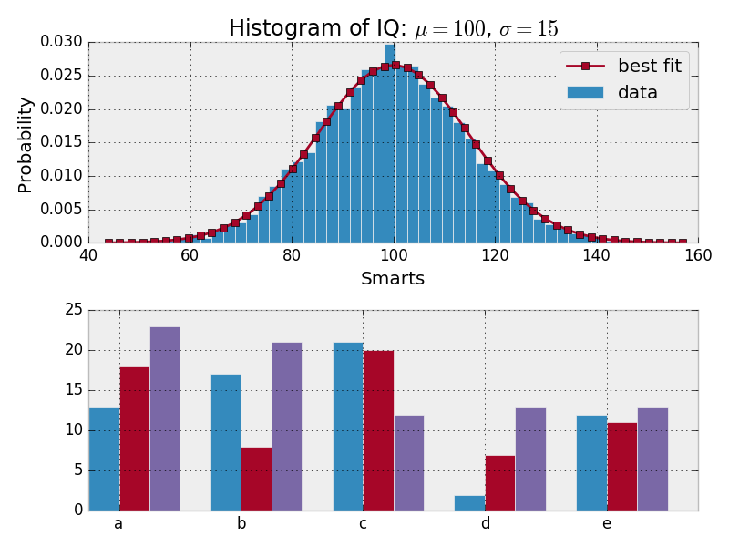
MatPlotLib
Mathematical Plotting Library for Python

Slide 3
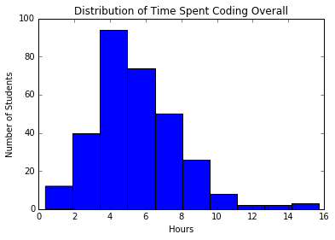
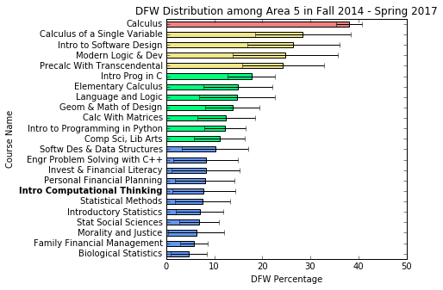
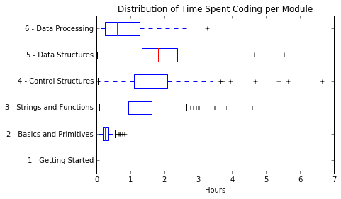
Plot Examples

Slide 4
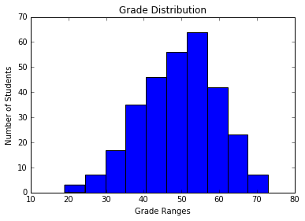
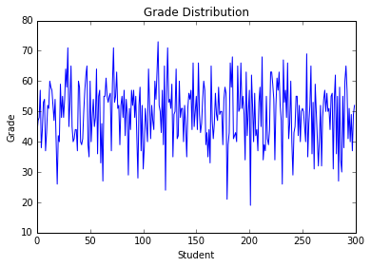
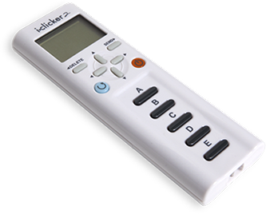
Which graph/ visualization is best for looking at a distribution of grades?
B)
Notes:
Obviously (A) because the variability of grades (or grade ranges) is far smaller than the variability of students (unless you group students based on some characteristic, like college year)

Slide 5
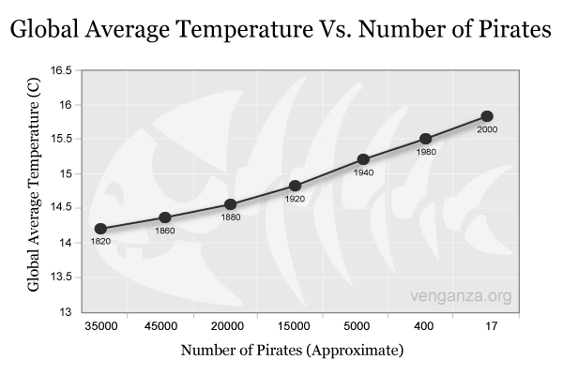
Decrease in pirates has caused global warming!
Probably true
Probably false
Notes:
Correlation is not the same as causation. Some data might be correlated for unknown reason and you should have very rigorous experimental control in place in order to make strong arguments about direct influence of intervention over some condition. E.g., administer drug over two populations and noticing significant improvement. Can you deduct that the drug improved the condition (i.e., health)? No, unless you make sure that all other factors remained the same across your sample; e.g., previous health, age, origin, etc.

Slide 6
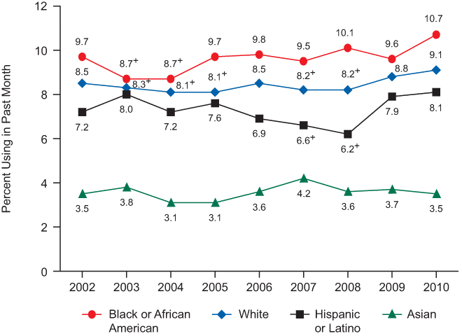
From this graph alone, is it safe to say that Asians consume less drugs?
“Past month” illicit drug use (age 12 or older) by race or ethnicity
Absolutely yes
Absolutely no
Notes:
Correlation is not the same as causation. Some data might be correlated for unknown reason and you should have very rigorous experimental control in place in order to make strong arguments about direct influence of intervention over some condition. E.g., administer drug over two populations and noticing significant improvement. Can you deduct that the drug improved the condition (i.e., health)? No, unless you make sure that all other factors remained the same across your sample; e.g., previous health, age, origin, etc.

Slide 7
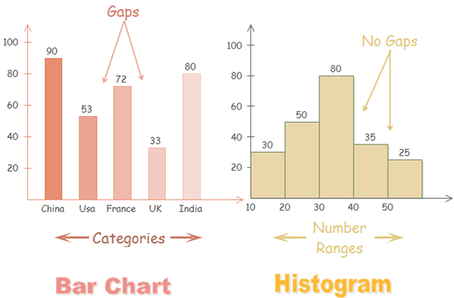
Histograms vs. Bar Charts

Slide 8
How many graphs does this code produce?
xs = [1,5,10,15,20,25,30,35,40]
ys = [random.randint(0, 10) for x in range(10)]
plt.scatter(xs, ys)
plt.hist(ys, 10)
plt.show()
One graph
Two graphs
None
Notes:
You need to call show() every time you want a graph to be created/printed!

Slide 9

Reminders
Module 10 closes on Friday 4/13 at 11:59pm
Module 11 due on Friday 4/13 at 11:59pm
Project 5: Data Science due on Friday 4/13 at 11:59pm

Slide 10

Lab Time
Work on class assignments
Finish as many problems as possible
Use instructor and TA’s time for assistance
IF YOU PLAN TO LEAVE
Make sure you inform me or the TAs
Show us your work progress

