Slide 1
Final Project Orientation
Week 12 – Day 1
CS-1064 Intro to Python
Dr. Panagiotis Apostolellis, Virginia Tech, 2018

Slide 2
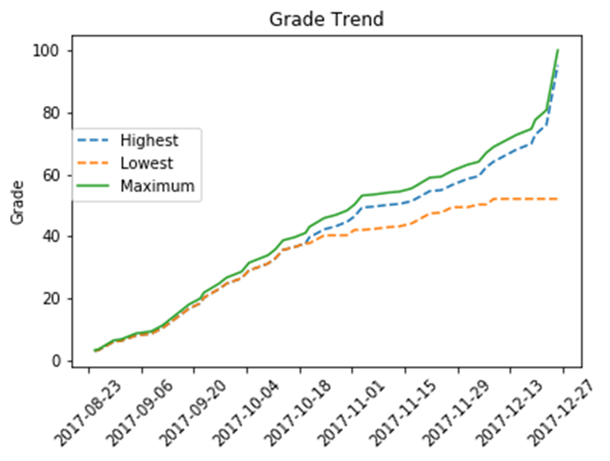

Final Project: Canvas Analyzer
Goal: Use a real-world data source to create a tool
Result: A system for analyzing your data on Canvas
Notes:
Start off with the vision for the project: a utility for checking canvas data. At this point, tab over to your reference solution and show it in action with the mock student data.

Slide 3
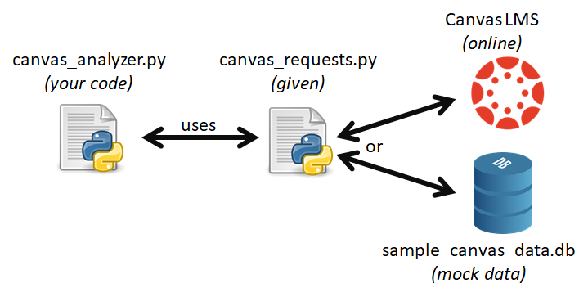
canvas_requests
When you're done, you can "Go live" with your own data!
Wrapper around Requests module
Provides test data
Connects to the actual Canvas API
See Documentation
Notes:
Explain the idea of an API, and how Canvas has a massive API that lets you get access to your data.
Then connect this to the Requests module – we can access that API programmatically through Python.
However, repeatedly accessing a website is rude and slow, so we'll be using a library that let's us make "pretend requests".
This library is canvas_requests – it has 3 functions that we'll need, and they access Canvas data from a local "cache" that emulates the website.
Bring up the documentation and show each of the functions, perhaps also demonstrating how they are used and what they return.
Highlight that this is really what the canvas API gives you – the project is designed so that students can use their own data when they're done by getting an API token.

Slide 4
Overview
main
user id
canvas_requests.get_user
user
print_user_info
canvas_requests.get_courses
courses
filter_available_courses
courses
print_courses
Need to implement 10 functions
Each function: 8 points
Code Organization: 20 points
get_course_ids
course ids
choose_course
course id
canvas_requests.get_submissions
submissions
summarize_points
summarize_groups
Legend
plot_scores
Function call
Data flow
plot_grade_trends
Notes:
Now we break down implementation.
The monstrosity on the right is meant to help them understand, along with the rest of the project write-up, what they are implementing.
Explain the data flow vs. function calls very clearly – definitely mention that the main function calls all the other functions directly.
Point out that there are 10 functions worth 8 points each, and 20 points for good code organization – this project is about 10% of their final course grade.

Slide 5
Level of Difficulty
Very Easy
Easy
Medium
Hard
print_user_info
filter_available_courses
summarize_points
summarize_groups
print_courses
plot_scores
plot_grade_trends
get_course_ids
choose_course
Scaling Difficulty
main
This is not to discourage you but rather to plan ahead!
Notes:
The transition highlights the difficulty of each function, and suggests an order of approach.
The first 5 functions (40% of the grade) should be pretty easy.
The next two functions (summarize_points and plot_scores) are not that much harder.
The last two functions are hard, and plot_grade_trends in particular could be very time consuming – they should focus on finishing everything else before deciding to commit to it.
The main function (also worth 8 points) is graded based on what functions you end up implementing. If you only implement print_user_info, that's the only one it checks that you called. So as long as you don't leave partially implemented functions, you'll get those 8 points when you submit to Web-CAT.

Slide 6

Getting Help
INDIVIDUAL PROJECT
Collaborations are an honor code violation
Your code WILL be tested for similarities
Google carefully
Copying code from the internet is also a violation
Again, your code will be checked
Course Staff will help sparingly, but will not guide you through step-by-step
Notes:
This project, unlike the earlier ones, is meant to be more summative. There is an expectation of students working alone and without reference to each other's solutions. Copying is detectable, and we have the means to do so (MOSS, etc.).
TAs are instructed to help in a reduced way, so that students can demonstrate what they have learned.
This slide is more about scaring them into good behavior – last semester, there were no serious issues with this.

Slide 7

Final Project Submission
Dates
Due: April 27 at 11:59pm
Locked: May 2 at 11:59pm
Submission Policy
5 points for submitting by due date!
No extensions for Web-Cat crashing
Why wait till the last minute? Finish the project this week, enjoy a week off.
Test/Submit early, test/submit often
Notes:
Explain the due date and lock date. Highlight that they get 5 points extra credit for submitting by the due date.
However, make sure they understand that the Web-CAT due date is strict. They shouldn't wait till the last minute, because sometimes Web-CAT goes down. If Web-CAT is down at 11:30pm on April 27 and they can't submit, then that's their poor planning. The idea is not to wait till the last minute, it's to submit well before then. To protect themselves, it would be a good idea to submit a few times along the way.
(Note: We'll probably be more merciful than what is presented here. The idea is to just get them to not ALL submit at the last minute).

Slide 8
Final Exam Information
Week 12 – Day 1
CS-1064 Intro to Python
Dr. Panagiotis Apostolellis, Virginia Tech, 2018

Slide 9

Final Exam Dates
Schedule:
Part One is Apr 26 at 11:10pm - 12:00pm
Part Two is May 1 at 11:10pm - 12:00pm
You must be present for both parts!
Notes:
Update this slide with your appropriate dates and times.
We'll be scheduling make-up exams with students individually.

Slide 10
Mechanics
Be here 5-10 minutes early (at regular class time 11 am)
Opens in Canvas at 11:10 am, closes promptly 50 minutes later
Part 1: Canvas Quiz
Part 2: BlockPy activity
Bring a fully charged laptop –
No extensions for hardware failures!
Notes:
Going over mechanics – recommend they show up early and ready to go.

Slide 11

Practice Material
Cumulative
Exam Practice Material:
Divided into 6 parts (4 quizzes, 2 programming)
Represents the entire possible set of final exam questions
Not graded
Notes:
The exam covers the entire course, but some parts are given more weight than others. For instance, there isn't a lot about While loops, but there is a lot about For loops.
The practice material is a superset of the possible exam questions, so they would do well to study it intensely. It's not graded, so it's up to them to decide how to use it.

Slide 12
1) Canvas Quiz Questions
Matching, True/False, Multiple Choice, Fill-in-the-blank
Cannot return to previous questions
Notes:
The first part of the exam is done through Canvas quiz questions.
As you complete problems, you cannot return to previous problems. I had a VERY angry student last semester who didn't understand this going in, he made quite the fuss (he ended up getting an A on the exam anyway, students are brats).

Slide 13
2) BlockPy Programming
No guiding feedback or correctness mark, only syntax and runtime errors
Instructions will be explicit about requirements
Can get partial credit
Able to go back and forth between questions
Notes:
The BlockPy section of the exam is a little trickier, of course. It doesn't tell you if you got it correct. It's probably worth bringing up some exam review problems and showing this off. To find out if they got a question right on the practice material, they can go check their submission in the Grades menu (show them as Test Student via Settings->Student View). This is cumbersome, and isn't possible during the final exam (the assignment is muted until everyone's done it).
Fortunately for them, there is copious amounts of partial credit. If a problem tells you that you need to loop through a list of elements, and you have a For loop in your code, odds are good that you'll get a 1/10 points just for that alone. Read the instructions closely, because they'll try to be as explicit as possible.

Slide 14

Cheat Sheet
Index card (3"x5"), back and front
Write whatever you want
Hand in afterwards
Notes:
Because memorizing language details is hard and not super important, they can write down some helpful information on an index card. Remind them that they have limited space and time to look at it – better to only put things they can't memorize.
Someone will probably ask: yes, they can have different cards for both days (how would we enforce something else?).

Slide 15

Final Exam Information
There's a page in Canvas about Final Exam Information
That is the true source of information
If something isn't covered in it, ask us and we'll add it
If we say something contradictory to what's in there, point it out to us
Notes:
Just to keep us honest, I added this slide. I want to make that page the "one true source of information" so that A) we're not asked questions that could be answered with a URL, and B) we keep things the same between sections.

Slide 16
Zero Tolerance Policy
Do not bring up other tabs or windows on your browser
No talking
No looking at others' screens
TAs will be proctoring
Violations will result in an instant zero!

Slide 17
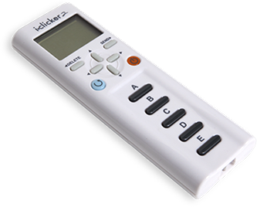
Regarding class attendance, I intend to…
Show up everyday and work on the project and exam prep, slowly but steadily
Show up until I finish the project early, so I can focus on other classes and not have to worry about this one
Skip class and wait until the end of the course to start the project, thereby risking to fail something worth 10% of my final course grade, because…
C) …other courses have higher priority than this
D) …I have terrible planning skills
Notes:
Obviously (A) because the variability of grades (or grade ranges) is far smaller than the variability of students (unless you group students based on some characteristic, like college year)

Slide 18
Attendance for next two weeks
Come in and work on the project and review for the exam
Dedicated work time, not a chance to skip class
There will be iClickers (possibly more Class Activities if attendance becomes an issue)
Unless you have fully submitted the project and studied all the material, you should not be skipping class
Notes:
This is the trickiest bit. Students start skipping around now, even though class time is meant to be used to work on the project. My policy will be strict – if they haven't submitted the project, they better be there. I doubt anyone will submit the project early on, but if some do I'll probably excuse them from any class activities here. But I'm really planning to periodically do attendance based checks. They need to be putting in time on this project, and the class time is explicitly surrendered to this goal.

Slide 19

Reminders
Module 11 closes on Friday 4/20 at 11:59pm
Project 5 closes on Friday 4/20 at 11:59pm
Final Project due on Friday 4/27 at 11:59pm

Slide 20

Lab Time
Work on class assignments
Finish as many problems as possible
Use instructor and TA’s time for assistance
IF YOU PLAN TO LEAVE
Make sure you inform me or the TAs
Show us your work progress

