Slide 1
Values, Types, Operations
Week 1 – Day 1
CS-1064 Intro to Python
Dr. Panagiotis Apostolellis, Virginia Tech, Spring 2018
Austin Cory Bart, Virginia Tech, 2018
Notes:
Instructor lecture notes will go down here.

Slide 2
Consent Forms
Dr. Bart will provide related information and administer forms
Notes:
Assuming your class participates, you will need to read the recruitment script here and hand out consent forms.

Slide 3
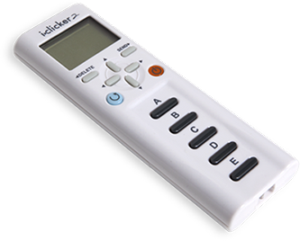
i>Clickers Today
Overall:
+1 point for answering most of the questions
Per question:
+0.5 points for an answer
+0.5 points for a correct answer
Example:
Today there are 4 questions, so there is a total of 5 points possible.
Notes:
Here's where you break down the scoring for your iclickers. I use this particularly scheme, and give an example.

Slide 4
i>Clicker: Think-Pair-Share
Think quietly
Submit an answer
Talk to your neighbors
Submit a fixed answer
Hear result
Notes:
Break down the model for the clicker activities.

Slide 5
Warm-up question: Why we teach Python?
A) We like the snake
B) It is very cheap
C) Easy and dynamic
D) That’s all we know
E) Because of Monty Pythons
Notes:
You want to start out with a question so they can immediately experiment with the iclickers and resolve problems.
This warm-up question works on one of the smaller objectives of the course: give students more awareness of the history of computing.

Slide 6

Programs & Consoles
We will be mainly using Spyder for code writing
You can write code in NotePad++ and open it
Notes:
Start by talking about the core idea of a program as a series of instructions. We write code and then have it run in a console. That program can have inputs and outputs.
At this point, move over to Spyder and start writing code. You can encourage them to follow along on their computers. You're going to highlight two major things:
First, using the REPL console in the bottom-right. Here, you enter commands and data, which are evaluated and printed. For example:
> 5
> 'Hello World'
> print("My first program")
Second, writing the same code in a script, saving it, and then running it. Only the things that are explicitly printed will appear in the console this time.

Slide 7


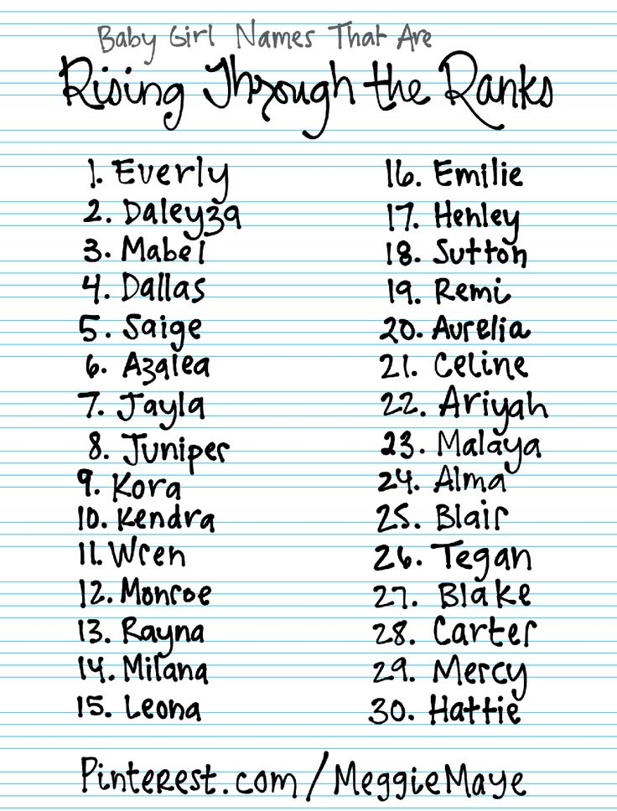
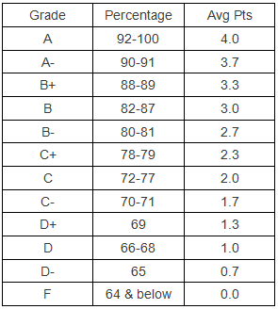
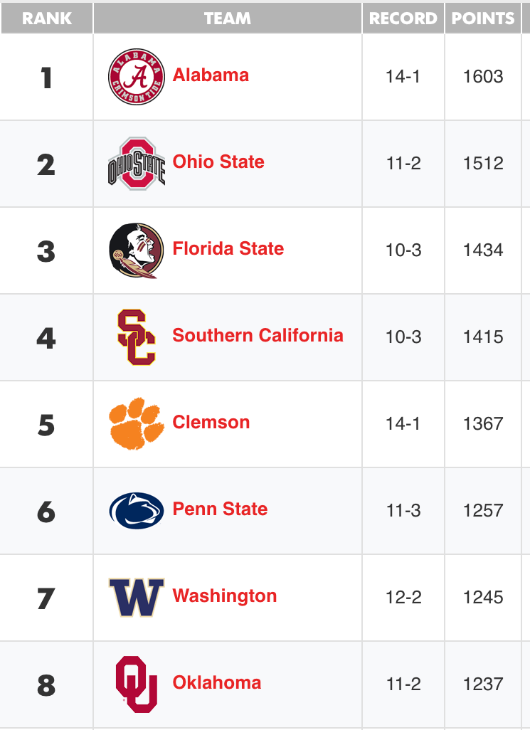
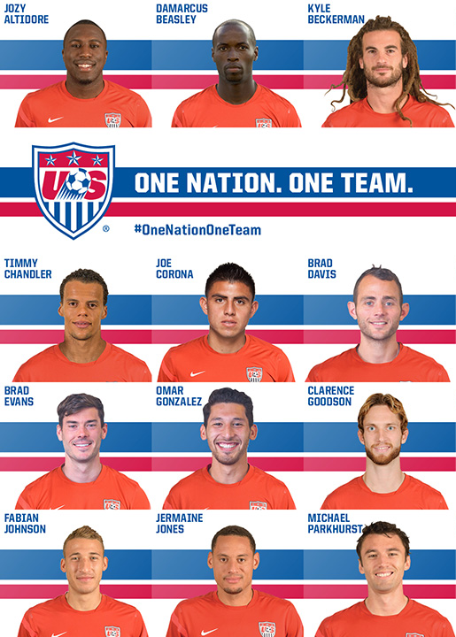
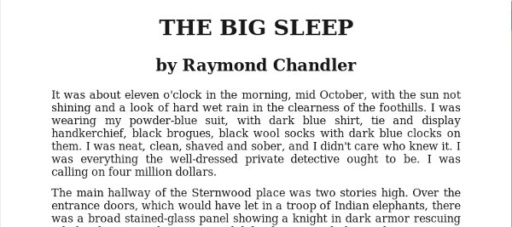
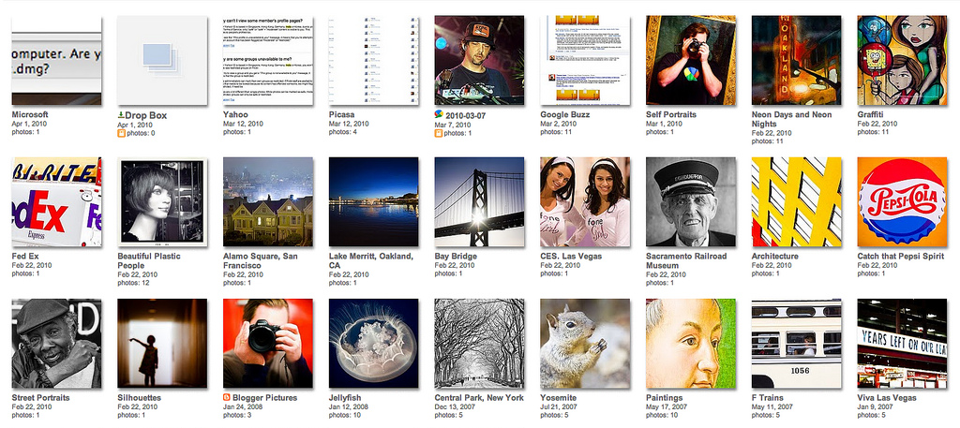
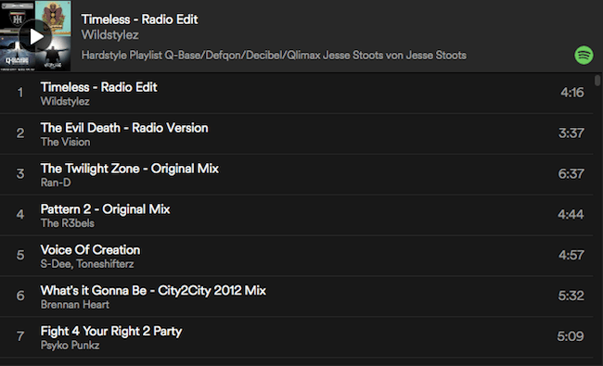
Values
Data into the machine
Values
List of names
School grades
Football league ranking
Team roster
Text of a book
Photo album
Playlist of songs
Notes:
Now you talk about the idea of representing the real world in the computer as data.
Anything can be data: football scores, a list of names, the text of your favorite book, pictures of cats.
This process of turning stuff into data skims off unimportant details. If you're trying to model students in a class, you might want to represent their names and majors, but you probably don't care about how many dogs they have or what their favorite colors are.
The actual data input process can be done in a number of ways: typing in data, collecting information from sensors, etc.

Slide 8

Types
Integer – whole numbers
Float – decimals numbers
String – text
Boolean – True/False values
None – Just None
Notes:
Once you have the idea of a value, you start talking about data in the context of types. Every value in Python has a type, and those types control what you can and cannot do with those values. Next you'll have students start making decisions about what types to assign values.

Slide 9
Which is the best type for representing… A name like "Klaus"?
A) Integer
B) Float
C) Boolean
D) String
Notes:
This first question encourages them to think about how to represent a name (in this case as a string). There isn't much argument here, strings are good for representing names.

Slide 10
Which is the best type for representing… The state of a lightbulb?
A) Integer
B) Float
C) Boolean
D) String
What about dimness level? 0.3 for 30% intensity
Also correct for binary: True (on), False (off)
Very unambiguous:
“On”, “Off”
Notes:
This second question gets at a simple idea of a Boolean. However, you can challenge them to think about whether a string might be appropriate too (the literal strings "off' and "on" are unambiguous, as opposed to assuming True == "on"). Further, you can talk about sophisticated light bulbs that have a "dimness level" (10% or 30%). You want to bring up the idea that there are multiple representations of an idea. If there's a lot of debate, you might not want to mark a correct answer.

Slide 11
Which is the best type for representing… The current day of the week?
A) Integer
B) Float
C) Boolean
D) String
Allows operations:
3+1 = 4 (Thursday)
Obvious one: “Monday”, “Tuesday”, “Wednesday”…
Notes:
You can raise arguments for both String and Integer. Strings are useful, because they are clear and unambiguous. Integers are good because you can add and subtract them ("tomorrow" is today+1). You can even point out that you could use a float, because what about 12pm on Monday (which is halfway to Tuesday compared to 12:01am). So I wouldn't mark this as having a correct answer.

Slide 12





Modeling Data
Gender?
Phone Number?
Really complex stuff with multiple parts?
People?
Businesses?
Notes:
Here are some more things that can be difficult to model, whether because of societal concerns or inherent difficulty.
Some people might want gender to be a Boolean, but which gender is True and which is False? What about people who want to recognize more than 2 genders?
Phone numbers are supposed to be numbers, but what does it mean when you add and subtract phone numbers from each other?
People have a lot of properties and things that make them up (name, age, place of birth, number of dogs owned), so how do we represent them?
These are not meant to be easily answered questions. They are there to encourage students to think about the nature of data and how we can represent the same thing in many ways for different purposes.

Slide 13
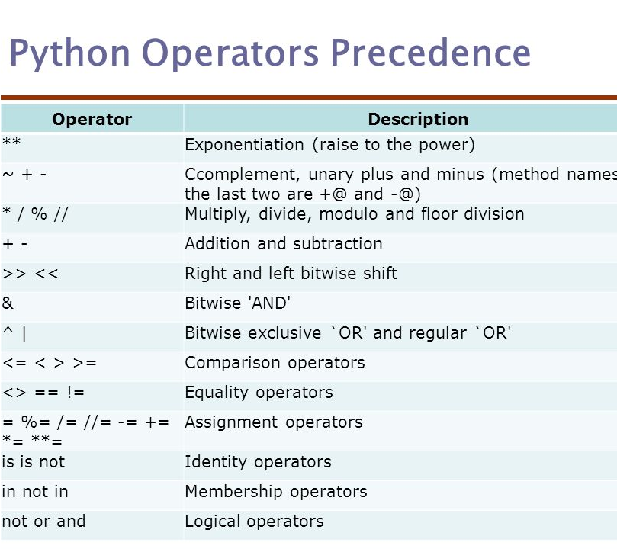
Basic Operations
Math:
+, -, /, *, **, %
Logic (comparison):
<, >, <=, >=, ==, !=
Logic (combination):
and, or, not
Notes:
This is a chance to review the basic operators. You can describe most of them as intuitive, and the ones that are not probably won't show up too often.
You can highlight the weird == and != operators (equality and inequality), and talk about how two values are equal only if they have the same type and the same value.
This is a good chance to pop over to Spyder and writing code that shows off various combinations of operations:
> 1 + 1
> "Dr." + "Bart"
> 4 < 5
> "Aardvark" < "Zebra"

Slide 14
1 + 1
A) 11
B) 2
C) "11"
D) "2"
E) Causes an error
Notes:
Now you start doing some clicker questions to have them make predictions about operations on types. Here is basic addition, hopefully they all get it right. I recommend typing each expression at the top into the interactive prompt as we go along to highlight the ideas.

Slide 15
"1" + "1"
A) 11
B) 2
C) "11"
D) "2"
E) Causes an error
Notes:
Next we try adding two strings. The answer is C, which is pretty straightforward.

Slide 16
"1" + 1
A) 11
B) 2
C) "11"
D) "2"
E) Causes an error
Notes:
Now things are tricky, and they might get things wrong. This causes an error, because Python has strong typing.

Slide 17
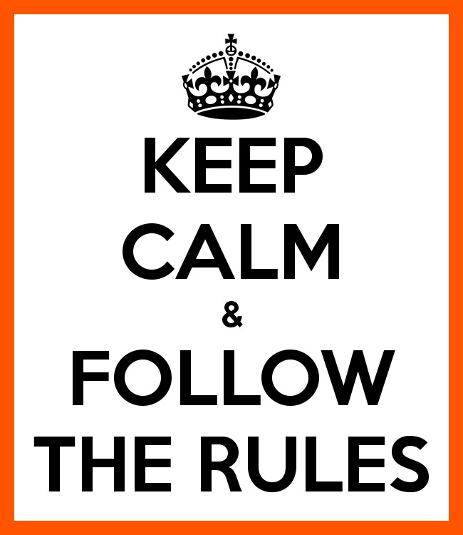
Each operator has rules!
> "Wow" * 3
"WowWowWow", not error
> "What" - "t"
TypeError, not "Wha"
> 1 == "1"
False, not error
> "1" < 5
TypeError, not True
Notes:
You can wrap up the discussion on operators by going over these many examples of (potentially) confusing rules for the operators. The thing to highlight is that each operator has its own rules, and they should experiment when trying to mix types. Usually it doesn't work, sometimes it does.

Slide 18

Lab Time
Work on class assignments
Finish as many problems as possible
Use instructor and TA’s time for assistance
IF YOU PLAN TO LEAVE
Make sure you inform me or the TAs
Show us your work progress
Notes:
You can wrap up the discussion on operators by going over these many examples of (potentially) confusing rules for the operators. The thing to highlight is that each operator has its own rules, and they should experiment when trying to mix types. Usually it doesn't work, sometimes it does.

