Slide 1
Variables, Expressions, Statements, Tracing
Week 1 – Day 2
CS-1064 Intro to Python
Dr. Panagiotis Apostolellis, Virginia Tech, Spring 2018
Notes:
Instructor lecture notes will go down here.

Slide 2
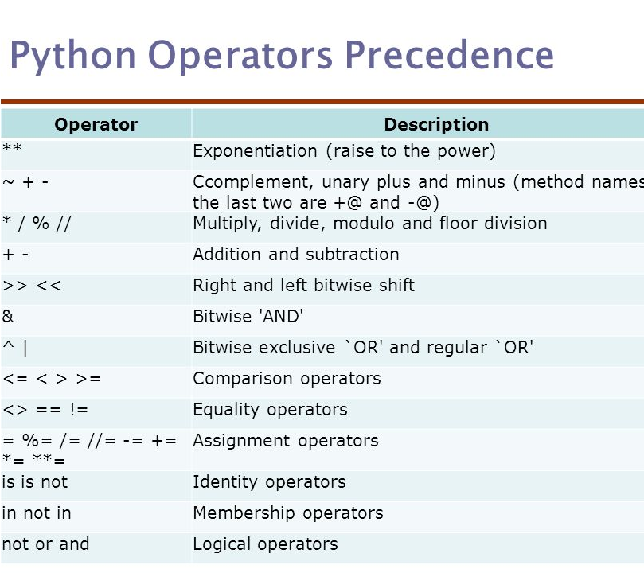
Basic Operations
Math:
+, -, /, *, **, %
Logic (comparison):
<, >, <=, >=
Logic (equality):
<>, ==, !=
Logic (combination):
and, or, not
Notes:
This is a chance to review the basic operators. You can describe most of them as intuitive, and the ones that are not probably won't show up too often.
You can highlight the weird == and != operators (equality and inequality), and talk about how two values are equal only if they have the same type and the same value.
This is a good chance to pop over to Spyder and writing code that shows off various combinations of operations:
> 1 + 1
> "Dr." + "Bart"
> 4 < 5
> "Aardvark" < "Zebra"

Slide 3

1 + 1
A) 11
B) 2
C) "11"
D) "2"
E) Causes an error
Notes:
Now you start doing some clicker questions to have them make predictions about operations on types. Here is basic addition, hopefully they all get it right. I recommend typing each expression at the top into the interactive prompt as we go along to highlight the ideas.

Slide 4
"1" + "1"
A) 11
B) 2
C) "11"
D) "2"
E) Causes an error
Notes:
Next we try adding two strings. The answer is C, which is pretty straightforward.

Slide 5
"1" + 1
A) 11
B) 2
C) "11"
D) "2"
E) Causes an error
Notes:
Now things are tricky, and they might get things wrong. This causes an error, because Python has strong typing.

Slide 6
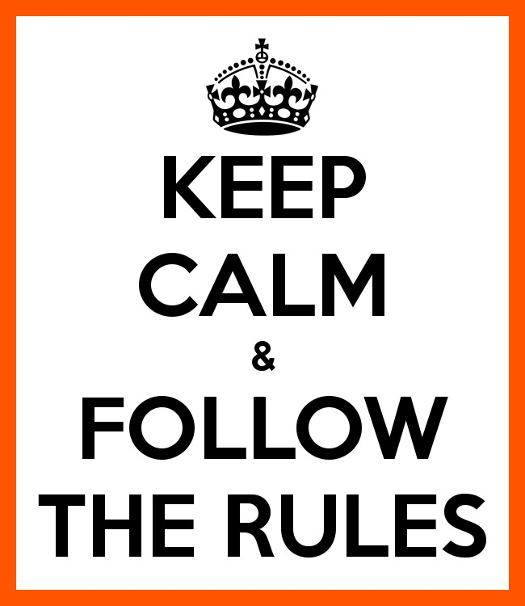
Each operator has rules!
> "Wow" * 3
"WowWowWow", not error
> "What" - "t"
TypeError, not "Wha"
> 1 == "1"
False, not error
> "1" < 5
TypeError, not True
Notes:
You can wrap up the discussion on operators by going over these many examples of (potentially) confusing rules for the operators. The thing to highlight is that each operator has its own rules, and they should experiment when trying to mix types. Usually it doesn't work, sometimes it does.

Slide 7
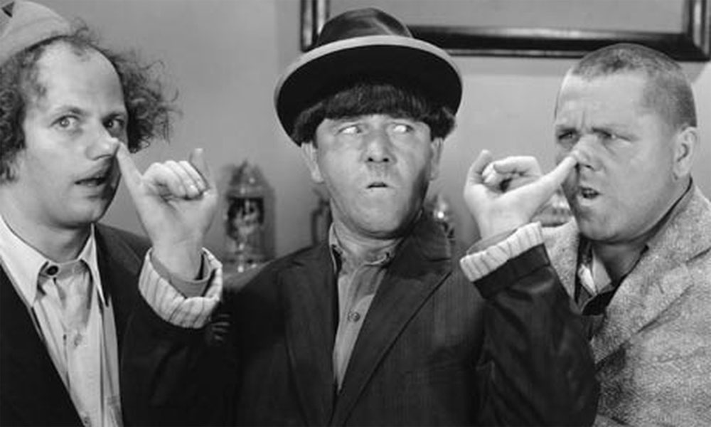
Variables
Names attached to values
Variables names must start with a letter or an underscore:
_underscore
underscore_
The remainder may consist of letters, numbers and underscores.
password1
name_10_zero
Names are case sensitive
name != NAME != Name
Larry Moe Curly
Notes:
This introduces the idea of variables. You can bring up Spyder and show them creating and then using variables.
> name = "Bart"
> Name
"Bart"
You can highlight how you can't use spaces, but you can use underscores:
> number of dogs = 1
SyntaxError
> number_of_dogs = 1
> number_of_dogs
1
And you should also demonstrate how you get a NameError by using a variable before it is declared:
> Score
NameError

Slide 8
Programs
Sequence of statements
Execution goes DOWN the program, like reading a script
Operations on the variables use the assigned values
Statements are evaluated based on precedence rules
5 + 5 * 10 = 55
A = (5 + 10) / 5 = 3
Larry Moe Curly
Notes:
Sequential execution is an important idea, and you'll want to highlight this by writing a program in Spyder instead of using the console.
grade= 32
adjusted_grade = grade * 2
adjusted_grade = grade + 10
print(adjusted_grade)
If you're using Thonny or PythonTutor, it is easy to demonstrate the line-by-line execution. You can use the step-by-step debugger in Spyder, but it's a little less intuitive so practice first. Regardless, you want to highlight how it goes line 1, line 2, line 3, and then line 4. You can point out that it isn't left to right, the right side is evaluated before the left side.

Slide 9
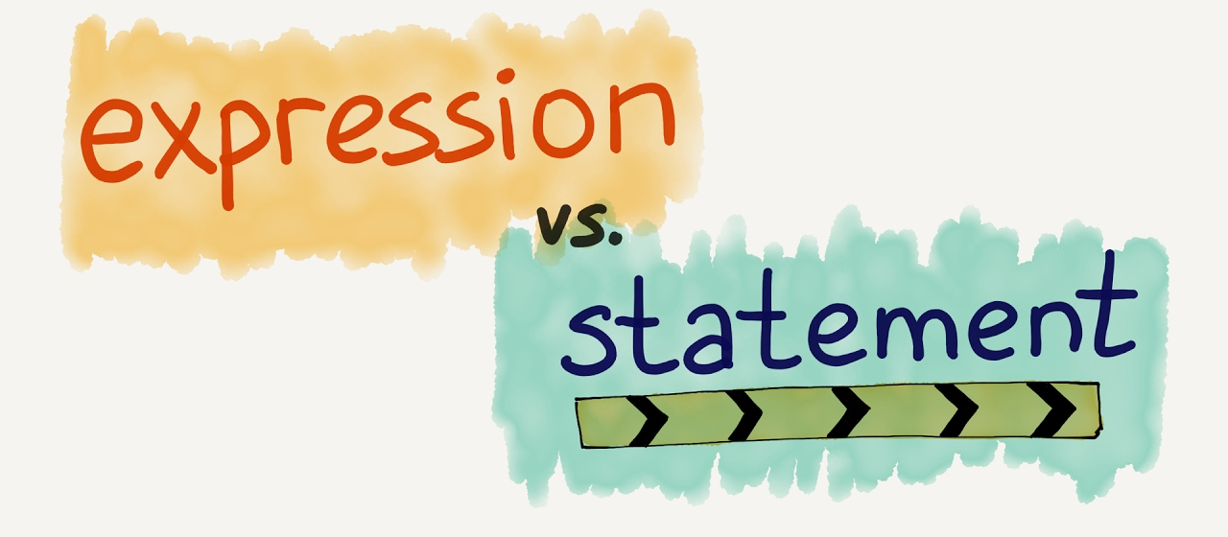
Statements and Expressions
Statements DO something
They are written vertically (multiple lines)
Often contain expressions
Expressions produce at least one value
They are horizontal (one line)
The are often used in statements
Expression statements do something using expressions
> print ('hello’) <- print statement
> x = 1 <- assignment statement
> 'hello’ + ‘world’
> 10 * 5
> print (10*2)
> x = 1 + 1
Notes:
You can talk about the difference between statements and expressions. I find that it helps to bring up BlockPy's Split mode here to highlight the difference between an expression block (with a notch on the left) and a statement block (with notches on the top and bottom).
In computer programming a statement can be thought of as the smallest standalone element of an imperative programming language. A program is formed by a sequence of one or more statements. A statement will have internal components (e.g., expressions).
Python statements from Wikipedia
In gross general terms: Statements Do Something and are often composed of expressions (or other statements)
In gross general terms: Expressions produce at least one value.

Slide 10
What is this line of code? print (“class”==3)
A) An expression
B) A statement
C) An expression statement
D) I don’t (want to) know
Notes:
“Class”==3 produces a value (False) which makes it an expression
The “print” function does something, which makes it a statement

Slide 11

Reminders
Module 0 closes on Friday 1/26 at 11:59pm

Slide 12

Lab Time
Work on class assignments
Finish as many problems as possible
Use instructor and TA’s time for assistance
IF YOU PLAN TO LEAVE
Make sure you inform me or the TAs
Show us your work progress
Notes:
You can wrap up the discussion on operators by going over these many examples of (potentially) confusing rules for the operators. The thing to highlight is that each operator has its own rules, and they should experiment when trying to mix types. Usually it doesn't work, sometimes it does.

