Slide 1
Strings
Week 2 – Day 1
CS-1064 Intro to Python
Dr. Panagiotis Apostolellis, Virginia Tech, Spring 2018
Notes:
Instructor lecture notes will go down here.

Slide 2

Anything can be a string
“a”+“b” = “ab”
But that doesn't mean everything should be a string
"1"+"1" = "11"
Notes:
This lecture is about strings, and you start off by talking about modeling data like we did last week. Strings are useful because they can represent anything (just put quotes around it), but they are limited in what you can do with them. The example here is that you can't do arithmetic with strings the way you can with numbers. They have their own rules.

Slide 3

In this code, string_value is a….
A) Value
B) Variable
C) Causes an error
"string_variable" = string_value
Notes:
This and the subsequent questions check to see if students understand the difference between variables and string values. Some students get confused about the difference here (that one is data and the other is a tool for naming and referring to data). Ideally, most should get that this one is C, you cannot put a string on the left side of an assignment operator (only variable names go there).

Slide 4
In this code, string_value is a….
A) Value
B) Variable
C) Causes an error
string_value = "string_variable"
Notes:
This question checks to make sure they understand that variable names have no meaning to Python – they shouldn't think that string_value is a value just because it is named so. The answer is B.

Slide 5
In this code, string_value is a….
A) Value
B) Variable
C) Causes an error
string_variable = "string_value"
Notes:
This question might not even be necessary, but it's a sanity check after the other ones. If students are paying attention, it should be obviously A. However, if they've gotten a little confused with the previous questions, this might trip them up – if this happens, remember to explain that this is the "normal" looking one and the others are wrong and misleading, respectively.

Slide 6
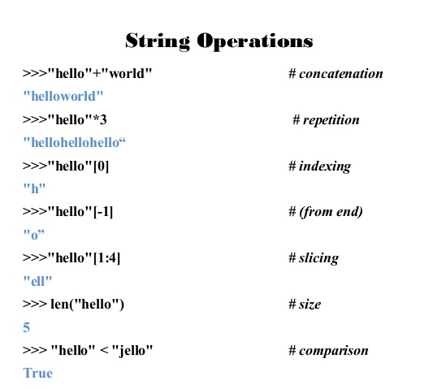
String Operations
>>> “hello” in “hello world” # membership testing
True
Notes:
The four operators they need to know about are string addition (concatenation), membership testing (which tests if one string is in another string), indexing (getting a character at an index, which will be a string in Python), and subscripting (getting a substring from a string).

Slide 7
The first index of a string is…
A) 0
B) 1
C) 2
D) Strings do not have indices
Notes:
Here's the first clicker question. Easy if they've done the lesson, but they might not even understand the question otherwise. The answer is 0 in Python.

Slide 8
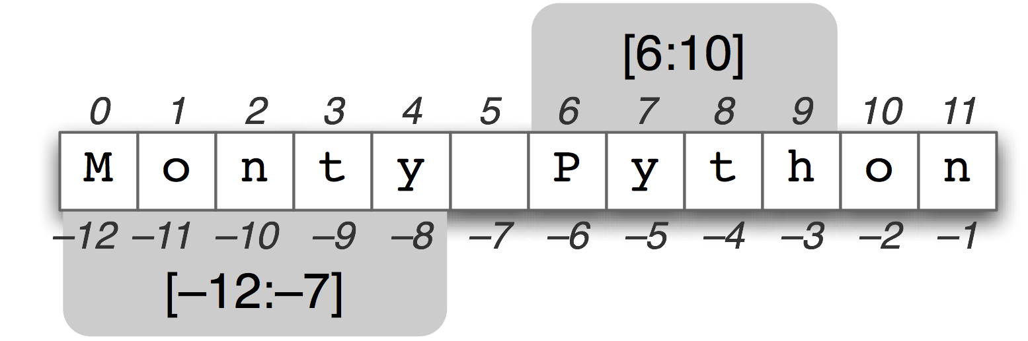
String slicing
Positive index starts from the beginning
Negative index starts from the end
Omitting an end implies starting from or ending at that end

Slide 9
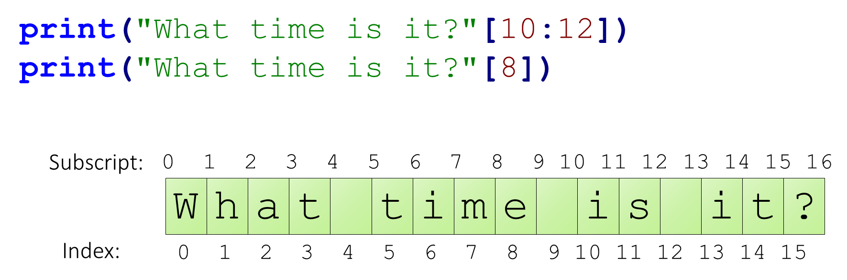
Indexing and Subscripting Tip
Use scratch paper!
Notes:
Here's a chance for a pro-tip to students. Most of them will just try to count indexes in the air, which error-prone. Recommend they bust out the scratch paper and label each index. Then it's very to see what numbers they need to use. However, you'll need to point out the difference between subscripts (which start to the left of the character) and indexes (which start on the character). Going over the examples here or some other ones might be a good idea to nail the concept.

Slide 10
What is the output of this code?
"This should be easy!"[5:11]
A) “ should”
B) “should”
C) “should ”
D) “easy!”
E) Causes an error
Notes:
Help students understand how string slicing works.

Slide 11
What is the output of this code?
"How does this work?" [-5:]
A) “How ”
B) “How d”
C) “work?”
D) “this”
E) Causes an error
Notes:
Help students understand how string slicing works.

Slide 12

Reminders
Module 1 closes on Friday 2/2 at 11:59pm
Will be out next Tue 2/6 – Lecture by Navya (GTA)

Slide 13

Lab Time
Work on class assignments
Finish as many problems as possible
Use instructor and TA’s time for assistance
IF YOU PLAN TO LEAVE
Make sure you inform me or the TAs
Show us your work progress
Notes:
You can wrap up the discussion on operators by going over these many examples of (potentially) confusing rules for the operators. The thing to highlight is that each operator has its own rules, and they should experiment when trying to mix types. Usually it doesn't work, sometimes it does.

