Slide 1
Calling Functions
Week 2 – Day 2
CS-1064 Intro to Python
Dr. Panagiotis Apostolellis, Virginia Tech, Spring 2018
Notes:
Instructor lecture notes will go down here.

Slide 2
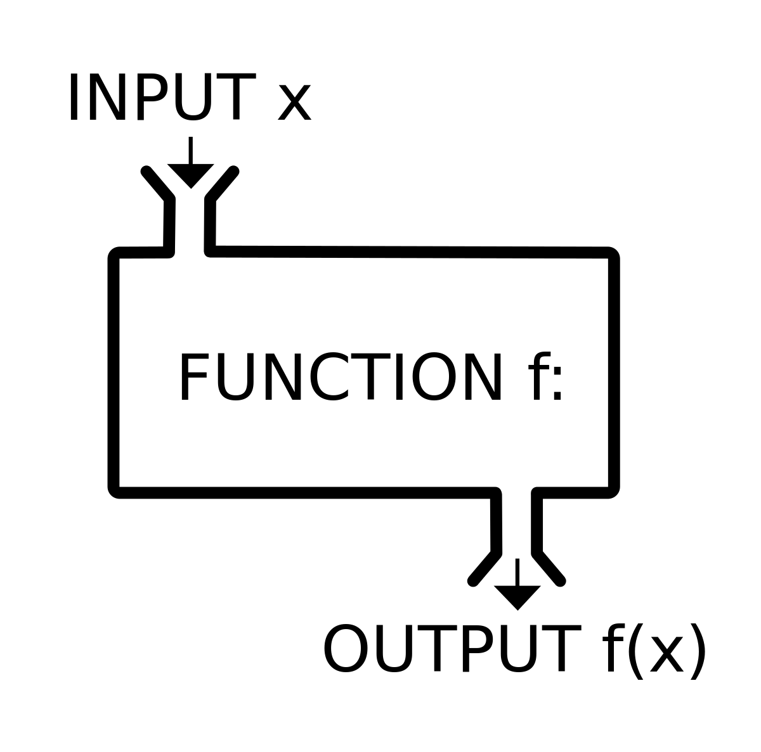
Functions
Functions encapsulate a bit of functionality in an easy-to-think about way
Notes:
"Functions are the smallest divisible unit of a program“ –Phill Conrad
This quote is by a friend of mine, and gets at the importance of functions. Most useful programs are made up of functions and function calls. You use them to encapsulate a bit of functionality in an easy-to-think about way. This week we're going to use functions, and next week we'll start making our own.

Slide 3
Call functions to do stuff
input("Get stuff from the user")
print("Write stuff to the user")
converted_number = int(4.3)
converted_string= str(27)
converted_float = float("3.0")
shouted_version = "Hello!".upper()
removed_whitespace = " dog ".strip()
Notes:
You can type these into the console to demonstrate how they work, but the idea is to show off a bunch of function and method calls.
Students will probably not have a good idea about when something is a function or a method. The reality is that there's no solid rule, it's just a matter of memorization. There's some reference on Canvas for these functions and methods that explain them further.

Slide 4
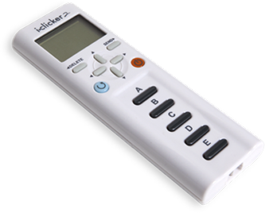
Parentheses are _____ in function and method calls
A) Always required
B) Sometimes required, sometimes optional
C) Always optional
Notes:
Students frequently misunderstand that parentheses are what actually calls the function. Without parentheses, you have just the name of the function. Therefore, the answer is A.

Slide 5
Which is closest to what is printed?
print("UPPER".lower)
A) UPPER
B) upper
C) LOWER
D) lower
Notes:
The answer to this question is D. Notice the lack of parentheses after the call to lower? This means that the result is something like the following:
<built-in method lower of str object at 0x000001E9162DA5A8>
The only word that appears is "lower" in lowercase, so it wins. I recommend you show them this visually to reveal the answer, so that they believe you.

Slide 6
Which is closest to what is printed?
print("UPPER".lower())
A) UPPER
B) upper
C) LOWER
D) lower
Notes:
Now this should do what is expected. The answer is B.

Slide 7
Example 1
get some user input (input)
Example 2
get some user input (input)
Convert it to an integer (int)
find the absolute value (abs)
and then print the result (print)
replace b’s with a’s (replace)
lowercase it (lower), and
count the number of a’s (count).
Nesting Function Calls
Notes:
Bring up your console and show off how you can call chain functions nesting them inside each other. Doing this in BlockPy highlights this visually, but make sure they see the code.
Example, convert some user input (input) to an integer (int), find the absolute value (abs), and then print the result (print)
print(abs(int(input("Gimme a negative number"))))
Then, show how you can chain methods calls by continually adding more methods onto the end. This example has them counting the number of As and Bs, correctly handling capital letters. BlockPy doesn't handle it quite as gracefully, but still gives the idea of nesting.
Example: get some input (input), replace bs with as (.replace), lowercase it (.lower), and then count the number of As (.count).
Input("Gimme some letters").replace("b", "a").lower().count("a")

Slide 8
What is the output of this?
print("trick1".upper()[-1].int()==1)
A) 1
B) 2
C) True
D) False
E) Causes an error
Notes:
AttributeError: 'str' object has no attribute 'int’
Int() is not a method but a function (takes something to convert to integer as an argument)

Slide 9
What is the output of this code?
print(int("trick1".upper()[-1])==1)
A) 1
B) 2
C) True
D) False
E) Causes an error
Notes:
This is the right way to use int()

Slide 10
What is the output of this code?
print("trick or treat".replace(' ','t')
[-10:-1].count('t'))
A) 1
B) 2
C) 3
D) 4
E) Causes an error
Notes:
Test their understanding of how nested function calls work

Slide 11
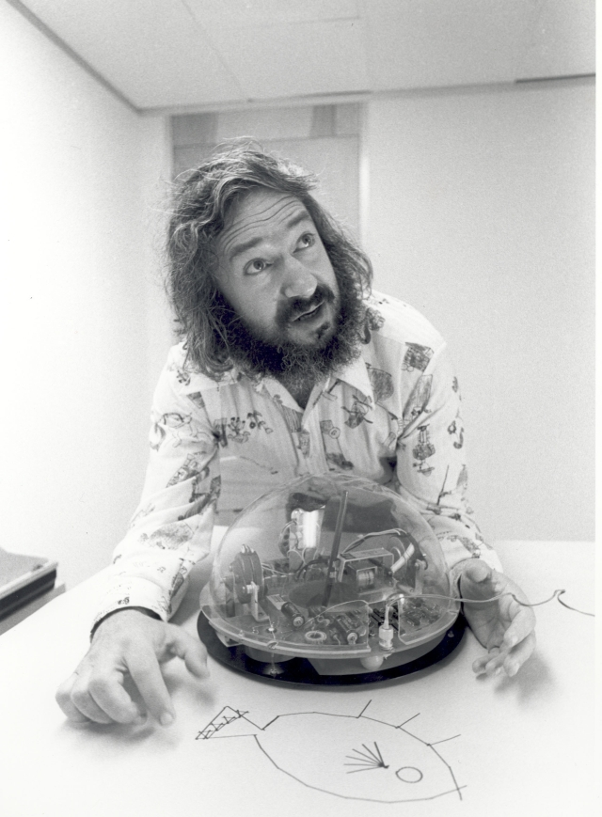
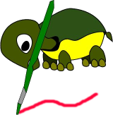
Project 1: Turtle Graphics!
"Imagine a turtle walking around with a pen, being directed about what to draw."
Notes:
This module has the first project. You'll need to introduce the idea of turtle graphics. You can explain the core idea as a turtle walking around with a pen being given directions. This is also a chance for a quick history lesson. The man on the right is Seymour Papert, the inventor of Turtle Graphics. In the 60s, he created a language called Logo based around Turtle Graphics. The small dome in front of him was a robotic turtle that could actually draw real things via Logo.

Slide 12
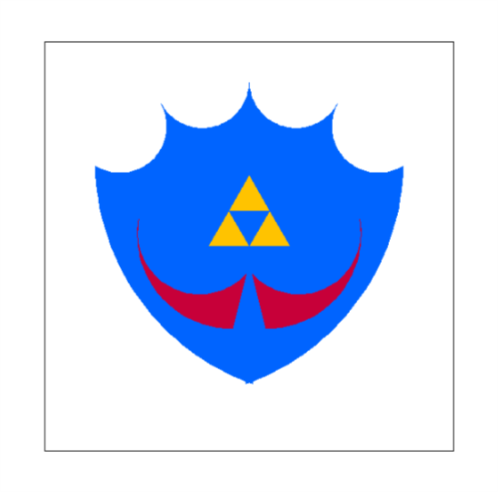
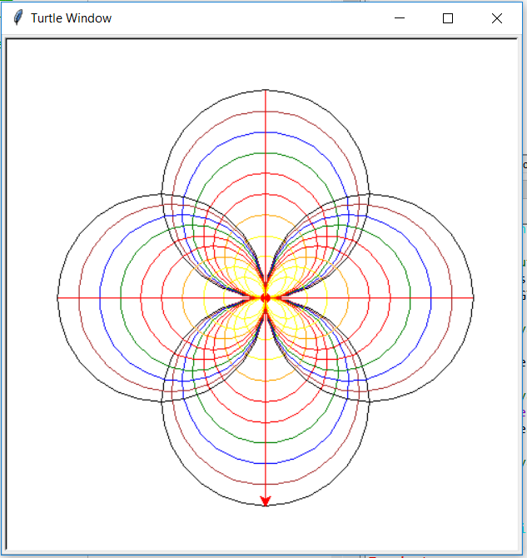
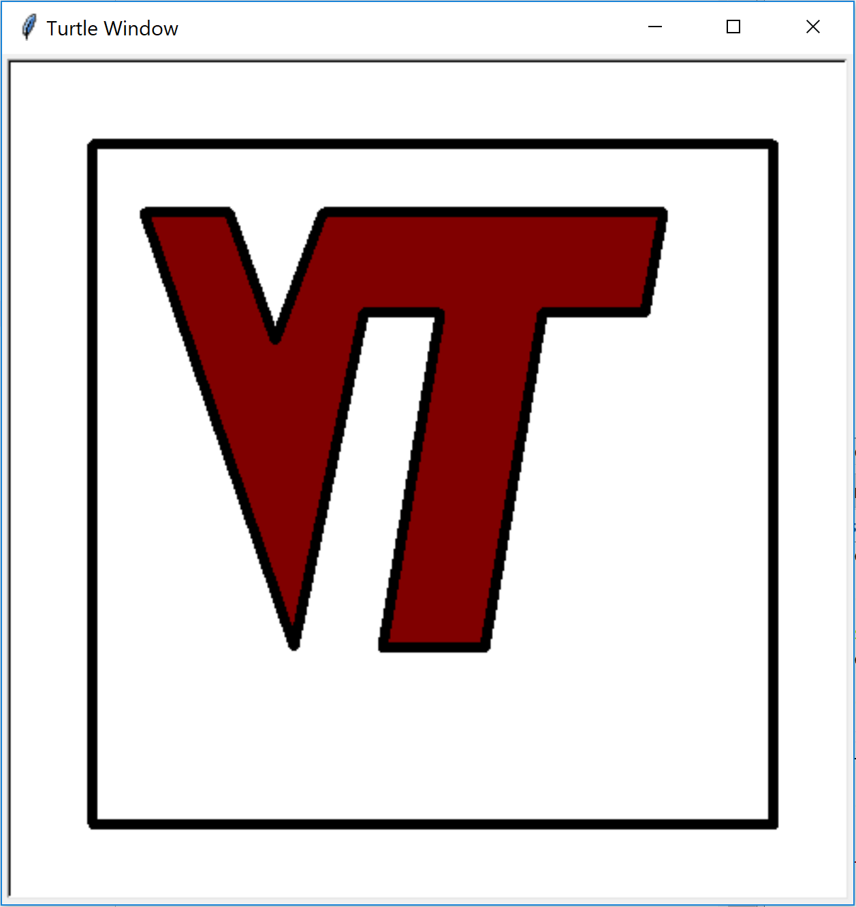
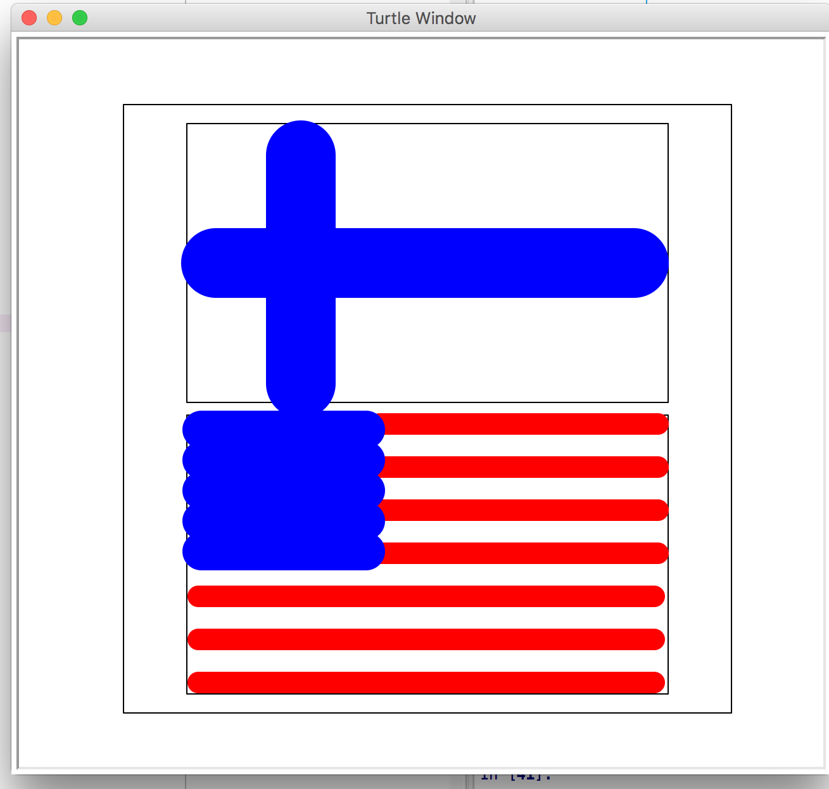
Assignment Goal: Create a wok of art
Requirements:
Should have a black, drawn border
Actual attempt, not just a blank canvas or "An orange".
Everything done via code (must submit .py)
READ THE INSTRUCTIONS VERY CAREFULLY!
Notes:
You'll need to break down the project's goal and requirements. However, you need to make students understand that the project spec is the first place to look for answers. They must learn to read instructions carefully. Never be afraid to refer them to the project spec, if their question is covered.
A hard thing to convey is the scope of the work of art. Everyone is required to draw a border frame around their work, but after that it's on them to make a decision. In the spec, it says to "make something that you want a loved one to print out and put on their fridge". It also suggests a minimum of 10-15 minutes of work. Students cannot just draw a line or a squiggle or a circle and call it a day. The examples on the right should be used to highlight what they have to make.
This is also an opportunity to remind them that they are uploading a .py file AND a screenshot. Otherwise, their submission will be rejected and they get no points (the assignment is only 1% of their final grade, so not the biggest deal, but they gotta learn to follow instructions).

Slide 13
Getting started
Read the instructions
Download the starting code
Decide what to draw
Dog, cat, VT logo, self-portrait
Write code
Draw the border
Draw the art
Screenshot the Turtle window
Submit code and screenshot
Try this before you leave today!
Notes:
Here's a chance to give a high-level overview of the project. Emphasize reading the instructions (seriously they never read the instructions) before they begin, and to refer to them throughout the project. They should download the starting code and make sure they can get it running. Strongly recommend they not leave without having the border drawn (which is a good test of whether they have the basics about writing the code).
If anyone asks, they can use advanced python features (e.g., loops, functions) but they don't get extra credit for doing so. The goal is to practice calling functions and methods. You should also remind them that they better not be copying code from the internet. It's often obvious when that happens and it will be an honor code violation.

Slide 14
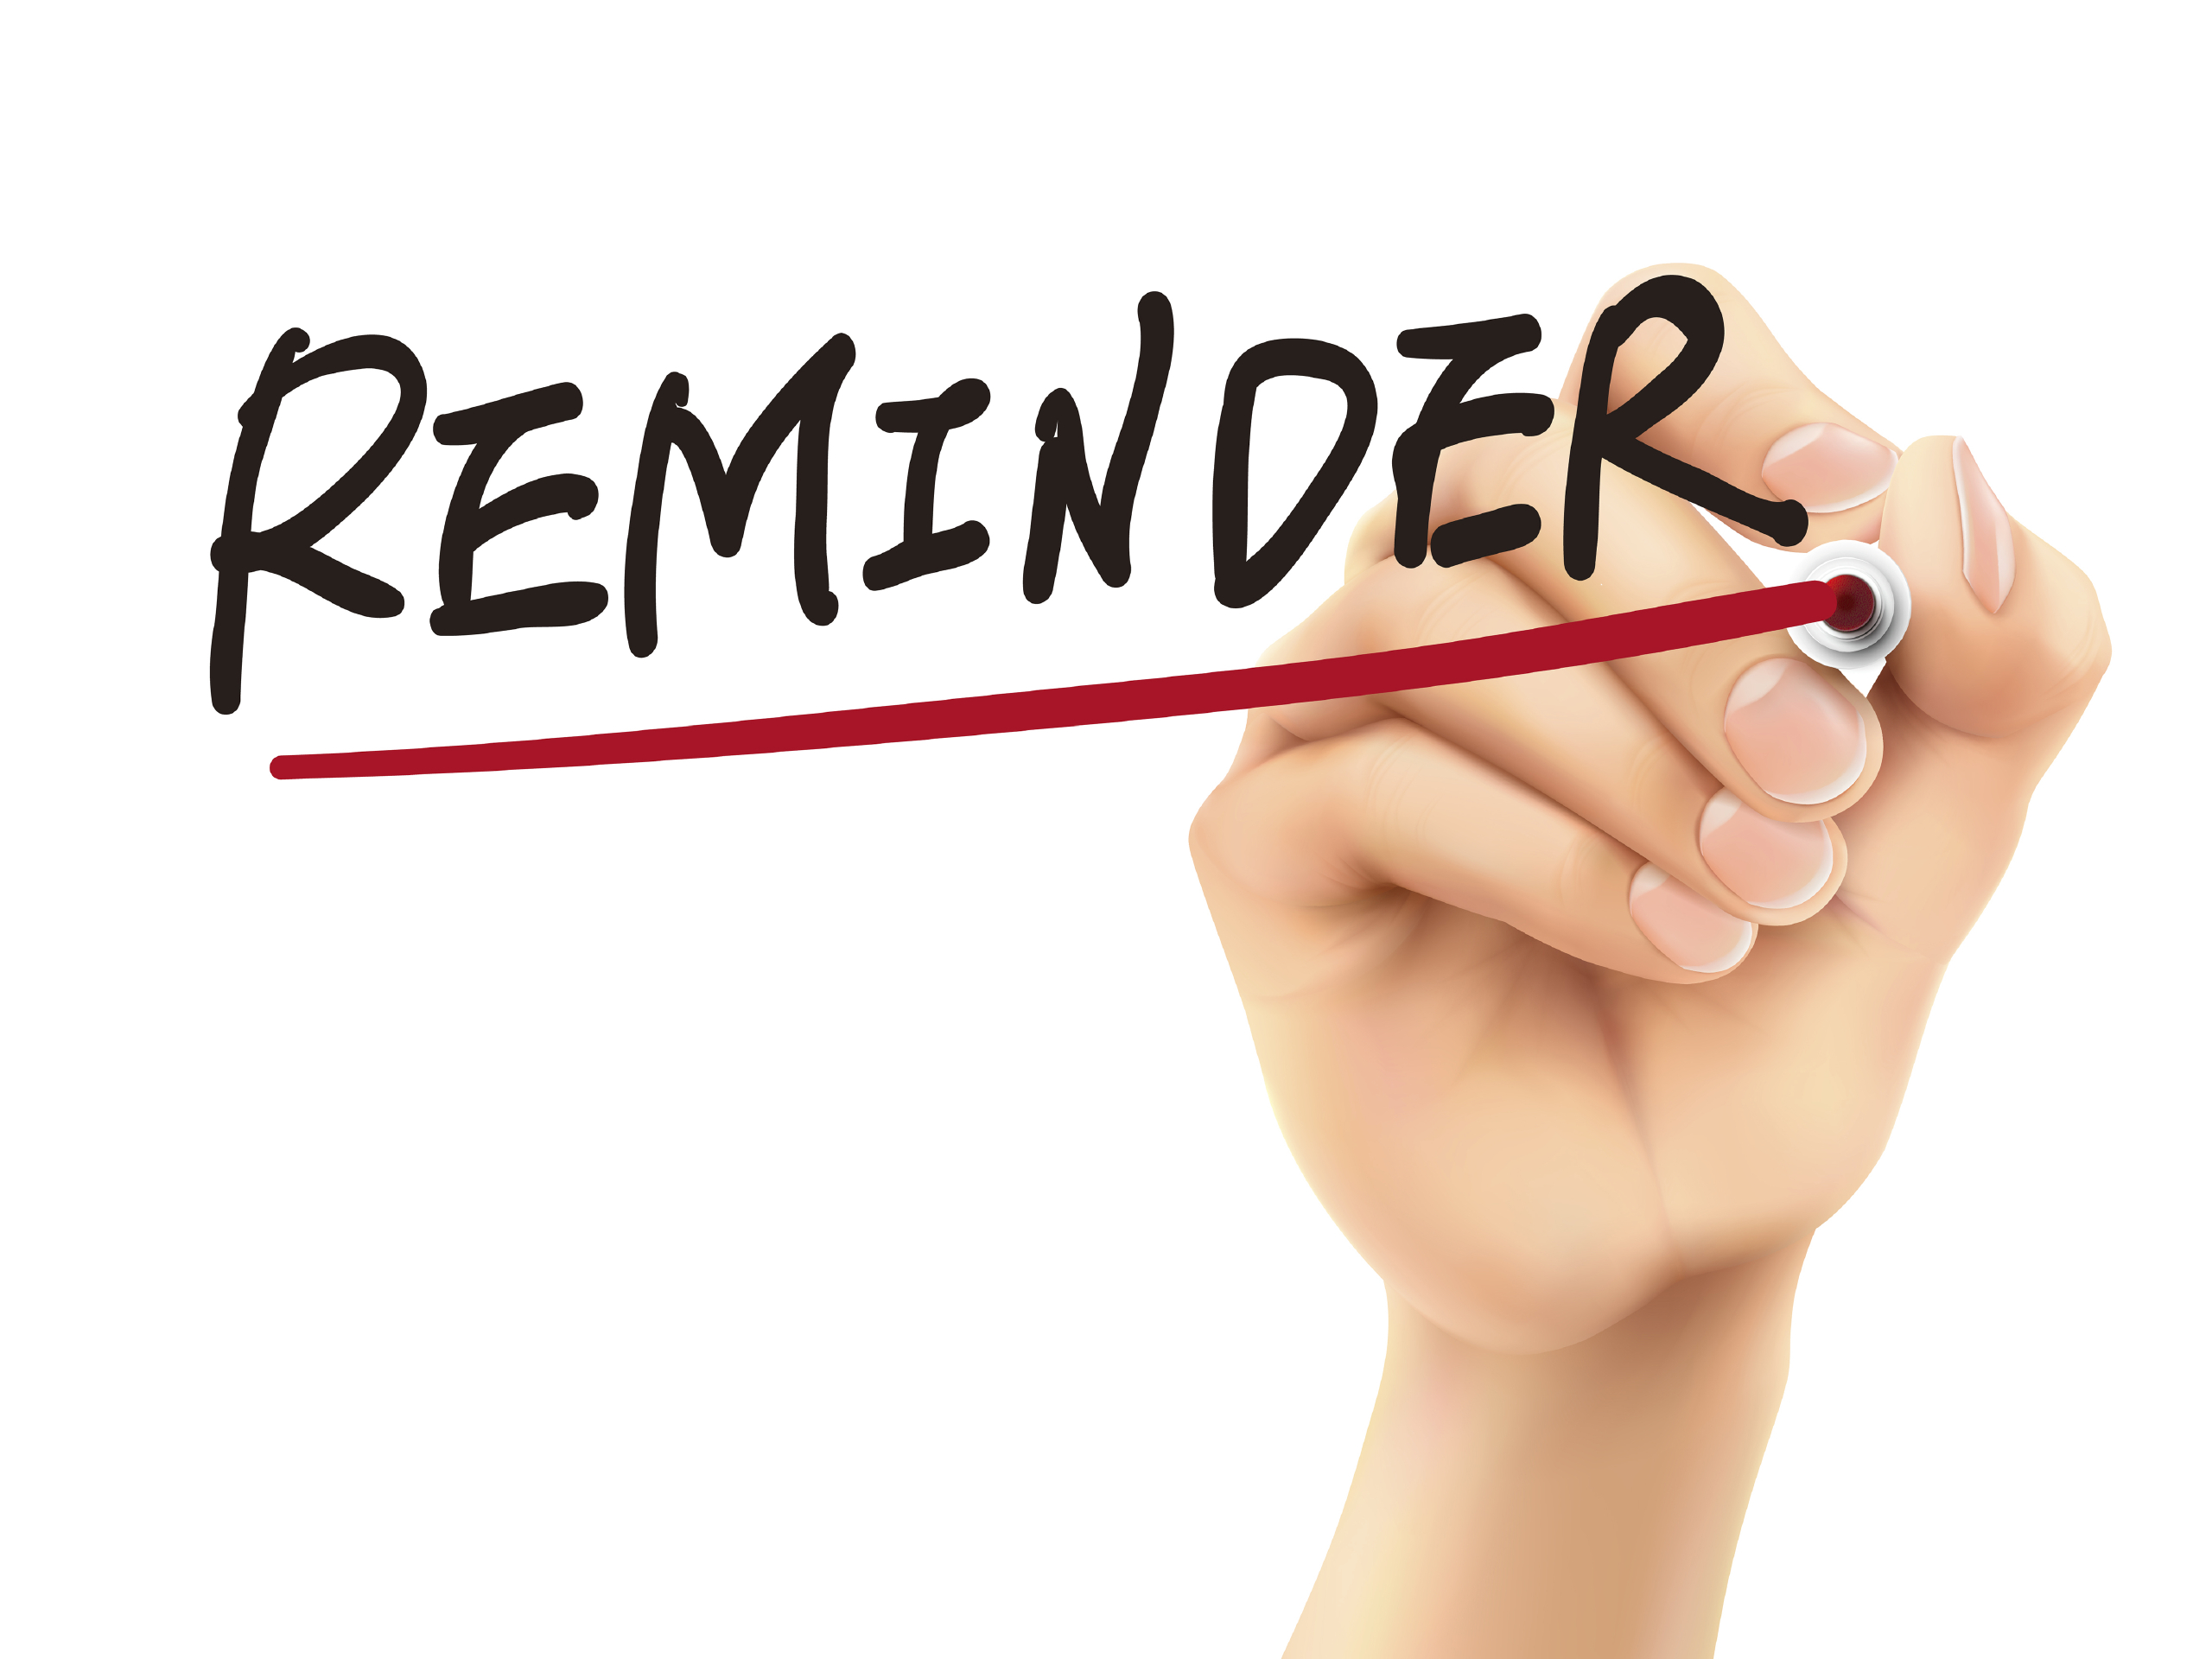
Reminders
Module 1 closes on Friday 2/2 at 11:59pm
Will be out next Tue 2/6 – Lecture by Navya (GTA)

Slide 15
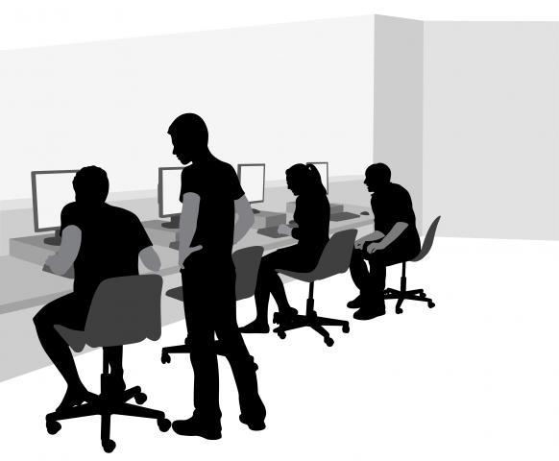
Lab Time
Work on class assignments
Finish as many problems as possible
Use instructor and TA’s time for assistance
IF YOU PLAN TO LEAVE
Make sure you inform me or the TAs
Show us your work progress
Notes:
You can wrap up the discussion on operators by going over these many examples of (potentially) confusing rules for the operators. The thing to highlight is that each operator has its own rules, and they should experiment when trying to mix types. Usually it doesn't work, sometimes it does.

