Slide 1
Defining Functions 2
Week 3 – Day 2
CS-1064 Intro to Python
Dr. Panagiotis Apostolellis, Virginia Tech, Spring 2018
Notes:
Instructor lecture notes will go down here.

Slide 2
Ethics Activity
Brief writing activity
Supports university's new Pathways Initiative
Broaden your thinking beyond just code to the societal implications
Notes:
You're going to start off by giving them an overview of WHY we're doing ethics stuff in a programming course. Part of this is procedural (university wants us to), but it's also because it's important. We're all affected by the decisions that programmers make, and they have power over us. Ethic is a shield to protect and guide us.

Slide 3

Ethical Dilemma
No Right Answers!
Bad Choice
Equally Bad Choice
Notes:
You want to impress upon students that they will be faced with ethical dilemmas, which often have no right or wrong answers. These will not be True/False kind of scenarios, but ones where they have to think about, summarize, and present their own arguments about. Some may be uncomfortable with this idea, but reinforce here that they are not graded based on their stance, but based on their ability to argue for that stance.

Slide 4
Ethics
Virtue
Duty
Consequentialism
Benevolence
Justice
Lawfulness
…
Guidelines and Theories to help guide you
Notes:
You want to give a high-level idea of what ethics are – the guidelines and theories that guide people in making ethical decisions. You might consider reviewing a few of these theories in the linked guides, so you can discuss them briefly. The idea is not to spend too much time teaching theories – students should peruse the collection and find ones that resonate with themselves. You want to be knowledgeable enough to be dangerous, without exhausting your own time.

Slide 5
Rubric
Criteria
Summarize the situation
Take a clear stance
Write a coherent argument
Reference an ethical theory or guideline
Use proper spelling, grammar, and punctuation
Levels | Points
Full Marks | 1
Adequate | .85
Inadequate | .7
Missing | 0
×
Notes:
Here's where you explain the scoring rubric. There are five criteria to be judged on, and each one can score 1 point (for up to a total of 5 points). These criteria can be scored at 4 levels (Full marks, adequate, inadequate, missing), and those levels determine the number of points for that criteria. The criteria has students respond to a scenario by summarizing the situation, then taking a clear stance on that situation. After they take a stance, they need to write a coherent argument that builds off an established ethical theory or guideline. Throughout their response, they must use proper spelling, grammar, and punctuation.

Slide 6

Example Prompt
Virginia Tech announced today that all undergraduate students are required to buy and use VT-brand laptops. These new "HokieTops" come preinstalled with software that allows the administration to monitor everyone's browsing and desktop behavior. The administration hopes that the new oversight software will prevent students from participating in undesirable activities such as pirating content, cheating on exams, or facebooking too much.
Is this new policy ethical?
Notes:
Shown here is an example prompt. I recommend reading it out loud to the students. You can also remind them that the online guide has this same example shown on it.

Slide 7
Summarize the Situation
Answer, who cares?
Multiple Stakeholders
General Stakeholders
Impact on the stakeholder's lives
New powers
New costs
New benefits
New risks
Example
Students
Have to buy laptops
Have better tech support available
Tech manufacturer
New customers
Need to handle FERPA laws
Lawyers
Might be interested in suing
etc.
Notes:
Breaking down the first rubric component, students need to summarize the situation. In doing so, they need to highlight stakeholders. The goal is to avoid overly-specific stakeholders, and to think broadly about society. Encourage them to go beyond the obvious actors and think about policy makers, other industries, etc. that could be relevant. They also need to think about the impacts on the stakeholders, not just list them out.

Slide 8
Take a Clear Stance
Agree? Disagree?
Make recommendations
To each stakeholder
Example
This new policy is ethical.
Students should buy laptops
Lawyers should stay out of this
HokieTop manufacturers should review the relevant laws very carefully
Notes:
Taking a stance is not just saying "Agree" or "Disagree". They need to make recommendations for their stakeholders.

Slide 9
Reference an Ethical Theory
Explicitly name theory
Suggest you include citation to avoid ambiguity
Described
Make it clear how it connects
The theory of "Utilitarianism"[1] suggests that actions are ethical if the good of their outcomes outweighs the bad. In this situation, we have to evaluate if the harm of requiring laptops balances out the potential benefits.
[1] http://utilitarianism.info/about
Notes:
It is not enough to just a list theory. They should explain it too. Let them know that they can't be ambiguous with their reference. Capitalization, quotation marks, a citation… something should be done to make it obvious that they are using a specific theory.

Slide 10
Write a Coherent Argument
Well-laid out argument
No fallacies
Compelling evidence
Citations/links to reputable sources
Example
This new policy is ethical because students surrender all their rights when they become students, according to Official Virginia Tech policy[1]. Since they have no rights, we need only look at the benefits to the HokieTop manufacturers, and the large amount of money they will make.
[1] https://vt.edu/policy
Notes:
There are many kinds of fallacies, and it's difficult to list all the ways that arguments fall apart. However, an easy way to mess this up is to provide no evidence. A quick google search should provide all the info you need.

Slide 11
150-300 word limits
In this ethical situation, various stakeholder have been affected. Students are now required to buy Virginia Tech laptops with monitoring software, which could spy on their browsing habits and invade their privacy. Parents and others supporting VT students have to have pay for this, which means an additional financial burden. The university must now store and keep safe all this data being collected about students, or they could harm students and be vulnerable to lawsuits.
I think that this new policy violates students' personal rights and is unethical. People should refuse to pay for the laptops specified in this policy. Students should uninstall the software if possible. If the university moves forward with the policy regardless, they should be very careful about protecting students' right to privacy.
The ethical theory of Rights[1] suggests that everyone has certain inalienable rights, such as being entitled to life, happiness, health, or privacy. This last right suggests that it is inherently wrong for people to spy or pry into someone's business without their consent.
According to the Rights theory, Virginia Tech students have a right to privacy and it is wrong to violate it. If students data was being collected and was not private to only the students, then it would be very easy for people to target individual students. Even if the data is only meant to be analyzed by a computer, data breaches are very common nowadays even in universities, according to a report by the X Group[2]. Therefore, students cannot reasonably expect to have their privacy kept safe in this new policy.
260 Words
(Citations don’t count)
Notes:
You will not want to spend too much time reviewing this example. Explain that each part of the expected response is in the example on Canvas, and they should look at it more closely. There is an example for each level of the rubric.

Slide 12
Grading
4 Ethics Activities
5 points each
5% of your final grade
Notes:
There are only 4 ethics activities, so even though the category has a small impact on their final grade, it is worth doing well on it.
Tell students clearly and distinctly now that if they disagree with their grade, they need to bring it up with the grading TA first. Do not let them contact you without contacting the TAs first.

Slide 13
Parameters vs. Arguments
Parameters:
When you define a function, you specify the formal parameters.
Arguments:
When you call a function, you replace the parameters with arguments (values)
return width * length * height
calculate_volume(5, 10, 7)
Notes:
Students get tripped on parameters vs. arguments, but it's a vocabulary thing. Going over it in class highlights its importance.
This is a chance to practice writing another function:
def calculate_volume(width, length, height):
return width * length * height

Slide 14

Which of these is most true?
A) Functions can return variables
B) Printing is the same as returning
C) Parameters do not have types
D) Print is used to call functions
Notes:
This question is very tricky.
A) Functions return values, not variables. Variables inside functions disappear at the end of the function's body.
B) Printing and returning are very different things.
C) Correct: Parameters will take on values (and values have types), but parameters do not have a formal type
D) Print is not necessary for calling functions.

Slide 15
What does this function print?
def add_numbers(first, second):
return print(first+second)
add_numbers("1", "1")
A) “2”
B) “11”
C) Nothing
D) Impossible to tell
Notes:
This does print, because we call the print inside the function.

Slide 16
What type does this function return?
def add_numbers(first, second):
return print(first+second)
add_numbers("1", "1")
A) Integer
B) Float
C) String
D) Boolean
E) None
Notes:
Because the print function returns None, this function returns None. Highlight that this is awful and a mistake.

Slide 17
Does this function print?
def add_numbers(first, second):
return first+second
print(add_numbers("1", "1"))
A) Yes
B) No
D) Impossible to tell
Notes:
This function does not print, because the print call is outside the function. However, running the code will print the same as before!

Slide 18
What does this code return?
def add_numbers(first, second):
return first+second
print(add_numbers("1", "1"))
A) Integer
B) Float
C) String
D) Boolean
E) None
Notes:
The answer this time is String. This questions should be easy if they are following along.

Slide 19
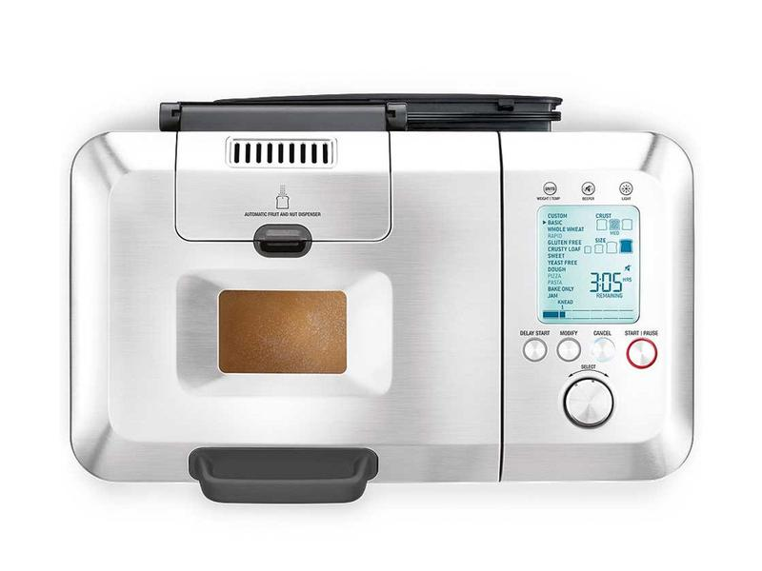
Function Metaphor
def check_ingredients(flour, yeast, salt, sugar, water, oil):
if (flour + yeast + salt + sugar + water + oil < 10):
portion = 1
else:
portion = 2
print ("Ready to make plain bread for", portion)
Let’s make some bread!
Flour: 1 lb
Yeast: 0.2 oz
Salt: 0.5 tsp
Sugar: 1 tsp
Water: 3 oz
Oil: 2 tbsp
Ready to make plain bread for 1
check_ingredients(1lb, 0.2oz, 0.5tsp, 1tsp, 3oz, 2tbsp)

Slide 20
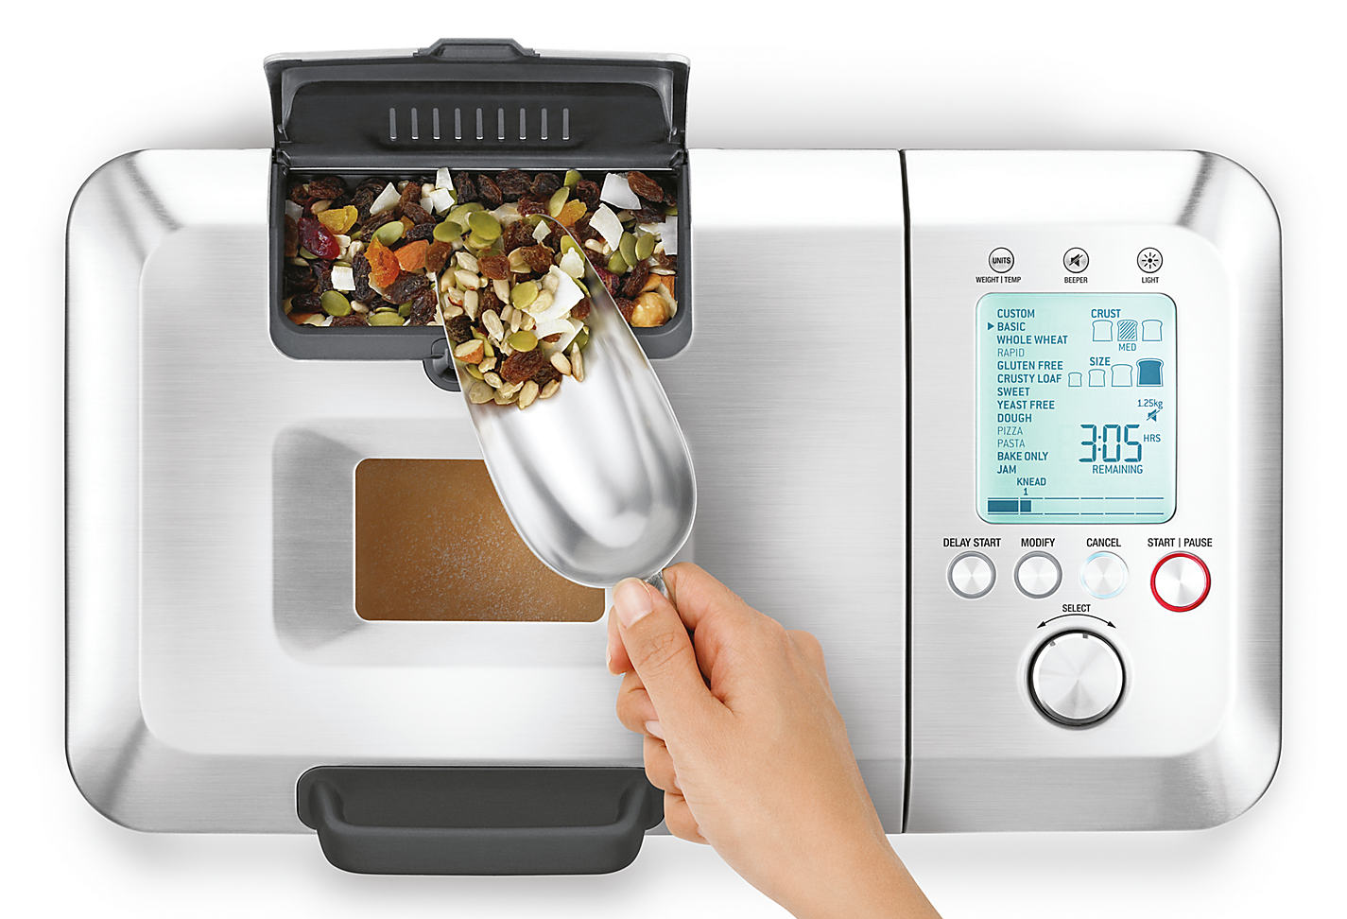
def check_ingredients(flour, yeast, salt, sugar, water, oil, seeds):
if (flour + yeast + salt + sugar + water + oil < 10):
portion = 1
else:
portion = 2
if seeds > 0: type = "seeded"
print ("Ready to make " + type + " bread for", portion)
Function Metaphor
Let’s make some seeded bread!
Flour: 1 lb
Yeast: 0.2 oz
Salt: 0.5 tsp
Sugar: 1 tsp
Water: 3 oz
Oil: 2 tbsp
Ready to make seeded bread for 2
check_ingredients(2lb, 0.4oz, 1tsp, 2tsp, 6oz, 4tbsp, 1scoop)

Slide 21
def make_bread(flour, yeast, salt, sugar, water, oil, seeds):
if (flour + yeast + salt + sugar + water + oil < 10):
portion = 1
else:
portion = 2
if seeds > 0: type = "seeded"
print ("Making " + type + " bread for", portion)
return mix_and_make_bread()
Function Metaphor
Let’s make some seeded bread!
Flour: 1 lb
Yeast: 0.2 oz
Salt: 0.5 tsp
Sugar: 1 tsp
Water: 3 oz
Oil: 2 tbsp
Making seeded bread for 2
make_bread(2lb, 0.4oz, 1tsp, 2tsp, 6oz, 4tbsp, 1scoop)

Slide 22

Reminders
Module 2 closes on Friday 2/9 at 11:59pm
Ethics activity 1 opened on Tue 2/6 (due 2/16)

Slide 23

Lab Time
Work on class assignments
Finish as many problems as possible
Use instructor and TA’s time for assistance
IF YOU PLAN TO LEAVE
Make sure you inform me or the TAs
Show us your work progress
Notes:
You can wrap up the discussion on operators by going over these many examples of (potentially) confusing rules for the operators. The thing to highlight is that each operator has its own rules, and they should experiment when trying to mix types. Usually it doesn't work, sometimes it does.

