Slide 1
Project 2: Magical Banking
Week 4 – Day 1
CS-1064 Intro to Python
Dr. Panagiotis Apostolellis, Virginia Tech, 2018

Slide 2

Overview
You have just started working for the Goblin Bank
Creating a Magical Loan System
Your senior colleague Grindlehook has written a function for calculating user ratings, critical to evaluating loan applications
Your task: integrate his function into the complete system and satisfy the bosses exacting unit tests.
Notes:
Set the stage for the project. The context is that they are a programmer for a goblin bank, making a system for approving wizard loans. Their senior colleague has given them an awful function they must use. They have to write the rest of the system.
After giving an overview, open up the example solution and show what it looks like when you run (avoid sharing the code itself).

Slide 3
Learning Objectives
Read and respond to real unit tests
Move data through a large program with multiple functions
Differentiate between printing, returning, inputted data, and parameters
Work with a "black-box" function (only knowing its inputs and outputs)
Notes:
In no particular order, let the students know WHY we're doing this.

Slide 4
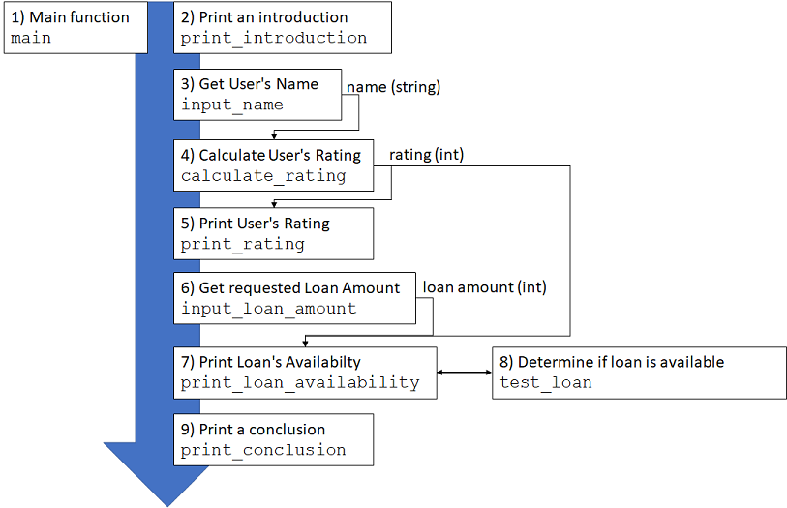
Program overview
Notes:
This diagram highlights the flow of the function. The main function calls the other functions. Some of the functions consume values, some of them return values, some of them get input, some of them print. Briefly go over the flow, and highlight which ones feed into others.

Slide 5
#%%
# Do NOT change the following function definition
def calculate_rating(name):
'''
Returns the customer's credit rating, according to the bank's current
status, the customer, and the alignment of the stars. This function
is a little delicate, and will break after being called once.
NOTE (ghook@1/15/2018): DO NOT TOUCH THIS, I FINALLY GOT IT WORKING.
Returns:
int: An integer (0-9) representing the customer's credit rating.
'''
c=calculate_rating;setattr(c,'r',lambda:setattr(c,'o',True))
j={};y=j['CELESTIAL_NAVIGATION_CONSTANT']=10
j[True]='CELESTIAL_NAVIGATION_CONSTANT'
x=str(''[:].swapcase);y=y+11,y+9,y+-2,y+-2,y+4,y+-5,y+-1,y+11,y+9,\
y+-6,y+-6,y+-1,y+-5,y+3,y+-7,y+7,y+-1,y+-5,y+8,y+-7,y+11,y+1
z=lambda x,t,o=0:''.join(map(lambda j:x.__getitem__(j+o), t))
if hasattr(c,'o')and not getattr(c, 'o'): return z(x,y)
c.o=False;j['CELESTIAL_NAVIGATION_CONSTANT'].bit_length
d=(lambda:(lambda:None))()();g=globals()
while d:g['X567S-lumos-17-KLAUS']=((d)if(lambda:None)else(j))
p=lambda p:sum(map(int, list(str(p))))
MGC=p(sum(map(lambda v: v[0]*8+ord(v[1]), enumerate(name))))
while MGC>10:MGC=p(MGC)
if c:return MGC
Notes:
This is Grindlehook's function, which can only be used once in the program before it breaks. Emphasize to students that they should not waste time decoding it. The function is extremely poorly written, and Grindlehook is a bad programmer. Good programmers 1) do not write code that is hard to read, 2) write code that breaks after its first usage, and 3) do not yell at people for trying to understand and improve their code. However, there are many Grindlehooks in the world, and we have to learn how to deal with them.
If you can decode the entire function, you should probably not be taking this course.

Slide 6
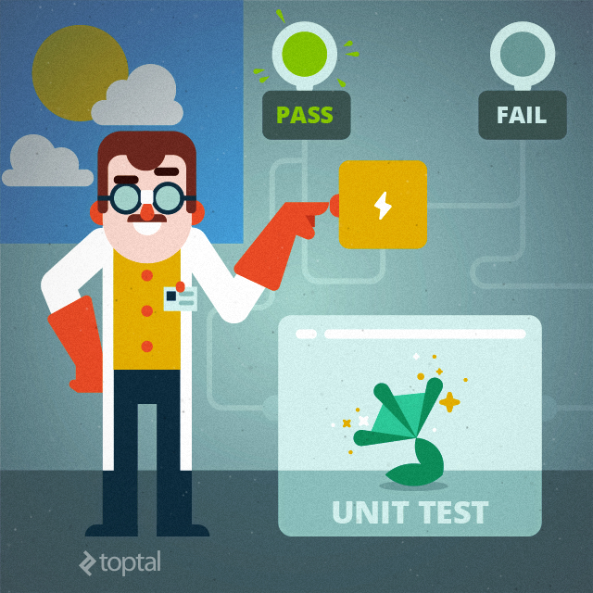
Unit Tests
Unit tests determine if you are correct
The unit tests are EXTREMELY specific
Capitalization
Spelling
Whitespace
Eyeballing the output is not enough
YOU MUST RUN THE UNIT TESTS TO COMPLETE THIS PROJECT!
Notes:
You're never going to tell them this enough, but they have to use the unit tests. Running them early and often is the only measure of whether they are writing the code correctly. These tests are so specific, they are almost certain to make mistakes.
Unit test is a software testing method by which individual units of source code are tested to determine whether they are fit for use or not
They ensure that code meets its design specifications and behaves as intended
Its goal is to isolate each part of the program to show that the individual parts are correct

Slide 7
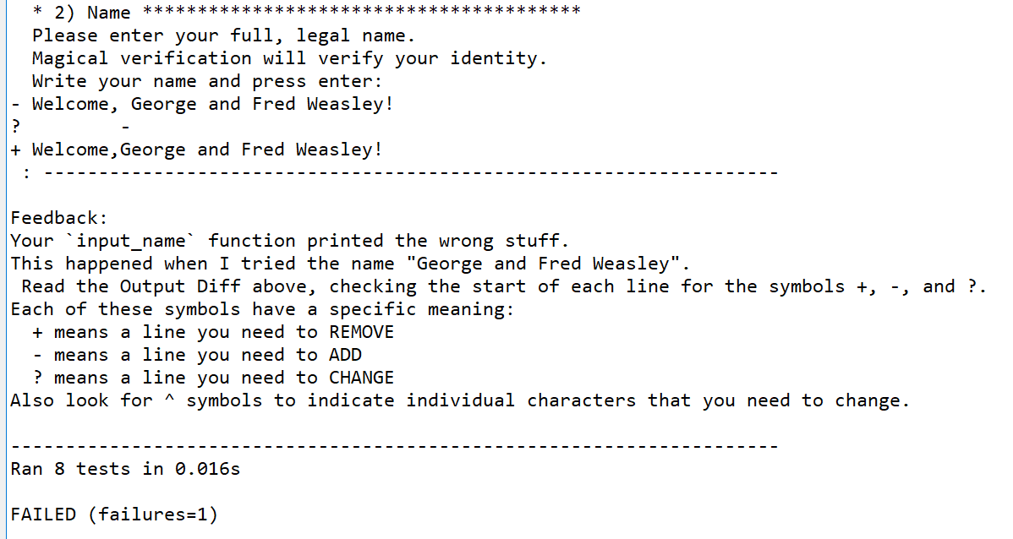
Reading Unit Tests
Refer to reference sheet
Notes:
When unit tests fail, they give feedback. Students struggle to understand this feedback.
At this point, switch over to the editor and demonstrate a failing test case (good opportunity to demonstrate how to run the unit tests too). Interpret each part of the failing test case.

Slide 8

Web-CAT
When you are done, you will submit on Web-CAT
Indicates you passed or failed the test cases
Run the local test cases to determine which ones you are failing
5 points assigned by TAs for good code style
Check the code organization guide
Notes:
Mention Web-CAT here. You can also give a demo during the next class on how to use it.

Slide 9
Getting Started
Read
Read project spec
Fill In
Complete Canvas quiz table
Write the arguments, input/print status, and return type for each function
Download
Download starting code
Write
Finish first function (print_introduction)
Test
Run unit test file
Notes:
Go over these instructions for getting started. When you finish the rest of the presentation, return to this slide.

Slide 10
Class Format
Class is organized into pairs or tripplets
TA is assigned to each color group
TA will check that you completed the functions overview quiz table.
Your group is STRONGLY ENCOURAGED to collaborate on:
Quiz table on Canvas
print_introduction function
Make sure you pass the unit tests by running "test_my_solution.py"!!!!
input_name function
Make sure you pass the unit tests by running "test_my_solution.py"!!!!
You are not allowed to collaborate on other aspects of the project outside of class
Notes:
Modify this appropriately. In my class, students will be organized into large groups to make them feel comfortable seeking help and getting each other on the same page.

Slide 11
Goals
Tuesday 2/13
Complete first two functions (Canvas quiz table)
Thursday 2/15
Complete remaining functions (in banking.py)

