Slide 1
Project 2: Magical Banking Act it out!
Week 5 – Day 1
CS-1064 Intro to Python
Dr. Panagiotis Apostolellis, Virginia Tech, 2018

Slide 2
Learning Objectives
Experience how functions are defined and called
Move data through a large program with multiple functions
Differentiate between printing, returning, inputted data, and parameters
Understand the (flow of) execution of a program
Notes:
In no particular order, let the students know WHY we're doing this.

Slide 3

[code]
Pick a role and help program the Magical Banking with your body!
Notes:
Set the stage for the project. The context is that they are a programmer for a goblin bank, making a system for approving wizard loans. Their senior colleague has given them an awful function they must use. They have to write the rest of the system.
After giving an overview, open up the example solution and show what it looks like when you run (avoid sharing the code itself).

Slide 4
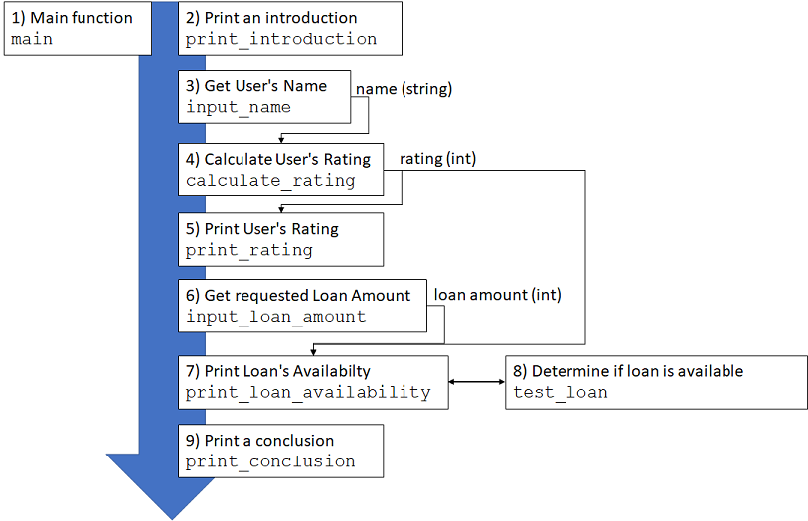
Program Overview
Notes:
This diagram highlights the flow of the function. The main function calls the other functions. Some of the functions consume values, some of them return values, some of them get input, some of them print. Briefly go over the flow, and highlight which ones feed into others.

Slide 5
Magic Banking role-play
Read
Read Program Overview very-very carefully
Understand
Understand what each function does and how to define it
Embody
Select a “role” and come to the “stage” to act it out
Verify
Think collectively about your “written” code and what it does
Execute
“Run” the program by acting each line one-by-one
Notes:
Go over these instructions for getting started. When you finish the rest of the presentation, return to this slide.

Slide 6
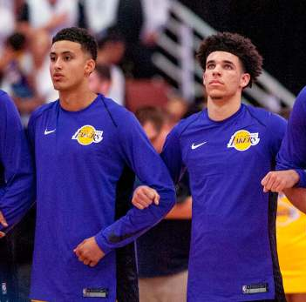
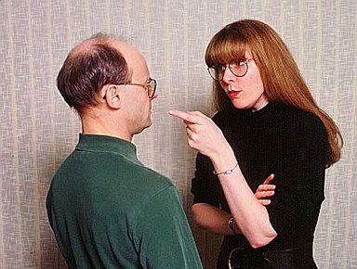
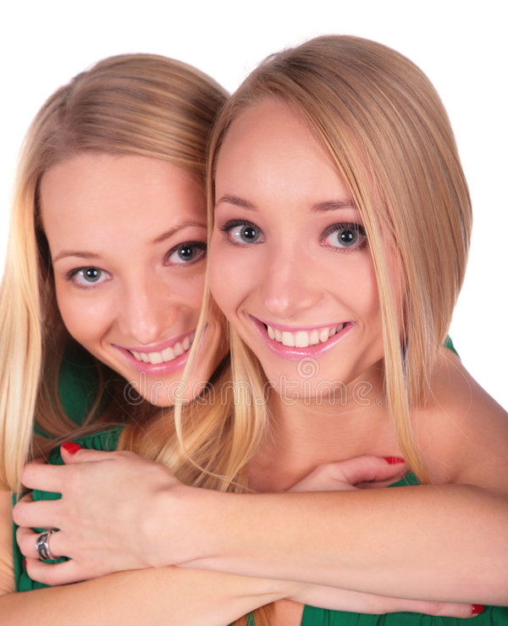
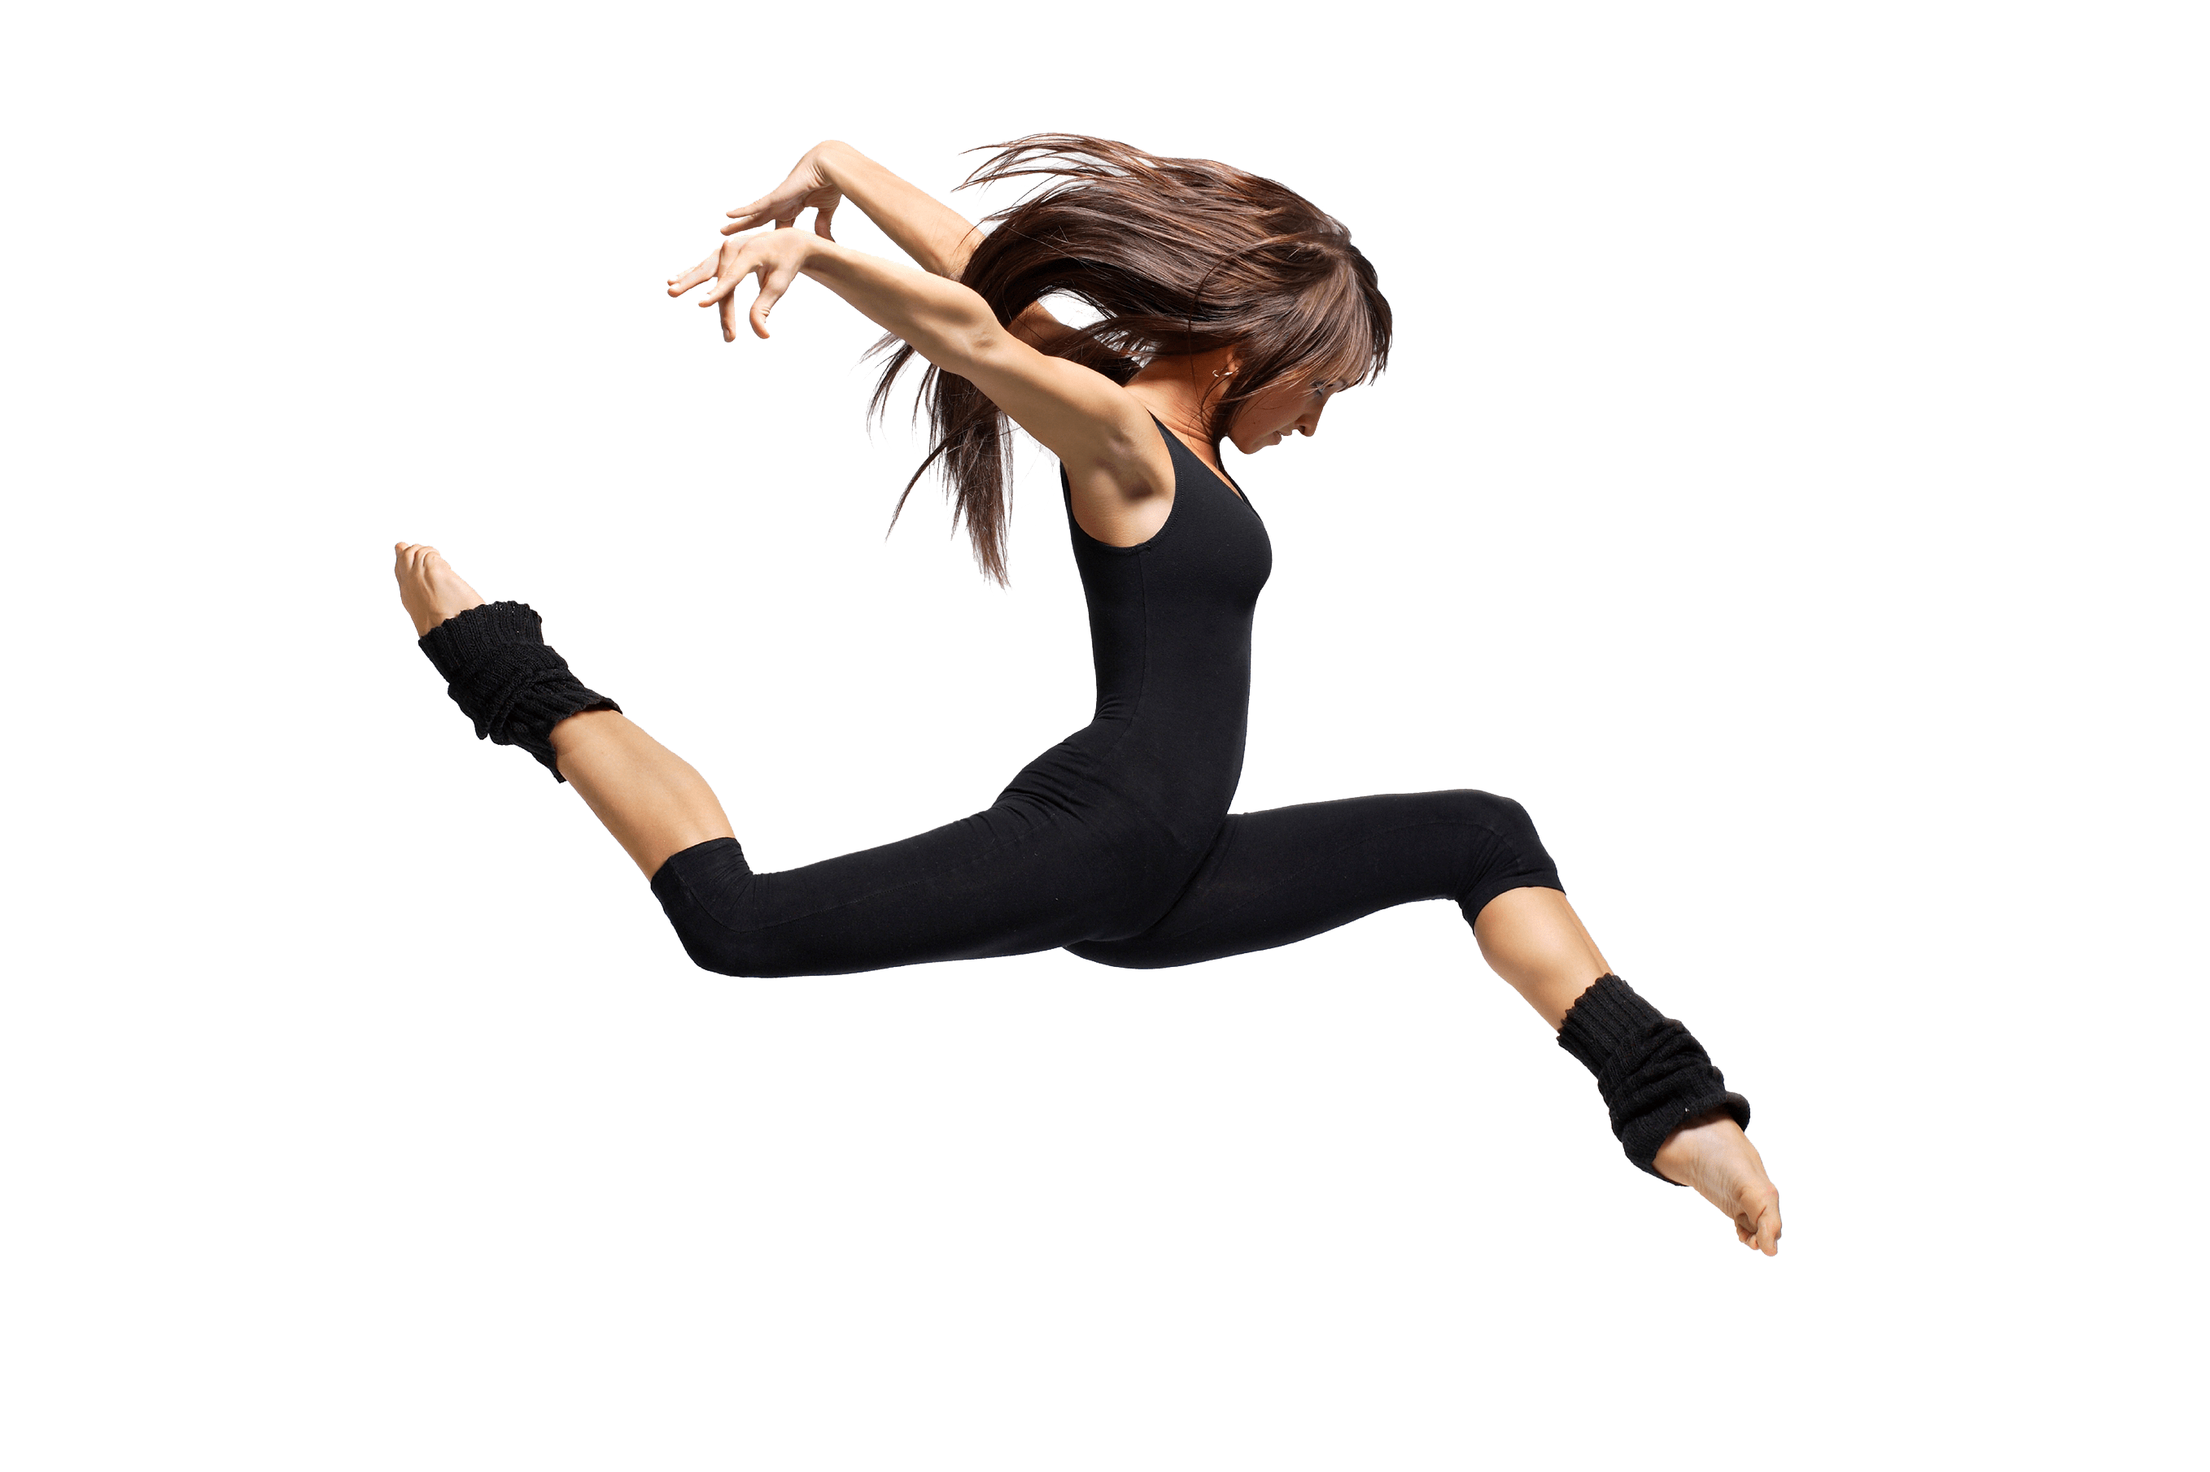
Conventions
Link arms:
arguments, parameters, or combination of values, variables and operations
E.g., print(“Hello”, name)
Embrace:
Function “embraces” its parameters or arguments
E.g., print(my_name)
Point at:
Variable assignment
E.g., name = get_name()
Move (or dance):
Pass values between variables, arguments, and parameters
ONLY during run-time
Function call
Variable
Value
Variable
get_name()
name
“Hello”
name
Value
Function
call
“Panagiotis”
Parameter
print
my_name

Slide 7
Read & Understand
Group 1
Embody 1
Group 2
Notes:
This diagram highlights the flow of the function. The main function calls the other functions. Some of the functions consume values, some of them return values, some of them get input, some of them print. Briefly go over the flow, and highlight which ones feed into others.

Slide 8
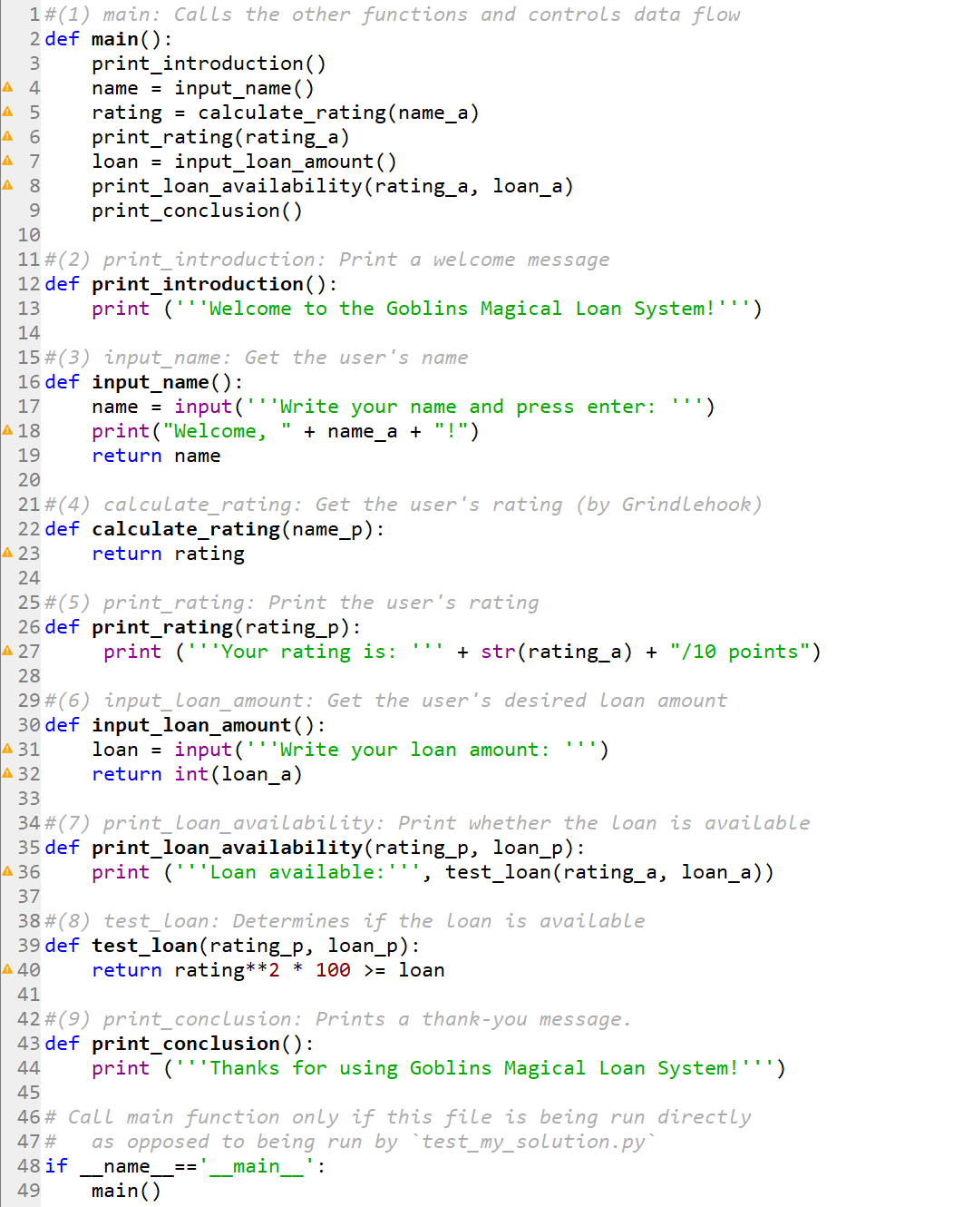
Verify & Execute
Embody 1
Notes:
This diagram highlights the flow of the function. The main function calls the other functions. Some of the functions consume values, some of them return values, some of them get input, some of them print. Briefly go over the flow, and highlight which ones feed into others.

Slide 9
Read & Understand
Group 1
Embody 2
Group 2
Notes:
This diagram highlights the flow of the function. The main function calls the other functions. Some of the functions consume values, some of them return values, some of them get input, some of them print. Briefly go over the flow, and highlight which ones feed into others.

Slide 10
Verify & Execute
Embody 2
Notes:
This diagram highlights the flow of the function. The main function calls the other functions. Some of the functions consume values, some of them return values, some of them get input, some of them print. Briefly go over the flow, and highlight which ones feed into others.

Slide 11
Give yourselves a hand!

