Slide 1
For Loops
Week 6 – Day 1
CS-1064 Intro to Python
Dr. Panagiotis Apostolellis, Virginia Tech, 2018

Slide 2
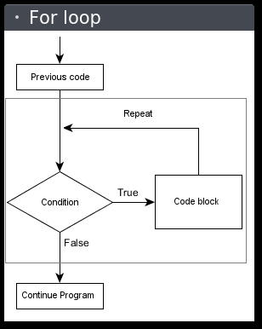
For Loops
Traversing list elements
Notes:
For loops are an amazing invention. They are a very safe form of iteration that lets us work with lists. When you use a for loop, you have an abstract element that represents "some element of the list" and you write code that uses it. The for loop is the primary way to loop in Python.
If you're feeling belligerent, this is the first opportunity to trash talk While loops. Students with prior programming experience flock to While loops and try to use them everywhere because that's what other languages emphasize. But to do so, they make their lives harder and their code more complex.

Slide 3
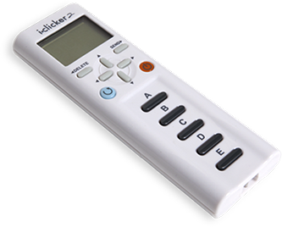
How do we call a for loop that counts to 10 in Python?
for (i=1; i<=10; i++)
while (i <= 10)
for i in range(1,11)
repeat i for i <= 10
None of these
Notes:
At this point, we've seen a lot of terminology, so now's a good time to reinforce Functions vs. Keywords. The answer is B (3) as shown on the next slide.

Slide 4
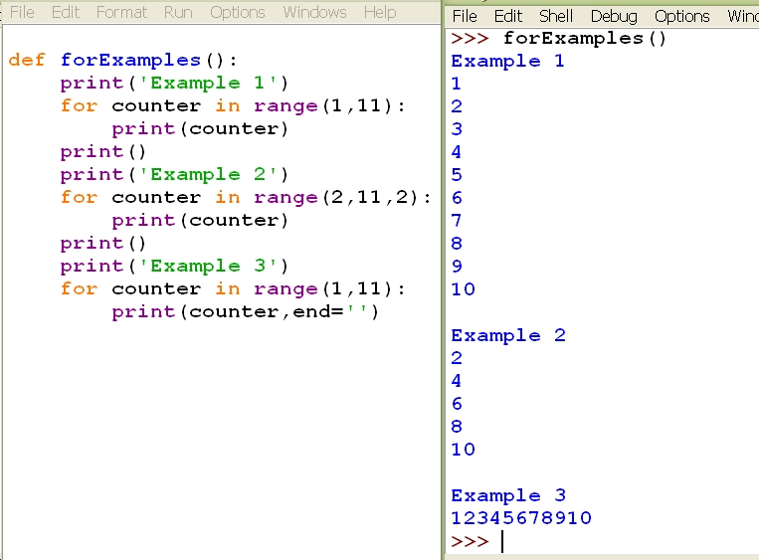
For Loops
Examples
Notes:
For loops are an amazing invention. They are a very safe form of iteration that lets us work with lists. When you use a for loop, you have an abstract element that represents "some element of the list" and you write code that uses it. The for loop is the primary way to loop in Python.
If you're feeling belligerent, this is the first opportunity to trash talk While loops. Students with prior programming experience flock to While loops and try to use them everywhere because that's what other languages emphasize. But to do so, they make their lives harder and their code more complex.

Slide 5
Loop Patterns
Accumulate
Count: count = count + 1
Sum: sum = sum + i
Filter
if i < 100: result = result + i
Map/Transform:
Map: list.append(i)
Transform: list.append(i*2)
Min/Max
Max: if i > max: max = i
Practice and get comfortable using them!
Notes:
Learning how to write loops is hard, but it helps to start developing schemas for common loop patterns. Besides knowing the mechanics of loops, let students know that they should be able to recite any of these patterns from scratch. Also, point out that all of them work with almost any kind of data. You can apply the Accumulate pattern on a list of Booleans, or a list of integers, or a list of lists.

Slide 6
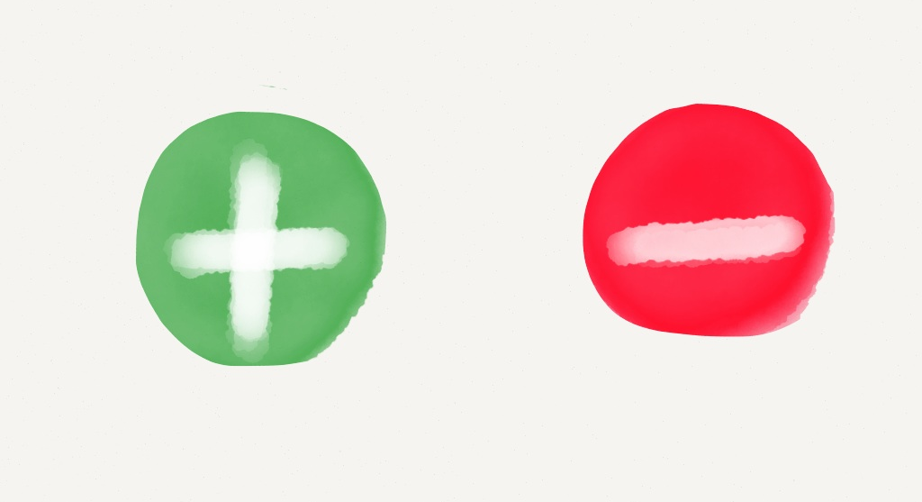
Lists and Loops
Create a function that will consume a list of numbers and return the sum of all the numbers that are negative.
Type of pattern?
Filter & Sum
Example:
Input: [-10, -5, 0, 5, 10]
Output: -15
Notes:
Here's a quick example problem.
sum = 0
for i in [-10,-5,0,5,10]:
if i < 0:
sum =+ i

Slide 7

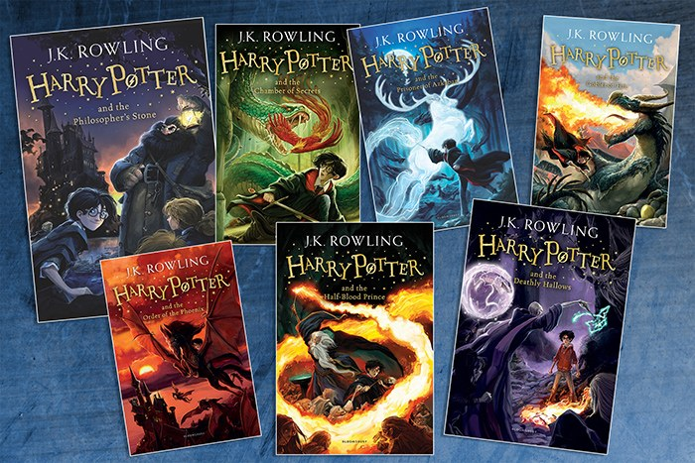
Processing Lists of Any Type
A scientist has a long list of Boolean values indicating whether his test subjects responded to a treatment. Create a function that consumes a list of Boolean values and count the number of times that it was True.
Filter & Count
Write a function that consumes a list of strings representing books and returns whether any of the strings contains the word "harry potter".
Filter OR Accumulate
Notes:
Here are two more potential example problems.
def count_trues(test_subjects):
count = 0
for test in test_subjects:
if test:
count += 1
return count
def has_harry_potter(some_books):
result = False
for book in some_books:
result = result or ("harry potter" in book.lower())
return result

Slide 8
Which is the best way to sum the list?
A)
sum = 0
for price in prices:
sum += price
B)
sum = 0
index = 0
while index < len(prices):
sum += prices[index]
index += 1
C)
sum = 0
for index in range(len(prices)):
sum += price[index]
Notes:
This problem is for the benefit of those who have prior programming experience.

Slide 9
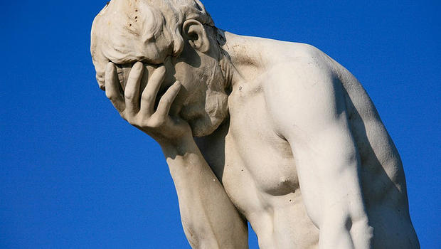
No more indexing in loops
If you have programmed in Java, C, etc. before:
prices = [4, 3, 6]
for price in prices:
… price …
Beautiful!
for index in range(len(prices)):
… price[index] …
Horrifying!
Notes:
This code here shows the difference between using indexes to access elements rather than just using the elements directly. In this course, "That's what makes sense to me" is NOT a justification for using while loops or for/range looping constructs. Students need to get comfortable working with collection-based iteration correctly.

Slide 10

Lab Time
Work on class assignments
Finish as many problems as possible
Use instructor and TA’s time for assistance
IF YOU PLAN TO LEAVE
Make sure you inform me or the TAs
Show us your work progress
Notes:
You can wrap up the discussion on operators by going over these many examples of (potentially) confusing rules for the operators. The thing to highlight is that each operator has its own rules, and they should experiment when trying to mix types. Usually it doesn't work, sometimes it does.

