Slide 1
Mutability
Week 6 – Day 2
CS-1064 "Intro to Python"
Austin Cory Bart, Virginia Tech, 2018

Slide 2
Mutability
"Can you change the value?"
Strings, numbers, booleans: immutable
Lists: mutable

Slide 3
Which of these change the value of the variable?
A) my_string.lower()
B) round(my_integer)
C) int(my_float)
D) my_list.append(5)
E) not my_boolean

Slide 4
Demonstration
Notes:
Bring up the PythonTutor or Thonny, and demonstrate how these environments can showcase the mutability of the other statements.
my_string = "Harry Potter"
my_integer = 5
my_float = 12.7
my_list = [1,2,3]
my_boolean = True
my_string.lower()
my_list.append(5)
etc.

Slide 5
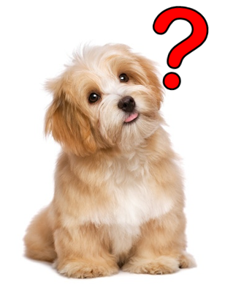
Any questions?

