Slide 1
Mutability
Week 6 – Day 2
CS-1064 Intro to Python
Dr. Panagiotis Apostolellis, Virginia Tech, 2018

Slide 2
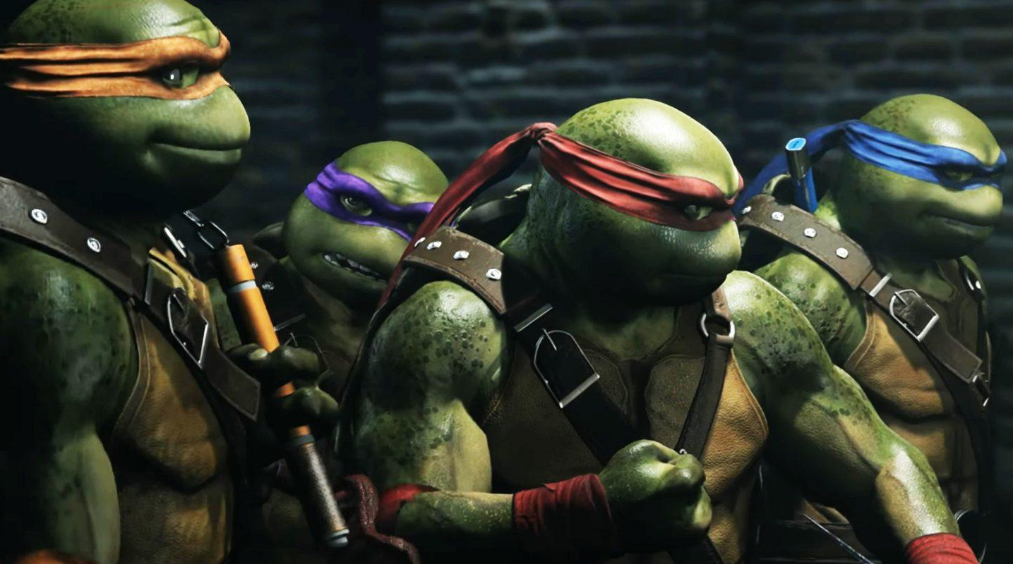

Mutability
Lists
…so are
strings, numbers, booleans
noun
liability or tendency to change.
“the incessant mutability of species”
“Can you change the value?”

Slide 3
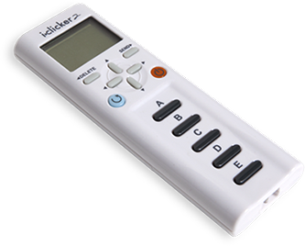
Which of these change the value of the variable?
A) my_string.lower()
B) round(my_integer)
C) int(my_float)
D) my_list.append(5)
E) not my_boolean
Notes:
At this point, we've seen a lot of terminology, so now's a good time to reinforce Functions vs. Keywords. The answer is B (3) as shown on the next slide.

Slide 4
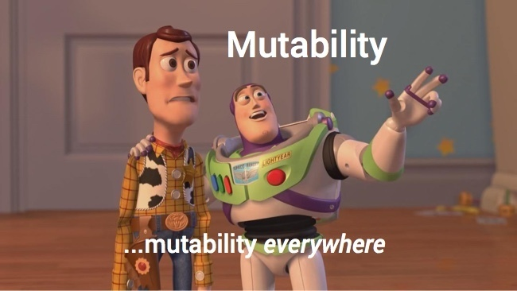
Demo
my_string = "Harry Potter"
my_integer = 5
my_float = 12.7
my_list = [1,2,3]
my_boolean = True
Notes:
Bring up the PythonTutor or Thonny, and demonstrate how these environments can showcase the mutability of the other statements.
my_string = "Harry Potter"
my_integer = 5
my_float = 12.7
my_list = [1,2,3]
my_boolean = True
my_string.lower()
my_list.append(5)
etc.

Slide 5
How does this expression affect the variable?
my_string = my_string.upper()
A) It doesn’t
B) It makes it uppercase
C) It makes it lowercase
D) It returns an error

Slide 6
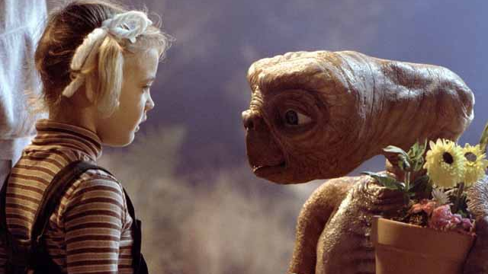
Project 3
You are a member of an advanced race of aliens, sent to Earth to learn more about humans. Your grand leader has demanded that you formulate an important question to ask 10 humans. Once the data has been collected, you will write a series of functions to analyze the data using common statistical formula.

Slide 7

Lab Time
Work on class assignments
Finish as many problems as possible
Use instructor and TA’s time for assistance
IF YOU PLAN TO LEAVE
Make sure you inform me or the TAs
Show us your work progress
Notes:
You can wrap up the discussion on operators by going over these many examples of (potentially) confusing rules for the operators. The thing to highlight is that each operator has its own rules, and they should experiment when trying to mix types. Usually it doesn't work, sometimes it does.

