Slide 1
Comprehensions
Week 7 – Day 1
CS-1064 Intro to Python
Dr. Panagiotis Apostolellis, Virginia Tech, 2018

Slide 2

What does this print?
my_string = "What does this print?"
for i in my_string[5:14].split(' '):
print(i)
A) >What >does >this >print?
B) >does this
C) >does >this
D) >this print?
E) It prints nothing
Notes:
At this point, we've seen a lot of terminology, so now's a good time to reinforce Functions vs. Keywords. The answer is B (3) as shown on the next slide.

Slide 3
Looping over Strings
a_string = "1, 2, 3"
Iterating by character
Iterating on a split list
Iterating on whitespace
for a_character in a_string:
print(a_character)
for an_item in a_string.split(","):
print(an_item)
for a_chunk in a_string.split():
print(a_chunk)
Notes:
Around this time, people seem to get confused about how to iterate through strings. They don't realize that they can iterate by character through using the string as the iteration list, rather than using the split method. It's important that they understand that the split method is only used when you need to GROUP characters using some rule, as opposed to iterating through each character.

Slide 4
List compre-hension for doubling the values of a list?
my_list = [5,6,7,8,9,10]
A) [for i in my_list: return i*2]
B) [for i in my_list: i*2]
C) [i*2 for i in my_list:]
D) [i*2 for i in my_list]
E) This is impossible!

Slide 5
List Comprehensions
When you want a new list based on an old list.
Example:
filter a list to get any element satisfying a condition:
Conventional way
new_list = []
for item in old_list:
if item > 10:
new_list.append(item)
old_list = [1, 10, 15, 20]
new_list = [item for item in old_list if item > 10]
List Comprehension
Notes:
Highlight the convenient List Comprehension syntax. In particular, describe how it is read inside out (the "for x in y" part comes first, then the filter condition, then the item expression). You also can highlight the filter condition as an optional piece.

Slide 6

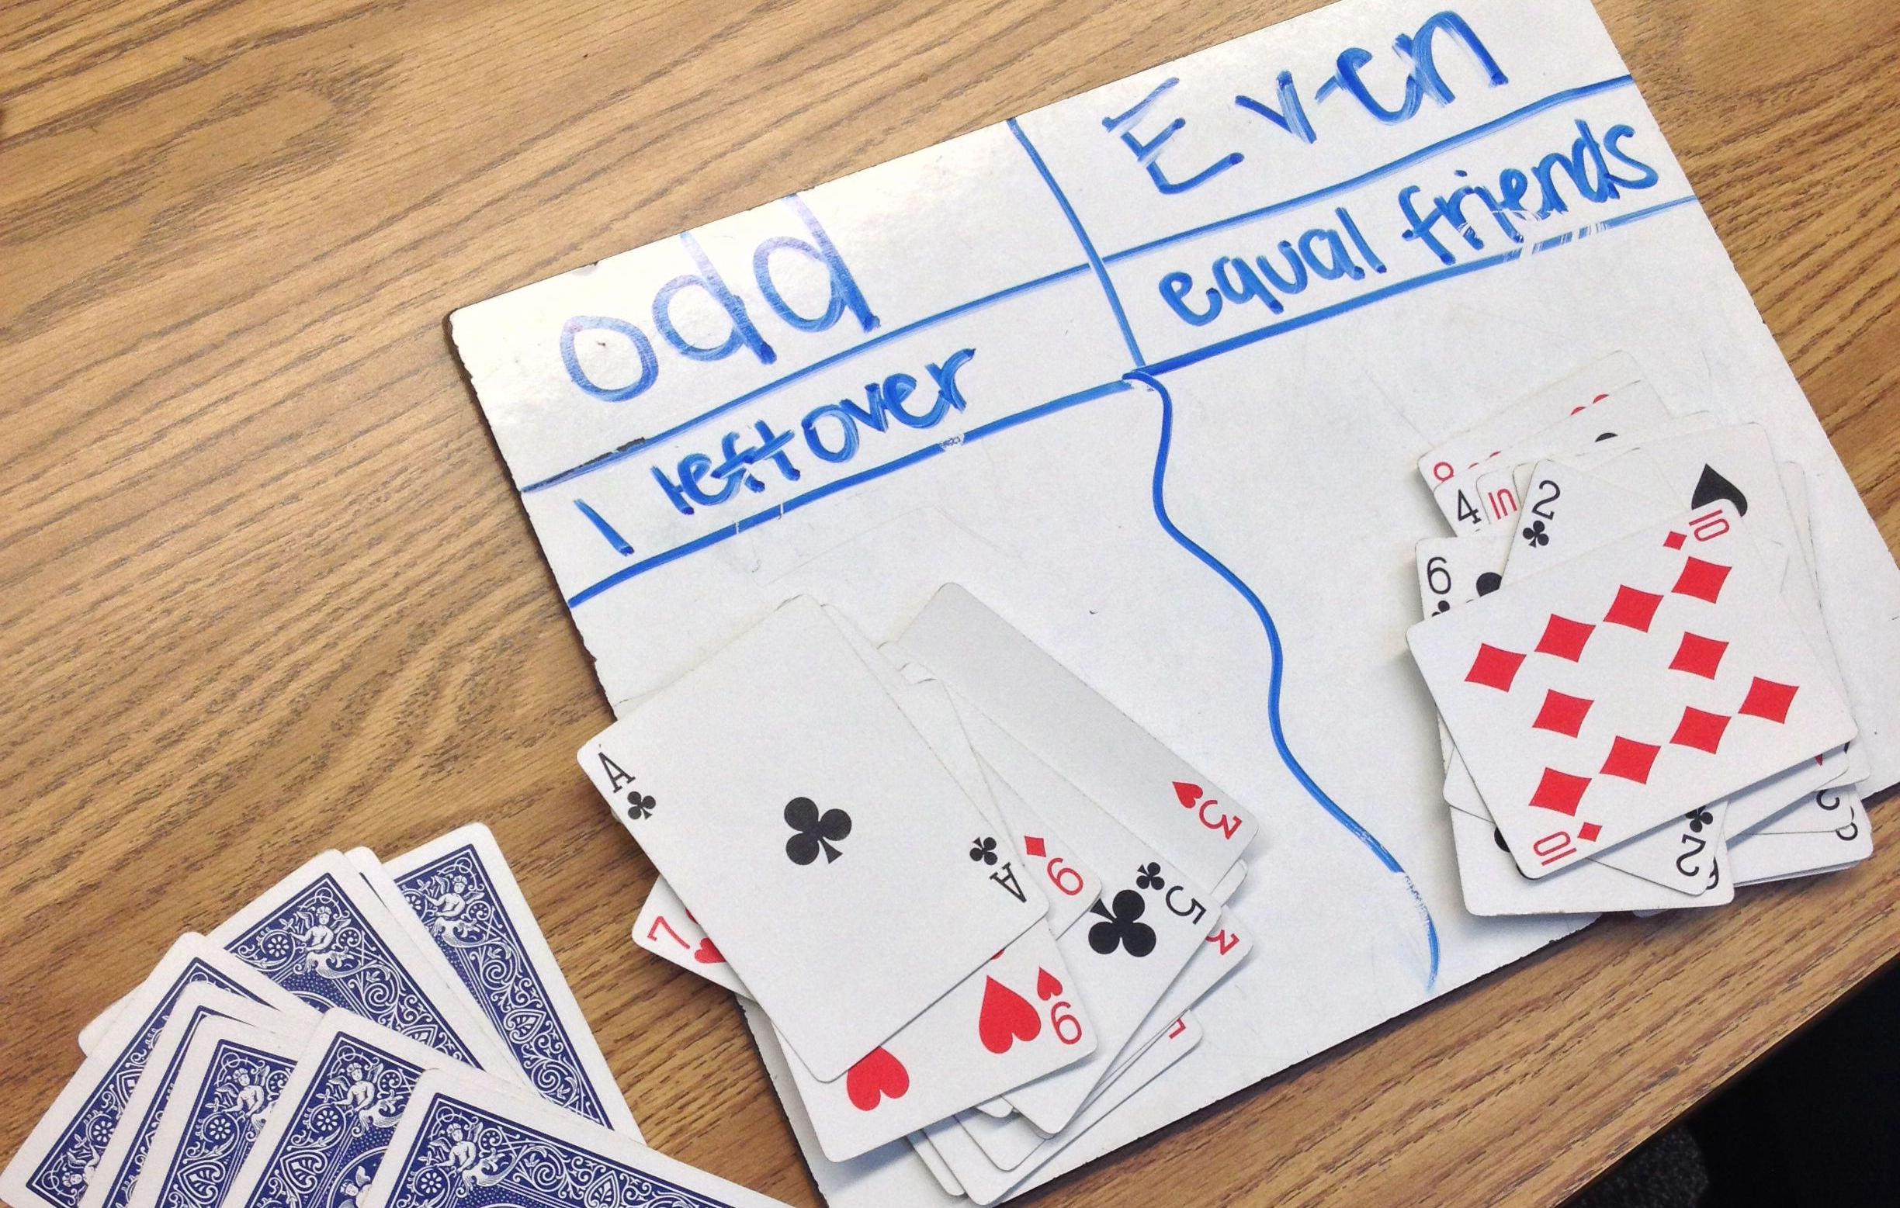
Filtering List Comprehension
Write a function remove_negatives that consumes a list and returns a new list without any negative numbers.
Write a function remove_evens that consumes a list and returns a new list without any even numbers.
numbers
list
num_list = [1, -6, 10, 5, -20 , -3]
num_list = [1, 5, 10, 7, -20 , -3]
Notes:
Nothing better than an example! You can solve this problem in two ways, using the if/append approach or with a list comprehension. Worth talking about how one answer is less complex and requires fewer lines of code. However, you can remind them this only works for Map/Filter problems, not Accumulation type.
def remove_evens(a_list):
new = []
for item in a_list:
if item >= 0:
new.append(item)
return new
def remove_evens(a_list):
return [item for item in a_list if item >= 0]

Slide 7


Mutability
Lists
…so are
strings, numbers, booleans
noun
liability or tendency to change.
“the incessant mutability of species”
Don’t change your lists… make new lists!
Notes:
This is also an opportunity to talk about mutability of lists. List comprehensions require us to think about "Make a new list from an old list" instead of "Change the list". The idea is to remove mutable state. When you have big programs, you want to pass new lists around rather than having the program repeatedly modify the same list. This is the same justification as Global Variables - it is easier to reason about small chunks of code in isolation. Now, students may not be ready for this lesson, but I think it helps to vocalize the idea so they can come back to it later in their careers.

Slide 8

Reminders
Module 6 closes on Friday 3/16 at 11:59pm
Module 7 due on Friday 3/23 at 11:59pm
Ethics activity 3 due on Friday 3/16 at 11:59pm

Slide 9

Lab Time
Work on class assignments
Finish as many problems as possible
Use instructor and TA’s time for assistance
IF YOU PLAN TO LEAVE
Make sure you inform me or the TAs
Show us your work progress
Notes:
You can wrap up the discussion on operators by going over these many examples of (potentially) confusing rules for the operators. The thing to highlight is that each operator has its own rules, and they should experiment when trying to mix types. Usually it doesn't work, sometimes it does.

