Slide 1
While Loops
Week 7 – Day 2
CS-1064 Intro to Python
Dr. Panagiotis Apostolellis, Virginia Tech, 2018

Slide 2
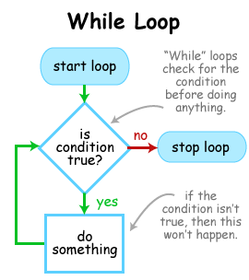
For Loops vs. While Loops
For: The program “knows” exactly how many times to loop
While: There is a specific condition that will terminate the loop

Slide 3

While loops: mechanics
command = True
while command:
command = input("Give me a word")
print(command)
Works fine
Doesn’t work because no condition check
Doesn’t work because command changes type
Doesn’t work because print is inside the loop
Notes:
This code works perfectly fine. It repeatedly accepts user input and prints the user's command, until the user inputs a blank string.
B) Gets at the idea of truthiness, and that it applies to While loops same as If statements.
C) Gets at the idea that variables don't have types, which is weird and annoying but still a factor in our programs.
D) Is a weird misconception and it needs to die. You can print anytime, but you need to read a problem description to know if you should print or not.

Slide 4
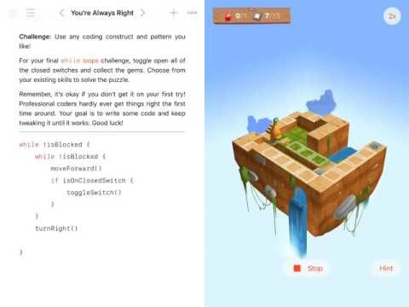
When do we While Loop?
1) Repeatedly accept user input (human interaction)
2) Services that are idle until needed (Web servers)
3) Main program loop (loop until game ends, or possibly forever)
Notes:
But you shouldn't stay negative. Now you want to highlight the reasons why people do use while loops. Mostly it's about interacting with humans and for services (e.g,. Web servers) that loop until you stop needing them.

Slide 5
Will this while loop be executed?
var = x + 5
while var:
var -= 1
print(“variable=", var)
Yes, definitely
Yes, but will be an infinite loop
No, it will never enter the loop
It depends
Notes:
Different programming concepts examined here, like truthiness, operations, and while loop.
This is only the case for any x > -4
This is the case for x < -5
This is the case for x = -5
This is the right answer

Slide 6

While Loops are mostly Awful
1) Flexible, but more work to set them up
2) Easy to do wrong and be trapped in an infinite loop
CTRL+C => “Stop this process”
Notes:
We've talked before about While loops, but now you can highlight their dangers:
While loops are very flexible, but that means you have to do more work to get them set up
It is very easy to write a condition that never becomes false, which means you are trapped forever in the loop
While loops are less common than For loops in Python, but are more common in other languages.
This is also a chance to drop the infamous pro-tip for programmers: use "CTRL+C" to break out of an infinite loop. This terminates the current process.

Slide 7

Reminders
Module 6 closes on Friday 3/16 at 11:59pm
Module 7 due on Friday 3/16 at 11:59pm
Ethics activity 3 due on Friday 3/16 at 11:59pm

Slide 8

Lab Time
Work on class assignments
Finish as many problems as possible
Use instructor and TA’s time for assistance
IF YOU PLAN TO LEAVE
Make sure you inform me or the TAs
Show us your work progress
Notes:
You can wrap up the discussion on operators by going over these many examples of (potentially) confusing rules for the operators. The thing to highlight is that each operator has its own rules, and they should experiment when trying to mix types. Usually it doesn't work, sometimes it does.

