Slide 1
Dictionaries
Week 8 – Day 1
CS-1064 Intro to Python
Dr. Panagiotis Apostolellis, Virginia Tech, 2018

Slide 2

Representing the World
:
key
value
Notes:
I have strong positive feelings about dictionaries. They can be a very useful way to represent data (emulating structs/records/objects) or as a fast lookup tool. Students are a bit more reserved about them, and have a hard time understanding why they are useful.
Go to your programming environment, and demonstrate how you can represent more complex objects using a dictionary. Creating something like the following, for instance:
person = { "name": "Cory", "instructor?": True, "number of dogs": 1, "friends": ["Ellie Bart", "Becky Trexler", "Dan Tilden"]}
You can also highlight how you can get fields:
person["name"]
And even change fields:
person["name"] = "Dr. Bart"

Slide 3
Dictionary Examples
We've annotated many problems with worked examples.
If you are having trouble getting started, please review them!
Notes:
Highlight these examples as helpful guides to students, we'd like to gather data on their usage!

Slide 4
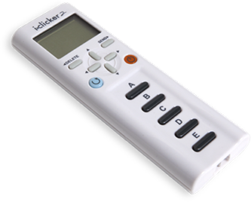
What happens?
a_book = {
"Name": "Count of Monte Cristo",
"Pages": 928,
"Paperback?": True
}
print(a_book["Count of Monte Cristo"])
Prints "Count of Monte Cristo"
Prints "Name"
Raises an error
Notes:
This is an error – you can't use a value to index a dictionary

Slide 5
What happens?
a_book = {
"Name": "Count of Monte Cristo",
"Pages": 928,
"Paperback?": True
}
print("Count of Monte Cristo" in a_book)
Prints True
Prints False
Raises an error
Notes:
This prints False; you can check if a dictionary has a value, but it's checking the keys not the values.

Slide 6
What happens?
a_book = {
"Name": "Count of Monte Cristo",
"Pages": 928,
"Paperback?": True
}
print(a_book["Name"])
Prints "Count of Monte Cristo"
Prints "Name"
Raises an error
Notes:
This prints (A). It is a correct lookup by key.

Slide 7

Reminders
Module 7 closes on Friday 3/23 at 11:59pm
Project 4 due on Friday 3/23 at 11:59pm
Survey: weeks 7-8 due on Friday 3/23 at 11:59pm

Slide 8

Lab Time
Work on class assignments
Finish as many problems as possible
Use instructor and TA’s time for assistance
IF YOU PLAN TO LEAVE
Make sure you inform me or the TAs
Show us your work progress

