Slide 1
Project 4: Text Adventure Game
Week 8 – Day 2
CS-1064 Intro to Python
Dr. Panagiotis Apostolellis, Virginia Tech, 2018

Slide 2
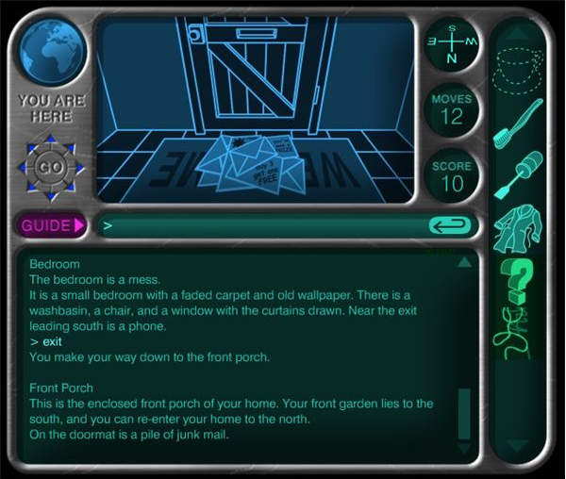
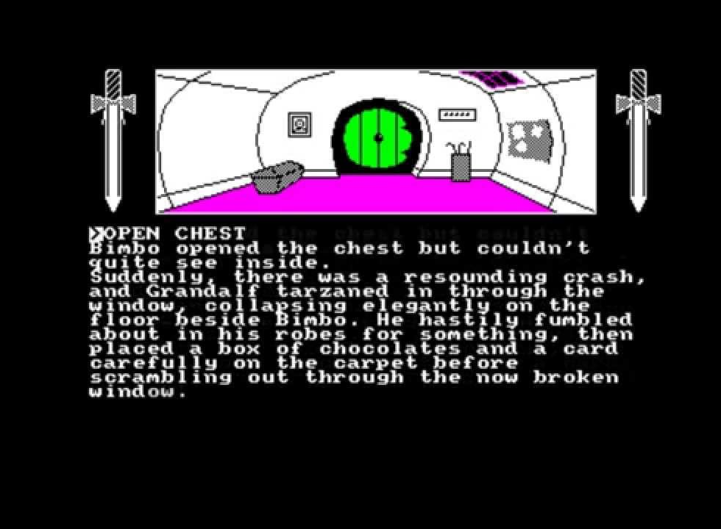
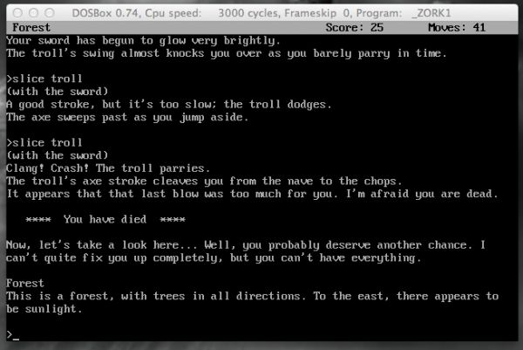
Text-based Adventure Games
Playable examples:
Zork
Spooky House
Finding Adventure

Slide 3
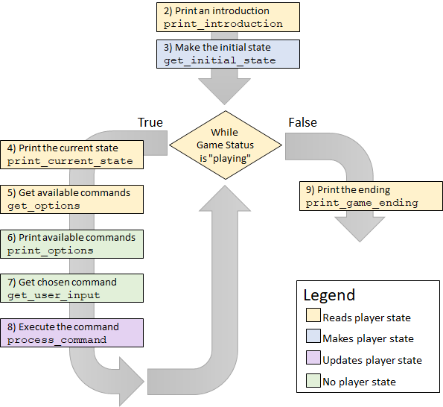
Main Game Loop
Develop all the individual functions and connect them

Slide 4
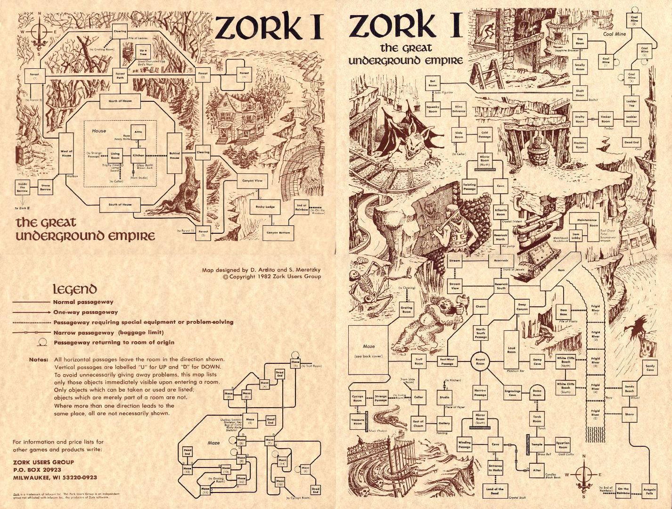
Zork Game Location Diagram

Slide 5
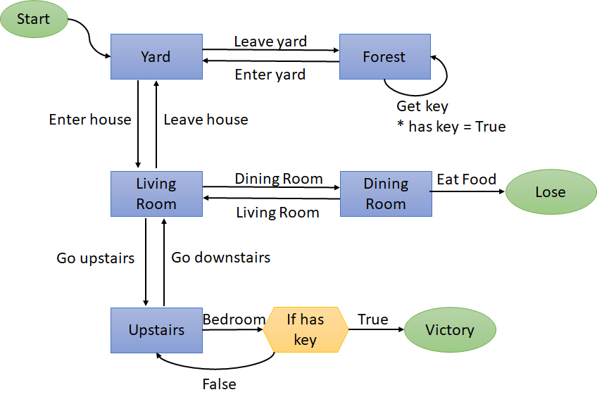
Two Diagrams
Game Location Diagram
Player State Table
Key | Value | Initial | Description
game status | string | "playing" | Whether the game is in progress or has ended
location | string | "Yard" | Where the player is in the world
has key | boolean | False | Whether they have collected the bedroom key
Submit those two diagrams along with your game

Slide 6
Functional Requirements
Clear, deterministic path to Win and Lose
Able to Quit at any time
At least 4 player fields (2 of which are required)
Every field used
Every field modified
Some creativity and self-expression
Good code organization

Slide 7

Developing the functions
Sequential Design
Agile Design
Write and test each function, one at a time, after the other
Comment out parts of the engine you aren't ready yet to test
Always have a runnable game, even if it is uninteresting
Slowly add features and complexity
Test incrementally

Slide 8

Escaping Infinite Loops
If your game gets locked in to an infinite loop, here are ways to escape:
CTRL+C
Breaks out of the program
CTRL+.
Restarts the console
Press the red X on the console tab in spyder
Restarts the console
Close and reopen Spyder
Restarts Spyder

Slide 9

Reminders
Module 7 closes on Friday 3/23 at 11:59pm
Project 4 due on Friday 3/23 at 11:59pm
Survey: weeks 7-8 due on Friday 3/23 at 11:59pm

Slide 10

Lab Time
Work on class assignments
Finish as many problems as possible
Use instructor and TA’s time for assistance
IF YOU PLAN TO LEAVE
Make sure you inform me or the TAs
Show us your work progress
Notes:
You can wrap up the discussion on operators by going over these many examples of (potentially) confusing rules for the operators. The thing to highlight is that each operator has its own rules, and they should experiment when trying to mix types. Usually it doesn't work, sometimes it does.

