Slide 1
Nested Data
Week 9 – Day 1
CS-1064 Intro to Python
Dr. Panagiotis Apostolellis, Virginia Tech, 2018

Slide 2
Representing the Real World
A list of weather forecasts with a place, a date, and a weather information.
Place | Report | Date
. . . | . . . | . . .
Temperature | Humidity | Wind
76 | 55 | 18
City | State | Zip
Blacksburg | VA | 24061
Month | Day | Year | Time
May | 20 | 2015
Hour | Min | Sec
11 | 32 | 52
Notes:
When we're trying to capture more realistic things, we need more sophisticated data representations. This means putting lists inside of dictionaries inside of lists inside of dictionaries

Slide 3
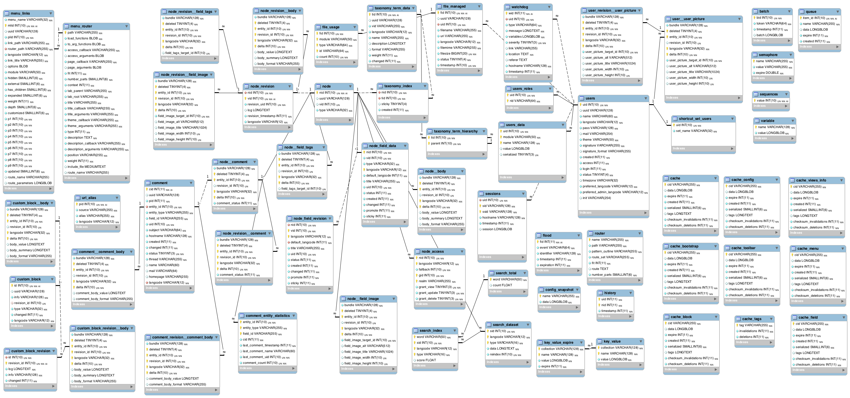
Real Life: Messy and Complex
The sky (memory) is the limit!
Notes:
There's no end to how much we can nest things, besides what our computer can store in memory – and our computers have a lot of memory.

Slide 4

Which of these consumes a list of dictionaries parameter?
A
def find_record(list_of_dictionaries):
def find_record([list_of_dictionaries]):
def find_record({list_of_dictionaries}):
def find_record([{list_of_dictionaries}]):
B
C
D
Notes:
This speaks back to the old problem that students have with typing in python. They want to make a function consume a specific type, so they try to enforce types with the literal syntax. The answer is (A).

Slide 5
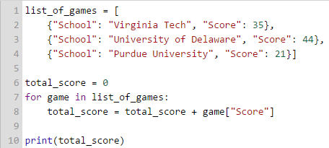
What is the type of list_of_games?
String
List
Integer
Dictionary
Notes:
This is question is a set-up for the next question, but students frequently get it wrong – they will say it's a dictionary instead of B) List. Of course, the variable's name sort of gives it away, so hopefully they don't make a mistake here.

Slide 6
What is the type of game?
String
List
Integer
Dictionary
Notes:
This is where things go off the rails. They think that because the string is unique and identifying (a natural index, even), that's what game will be. But you need to hit home here: game is a D) dictionary: it is a composite of several keys and values.

Slide 7





Finding vs. Look-up
Finding -> Iteration
Look-up -> Access
Notes:
Create a dictionary of dictionaries and a list of dictionaries that are very long (perhaps make one with a mocker library like faker). Then, demonstrate the difference between finding an element (iteration) vs. looking up an element (dictionary access). This is when the difference between a dictionary and a list can really shine.
for item in a_list:
if item['name'] == "Virginia Tech":
print(item[students’])
# vs.
print(item['Virginia Tech']['students']

Slide 8
Learn the Schema, Apply the Rules
Function Definition
I need to write a function that consumes a list of dictionaries and finds the highest value associated with the key "Name".
Parameter
Nested Structures
Max Pattern
Dictionary Access
Notes:
If you have the time, wrap up the conversation by discussing the strategies for reading the problems. They start getting more complicated now, with all these different components.

Slide 9

Reminders
Module 8 due on Friday 3/30 at 11:59pm
Project 4 closes on Friday 3/30 at 11:59pm
Survey: weeks 7-8 closes on Friday 3/23 at 11:59pm

Slide 10

Lab Time
Work on class assignments
Finish as many problems as possible
Use instructor and TA’s time for assistance
IF YOU PLAN TO LEAVE
Make sure you inform me or the TAs
Show us your work progress

