Slide 1
Tuples
Week 9 – Day 2
CS-1064 Intro to Python
Dr. Panagiotis Apostolellis, Virginia Tech, 2018

Slide 2
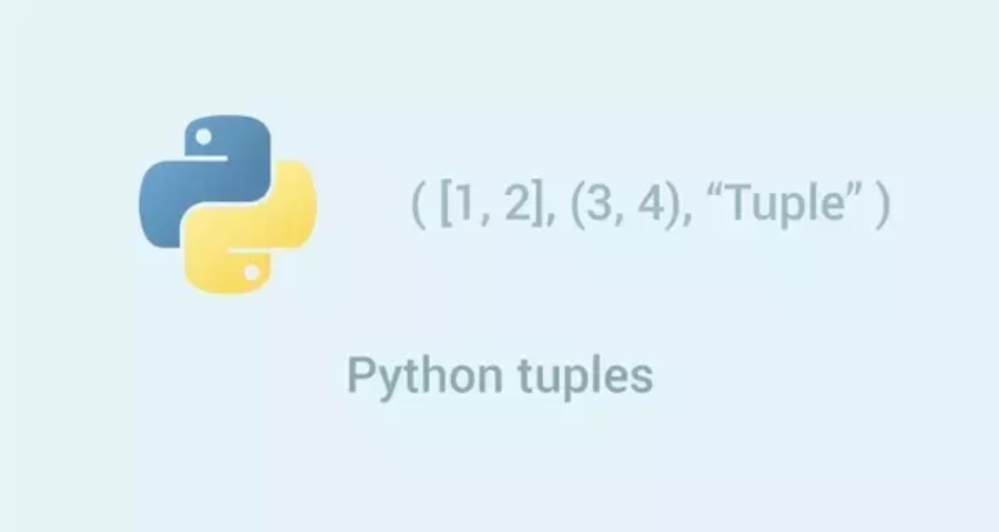
Tuples
1. Creating tuples
>>> percentages = (99,95,90,89,93,96)
2. Packing and Unpacking
>>> b = 1, 2.0, 'three'
>>> percentages = (99,95,90,89,93,96)
>>> a,b,c,d,e,f = percentages
3. Accessing and Slicing
>>> percentages[5]
>>> percentages[2:4]
Fixed-size lists (immutable)
4. Reassigning
>>> my_tuple=(1,2,3,4,5)
>>> my_tuple=(1,2,3,[4,5])
5. Deleting
>>> del percentages[2:4]
Notes:
We're introducing Tuples here, which students may find unusual. They're just like lists, except you can't add and remove things from them. Pose it as a mystery – why does that seem useful? Let's find out.

Slide 3
Multiple Assignment and Return
def combine_two_ways(first, second):
return first+" "+second, second+" "+first
breakout, outbreak = combine_two_ways("break", "out")
lookout, outlook = combine_two_ways("look", "out")
Watch the comma!
Notes:
The answer is multiple assignment and return. It's frequently very useful to return more than one value, and to assign to more than one variable.

Slide 4

What is the output of this code?
>>> percentages = (99,95,90,89,93,96)
>>> percentages[2:4]
95, 90
90, 89
95, 90, 89
90, 89, 93
Raises an error
Notes:
This is correct – you can slice a tuple just like a list

Slide 5
What is the output of this code?
>>> my_tuple=(1,2,3,[4,5])
>>> my_tuple[3][0] = 10
>>> print(my_tuple)
(1, 2, 3, [4, 5])
(1, 2, 3, [14, 5])
(1, 2, 3, [10, 5])
(1, 2, 3, 10, 5)
Raises an error
Notes:
C) Is correct because the list inside the tuple is mutable, so you can slice a list

Slide 6
What is the output of this code?
>>> my_tuple=(1,2,3,[4,5])
>>> my_tuple[3].append(10)
>>> print(my_tuple)
(1, 2, 3, [4, 5, 10])
(1, 2, 13, [4, 5])
(1, 2, 3, 10, [4, 5])
(1, 2, 3, [4, 5], 10)
Raises an error
Notes:
A) Is correct because the list inside the tuple is mutable, so you can use append to add elements

Slide 7
What is the output of this code?
>>> my_tuple=(1,2,3,[4,5])
>>> my_tuple[3][1].append(10)
>>> print(my_tuple)
(1, 2, 3, [4, 15])
(1, 2, 13, [4, 5])
(1, 2, 3, 10, [4, 5])
(1, 2, 3, [4, 5], 10)
Raises an error
Notes:
E) This is an error because the indexing gives us an integer (5) and we cannot append to an integer!

Slide 8

Reminders
Module 8 closes on Friday 3/30 at 11:59pm
Module 9 due on Friday 3/30 at 11:59pm
Project 4 closes on Friday 3/30 at 11:59pm

Slide 9

Lab Time
Work on class assignments
Finish as many problems as possible
Use instructor and TA’s time for assistance
IF YOU PLAN TO LEAVE
Make sure you inform me or the TAs
Show us your work progress

