Slide 1

Programming Languages
An Introduction to Programming in Python
Notes:
Let's learn about programming languages.

Slide 2
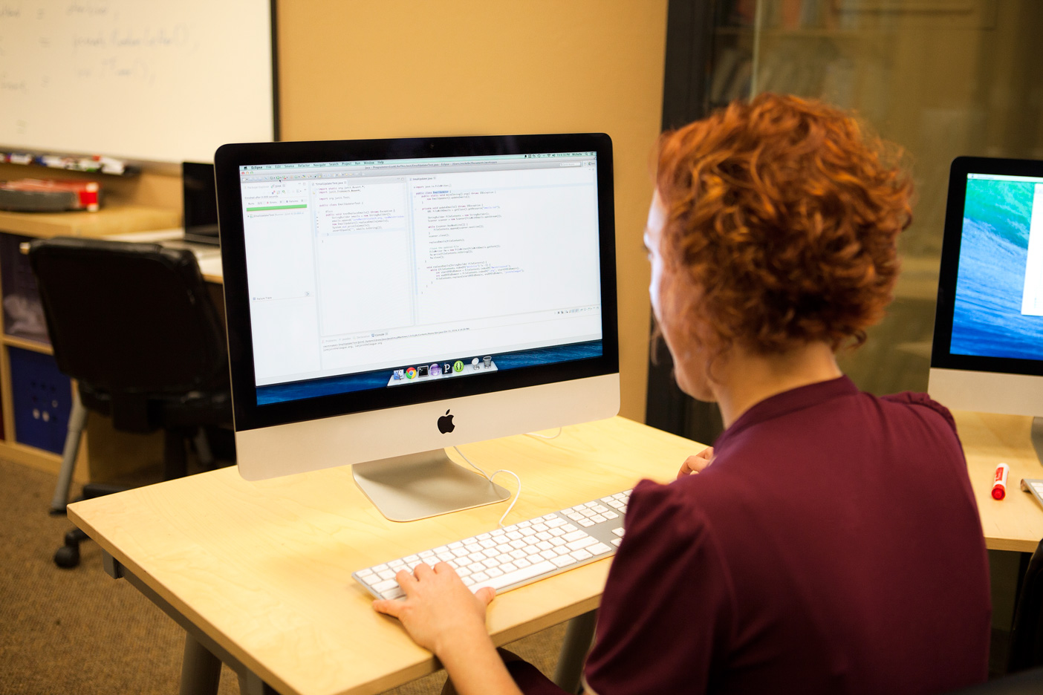
What is a Programming Language
OPEN THE FILE
INITIALIZE THE SUM
READ EACH LINE OF THE FILE
FOR EACH LINE,
ADD IT TO THE SUM
PRINT THE RESULT
Notes:
Programs are created by writing programs in a programming language.
Programming languages were created by people to give computers clear instructions.

Slide 3
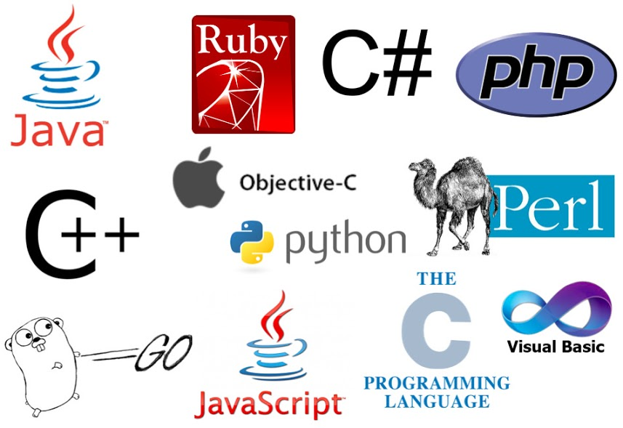
Python and its Competition
Notes:
In this course, you are learning a programming language named Python.
However, there are many programming languages out there.

Slide 4
Why Python?
Popular
Useful
Friendly
Most Popular Programming Languages
Use Cases
Rank | Language
1 | Java
2 | C
3 | C++
4 | Python
5 | C#
Application Area
Scientific Computing
Web Server
Data Science
Game Development
Scripting Language
https://www.tiobe.com/tiobe-index/
Notes:
You might be wondering why Python is a good language to learn, if there are so many options.
First, Python is one of the most popular languages in the world.
Second, it has a huge number of libraries that make it useful for a wide range of problems.
Third, it is a friendly language for beginners.

Slide 5
A Small Language
Small Word
Small Word
Small Word
Small Word
New Big Word
Notes:
Imagine you were giving commands to a very small child in English.
The child only knows a few words.
If they don't know a word, you will have to explain it to them using words they already understand.
Programming Languages are similar to this - you build new words using a small set of original words.

Slide 6
Commands
Go to the market.
Get me eggs and milk.
Then return home.
Don't tell me what to do!
Notes:
Human languages, like English, can be used to talk about many complex ideas.
However, programming languages are good for only one thing: giving instructions to a computer.
We don't use programming languages to talk to each other the same way we do human languages.

Slide 7
Rules
Syntax
Semantics
Grammar
Spelling
Punctuation
Logic
Making sense
Intent
Notes:
Programming languages have very strict rules.
This is similar to how we have rules in English.
There are two kinds of rules: syntax and semantics.

Slide 8
Syntax
Capitalization?
"Run can . upways the, to healp?!?"
Spelling?
Period?
Notes:
In English, we follow grammar rules about how we can structure our sentences.
The sentence below is not grammatically correct english, so we would reject it.
Similarly, in Python, we use symbols, spaces, and words in very precise ways.
Using them incorrectly will give you a "syntax error".
You will probably make many syntax errors as you learn to program.

Slide 9
Semantics
Ideas can't sleep?
"Colorless green ideas sleep furiously"
Colorless, but green?
Sleeping furiously?
Notes:
Although the sentence below follows grammar rules, it doesn't make any sense.
This is the idea of semantics.
It is very easy to write perfectly valid sentences in Python that accomplish nothing at best and hurt things at worst.
You need to think when programming, to recognize when you've written something that makes no sense.

