Slide 1

Execution
An Introduction to Programming in Python
Notes:
Let's learn about Executing Programs.

Slide 2
Executing a Program
my_code.py
Line 1
Line 2
Line 3
Line 4
….
Notes:
Once a program is written, it can be executed.
This means that the computer will read the text of the program line by line, and perform each step.

Slide 3
Terminology
"Run"
"Executed"
Although it may sound like a synonym, to "kill" a program means to end it (the opposite of "executing" it!)
Notes:
We say that a program is "Run" or "Executed".

Slide 4
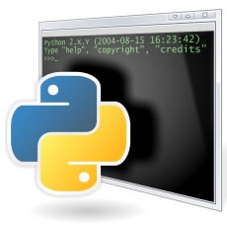
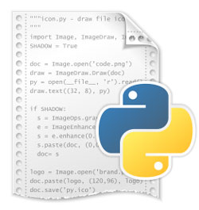
Python
Programming Language
Program
"Each statement should…"
"You cannot begin a variable with…"
"Defining a function requires …"
…
Notes:
Python is two things:
First, as a programming language it is a set of rules for writing Python programs.
Second, it is a program that can execute programs written in the Python programming language.

Slide 5
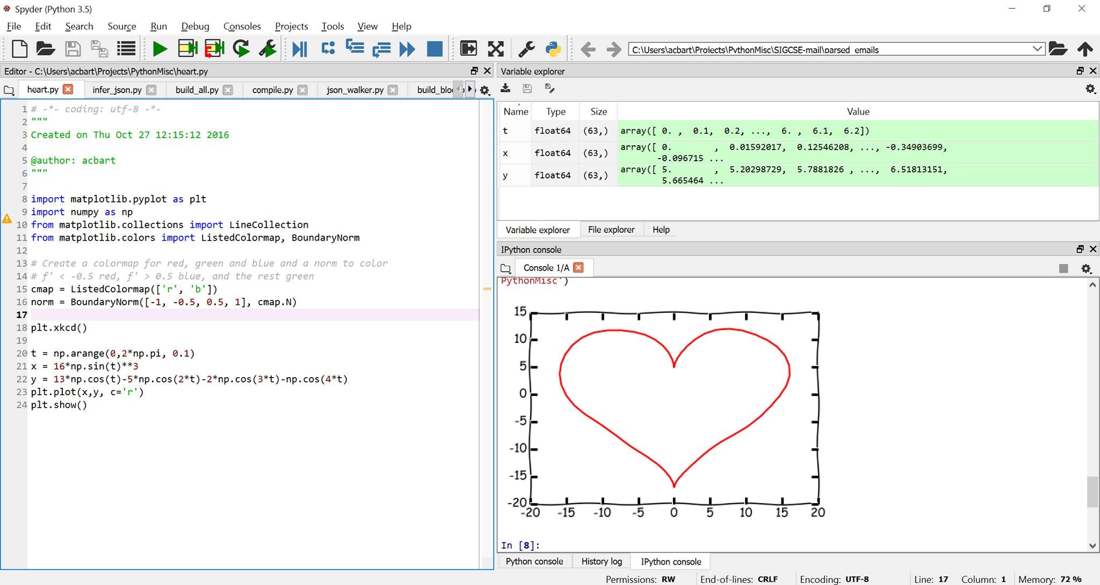
Programming Environments
Run Button
Program Editor
Output Area
Notes:
Technically, you can write programs in a text editor and then run them with Python separately.
However, most programmers use a Programming Environment that makes it very easy to write programs and then press a single button to run them.

Slide 6
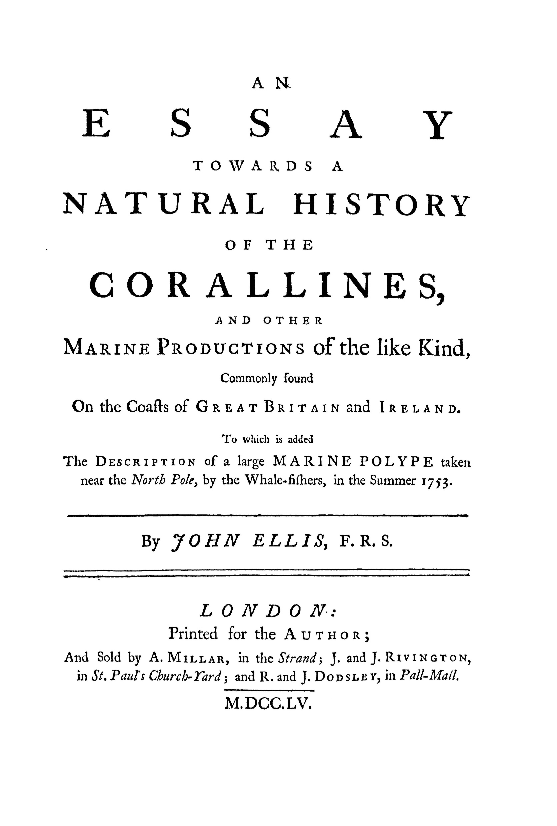
Programs are Text
Notes:
When you write a Python program, you are really just writing some text.
That text needs to be valid Python text, following all of it syntax rules.
But that means its not that different from an essay you might write in English.

