Slide 1

Values
An Introduction to Programming in Python
Notes:
Let's learn about Values

Slide 2
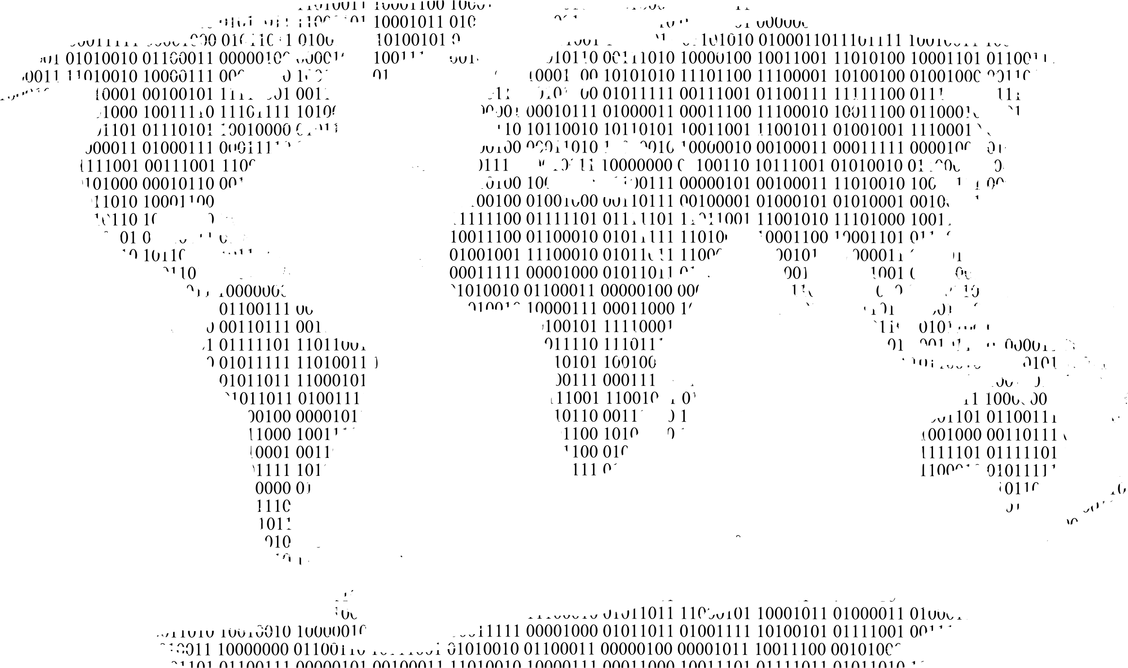
Values Represent the World
Notes:
Programming is all about inputting data so that we can manipulate it to get some output.
Therefore, we use values to represent the real world as data in the computer.

Slide 3
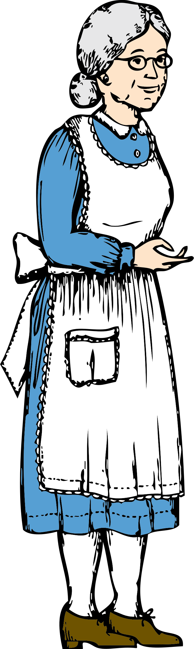
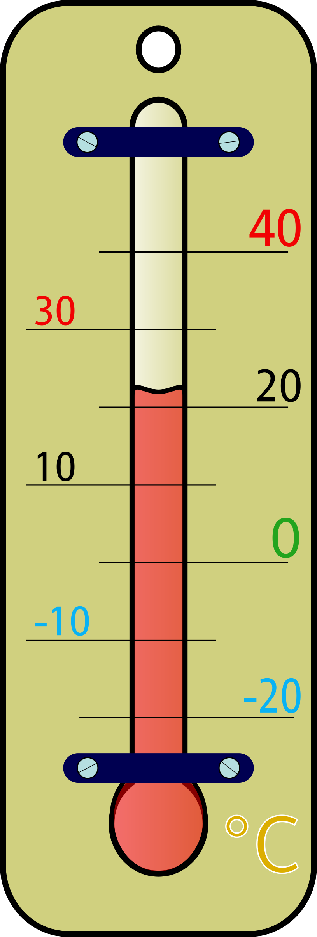

Values
74
23.4
"Mr. and Mrs. Dursley, of number four, Privet Drive, were proud to say that they were perfectly normal, thank you very much..."
Notes:
Values can represent anything in the real world that we can measure and concretely describe.
Distances, temperatures, peoples' ages, our names, even the text of entire books.

Slide 4

Writing Values
Literal Value
Input from a User
7 is a literal value
Notes:
When we write values directly in code, we call them "Literal Values", as opposed to values in a file or received as input from a user.
Sometimes we also call this "Hard Coding a value".
These hard-coded values are usually useful for developing simple programs.

Slide 5
Printing Values
> print("This will be shown to the user")
This will be shown to the user
> print("This is a literal value")
This is a literal value
> print(142)
142
Notes:
Once we have put data into the computer as values, we need to do something with it.
A very simple action is to simply print it out.
Soon, we will learn more complex actions.
Look at these examples of how we can write literal values and then print them out.

Slide 6

Understanding Values
17
"This value represents the age of my dog!"
Notes:
It is very easy to put values into the computer.
However, it is very difficult to immediately understand what those values mean.
It is up to us programmers to communicate the meaning of values.

