Slide 1

Arithmetic
An Introduction to Programming in Python
Notes:
Let's learn about Arithmetic.

Slide 2
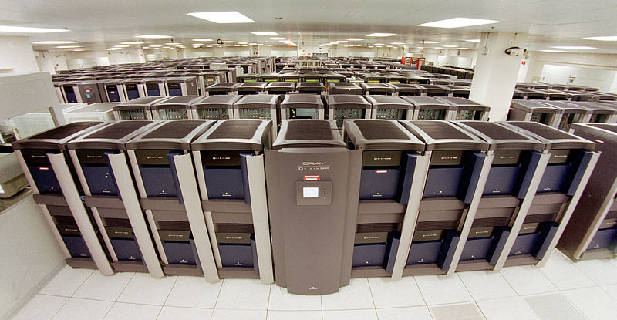
Purpose
2+2
"File:Blue Mountain Supercomputer.jpg." Wikimedia Commons, the free media repository. 6 Jun 2013, 14:41 UTC.7 Aug 2017, 16:34
<https://commons.wikimedia.org/w/index.php?title=File:Blue_Mountain_Supercomputer.jpg&oldid=97682898>.
Notes:
In some ways, computers are just large machines for doing arithmetic.
Computers are very, very good at doing math.
In fact, modern computers can perform billions or even trillions of calculations per second.

Slide 3
Operators
+
-
*
/
**
%
Addition
Subtraction
Multiplication
Division
Exponentiation
Modulo
Notes:
There are six basic mathematical operators in Python that you should be familiar with: Addition, Subtraction, Multiplication, Division, Exponentiation, and Modulo.

Slide 4
Addition and Subtraction
Addition (+)
> 1+1
2
> -10+10
0
Subtraction (-)
> 5-8
3
Notes:
The plus sign (+) and minus sign (-) are used for addition and subtraction.

Slide 5
Multiplication and Exponentiation
Multiplication (*)
> 4*2
8
> -5*5
-25
Exponentiation (*)
> 2**4
16
Notes:
One asterisk (*) is used for multiplication.
Two asterisks (**) are used for exponents (also known as powers).

Slide 6
Division
Division (/)
> 3/12
0.25
> 1/1
1.0
> 2.5/.5
5.0
Division always results in a float!
Notes:
The forward slash is used for division.
When you divide two integers, you will always get a floating point number.
I'll say that again - whenever you do division, the result will always be a float!
Keep in mind, you cannot divide by 0!

Slide 7
Modulo
Modulo (%)
> 16%12
4
> 4%2
0
> 5%2
1
Modulo by 2 results in 0 or 1, for even or odd.
Notes:
You have probably never heard of the Modulo operator, but it's simple: it calculates the remainder.
Modulo is sometimes called "Clock Arithmetic", because it makes it easy to figure out time.
If someone said "It is 1600 hours", you could do "16 modulo 12" and find out they meant "4pm".
However, modulo has many other uses, such as for figuring out if numbers are even or odd.

Slide 8
Using the Operators
Code
In the computer's head…
> 2+3+4
2+3+4
Becomes…
5+4
Becomes…
9
Notes:
When you run a program with operators, Python will do the math and then replace the result.
You will not be able to see the computer do the math by looking at just the code!
Notice the difference between the code on the left, and the actual actions that occur on the right.

Slide 9
Order of Operations
Please (Parentheses)
Excuse (Exponents)
My (Multiplication)
Most (Modulo)
Dear (Division)
Aunt (Addition)
Sally (Subtraction)
Notes:
When you use operators, there is an order of operations.
Parentheses, Exponent, Multiplication, Modulo, Division, Addition, Subtraction.
Whenever there's a tie, the left-most operation happens first.
Notice that you can always override any ordering by using parentheses.
You might already be familiar with this order: if not, here is a useful mnemonic:
Please Excuse My Most Dear Aunt Sally.

