Slide 1

An initial survey of the wave drifter data

Slide 2
TC relative observations
Observations are ALAMO float SST (°C) observations within 400 km of Hurricanes Irma and Florence in a storm‐centered, storm‐relative framework.
At each observation time, a range and bearing to the TC center is calculated and then plotted with bearing rotated relative to the TC motion.
Shaded arrows identify the direction of storm motion.
Sanabia & Jayne, 2020: Ocean observations under two major hurricanes: Evolution of the response across the storm wakes. AGU Advances, 1, e2019AV000161, doi:10.1029/2019AV000161.

Slide 3
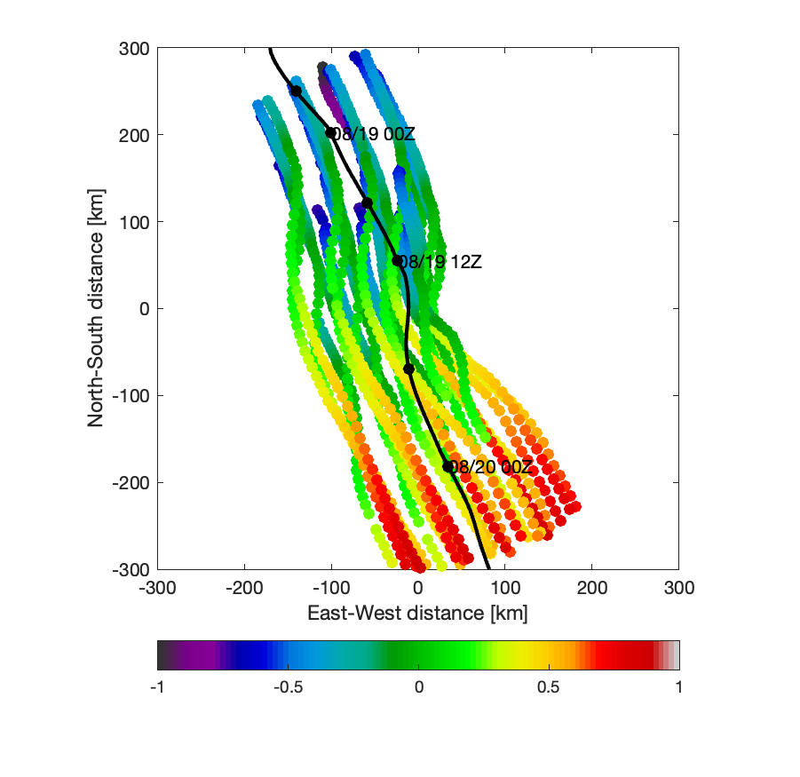
Observations over time relative to storm center
Observations are sea level pressure from all 24 A-DWSB drifters
Not rotated into storm translation direction as of now
1440 total observations covering about ±1 day of the closest approach of Erin to the array within a CPA radius of 300 km
Mostly observed the lefthand side of the storm, far fewer observations on the righthand side – track shifted to the east compared to forecast
Time relative to closest approach [days]

Slide 4
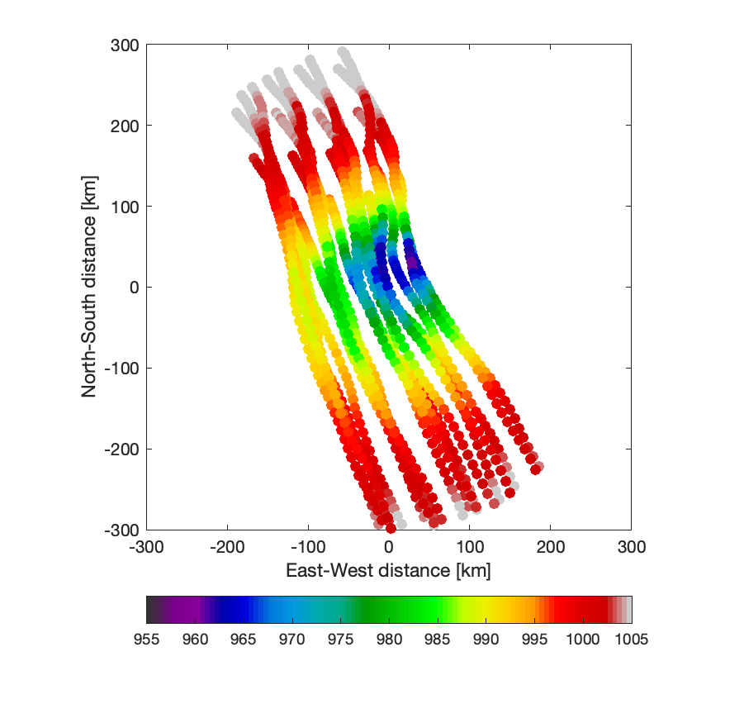
Sea level pressure reconstruction
Initial pressure reconstruction looks promising
Minimum observed pressure of 957.5 mbar (compared to 960 mbar from closest aircraft vortex message)
But looking at the details of the reconstruction reveals issues related to the exact track used to calculate ranges and bearings

Slide 5
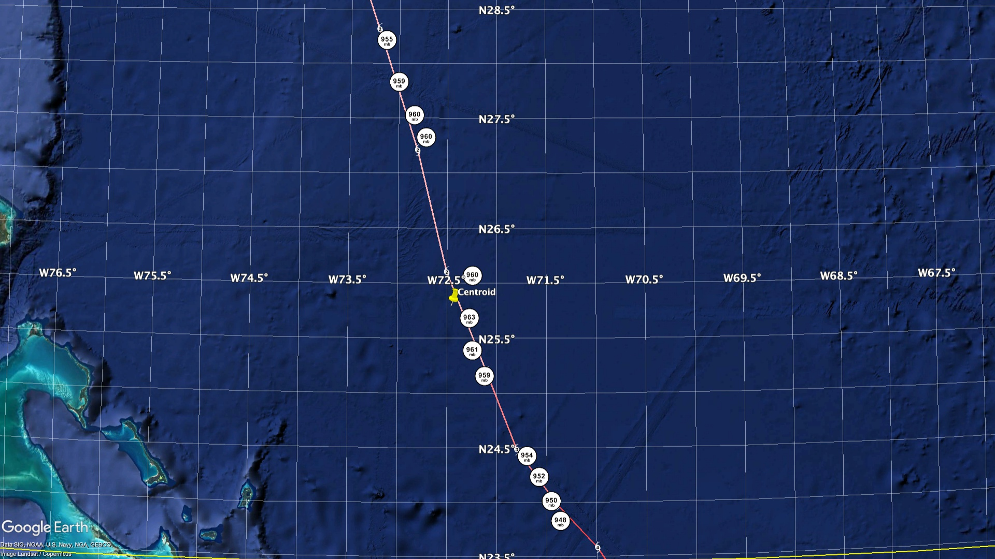

Slide 6
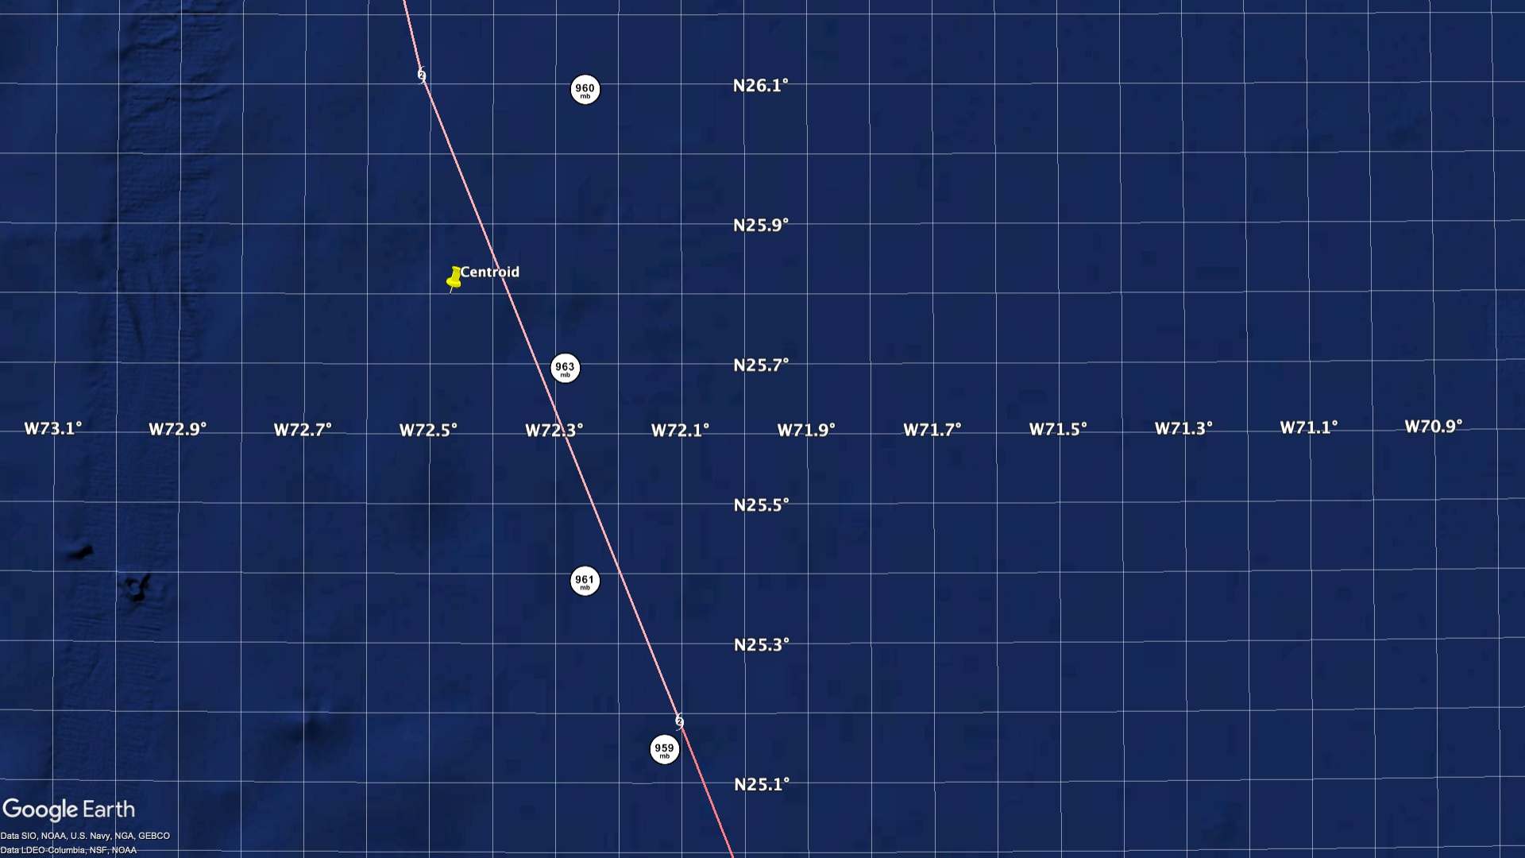

Slide 7
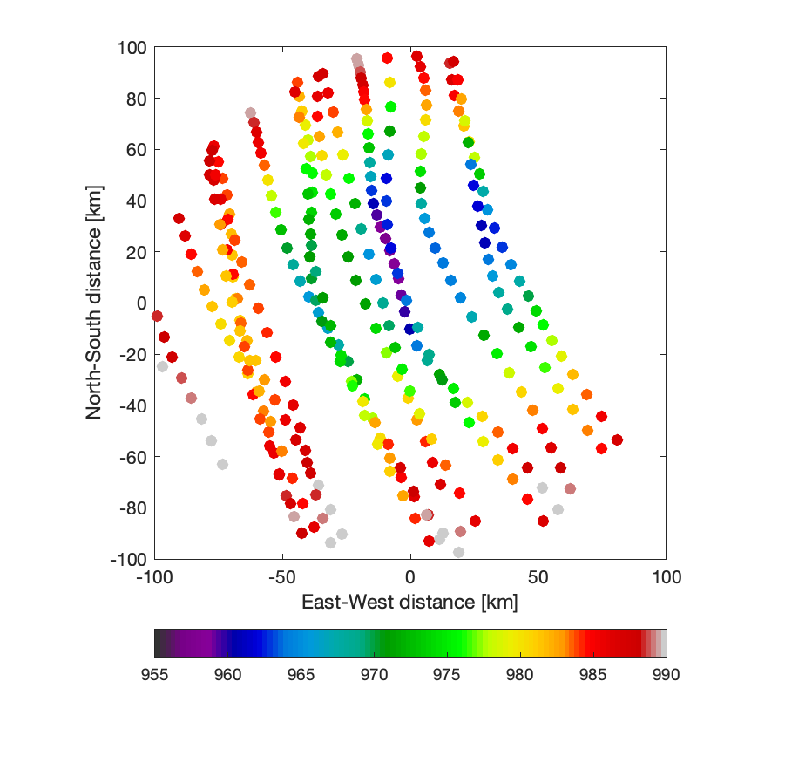
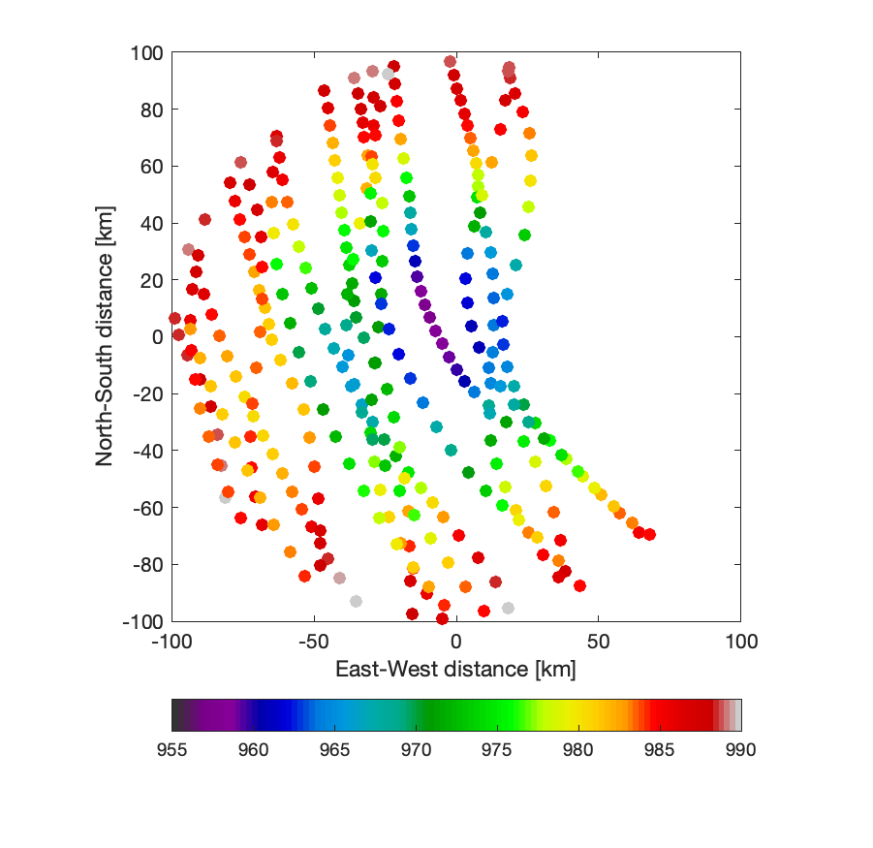
Details of the TC track matter for referencing obs…
Track 1: preliminary best track
Track 2: my track estimate

Slide 8
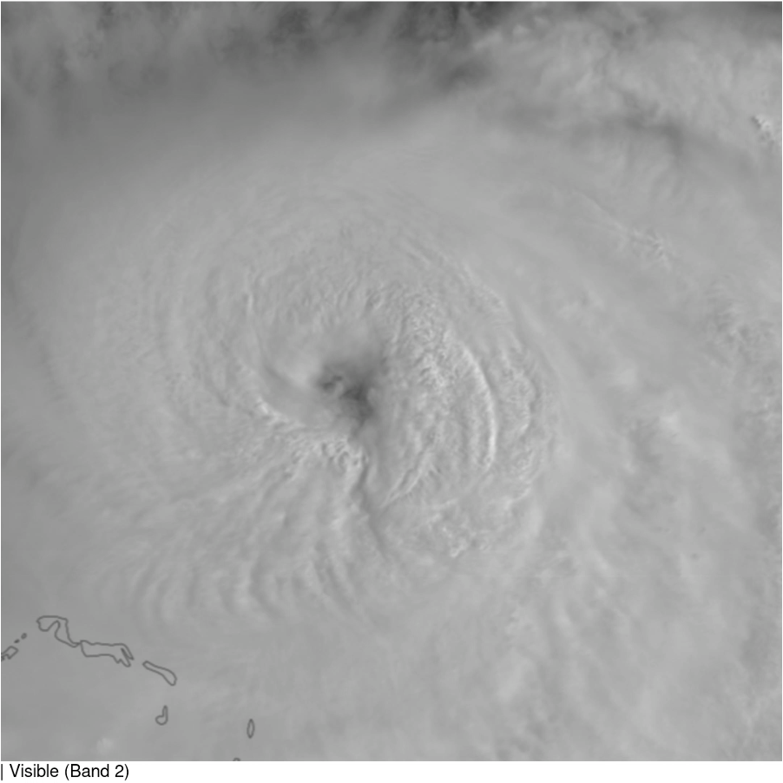
Higher-resolution track
We need more accurate and higher-temporal resolution best track data
HRD will produce a 2-minute track from aircraft observations.
Automated Rotational Center Hurricane Eye Retrieval (ARCHER) product doesn’t add a lot more temporal resolution.
ML or AI location retrievals using Particle Image Velocimetry (PIV) on geostationary satellite imagery could be used – at least in a hurricane’s mature phase.

Slide 9
What is the center?
Vortex Message (°N, °W) | SWANN (°N, °W) | Difference (km) | Diameter (km)
22.80, 70.39 | 22.83, 70.43 | 5 | 44
22.89, 70.59 | 22.88, 70.57 | 2 | 56
22.92, 70.68 | 22.93, 70.65 | 3 | 59
23.07, 70.71 | 23.07, 70.70 | 1 | 74
23.86, 71.37 | 23.88, 71.40 | 4
24.04, 71.46 | 24.03, 71.47 | 2
24.26, 71.58 | 24.27, 71.55 | 3
24.45, 71.70 | 24.45, 71.71 | 0
25.17, 72.12 | 25.15, 72.05 | 7
25.40, 72.24 | 25.42, 72.23 | 2
25.69, 72.27 | 25.70, 72.23 | 4
26.07, 72.24 | 26.07, 72.25 | 1
27.31, 72.71 | 27.17, 72.60 | 19 | 59
27.51, 72.83 | 27.52, 72.82 | 1 | 44
27.81, 72.99 | 27.82, 72.93 | 6 | 44
28.19, 73.12 | 28.20, 73.10 | 2
29.43, 73.68 | 29.40, 73.67 | 3 | 36
29.58, 73.66 | 29.62, 73.72 | 7 | 37
29.91, 73.69 | 29.92, 73.73 | 4 | 33
30.36, 73.60 | 30.43, 74.52 | 88 | 37
How precisely can we know the center of circulation?
Compare vortex messages from aircraft fixes to the CSU Surface Winds from Aircraft with a Neural Network (SWANN) analysis

Slide 10
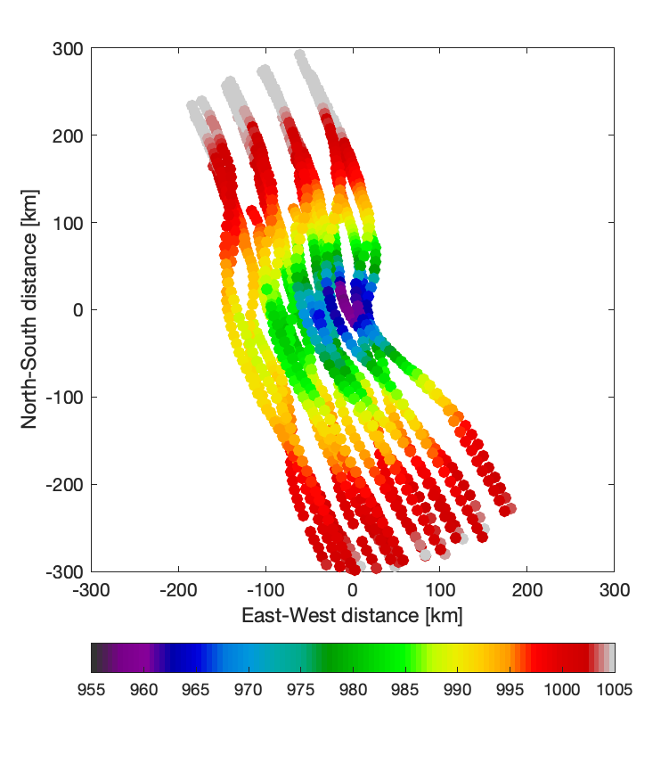
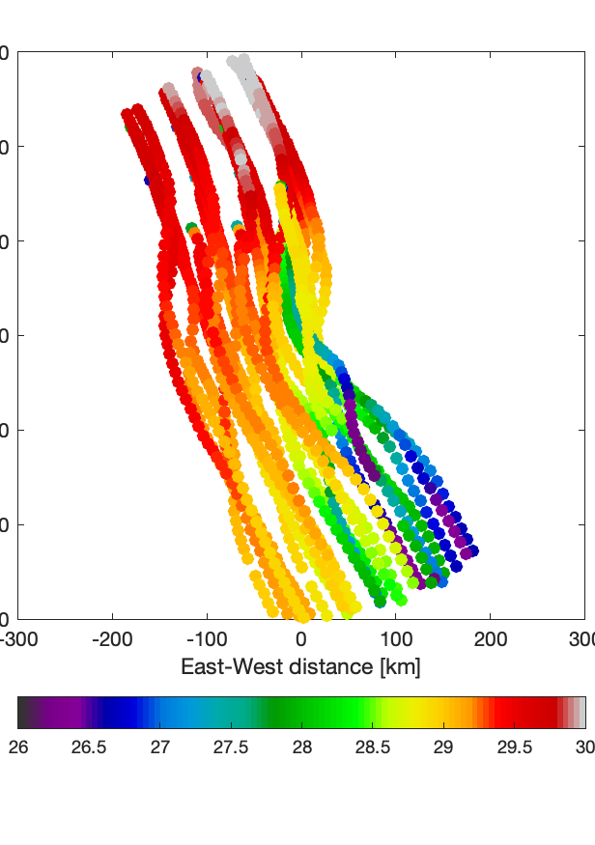
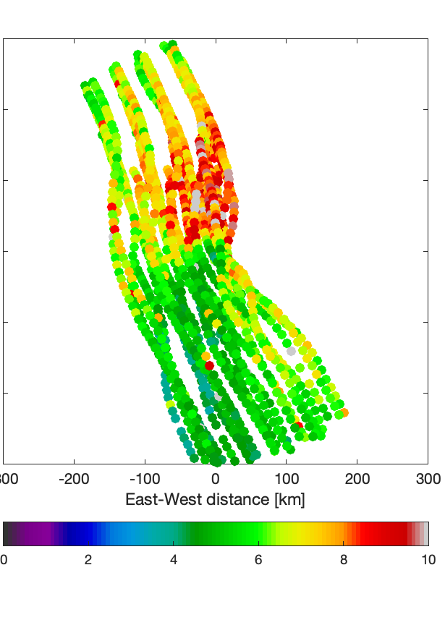
Quick initial survey of pressure, SST, and waves data
Sea level pressure
Sea surface temperature
Significant wave height
Sea level pressure [mb]
Sea surface temperature [°C]
Significant wave height [m]

