Slide 1
Software Testing and Quality Assurance SEng4142
Chapter 1: Software Quality Assurance (Introduction)
Bit
Department of software engineering

Slide 2
Quality?
Quality is an intangible concept.
Most people can recognize it easily but they find it difficult to give a clear description of the term.
The terms good quality, poor quality are used in our everyday life to tell how good or bad a product functions.
A number of factors influence the making and buying of software products. These factors include:
User’s needs and expectations,
The manufacturer’s considerations,
The inherent characteristics of a product,
The perceived value of a product.
To be able to capture the quality concept, it is important to study quality from a broader perspective. This is because the concept of quality predates software development.

Slide 3
Views of Quality
Transcendental View
In the transcendental view, quality is something that can be recognized through experience but is not defined in some tractable form.
Quality is viewed to be something ideal, which is too complex to lend itself to be precisely defined. However, a good-quality object stands out, and it is easily recognized.
User’s View
It perceives quality as fitness for purpose. According to this view, while evaluating the quality of a product, one must ask the key question: “Does the product satisfy user needs and expectations?”

Slide 4
Views of Quality
Manufacturing View
Here quality is understood as conformance to the specification. The quality level of a product is determined by the extent to which the product meets standards and specifications set by the organization.
Product View
In this view, quality is viewed as quantifiable and measurable internal characteristics of a product. That is, internal qualities, determine its external qualities. Example: reliability of a product can be measured by mean time between failure
Value-Based View
Quality, in this perspective, depends on the amount a customer is willing to pay for it (the cost and price associated with the product).

Slide 5
Software ?
Based on IEEE definition,
Software is: computer programs, procedures, and possibly associated documentation and data pertaining to the operation of a computer system
ISO definition lists out the following components of software:
Computer programs (the “code”)
Procedures
Documentation
Data necessary for operating the software system

Slide 6
Software Quality
Pressman’s definition:
Conformance to explicitly stated functional and performance requirements, explicitly documented development standards, and implicit characteristics that are expected of all professionally developed software.
IEEE definitions:
The degree to which a system, component, or process meets specified requirements.
The degree to which a system, component, or process meets customer or user needs or expectations.

Slide 7
Software Quality Assurance
IEEE definitions:
A planned and systematic pattern of all actions necessary to provide adequate confidence that an item or product conforms to established technical requirements.
A set of activities designed to evaluate the process by which the products are developed or manufactured.

Slide 8
Software Quality
Software development process is unique:
High complexity, as compared to other industrial products
Invisibility of the product
Opportunities to detect defects (“bugs”) are limited to the product development phases
The uniqueness of software products creates the need to have a special method and tools for software quality assurance
The big question?
How do we assure quality?

Slide 9
Verification and Validation
Verification
Evaluation of software system that help in determining whether the product of a given development phase satisfy the requirements established before the start of that phase
Building the product correctly
Validation
Evaluation of software system that help in determining whether the product meets its intended use
Building the correct product

Slide 10
Role of Testing
Software quality assessment divide into two categories:
Static analysis
It examines the code and reasons over all behaviors that might arise during run time
Examples: Code review, inspection, and algorithm analysis
Dynamic analysis
Actual program execution to expose possible program failure
One observe some representative program behavior, and reach conclusion about the quality of the system
Focus is to combines the strengths of both approaches
Static and Dynamic Analysis are complementary in nature

Slide 11
Software Errors, Faults and Failures
Software Errors: are sections of the code that are partially or totally incorrect as a result of a grammatical, logical or other mistake made by a systems analyst, a programmer, or another member of the software development team.
Software Fault: are software errors that cause the incorrect functioning of the software during a specific application
The origin of software failure is from software errors made by programmers.
However, not all errors can become software faults.
All software faults do not necessarily end with software failure
Software faults cause software failure only when activated
i.e when the specific faulty application is used

Slide 12
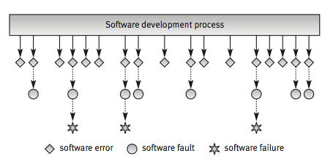
Software Errors, Faults and Failures
Types of Errors:
code error
procedure error
documentation error
software data error

Slide 13
Software Errors, Faults and Failures Example1:
The “Meteoro-X” meteorological equipment firmware (software embedded in the product) were meant to block the equipment’s operation when its internal temperature rose above 60°C.
A programmer error resulted in a software fault when the temperature limit was coded as 160°.
This fault could cause damage when the equipment was subjected to temperatures higher than 60°.
Since the equipment was used only in those coastal areas where temperatures never exceeded 60 ,the software fault never turned into a software failure.

Slide 14
Software Errors, Faults and Failures
Some Famous Software Errors
Airane 5
Therac-25
Patriot Missile System
NASA's Mars Polar Lander
ESA's Ariane 5 Launch System
2003 Blackout
Y2K

Slide 15

Famous Software Failures (Examples) Airane 5
Cost: $500 million
Disaster:
Ariane 5, Europe’s newest unmanned rocket, was intentionally destroyed seconds after launch on its maiden flight. Also destroyed was its cargo of four scientific satellites that were to study how the Earth’s magnetic field interacts with solar winds
Cause:
Shutdown occurred when the guidance computer tried to convert the sideways rocket velocity from 64-bits to a 16-bit format. The number was too big, and an overflow error resulted, as the floating point number had a value too large to be represented by a 16-bit signed integer . Efficiency considerations had led to the disabling of the exception handler for this error. This led to a cascade of problems, culminating in destruction of the entire flight
Notes:
The Ariane 5 software reused the specifications from the Ariane 4, but the Ariane 5's flight path was considerably different and beyond the range for which the reused code had been designed. Specifically, the Ariane 5's greater acceleration caused the back-up and primary inertial guidance computers to crash, after which the launcher's nozzles were directed by spurious data. Pre-flight tests had never been performed on the re-alignment code under simulated Ariane 5 flight conditions, so the error was not discovered before launch.
Because of the different flight path, a data conversion from a 64-bit floating point to 16-bit signed integer caused a hardware exception (more specifically, an arithmetic overflow, as the floating point number had a value too large to be represented by a 16-bit signed integer). Efficiency considerations had led to the disabling of the exception handler for this error. This led to a cascade of problems, culminating in destruction of the entire flight.

Slide 16
Famous Software Failures (Examples) British Passports to Nowhere (1999)
Cost: £12.6 million, mass inconvenience
Disaster:
The U.K. Passport Agency implemented a new Siemens computer system, which failed to issue passports on time for a half million British citizens.
The Agency had to pay millions in compensation, staff overtime and umbrellas for people queuing in the rain for passports.
Cause:
The Passport Agency rolled out its new computer system without adequately testing it or training its staff. At the same time, a law change required all children under 16 traveling abroad to obtain a passport, resulting in a huge spike in passport demand that overwhelmed the buggy new computer system

Slide 17
Common Causes of Software Errors
Faulty requirements definition
Client-developer communication failures
Deliberate deviations from software requirements
Logical design errors
Coding errors
Non-compliance with documentation and coding instructions
Shortcomings of the testing process
Procedure errors
Documentation errors

Slide 18
Importance of Software Quality
Software is a major component of computer systems (about 80% of the cost)
It is used for:
Communication (e.g. phone system, email system)
Health monitoring
Transportation (e.g. automobile, aeronautics)
Economic exchanges (e.g. e-commerce).
Entertainment.
etc.
Software defects are extremely costly in terms of
money
reputation
loss of life

Slide 19
Cost of Software Errors
"Software bugs, or errors, are so prevalent and so detrimental that they cost the U.S. economy an estimated $59.5 billion annually, or about 0.6 percent of the gross domestic product. …
Although all errors cannot be removed, more than a third of these costs, or an estimated $22.2 billion, could be eliminated by an improved testing infrastructure that enables earlier and more effective identification and removal of software defects.
These are the savings associated with finding an increased percentage (but not 100 percent) of errors closer to the development stages in which they are introduced.
Currently, over half of all errors are not found until "downstream" in the development process or during post-sale software use."
US Dept of Commerce
June 2002

Slide 20
Measuring Software Quality
The five viewpoints help us in understanding different aspects of the quality concept. On the other hand, measurement allows us to have a quantitative view of the quality concept.
Developers must know the minimum level of quality they must deliver for a product to be acceptable.
Organizations make continuous improvements in their process models and an improvement has a cost associated with it.
Organizations need to know how much improvement in quality is achieved at a certain cost incurred due to process improvement. This causal relationship is useful in making management decisions concerning process improvement.
The present level of quality of a product needs to be evaluated so the need for improvements can be investigated.

Slide 21
Software Quality Standards
Various software quality models have been proposed to define quality and its related attributes. The most influential ones are:
McCall's Software Quality Model
ISO 9126/1-2
Boehm’s model
FURPS/FURPS + model
Dromey’s model
CMM (Capability Maturity Model)

Slide 22
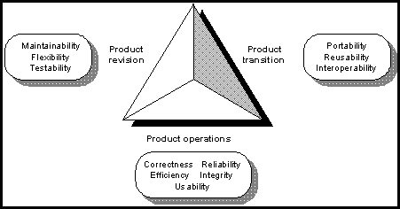
McCall's Quality Factors
McCall's Quality Factors have been grouped into three broad categories as follows:
Product operation
Product revision
Product transition

Slide 23
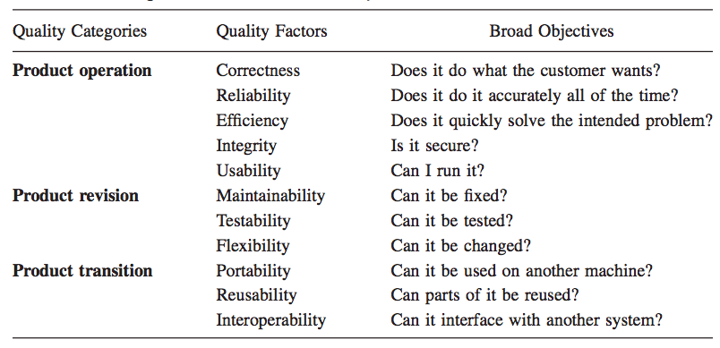
McCall's Quality Factors

Slide 24
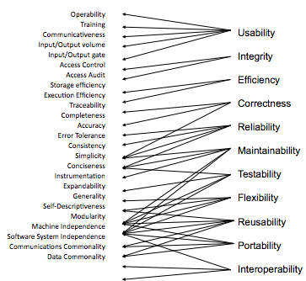
McCall's Quality Factors

Slide 25
ISO 9126 Software Quality Factors
Functionality
Reliability
Usability
Efficiency
Maintainability
Portability

Slide 26
Capability Maturity Model (CMM)
The Capability Maturity Model for Software developed by the SEI is a framework that describes the key elements of an effective software process.
The CMM describes an evolutionary improvement path for software organizations from an ad hoc, immature process to a mature, disciplined one.
The CMM covers practices for planning, engineering, and managing software development and maintenance.
When followed, these practices improve the ability of organizations to meet goals for cost, schedule, functionality, and product quality.

Slide 27
Levels of Capability Maturity Model
Initial
Repeatable
Defined
Managed
Optimizing

Slide 28
The Objectives of Testing
It does work
It does not work
Reduce the risk of failures
Reduce the cost of testing

Slide 29
What is a Test Case?
Test Case is a simple pair of <input, expected outcome>
State-less systems: A compiler is a stateless system
Test cases are very simple
Outcome depends solely on the current input
State-oriented: ATM is a state oriented system
Test cases are not that simple. A test case may consist of a sequences of <input, expected outcome>
The outcome depends both on the current state of the system and the current input
ATM example:
< check balance, $500.00 >,
< withdraw, “amount?” >,
< $200.00, “$200.00” >,
< check balance, $300.00 >

Slide 30
Expected Outcome
An outcome of program execution may include
Value produced by the program
State Change
A sequence of values which must be interpreted together for the outcome to be valid
A test oracle is a mechanism that verifies the correctness of program outputs
Generate expected results for the test inputs
Compare the expected results with the actual results of execution of the IUT

Slide 31
The Concept of Complete Testing
Complete or exhaustive testing means
“There are no undisclosed faults at the end of test phase”
Complete testing is near impossible for most of the system
The domain of possible inputs of a program is too large
Valid inputs
Invalid inputs
The design issues may be too complex to completely test
It may not be possible to create all possible execution environments of the system

Slide 32
The Central Issue in Testing
Figure 1: A subset of the input domain exercising a subset of the program behavior
Divide the input domain D into D1 and D2
Select a subset D1 of D to test program P
It is possible that D1 exercise only a part P1 of P

Slide 33
Testing Activities
Figure 2.Different activities in process testing
Identify the objective to be tested
Select inputs
Compute the expected outcome
Set up the execution environment of the program
Execute the program
Analyze the test results

Slide 34
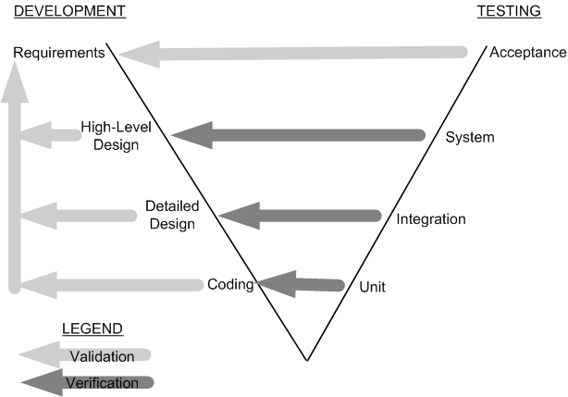
Testing Level
Unit testing
Individual program units, such as procedure, methods in isolation
Integration testing
Modules are assembled to construct larger subsystem and tested
System testing
Includes wide spectrum of testing such as functionality, and load
Acceptance testing
Customer’s expectations from the system
Figure 3: Development and testing phases in the V model

Slide 35
Source of Information for Test Selection
Requirement and Functional Specifications
Source Code
Input and output Domain
Operational Profile
Fault Model
Error Guessing
Fault Seeding
Mutation Analysis

Slide 36
White-box and Black-box Testing
Black-box testing a.k.a. functional testing
Examines the program that is accessible from outside
Applies the input to a program and observe the externally visible outcome
It is applied to both an entire program as well as to individual program units
It is performed at the external interface level of a system
It is conducted by a separate software quality assurance group
White-box testing a.k.a. structural testing
Examines source code with focus on:
Control flow
Data flow
Control flow refers to flow of control from one instruction to another
Data flow refers to propagation of values from one variable or constant to another variable
It is applied to individual units of a program
Software developers perform structural testing on the individual program units they write

