Slide 1
Transfer Learning in NLP
(ULMFiT)
Adrian Brasoveanu, 11/14/2019
[based on slides by Sebastian Ruder]
1

Slide 2
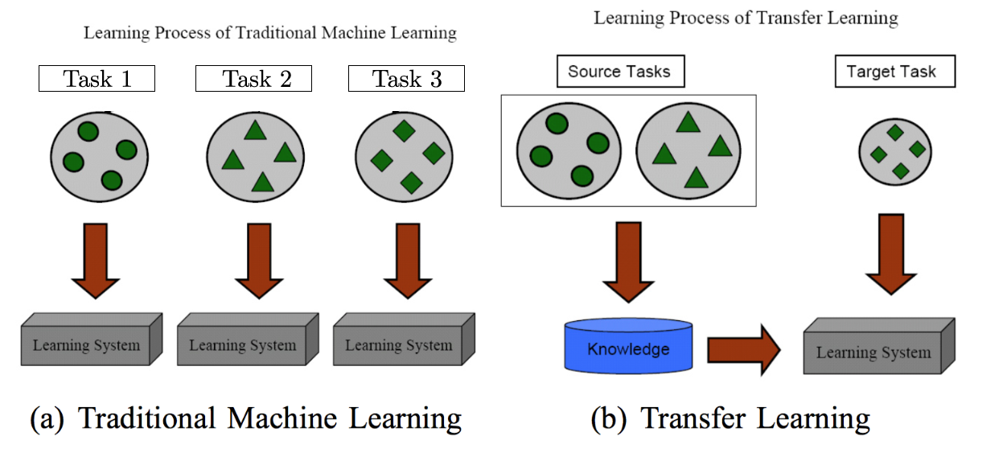
What is transfer learning?
Pan and Yang (2010)
1

Slide 3
Why transfer learning in NLP?
Many NLP tasks share common knowledge about language, e.g., cooccurence/distributional similarities, meaning representations
Tasks can inform each other, e.g., building a language model for English can help with subsequent text classification
Annotated data is (relatively) rare, unlabeled data is (usually) not; leverage unlabeled data to extract as much information as possible from annotated data
Empirically, transfer learning has resulted in SOTA for many supervised NLP tasks (classification, Q&A etc.) – see GLUE and Super-GLUE tasks
https://super.gluebenchmark.com/leaderboard
1

Slide 4
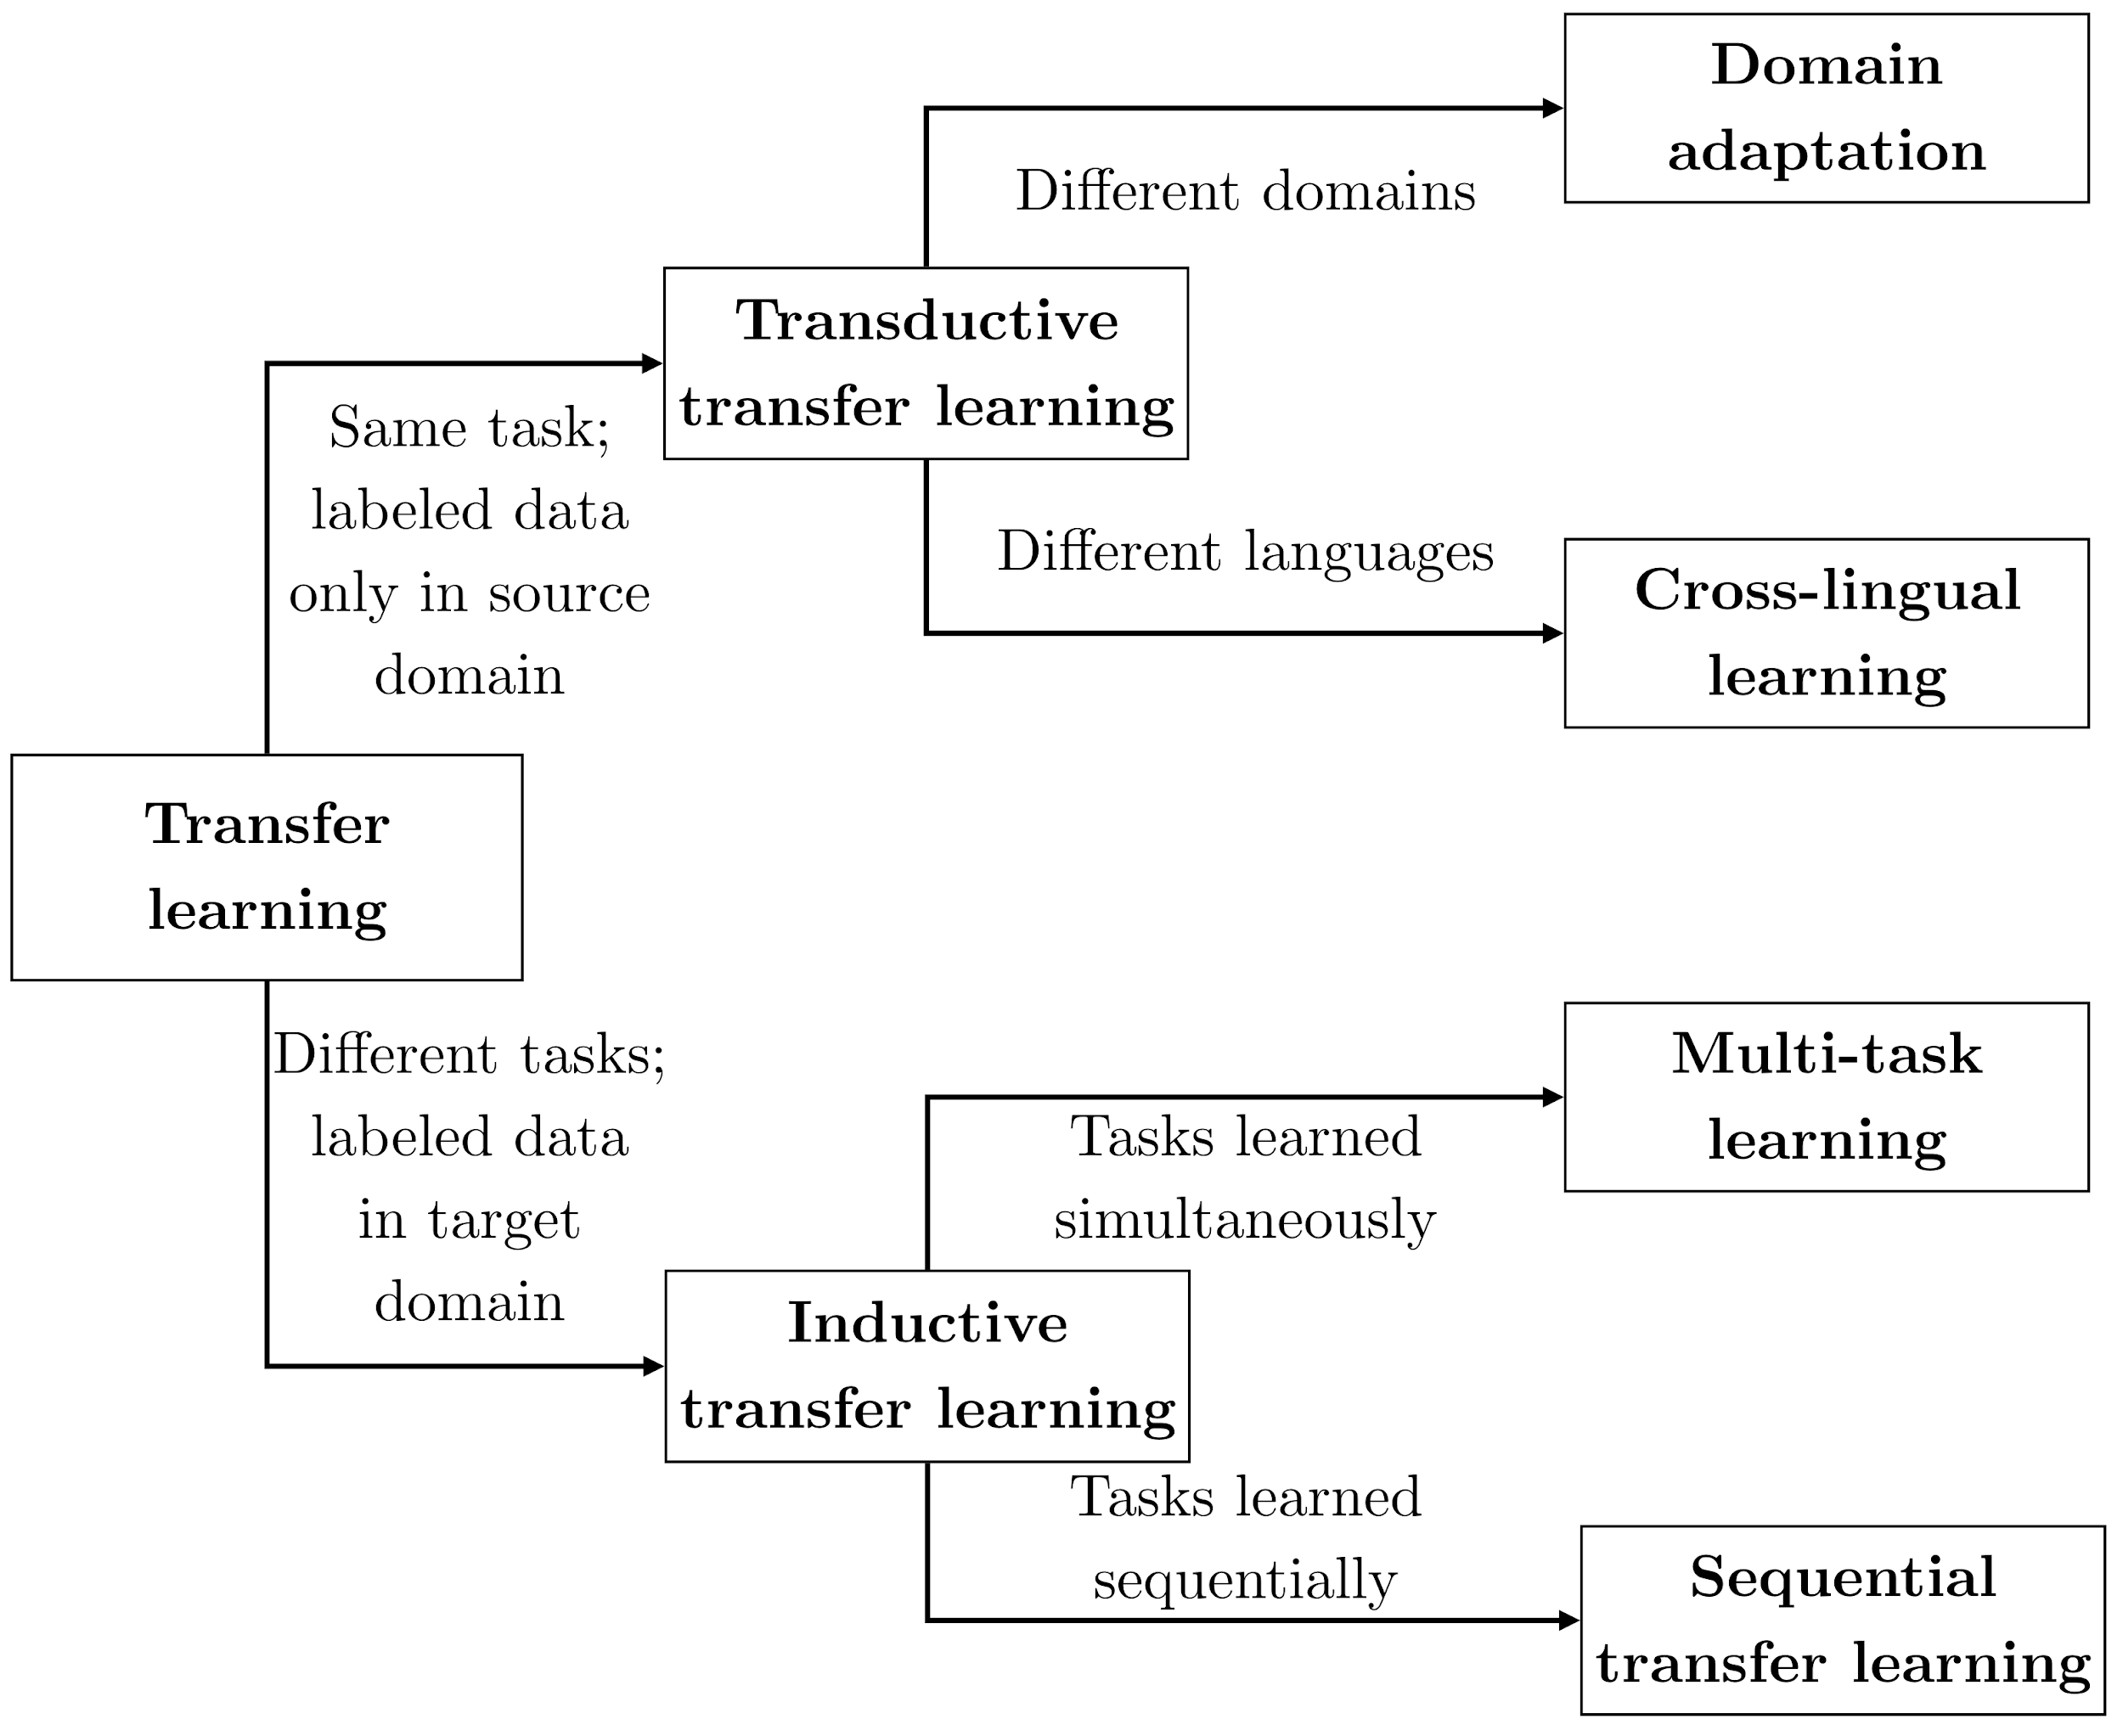
Types of transfer learning in NLP
We will focus on this
1
Ruder (2019)

Slide 5

Sequential transfer learning
Learn on one task / dataset, then transfer to another task / dataset
word2vec
GloVe
skip-thought
InferSent
ELMo
ULMFiT
GPT
BERT
Pretraining
Adaptation
classification
sequence labeling
Q&A
....
1

Slide 6
Example: word vectors
Word embedding methods (e.g. word2vec) learn one vector per word:
cat = [0.1, -0.2, 0.4, …]
dog = [0.2, -0.1, 0.7, …]
1

Slide 7
Example: word vectors
Word embedding methods (e.g. word2vec) learn one vector per word:
PRP VBP PRP NN CC NN .
I love my cat and dog .
cat = [0.1, -0.2, 0.4, …]
dog = [0.2, -0.1, 0.7, …]
1

Slide 8
Example: word vectors
Word embedding methods (e.g. word2vec) learn one vector per word:
PRP VBP PRP NN CC NN .
I love my cat and dog .
cat = [0.1, -0.2, 0.4, …]
dog = [0.2, -0.1, 0.7, …]
I love my cat and dog . }-> “positive"
1

Slide 9
Why embed words?
Embeddings are themselves parameters, can be learned
Much lower dimensional space than sparse one-hot encodings: easier to compute with
We can generalize across words via their continuous dense word embeddings, as opposed to categorical one-hot encodings; mitigates data sparsity
We can share word representations across tasks
1

Slide 10
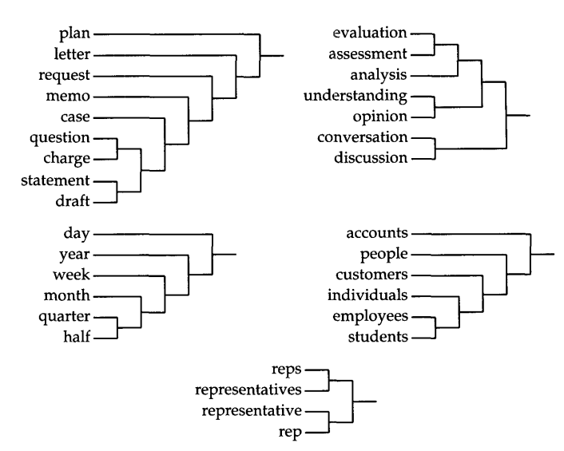
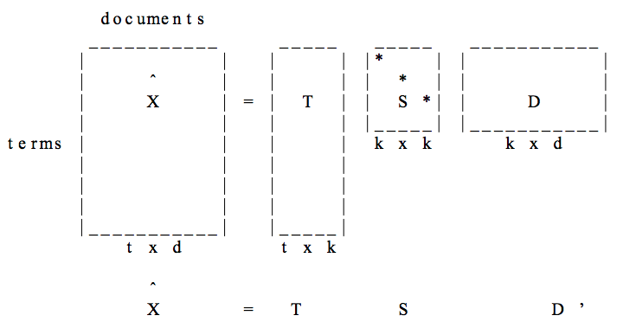
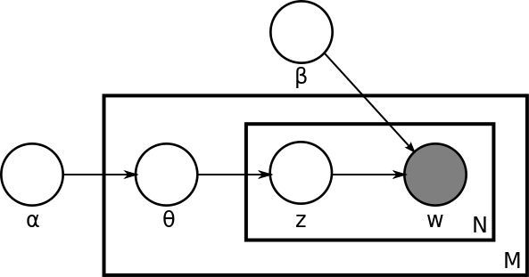
Unsupervised pretraining : Pre-Neural
Word Type Representation
Latent Semantic Analysis (LSA)—SVD of term-document matrix, (Deerwester et al., 1990)
Brown clusters, hard hierarchical clustering based on n-gram LMs, (Brown et al. 1992)
Latent Dirichlet Allocation (LDA)—Documents are mixtures of topics and topics are mixtures of words (Blei et al., 2003)
1

Slide 11
Language Model Pretraining
Many successful pretraining approaches are based on language modeling
Informally, a LM learns P_{ϴ}(text) or P_{ϴ}(text | some other text)
LMs don’t require human annotation
Many languages have enough text to learn high capacity model
Versatile—can learn both sentence and word representations with a variety of objective functions
1

Slide 12
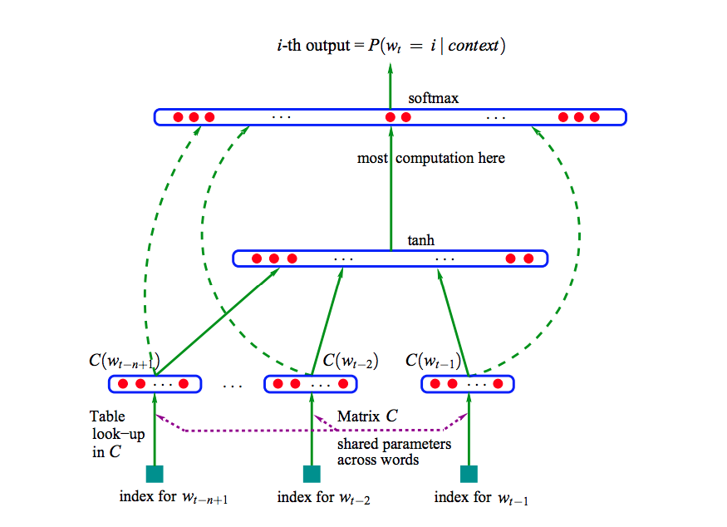
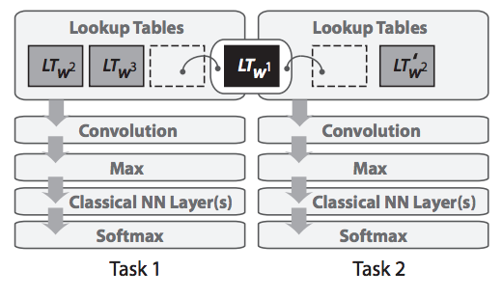
Word Type Representation
Word vector pretraining
n-gram neural language model (Bengio et al. 2003)
Supervised multitask word embeddings (Collobert and Weston, 2008)
1

Slide 13
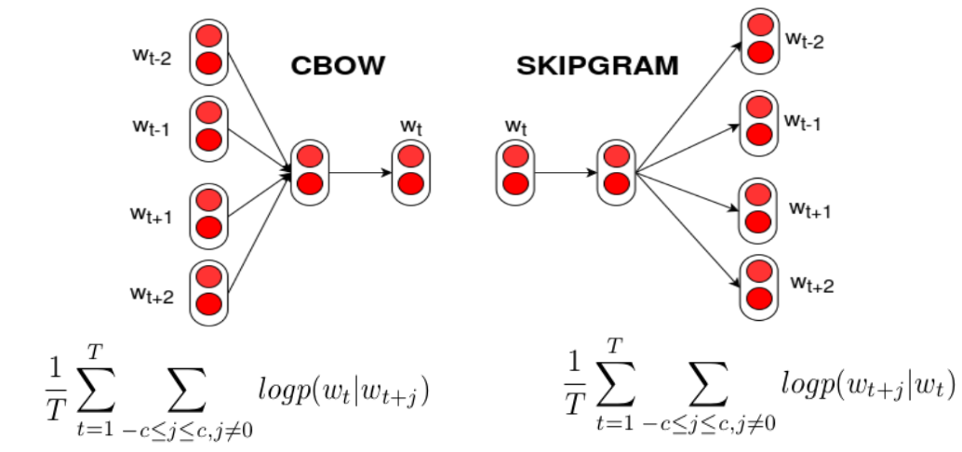
word2vec
Efficient algorithm + large scale training → high quality word vectors
(Mikolov et al., 2013)
See also: Pennington et al. (2014): GloVe Bojanowski et al. (2017): fastText
1

Slide 14
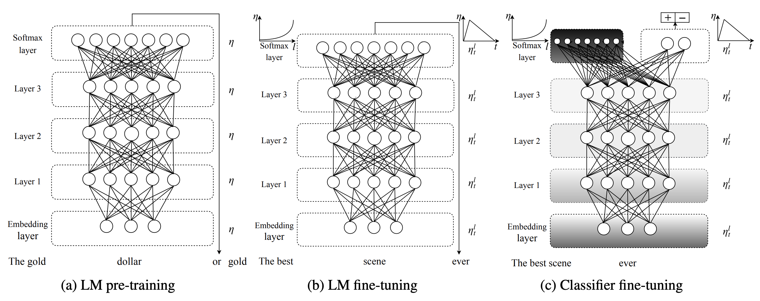
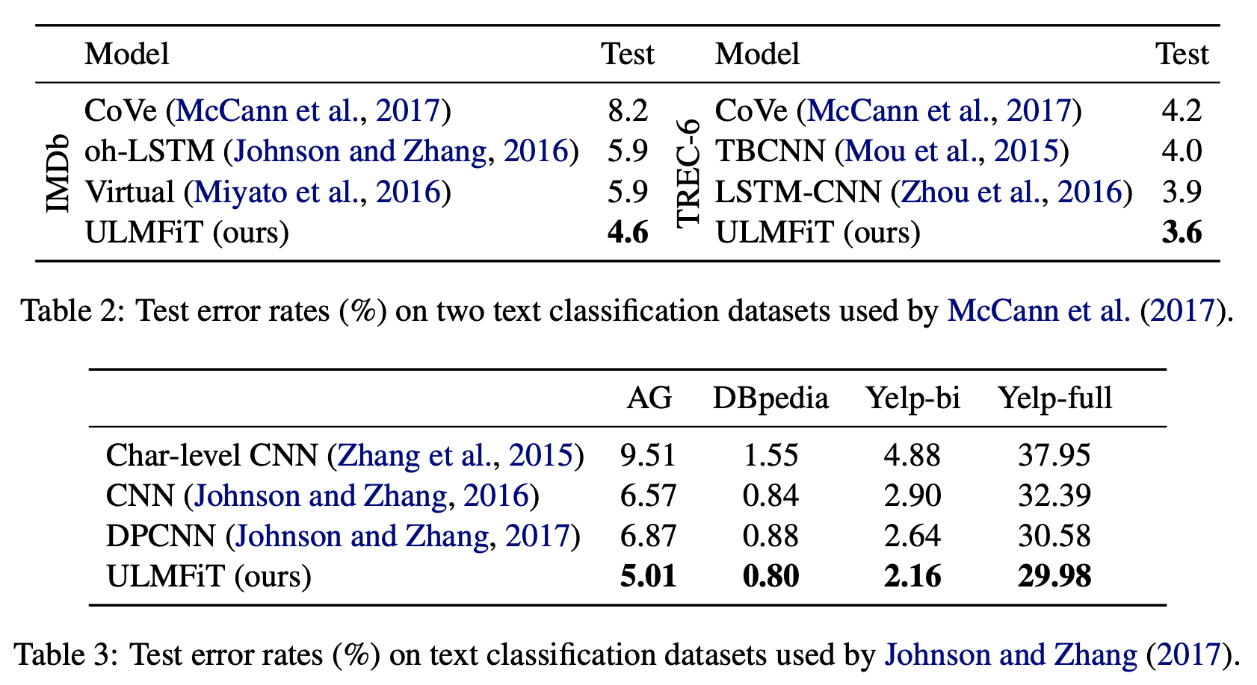
ULMFiT
Pretrain AWD-LSTM LM, fine-tune LM in two stages with different adaptation techniques SOTA for six classification datasets
(Howard and Ruder, ACL 2018)
1

Slide 15
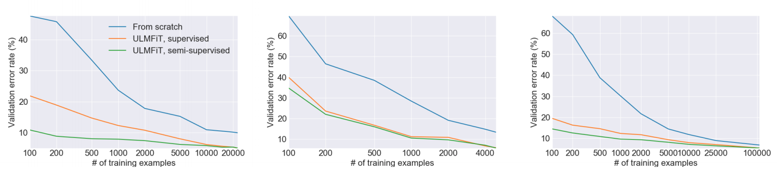
Pretraining reduces need for annotated data
(Howard and Ruder, ACL 2018)
1

Slide 16
Why does language modeling work so well?
Language modeling is a very difficult task, even for humans.
Language models are expected to compress any possible context into a vector that generalizes over possible completions.
“They walked down the street to ???”
To have any chance at solving this task, a model is forced to learn syntax, semantics, encode facts about the world, etc.
Given enough data, a huge model, and enough compute, can do a reasonable job!
Empirically works better than translation, autoencoding: “Language Modeling Teaches You More Syntax than Translation Does” (Zhang et al. 2018)
1

Slide 17
Today
Go through one example of sequential transfer learning for a classification task in full detail
Data: the IMDB movie reviews (Maas et al. 2011)
Transfer learning following the ULMFiT model (Howard and Ruder 2018)
We use the AWD-LSTM model (Merity et al 2017), a vanilla LSTM with four kinds of dropout regularization
Small, simple model: word embedding size of 300, 2 LSTM layers with 300 hidden size per layer, BPTT (back-propagation through time) of size 70
We pretrain a language model on Wikitext-103 (Merity et al. 2017b): 28595 preprocessed Wikipedia articles, a total of 103 million words
Pretrained model is small and simple (no attention, skip connections etc.) and the pretraining corpus is of modest size.
1

Slide 18
Today (ctd.)
We finetune the pretrained AWD-LSTM model using discriminative (Yosinski et al. 2014) and slanted triangular (Smith 2017; Howard and Ruder 2018) learning rates
Discriminative learning rates help us avoid catastrophic forgetting
Slanted triangular learning rates improve (rate of) convergence in training
We do the same kind of minimal preprocessing as in Howard and Ruder (2018)
Notebooks based on the Fastai course, v3, part 2: https://course.fast.ai/part2
We start with an overview of the preprocessing steps
We introduce the AWD-LSTM model
We show how to pretrain the AWD-LSTM model on Wikipedia
We do ULMFiT-style transfer learning for IMDB sentiment classification
1

