Slide 1
Workshop: Advent of Code – day 2
Adám Brudzewsky Richard Park Rodrigo Girão Serrão

Slide 2
Day 1
Array-oriented techniques
Bingo and Strings
Day 2
Reading and parsing data from files
Mathematical insights for array-oriented programming

Slide 3
Problems
15.2 Wrapping Presents
15.17 Filling Containers
16.3 Triangles
Topics
Reading and parsing data from files
Mathematical insights for array-oriented programming

Slide 4
Reading and Parsing Input
READ
PARSE
System Functions
⎕NGET
⎕JSON
⎕CSV
⎕MAP
⎕XML

Slide 5
Reading and Parsing Input
READ
PARSE
System Functions
⎕NGET
⎕JSON
⎕CSV
⎕MAP
⎕XML

Slide 6
⎕NGET
READ
PARSE
Vector of characters: ⊃⎕NGET filename .
┌→─────┐ .
│Hello,│ .
│World!│ .
│ │ .
└──────┘ .
Vector of character vectors: ⊃⎕NGET filename 1 .
┌→──────────────────┐ .
│ ┌→─────┐ ┌→─────┐ │ .
│ │Hello,│ │World!│ │ .
│ └──────┘ └──────┘ │ .
└∊──────────────────┘ .
Line separator is always ⎕UCS 10
⎕JSON
⎕CSV
⎕MAP
⎕XML

Slide 7
Reading and Parsing Input
READ
PARSE
System Functions
⎕NGET
⎕JSON
⎕CSV
⎕MAP
⎕XML

Slide 8
⎕MAP
READ
PARSE
Vector of characters: 80 ¯1 ⎕MAP filename .
.
n-row matrix: 80 n ¯1 ⎕MAP filename .
n-column matrix: 80 ¯1 n ⎕MAP filename .
n-column m-row array: 80 ¯1 n m ⎕MAP filename.
etc.
⎕NGET
⎕JSON
⎕CSV
⎕XML

Slide 9
Reading and Parsing Input
READ
PARSE
System Functions
⎕NGET
⎕JSON
⎕CSV
⎕MAP
⎕XML

Slide 10
⎕CSV
READ
PARSE
From array: ⎕CSV ('1,2,3' '4,5,6') ⍬ 4
┌→────┐ .
↓1 2 3│ .
│4 5 6│ .
└~────┘ .
From file: ⎕CSV 'foo.csv' ⍬ 4 .
┌→────┐ .
↓1 2 3│ .
│4 5 6│ .
└~────┘ ¸
⎕NGET
⎕JSON
⎕MAP
⎕XML
2 to error on non-numbers

Slide 11
⎕CSV
⎕CSV⊂'ab,cd' 'de,fg'
┌→──────────┐ .
↓ ┌→─┐ ┌→─┐ │ .
│ │ab│ │cd│ │ .
│ └──┘ └──┘ │ .
│ ┌→─┐ ┌→─┐ │ .
│ │de│ │fg│ │ .
│ └──┘ └──┘ │ .
└∊──────────┘ .

Slide 12
⎕CSV
⎕CSV⍠'Invert'1⊂'ab,cd' 'de,fg'
┌→──────────┐
│ ┌→─┐ ┌→─┐ │
│ ↓ab│ ↓cd│ │
│ │de│ │fg│ │
│ └──┘ └──┘ │ └∊──────────┘.
⍠ ⇔ ⎕OPT is in Classic

Slide 13
⎕CSV
For more techniques, watch is.gd/dyalog_csv
READ
PARSE
⎕CSV⍠'Invert'2⊂'ab,cd' 'de,fg'
┌→────────────────────────────┐
│ ┌→──────────┐ ┌→──────────┐ │
│ │ ┌→─┐ ┌→─┐ │ │ ┌→─┐ ┌→─┐ │ │
│ │ │ab│ │de│ │ │ │cd│ │fg│ │ │
│ │ └──┘ └──┘ │ │ └──┘ └──┘ │ │
│ └∊──────────┘ └∊──────────┘ │
└∊────────────────────────────┘
⎕NGET
⎕JSON
⎕MAP
⎕XML

Slide 14
Reading and Parsing Input
READ
PARSE
System Functions
⎕NGET
⎕JSON
⎕CSV
⎕MAP
⎕XML

Slide 15
⎕JSON
READ
PARSE
r←⎕JSON '{"Abe":31,"Bob":27}'
]names r
r.Abe r.Bob
r.Abe
31
⎕NGET
⎕CSV
⎕MAP
⎕XML

Slide 16
⎕JSON
READ
PARSE
⎕JSON⍠'M'⊢'{"Abe":31,"Bob":27}'
┌→──────────────┐
↓ ┌⊖┐ ┌⊖┐ │
│ 0 │ │ │0│ 1 │
│ └─┘ └~┘ │
│ ┌→──┐ │
│ 1 │Abe│ 31 3 │
│ └───┘ │
│ ┌→──┐ │
│ 1 │Bob│ 27 3 │
│ └───┘ │
└∊──────────────┘
⎕NGET
⎕CSV
⎕MAP
⎕XML

Slide 17
Reading and Parsing Input
READ
PARSE
System Functions
⎕NGET
⎕JSON
⎕CSV
⎕MAP
⎕XML

Slide 18
⎕XML
READ
PARSE
]OUTPUT.View
⎕XML '<root><sub>cont</sub>outer</root>'
┌→───────────────────────────────┐
↓ ┌→───┐ ┌⊖┐ ┌→────────┐ │
│ 0 │root│ │ │ ⌽ ┌⊖┐ ┌⊖┐ │ 7 │
│ └────┘ └─┘ │ │ │ │ │ │ │
│ │ └─┘ └─┘ │ │
│ └∊────────┘ │
│ ┌→──┐ ┌→───┐ ┌→────────┐ │
│ 1 │sub│ │cont│ ⌽ ┌⊖┐ ┌⊖┐ │ 5 │
│ └───┘ └────┘ │ │ │ │ │ │ │
│ │ └─┘ └─┘ │ │
│ └∊────────┘ │
│ ┌⊖┐ ┌→────┐ ┌→────────┐ │
│ 1 │ │ │outer│ ⌽ ┌⊖┐ ┌⊖┐ │ 4 │
│ └─┘ └─────┘ │ │ │ │ │ │ │
]TOOLS.APLCart
]WS.Names
⎕NGET
⎕JSON
]OUTPUT.Repr
⎕CSV
⎕MAP
]EXPERIMENTAL.Get

Slide 19
Reading and Parsing Input
READ
PARSE
System Functions
⎕NGET
⎕JSON
⎕CSV
⎕MAP
⎕XML

Slide 20
Reading and Parsing Input
READ
PARSE
"x"-delimited tuples to numeric matrix (15.2)
↑{⎕JSON'[',⍵,']'}¨'x'⎕R','⊃⎕NGET path 1
↑'x'(0 ⎕JSON¨≠⊆⊢)¨⊃⎕NGET path 1
⎕CSV⍠'Separator' 'x'⊢path ⍬ 2
⎕NGET
⎕JSON
⎕CSV
⎕MAP
⎕XML

Slide 21
Reading and Parsing Input
Lines of same length to character matrix (15.5, 16.6)
↑⊃⎕NGET path 1
⊃⎕CSV⍠'Invert' 1⊂path
{0 ¯1↓⍵⍴⍨n,⍨n÷⍨≢⍵}⊃⎕NGET path
0 ¯1↓80 ¯1 n ⎕MAP path
n is line length + 1

Slide 22
Reading and Parsing Input
Fixed-width fields to numeric matrix (16.3)
↑' '(0 ⎕JSON¨≠⊆⊢)¨⊃⎕NGET path 1
⎕CSV⍠'Widths'(5 5 5)⊢path ' ⍬ 2

Slide 23
Mathematical Insights
15.2 Wrapping Presents
15.17 Filling Containers
16.3 Triangles

Slide 24
Wrapping Presents
height
width
length

Slide 25
Wrapping Presents
Area of paper required:
Surface area of whole box
+
Area of smallest face
height
width
length

Slide 26
Wrapping Presents
(2×l×w)+(2×w×h)+(2×h×l)
+
Area of smallest face
height
width
length

Slide 27
Wrapping Presents
Area of smallest face
{⍵[⍋⍵]}
×/2↑
×/⍵[1 2]
Multiply all 3 sides and divide by largest
(×/÷⌈/) l w h
Take smallest of products of sides
⌊/ l w h × w h l
height
width
length

Slide 28
Wrapping Presents
Area of smallest face
Exercise: Using a similar insight, compute
the perimeter of the smallest face
Multiply all 3 sides and divide by largest
(×/÷⌈/) l w h
height
width
length

Slide 29
Filling Containers
CanFillRecursive←{
⍺≤0:⍺=0
0∊⍴⍵:0
+/(⍺-⍵)∇¨(⍳≢⍵)↓¨⊂⍵
}

Slide 30
Filling Containers
Combinations are related to Boolean vectors
When doing base conversion, ⎕IO←0
Exercise: Use ⊤ (or ⊥) to find all Boolean numbers 0 to ⍵

Slide 31
Filling Containers
Filtered arithmetic
Exercise: What is another way to write:
+/⍺/⍵
for Boolean vector ⍺ and numeric vector ⍵ ?

Slide 32
Filling Containers
Filtered arithmetic
Exercise: How can we filter numeric vector ⍵ using each row of Boolean matrix ⍺ ?
⍺: 3 5⍴1 0 0 1
1 0 0 1 1
0 0 1 1 0
0 1 1 0 0
⍵: 3 4 5 6 7
←: ⍝ result need not be nested
┌─────┬───┬───┐
│3 6 7│5 6│4 5│
└─────┴───┴───┘

Slide 33

Triangles
Three numbers may define a triangle if
$$a+b≥c$$
a
b
c

Slide 34
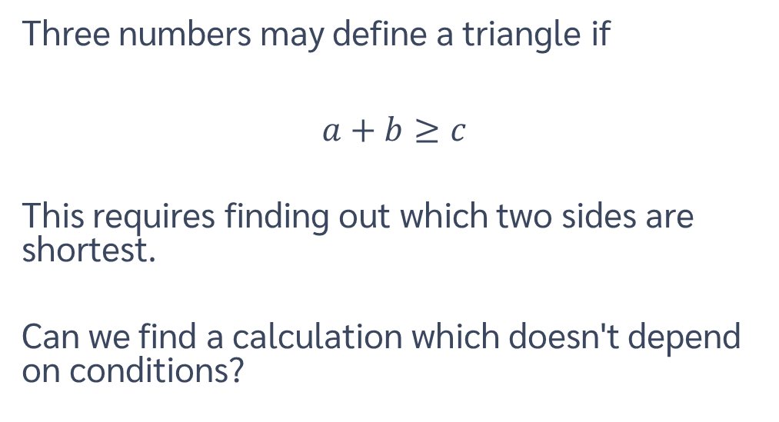
Triangles
Three numbers may define a triangle if
$$a+b≥c$$
This requires finding out which two sides are shortest.
Can we find a calculation which doesn't depend on conditions?
a
b
c

Slide 35
Triangles
For part 1, each row of 3 numbers defines the sides of a triangle.
For part 2, each vertical group of 3 defines the sides of a triangle.
How does the following code achieve this redefinition?
(⍴⍵)⍴,⍉⍵
a
b
c

Slide 36
We're here for you!
General support support@dyalog.com Forums forums.dyalog.com Chat room apl.chat Adám Brudzewsky adam@dyalog.com Richard Park rpark@dyalog.com Rodrigo Girão Serrão rodrigo@dyalog.com

