Slide 1
Workshop: Magnets Problem – day 1
Adám Brudzewsky Richard Park Rodrigo Girão Serrão

Slide 2
Workshop Overview
Day 1: TotalEnergy
Algorithms
Writing general code
Exercises
Day 2: Simulate
Code Review
Performance Tuning
Exercises

Slide 3

TotalEnergy
$$E=−J\sum_{\left\langle ij\right\rangle }{S_{i}S_{j}}$$ $$\begin{matrix} & N & \\ W & s & E \\ & S & \end{matrix}$$
$$s_{E}=−J×s×(N+E+S+W)$$

Slide 4

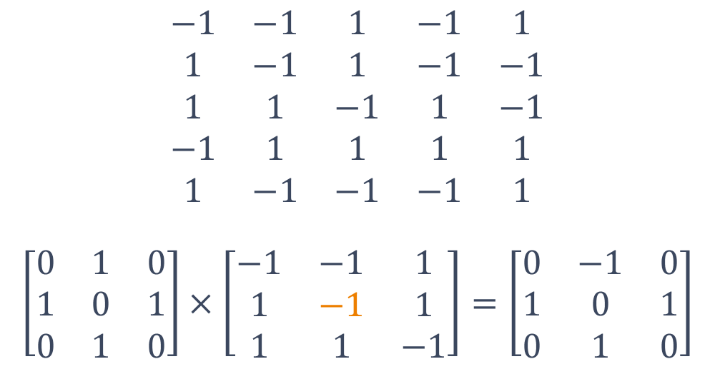
TotalEnergy using Stencil
$$\begin{matrix}−1 & −1 & 1 & −1 & 1 \\ 1 & −1 & 1 & −1 & −1 \\ 1 & 1 & −1 & 1 & −1 \\ −1 & 1 & 1 & 1 & 1 \\ 1 & −1 & −1 & −1 & 1\end{matrix}$$ $$\left[\begin{matrix}0 & 1 & 0 \\ 1 & 0 & 1 \\ 0 & 1 & 0\end{matrix}\right]×\left[\begin{matrix}−1 & −1 & 1 \\ 1 & −1 & 1 \\ 1 & 1 & −1\end{matrix}\right]=\left[\begin{matrix}0 & −1 & 0 \\ 1 & 0 & 1 \\ 0 & 1 & 0\end{matrix}\right]$$
$$\left[\begin{matrix}−1 & −1 & 1 \\ 1 & −1 & 1 \\ 1 & 1 & −1\end{matrix}\right]$$

Slide 5
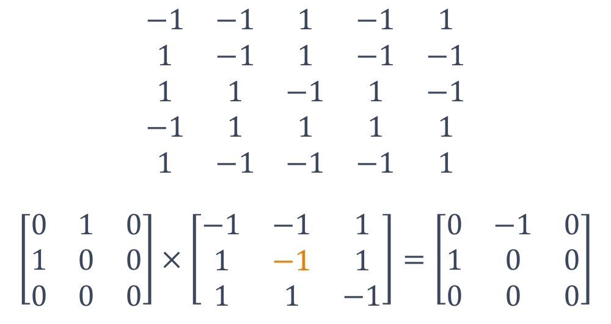
TotalEnergy using Stencil
$$\begin{matrix}−1 & −1 & 1 & −1 & 1 \\ 1 & −1 & 1 & −1 & −1 \\ 1 & 1 & −1 & 1 & −1 \\ −1 & 1 & 1 & 1 & 1 \\ 1 & −1 & −1 & −1 & 1\end{matrix}$$ $$\left[\begin{matrix}0 & 1 & 0 \\ 1 & 0 & 0 \\ 0 & 0 & 0\end{matrix}\right]×\left[\begin{matrix}−1 & −1 & 1 \\ 1 & −1 & 1 \\ 1 & 1 & −1\end{matrix}\right]=\left[\begin{matrix}0 & −1 & 0 \\ 1 & 0 & 0 \\ 0 & 0 & 0\end{matrix}\right]$$
$$\left[\begin{matrix}−1 & −1 & 1 \\ 1 & −1 & 1 \\ 1 & 1 & −1\end{matrix}\right]$$

Slide 6


TotalEnergy using Shifting
$$\begin{matrix}0 & 0 & 0 & 0 & 0 & 0 \\ 0 & −1 & −1 & 1 & −1 & 1 \\ 0 & 1 & −1 & 1 & −1 & −1 \\ 0 & 1 & 1 & −1 & 1 & −1 \\ 0 & −1 & 1 & 1 & 1 & 1 \\ 0 & 1 & −1 & −1 & −1 & 1\end{matrix}$$
$$\left[\begin{matrix}−1 & −1 & 1 \\ 1 & −1 & 1 \\ 1 & 1 & −1\end{matrix}\right]$$

Slide 7


TotalEnergy using Shifting
$\begin{matrix}0 & 0 & 0 & 0 & 0 & 0 \\ 0 & −1 & −1 & 1 & −1 & 1 \\ 0 & 1 & −1 & 1 & −1 & −1 \\ 0 & 1 & 1 & −1 & 1 & −1 \\ 0 & −1 & 1 & 1 & 1 & 1 \\ 0 & 1 & −1 & −1 & −1 & 1\end{matrix}$
$$\left[\begin{matrix}−1 & −1 & 1 \\ 1 & −1 & 1 \\ 1 & 1 & −1\end{matrix}\right]$$

Slide 8

TotalEnergy using Shifting
$\begin{matrix}0 & 0 & 0 & 0 & 0 & 0 \\ 0 & −1 & −1 & 1 & −1 & 1 \\ 0 & 1 & −1 & 1 & −1 & −1 \\ 0 & 1 & 1 & −1 & 1 & −1 \\ 0 & −1 & 1 & 1 & 1 & 1 \\ 0 & 1 & −1 & −1 & −1 & 1\end{matrix}$
$$\left[\begin{matrix}−1 & −1 & 1 \\ 1 & −1 & 1 \\ 1 & 1 & −1\end{matrix}\right]$$

Slide 9
TotalEnergy using Shifting
$$\begin{matrix}0 & 0 & 0 & 0 & 0 & 0 \\ 0 & −1 & −1 & 1 & −1 & 1 \\ 0 & 1 & −1 & 1 & −1 & −1 \\ 0 & 1 & 1 & −1 & 1 & −1 \\ 0 & −1 & 1 & 1 & 1 & 1 \\ 0 & 1 & −1 & −1 & −1 & 1\end{matrix}$$
$$\left[\begin{matrix}−1 & −1 & 1 \\ 1 & −1 & 1 \\ 1 & 1 & −1\end{matrix}\right]$$

Slide 10


TotalEnergy using Shifting
$$\begin{matrix}0 & 0 & 0 & 0 & 0 & 0 \\ 0 & −1 & −1 & 1 & −1 & 1 \\ 0 & 1 & −1 & 1 & −1 & −1 \\ 0 & 1 & 1 & −1 & 1 & −1 \\ 0 & −1 & 1 & 1 & 1 & 1 \\ 0 & 1 & −1 & −1 & −1 & 1\end{matrix}$$
$$\left[\begin{matrix}−1 & −1 & 1 \\ 1 & −1 & 1 \\ 1 & 1 & −1\end{matrix}\right]$$

Slide 11
TotalEnergy using Shifting
$$\begin{matrix}0 & 0 & 0 & 0 & 0 & 0 \\ 0 & −1 & −1 & 1 & −1 & 1 \\ 0 & 1 & −1 & 1 & −1 & −1 \\ 0 & 1 & 1 & −1 & 1 & −1 \\ 0 & −1 & 1 & 1 & 1 & 1 \\ 0 & 1 & −1 & −1 & −1 & 1\end{matrix}$$
$$\left[\begin{matrix}−1 & −1 & 1 \\ 1 & −1 & 1 \\ 1 & 1 & −1\end{matrix}\right]$$

Slide 12

TotalEnergy using N-wise Reduce
$$\begin{matrix}0 & 0 & 0 & 0 & 0 & 0 \\ & −1 & −1 & 1 & −1 & 1 \\ & 1 & −1 & 1 & −1 & −1 \\ & 1 & 1 & −1 & 1 & −1 \\ & −1 & 1 & 1 & 1 & 1 \\ & 1 & −1 & −1 & −1 & 1\end{matrix}$$
×

Slide 13

TotalEnergy using N-wise Reduce
$$\begin{matrix}0 & 0 & 0 & 0 & 0 & 0 \\ & −1 & −1 & 1 & −1 & 1 \\ & 1 & −1 & 1 & −1 & −1 \\ & 1 & 1 & −1 & 1 & −1 \\ & −1 & 1 & 1 & 1 & 1 \\ & 1 & −1 & −1 & −1 & 1\end{matrix}$$
×

Slide 14


TotalEnergy using N-wise Reduce
$$\begin{matrix}0 & 0 & 0 & 0 & 0 & 0 \\ & −1 & −1 & 1 & −1 & 1 \\ & 1 & −1 & 1 & −1 & −1 \\ & 1 & 1 & −1 & 1 & −1 \\ & −1 & 1 & 1 & 1 & 1 \\ & 1 & −1 & −1 & −1 & 1\end{matrix}$$
$$\begin{matrix}0 & 0 & 0 & 0 & 0 & 0 \\ & −1 & −1 & 1 & −1 & \\ & 1 & −1 & 1 & −1 & \\ & 1 & 1 & −1 & 1 & \\ & −1 & 1 & 1 & 1 & \\ & 1 & −1 & −1 & −1 & \end{matrix}$$
×

Slide 15


TotalEnergy using N-wise Reduce
$$\begin{matrix}0 & 0 & 0 & 0 & 0 & 0 \\ & −1 & −1 & 1 & −1 & 1 \\ & 1 & −1 & 1 & −1 & −1 \\ & 1 & 1 & −1 & 1 & −1 \\ & −1 & 1 & 1 & 1 & 1 \\ & 1 & −1 & −1 & −1 & 1\end{matrix}$$
$$\begin{matrix}0 & 0 & 0 & 0 & 0 & 0 \\ & −1 & −1 & 1 & −1 & \\ & 1 & −1 & 1 & −1 & \\ & 1 & 1 & −1 & 1 & \\ & −1 & 1 & 1 & 1 & \\ & 1 & −1 & −1 & −1 & \end{matrix}$$
×

Slide 16

TotalEnergy using N-wise Reduce
$$\begin{matrix}0 & 0 & 0 & 0 & 0 & 0 \\ & −1 & 1 & −1 & −1 & −1 \\ & 1 & −1 & −1 & −1 & 1 \\ & 1 & 1 & −1 & −1 & −1 \\ & −1 & −1 & 1 & 1 & 1 \\ & 1 & −1 & 1 & 1 & −1\end{matrix}$$
×

Slide 17

TotalEnergy using N-wise Reduce
$$\begin{matrix}0 & −1 & 0 & 0 & 0 & 0 \\ & 0 & 1 & −1 & −1 & −1 \\ & 0 & −1 & −1 & −1 & 1 \\ & 0 & 1 & −1 & −1 & −1 \\ & 0 & −1 & 1 & 1 & 1 \\ & 0 & −1 & 1 & 1 & −1\end{matrix}$$
×

Slide 18
Break

Slide 19
Maintainability
Others (and our future selves) can easily understand our code
Code is read much more often than it is written, so plan accordingly
It is easy to make changes to the behaviour

Slide 20
Changing the Rules
Change "constants"
Interaction constant
Temperature
Add an external magnetic field

Slide 21
Changing the Rules
Which neighbours
Nearest neighbours
Anisotropic influence
Distant neighbours

Slide 22
Changing the Rules
World shape
Plane
Cylinder
Torus

Slide 23

Interaction Constant
$$E=−J\sum_{ij}{s_{i}s_{j}}$$

Slide 24

External Field
$$E=−J\sum_{ij}{s_{i}s_{j}}−h\sum_{j}{s_{j}}$$

Slide 25
Change contribution from neighbours
Corners also contribute
↓ ⍐ ↓
⍐ ⍐ ↓
⍐ ↓ ⍐

Slide 26
Change contribution from neighbours
Anisotropic: southwest neighbours contribute more
↓ ⍐ ↓
⍐ ⍐ ↓
⍐ ↓ ⍐

Slide 27
Change contribution from neighbours
More distant neighbours contribute more than nearby neighbours
↓ ↓ ⍐ ⍐ ⍐
↓ ⍐ ↓ ⍐ ↓
⍐ ↓ ⍐ ↓ ⍐
⍐ ⍐ ⍐ ↓ ⍐
↓ ⍐ ↓ ⍐ ⍐

Slide 28
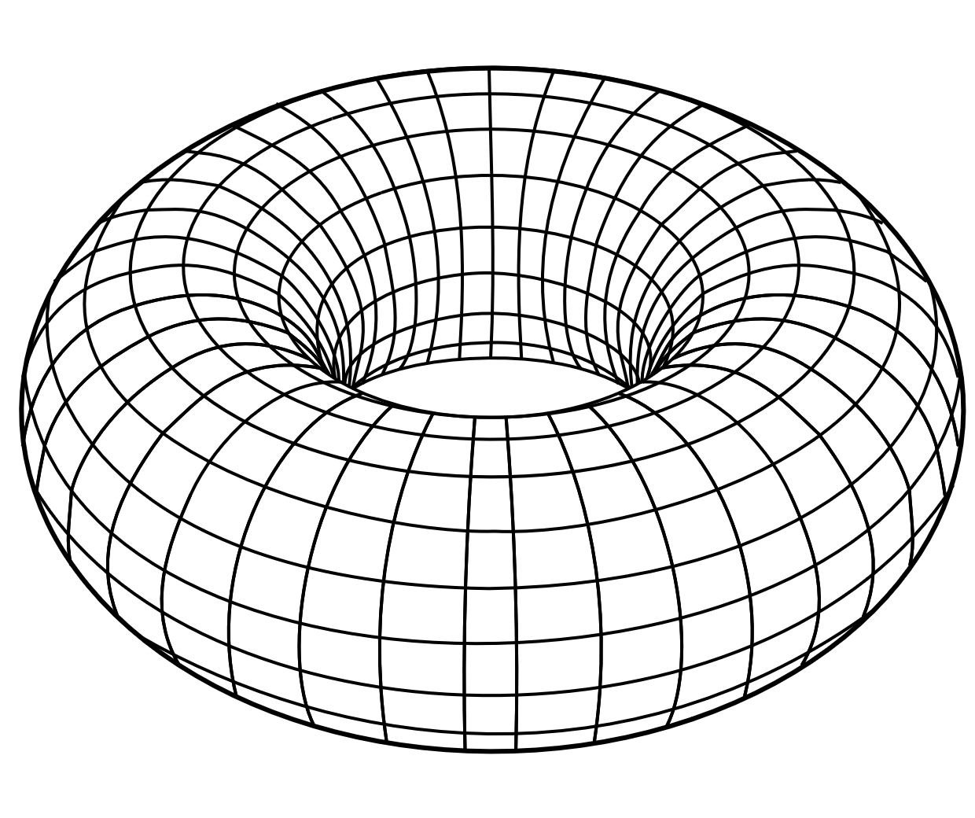
Change the World Shape
Bounded plane
From the problem description, we do not flip edge spins
Cylinder: one edge wraps around
Torus: all edges wrap around
BONUS: Consider
Non-rectangular lattice
3D (or higher?)

Slide 29
Exercise
For each of the approaches we have looked at, modify your code to allow the system to be changed:
Interaction constant
Constant external field
Modifiable neighbourhood
Which approaches do you find easy to understand? Which are easiest to change?

Slide 30
Exercise: Neighbourhood
Consider:
A static neighbourhood (similar to the problem description, Boolean)
A function of position and/or distance relative the "this spin"
How will you represent the neighbourhood influence?
Try to write:
Production quality code
Sensible variable names
Comments

Slide 31
See you next week!
Questions?

Slide 32
Workshop: Magnets Problem – day 2
Adám Brudzewsky Richard Park Rodrigo Girão Serrão

Slide 33
Simulate: The Metropolis Algorithm
Choose random (internal) spin in lattice
Does flip cause
∆E≤0 ?
NO
Next step
Next step
(?0)<*-∆E÷kT
YES
NO
Do not flip the spin
Flip the spin

Slide 34
Code Review
This code supposedly chooses a random spin to flip.
Can you spot the mistake?
shape ← ⍴lat
random ← ?shape
random -← random=shape
random +← random=1

Slide 35
Code Review
This code supposedly chooses a random spin to flip.
Can you spot the mistake?
random ← 1+2?¯2+≢lat

Slide 36
Code Review
This code supposedly chooses a random spin to flip, then does it or not, depending on DoFlip ∆E.
Can you spot the mistake?
RandomFlip ← {-@(1+?¯2+⍴⍵)⊢⍵}
∆E ← (TotalEnergy RandomFlip lat) - TotalEnergy lat
:If DoFlip ∆E
lat ← RandomFlip lat
:EndIf

Slide 37
Code Review: Bonus
This code supposedly chooses all random spins to flip, for the entire simulation, at once.
Can you spot the mistake?
shape←⍴lat
all_random ← 1+shape⊥⍉?n 2⍴shape-2

Slide 38
How to detect / prevent errors?
Simple visualisation
Logging
Plotting

Slide 39
Break

Slide 40
Performance
memory →
time →

Slide 41
Performance
]SpaceNeeded
memory →
time →

Slide 42
Performance
]SpaceNeeded
memory →
time →
]RunTime -c

Slide 43
Performance
]SpaceNeeded
memory →
time →
]RunTime -c
'cmpx'⎕cy'dfns'
cmpx '…' '…'

Slide 44
Performance
Explore various algorithms
Run-time is usually more important than memory usage
Try differently scaled input sizes
Compare parts of the solution to construct the best combo example: youtu.be/El0_RB4TTPA

Slide 45
Performant Simulate
Control iterations with:
:While counter
:For ... :In ⍳max_iter
{...}⍣max_iter

Slide 46
Performant Simulate
Determine new spin with:
Mathematical computation (¯1*...)
Data-driven conditional (...⊃¯1 1)

Slide 47
Performant Simulate
Assign new spin with:
new_spin@position
grid[position] ← new_spin

Slide 48
Performant Simulate
Compute spin contributions:
NESW neighbours, then halve

Slide 49
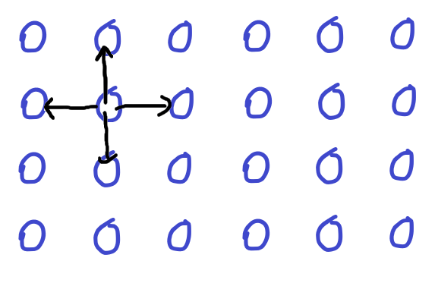

Slide 50
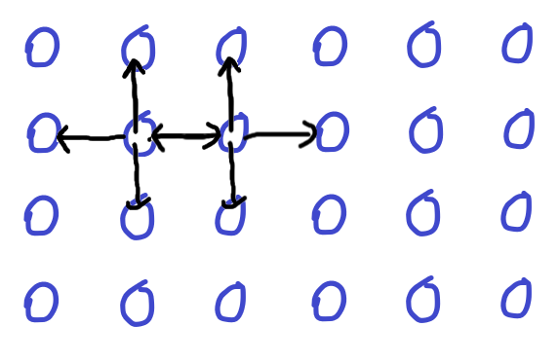

Slide 51
Performant Simulate
Compute spin contributions:
NSEW neighbours, then halve
2 neighbours, then tile

Slide 52
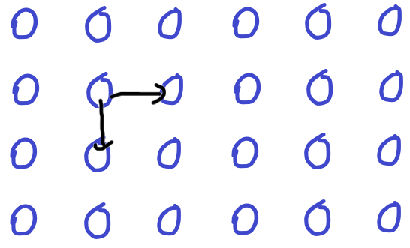

Slide 53
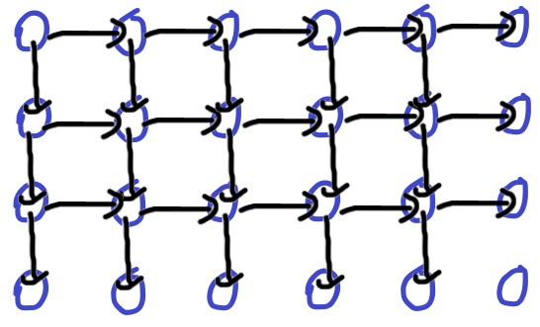

Slide 54
Performant Simulate
Cache current total energy

Slide 55
Performant Simulate
Change in energy:
Difference in total
Difference in the neighbourhood

Slide 56
We're here for you!
General support support@dyalog.com Forums forums.dyalog.com Chat room apl.chat Adám Brudzewsky adam@dyalog.com Richard Park rpark@dyalog.com Rodrigo Girão Serrão rodrigo@dyalog.com

