Slide 1
Task 1
)CLEAR to clear your workspace
)SAVE your workspace with a workspace ID like tasks6_your_name.dws

Slide 2
Task 2
Eliminate the inline assignment by rewriting the following single-line dfns as a multi-line dfn:
Bayes←{prod÷+/prod←⍺×⍵}

Slide 3
Task 3
Make this dfn into the equivalent tradfn:
OR←{ ⍝ Probabilistic OR
p←1-⍺
q←1-⍵
1-p×q
}

Slide 4
Task 4
Create the following tradfn:
r←Anagram b;Norm
r←(Norm a)≡(Norm b)
Create the following dfn:
Norm←{⍵[⍋⍵]~' '}
The Anagram function has two bugs preventing it from working. Fix them so the following expressions work:
'ELEVEN PLUS TWO' Anagram 'TWELVE PLUS ONE'
1
'ELEVEN PLUS TWO' Anagram 'TEN PLUS THREE'
0

Slide 5
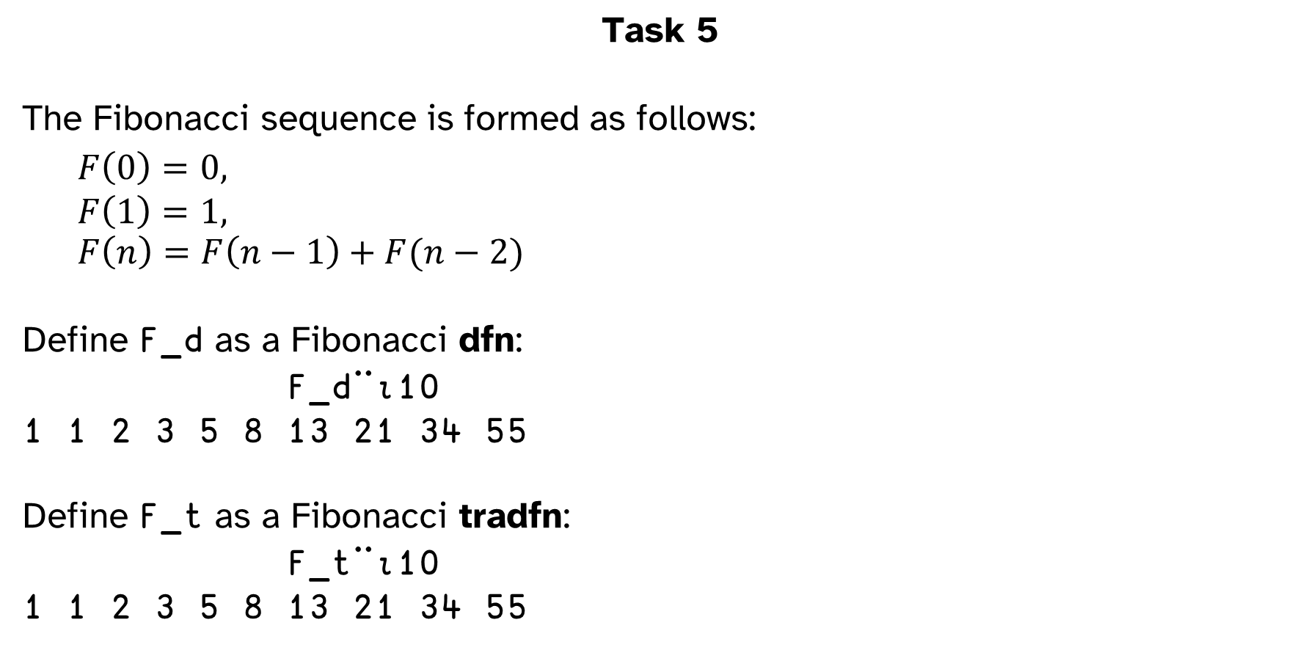
Task 5
The Fibonacci sequence is formed as follows:
$$F\left(0\right)=0,$$
$$F\left(1\right)=1,$$
$$F\left(n\right)=F\left(n−1\right)+F(n−2)$$
Define F_d as a Fibonacci dfn:
F_d¨⍳10
1 1 2 3 5 8 13 21 34 55
Define F_t as a Fibonacci tradfn:
F_t¨⍳10
1 1 2 3 5 8 13 21 34 55

Slide 6
Task 6
Don't worry about how it works for now, but execute the following:
⎕FX⎕A
This creates a function named A which has 26 lines.
Create the function SetStopsA which should take a list of line numbers as argument, and set stops on those lines for the function A. Your function should not return a result.
SetStopsA 3 1 4 15
⎕STOP 'A'
1 3 4 15

Slide 7
Task 7
Create the function clearStopsA which should not take any arguments, nor return a result. However, it should clear all the stop bits from the function A.
clearStopsA
⍴⎕STOP 'A'
0

Slide 8
Submit Your Workspace
Save your workspace, with a name like:
tasks6_your_name.dws
Email to workshops@dyalog.com with a subject like:
Tasks 6 Your Name

