Slide 1



ShiftShare
By Anna Bruestle, Andrew Ehlers, and Bradley Pulaski

Slide 2
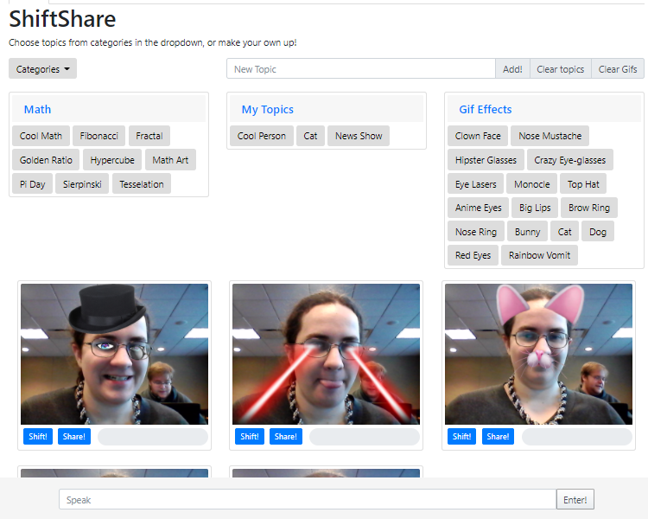
Overview
ShiftShare is a site with gif retrieval, image taking, face filtering, sharing, and chatting.

Slide 3
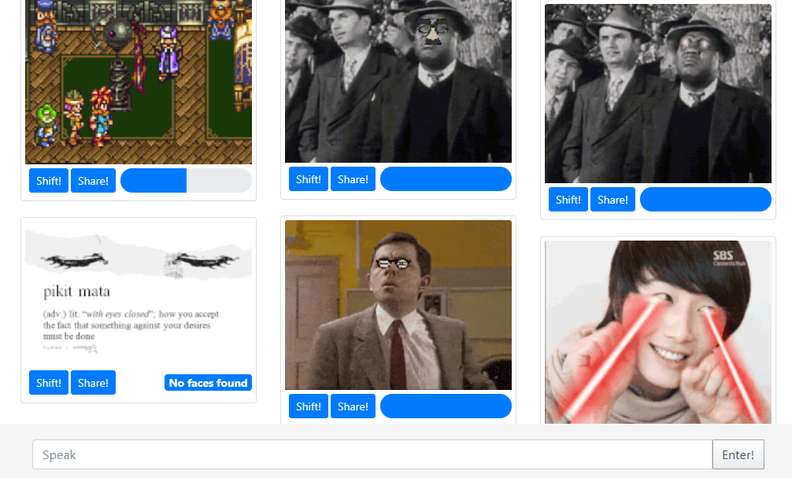
Shift
Gif Retrieval and apply filters

Slide 4
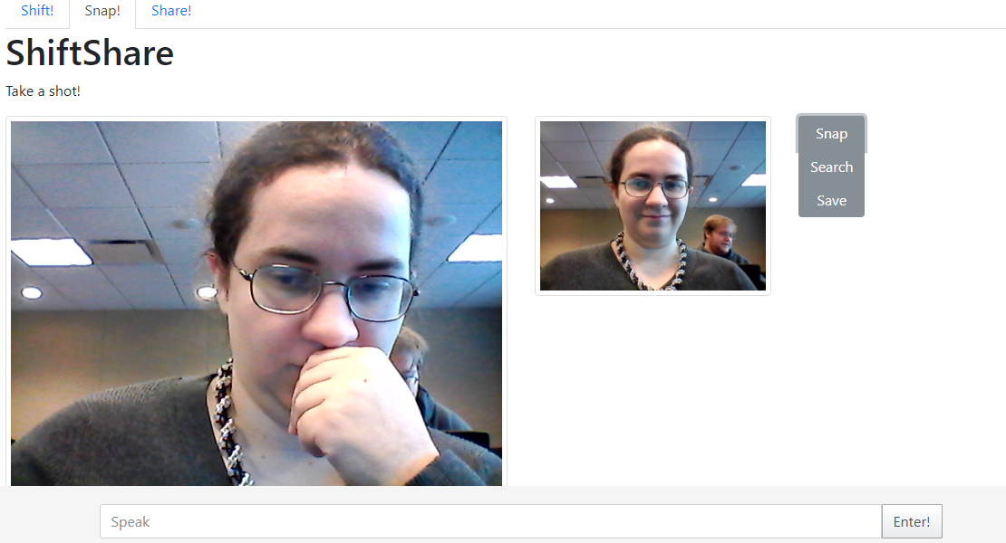
Snap
Take pictures from your webcam or downloads

Slide 5
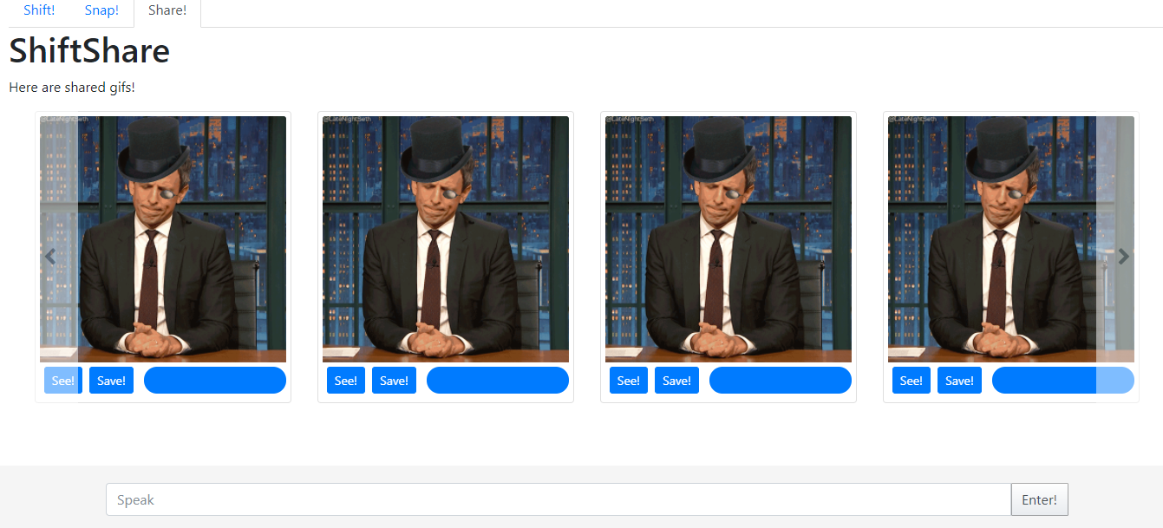
Share
Share and view shifts with the world

Slide 6
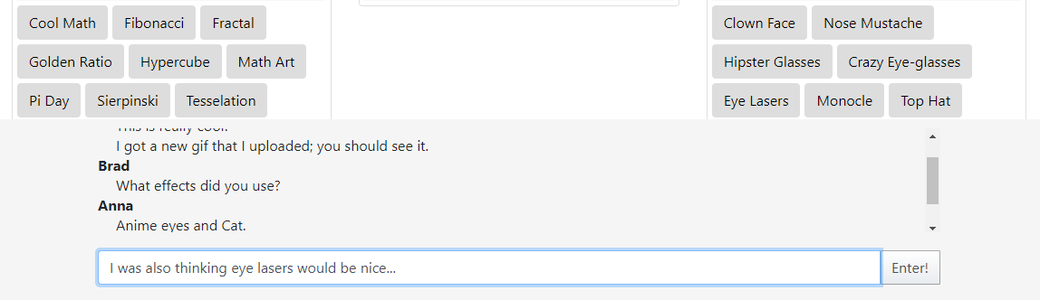
Speak
Chat function using Firebase.
Opens and closes with hovering

Slide 7
See ShiftShare
Github: https://github.com/abruestle/ShiftShare
Page: https://abruestle.github.io/ShiftShare/

Slide 8
Sometime Soon
Multiple face recognition
Share by topic (and maybe other options)

Slide 9
Sources
Presentation background: https://images3.alphacoders.com/555/555186.png
Gifs used from various gifs found with Giphy API.

