Slide 1
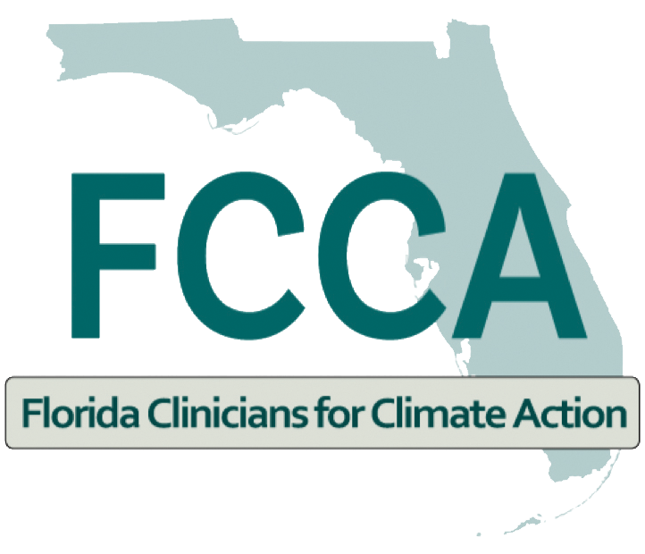

Heat Stress CME Series Session 9- Climate Change, Heat, and Making Your Practice Environmentally Sustainable
May 23, 2023

Slide 2
Climate Change, Heat, and Making Your Practice Environmentally Sustainable
Ludovica Martella
Heat Program Coordinator
Miami-Dade County Office of Resilience
May 23, 2023

Slide 3
Disclosure
I have no actual or potential conflict of interest in relation to this presentation.

Slide 4

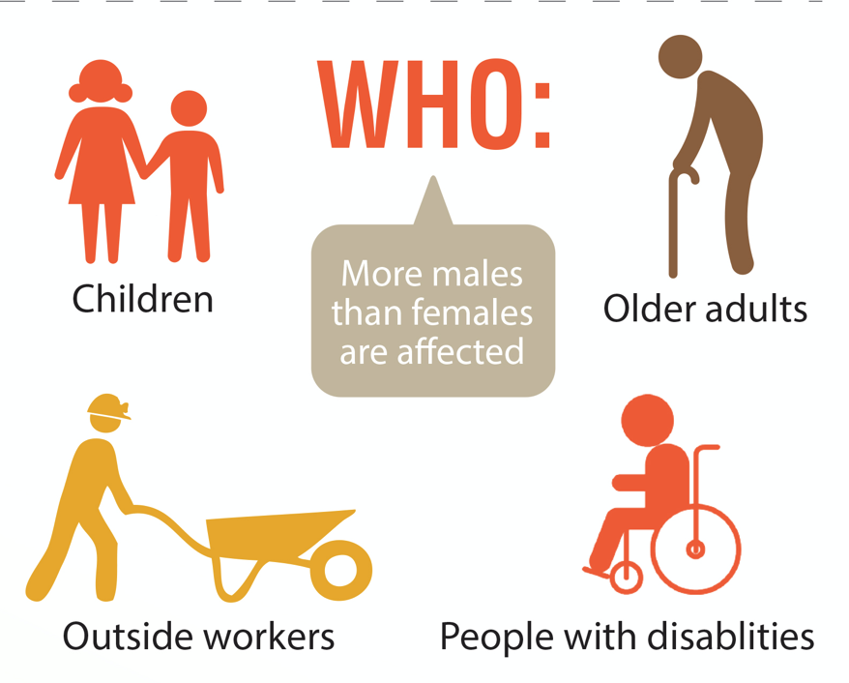

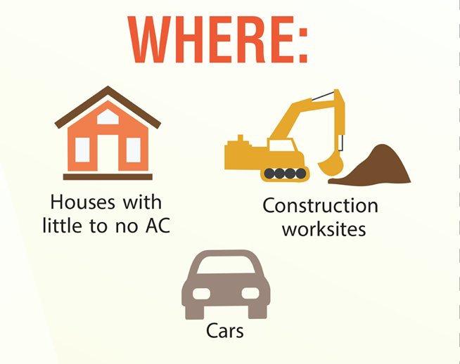
Extreme Heat
Heat is the leading weather-related killer in the United States
High heat and humidity can lead to heat-related illness, including heat cramps, heat exhaustion and heat stroke
Most HRIs and deaths are preventable
High risk groups experience a disproportionate amount of health impacts
Marginalized communities, the elderly, young children, pregnant women and outdoor workers are more vulnerable to heat related illnesses and deaths
Extreme heat conditions are increasing due to climate change and urban development.
Pregnant Women
Notes:
In Miami-Dade there are an average of 154 days a year where temperature and humidity combine to make it feel like 90 degrees Fahrenheit or hotter, according to calculations by the Union of Concerned Scientists. If climate change continues unabated, that number could creep to 187 days a year by mid-century. But the real change could be in days where it feels like 100 or more. Miami-Dade has about 41 of those days a year now, and it could skyrocket to 134 days a year by mid-century.
Read more at: https://www.miamiherald.com/news/local/environment/article257885013.html#storylink=cpy

Slide 5
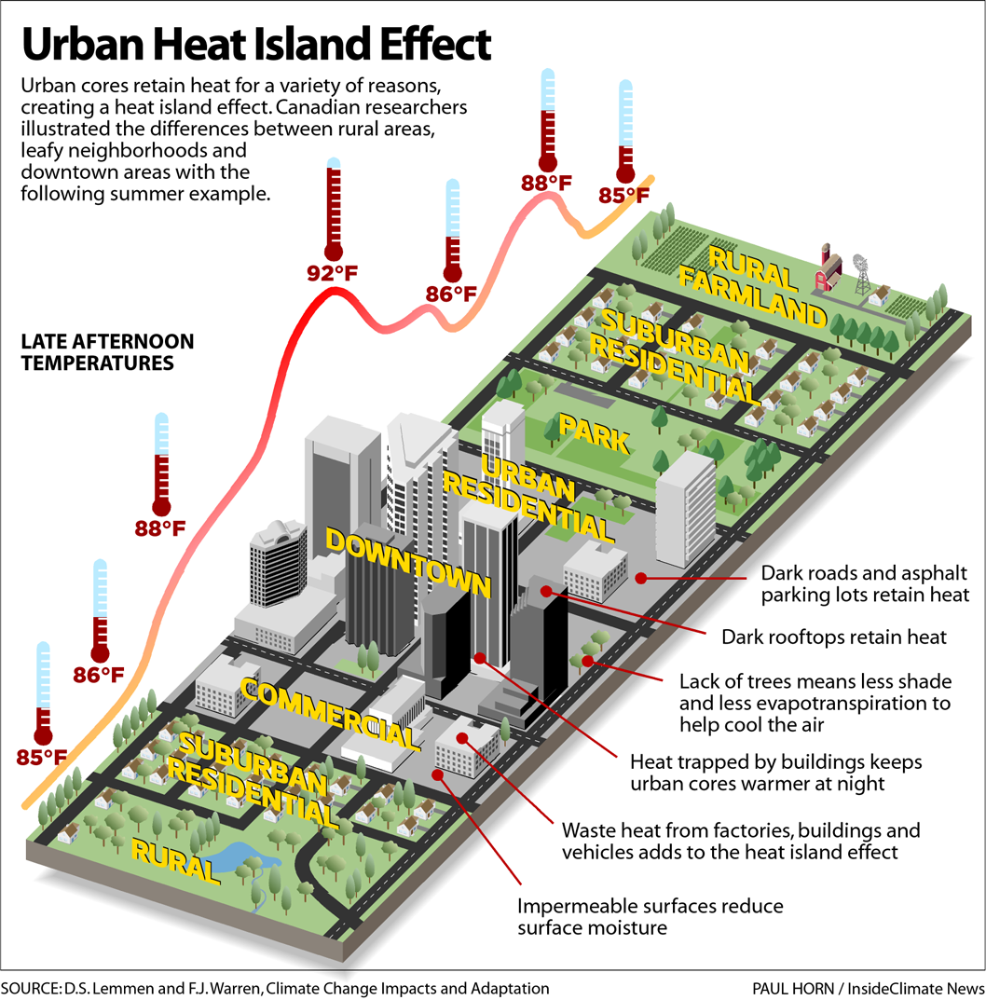
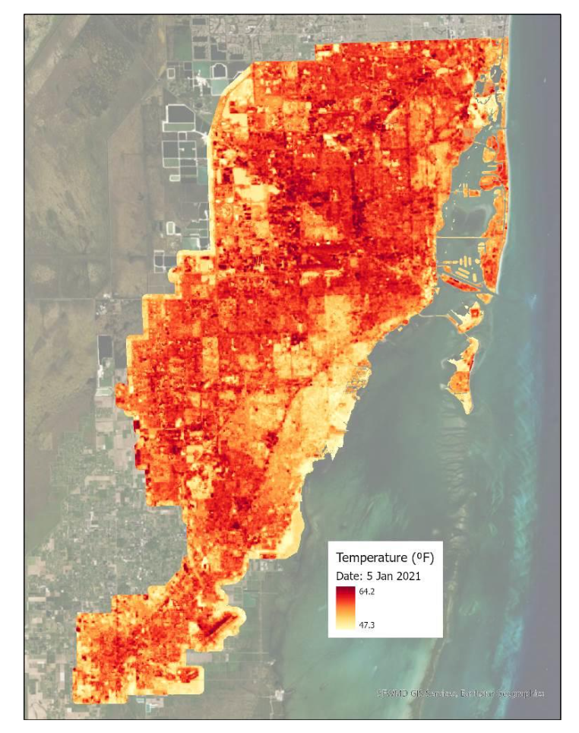
—
Notes:
Buildings, roads, and other infrastructure absorb and re-emit the sun’s heat more than natural landscapes (forests and water). Urban areas, because of the highly concentrated infrastructure and lack of greenery in urban environments, they become “islands” of higher temperatures relative to outlying areas.^{ii} Ambient air temperature can be 5-10 degrees hotter in an urban heat island over the more vegeated or rural areas.
Factors contributing to UHI: reduced natural landscape, urban materials (roofing, cement), spacing and alignment of buildings, Waste heat from vehicles, air-conditioning, industrial facilities)
Due to the urban heat island effect, cities are heating up at a rate twice that of the global average. “Severe heatwaves could affect 13.8% of the world population, or about 1.09 billion people, at least once every five years under 1.5°C of global warming-- a threshold that could be reached as soon as 2030. Under 2°C of global warming, 36.9% of the world population could be affected by severe heatwaves.”^{iii}
UHI’s impact on the economy is largely negative (increased energy consumption, particularly cooling, increased emission of GHGs and other pollutants, decreased water quality, human health and comfort impacts).^{i}

Slide 6
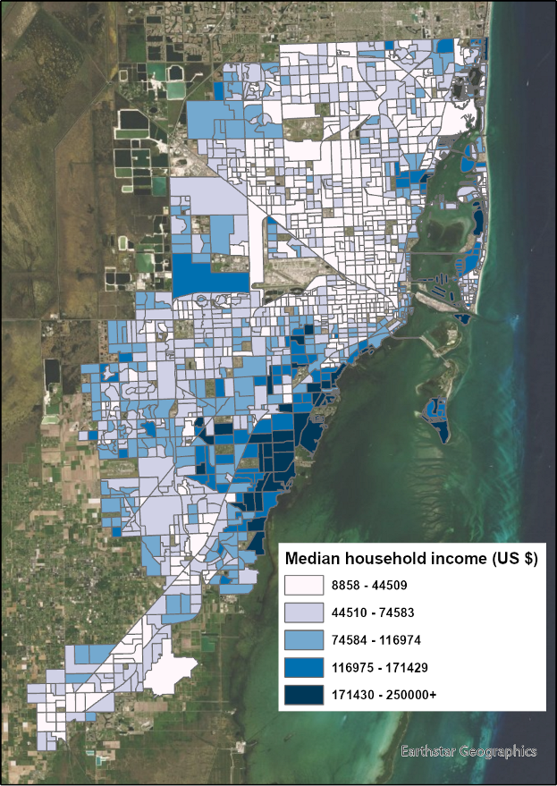
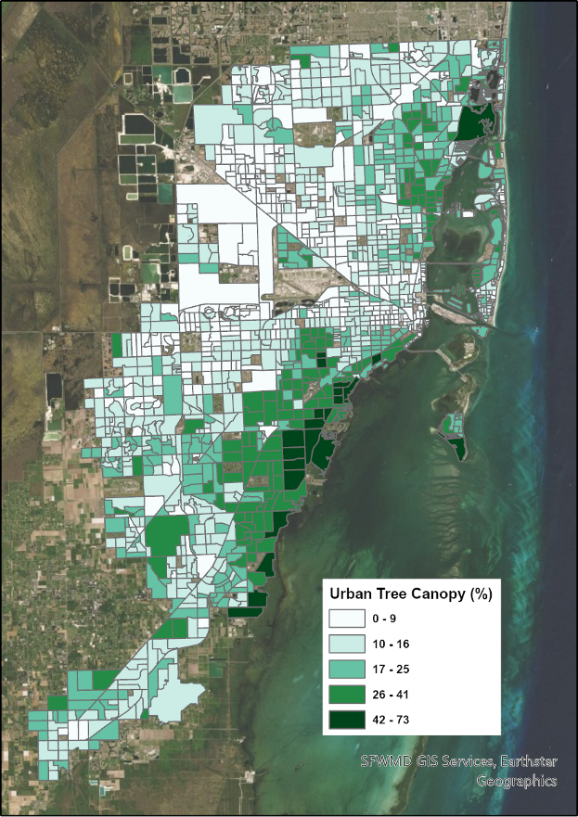
Notes:
The increase in apparent temperatures in our city are not only due to Climate Change but also to our urbanization to development patterns that have led to loss of tree canopy and vegetation and increase of impermeable surfaces.
Median household income and Urban Tree Canopy positive correlation
Equity and tree canopy
Usually urban heat islands are in poorer neighborhoods which have scarce tree canopy. In fact, through a 2016 Urban Tree Canopy Assessment, the County determined that lower-income areas, including predominantly African American and Hispanic neighborhoods, had significantly less tree canopy than their wealthier counterparts.
Benefits of Planting Trees
Reduces air-conditioning costs by providing shade
Improves a home's appearance, which can help to increase a property's real estate value
Provides a natural habitat for wildlife
Lessens flooding by absorbing excess rain water
Removes significant amounts of carbon dioxide from the air, which reduces the impact on climate change

Slide 7
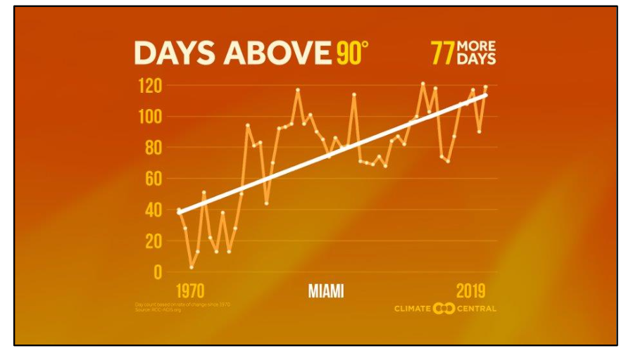
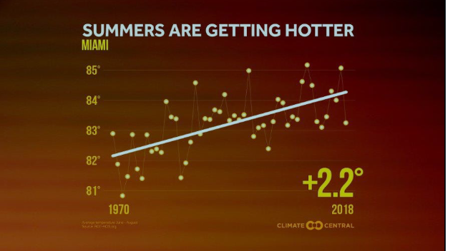
Currently in Miami
Risks to human health and wellbeing are INCREASING
Notes:
Southeast Florida is known for its tropical climate and warmer temperatures. Since 1970, Miami-Dade County has had an average increase of days above 90°F from 84 to now 133 days per year. Since 1985 our average minimum temperatures have risen a little over 2 degrees farhenheit since 1985.

Slide 8
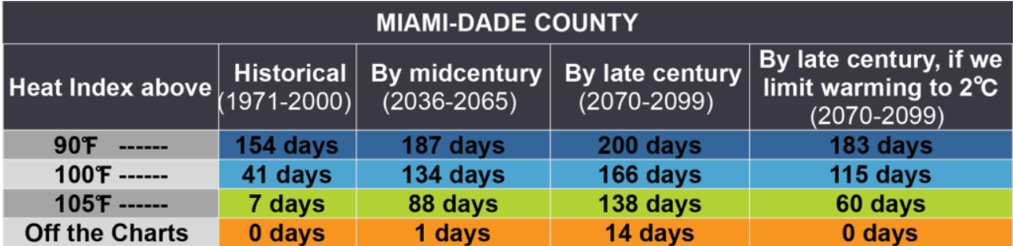
Notes:
And of course in South Florida we have very high average humidity, which makes it more difficult for our bodies to regulate the heat and therefore elevates the heat health related risks. Currently our humidity in the summer averages around 65-70% and so far we're seeing a slight avg increase in humidity over time. So This means that while historically Miami Dade County has experienced an average of 7 days or a week of days with a heat index at or above 105 degrees fahrenheit, by mid century that will likely increase to 88 days or essentially 3 months of days that reach a heat index of 105 or above.

Slide 9
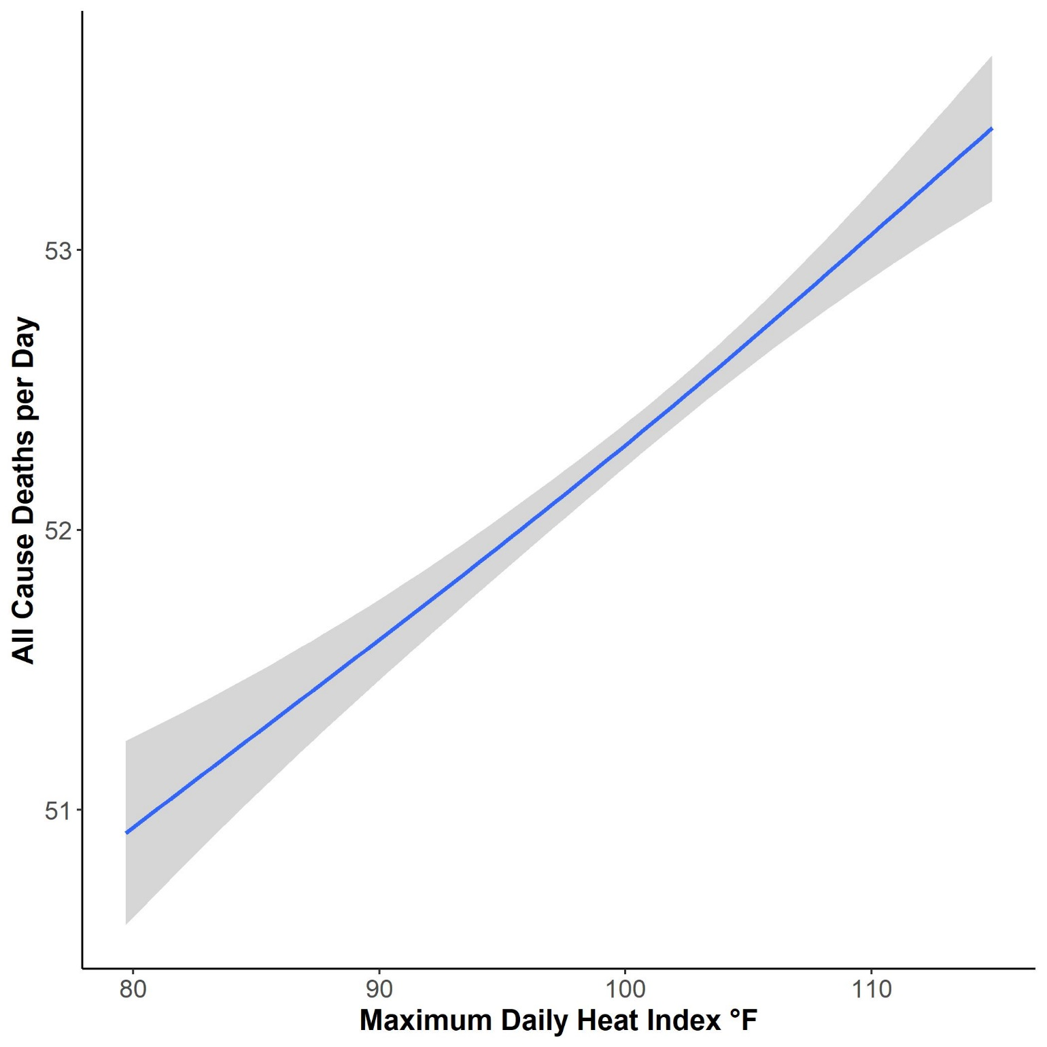

Slide 10

Climate & Heat Health Task Force
Goals reached:
Created workshops to gather info from different stakeholders, community priorities and opportunities
The Task Force will be made up of appointed members representing policy makers, scientific experts, and health care professionals as well as two citizen members who will ensure community voices are heard and lifted up in the formation of the heat plan.
Workshops available at:
https://miamifoundation.org/extremeheat/

Slide 11
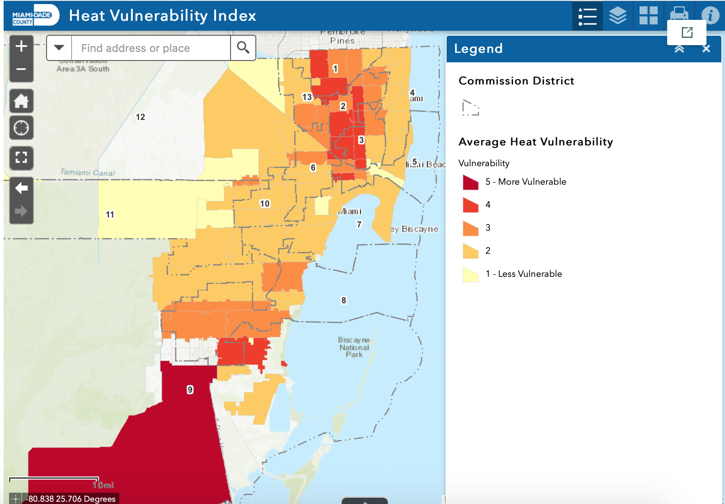
ArcGIS StoryMap: Vulnerability
Interact with the Heat Vulnerability Index web mapping application to identify vulnerable zip codes in Miami-Dade
Homestead, Florida City, Hialeah, Miami, Opa-Locka, and Miami Gardens
** Average of Heat Hospitalization and ER Visit Vulnerability as seen on previous slide

Slide 12
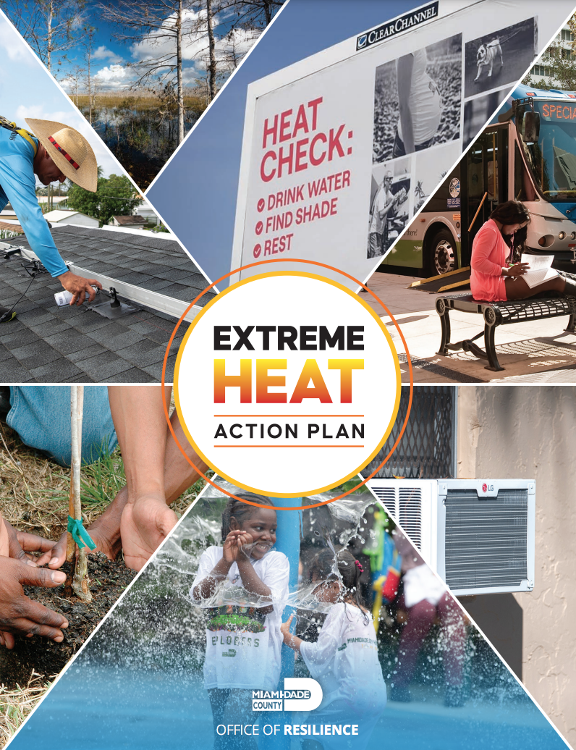



Extreme Heat Action Plan
Goal 1: Inform, Prepare and Protect People
Goal 2: Cool our Homes and Emergency Facilities
Goal 3: Cool our Neighborhoods

Slide 13
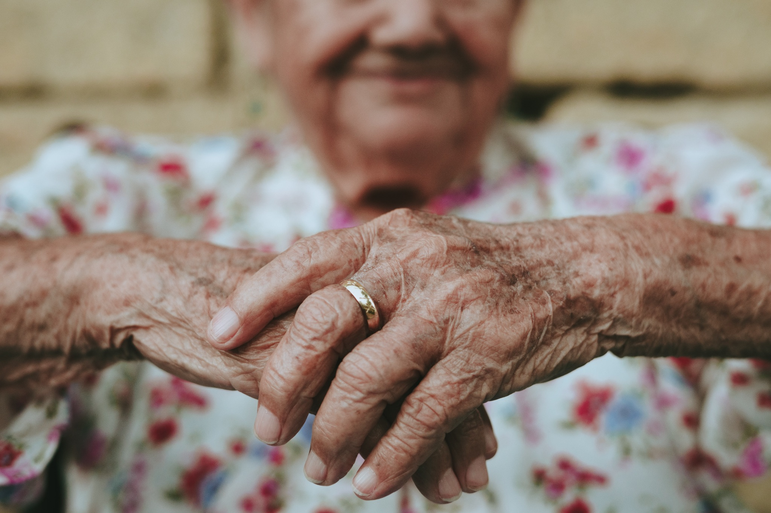



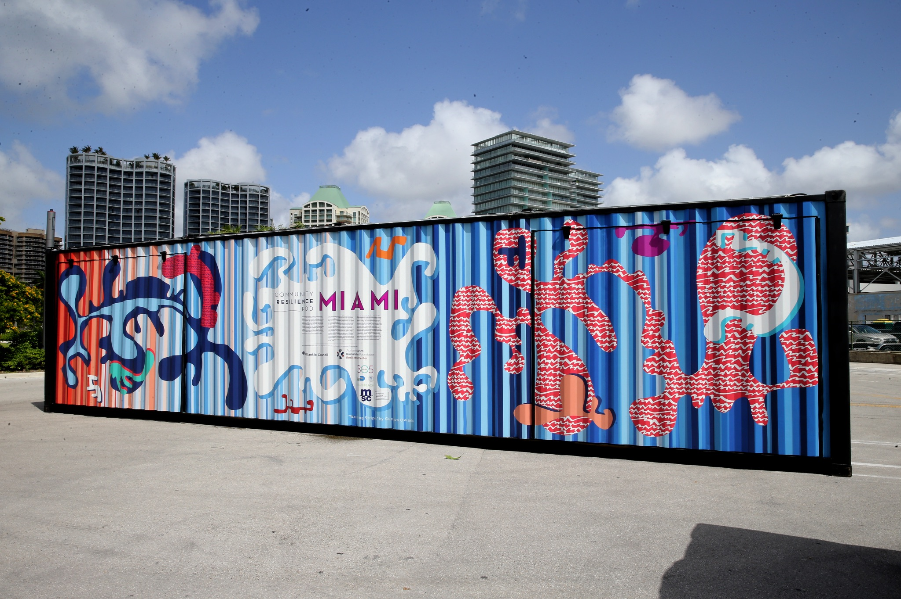
Goal 1: Inform, Prepare and Protect People
Foster healthy and resilient communities by bolstering outreach and education efforts, improving extreme heat warning systems and emergency protocols, protecting outdoor workers and building the capacity of healthcare practitioners to identify and respond to heat vulnerability and illness in their patients.
Build on the Success of the Heat Season Campaign
Enhance Messaging and Protocols
Engage and Support Employers of Outdoor Workers
Seek Worker Protections at all Levels of Government
Engage and Prepare Healthcare Practitioners
Leverage Urban Heat Research Group for Continued Learning
Notes:
https://www.miamidade.gov/parks/library/growing-green-bus-stops.pdf

Slide 14

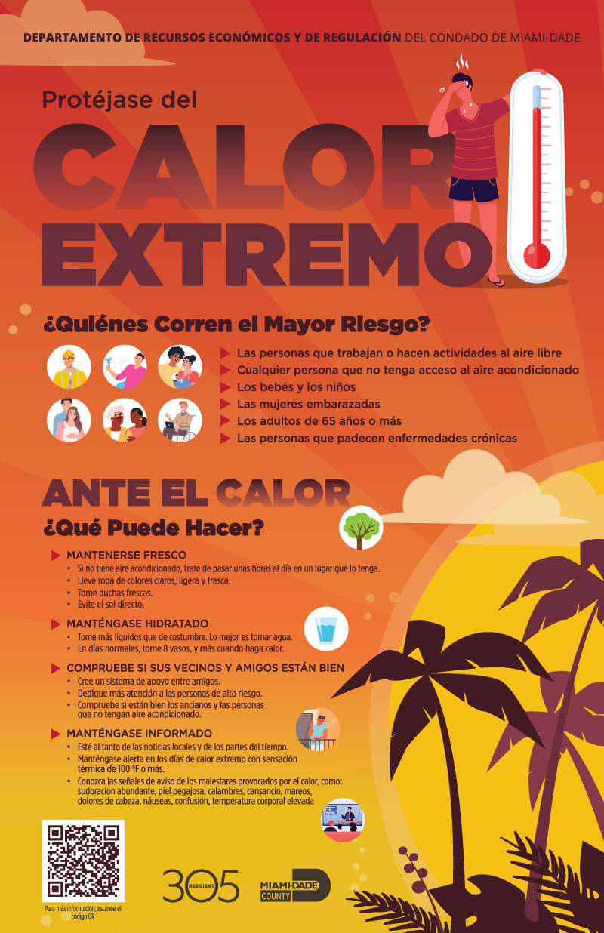
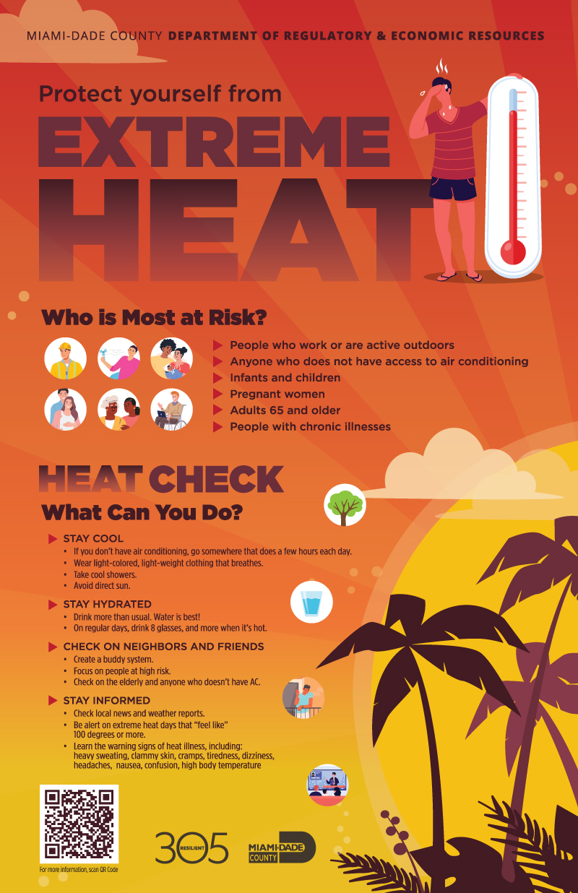
Heat Season Campaign
Notes:
https://www.miamidade.gov/parks/library/growing-green-bus-stops.pdf

Slide 15



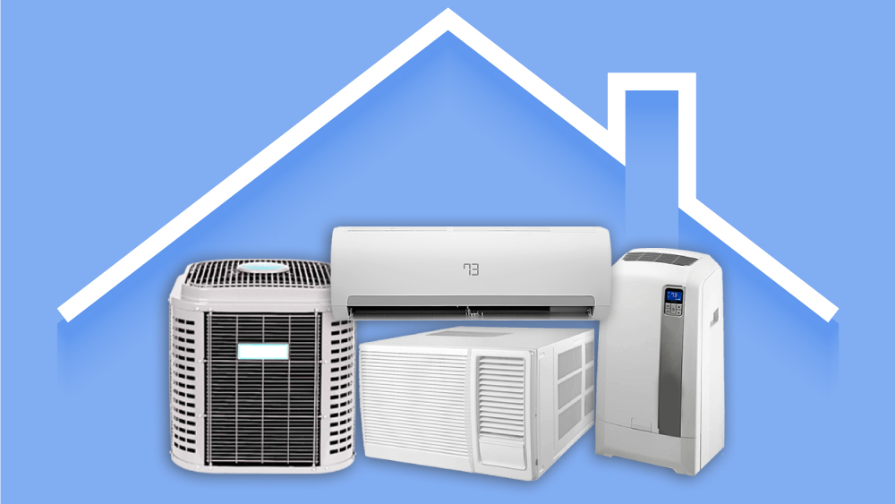
Goal 2: Cool our Homes and Emergency Facilities
Improve access to efficient and reliable cooling in homes and to a place to cool off in the event of a power outage.
7. Seek Increased Support for Efficiency and Cooling Upgrades
8. Advocate for Heat Safe and Affordable Housing Policies
9. Improve Coordination and Expand Outreach on Energy Efficiency
10. Invest in Energy Resilience at Evacuation Shelters
11. Ensure Compliance with Assisted Living/Nursing Home Generator Rule
12. Incorporate Extreme Heat in Countywide Resilience Hub Plan

Slide 16




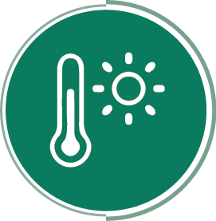
Goal 3: Cool our Neighborhoods
Reduce the excessive heat burden in urban areas by expanding the tree canopy and vegetation, improving access to water features and shade structures, and cooling our surfaces.
13. Create a Bold Tree Plan
14. Cool our Commutes
15. Cool Our Schools
16. Expand Access to Water and Shade
17. Plant and Protect Trees on County Land
18. Pilot and Scale Cool Pavements
19. Ramp up Engagement and Citizen Science
Notes:
https://www.miamidade.gov/parks/library/growing-green-bus-stops.pdf

Slide 17
THANK YOU!
Ludovica Martella
Program Coordinator, MDC Extreme Heat
ludovica.martella@miamidade.gov
Sign up for the resilience newsletter: miamidade.gov/resilience
Notes:
ST

