Slide 1
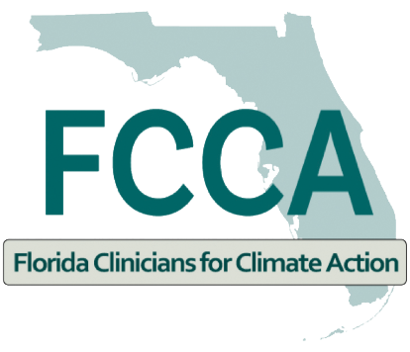

Climate Change Essentials
Cheryl L. Holder, M.D.
Co-Chair. Miami Dade Heat, Health Task Force
Co-Chair. Florida Clinician for Climate Action

Slide 2
Disclosure
I have no actual or potential conflict of interest in relation to this presentation.

Slide 3
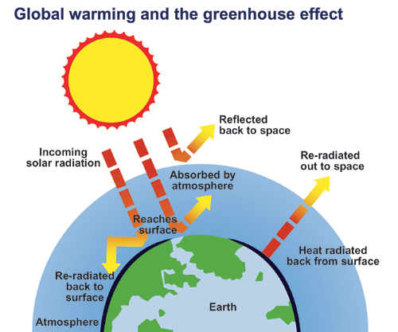
Greenhouse Effect

Slide 4
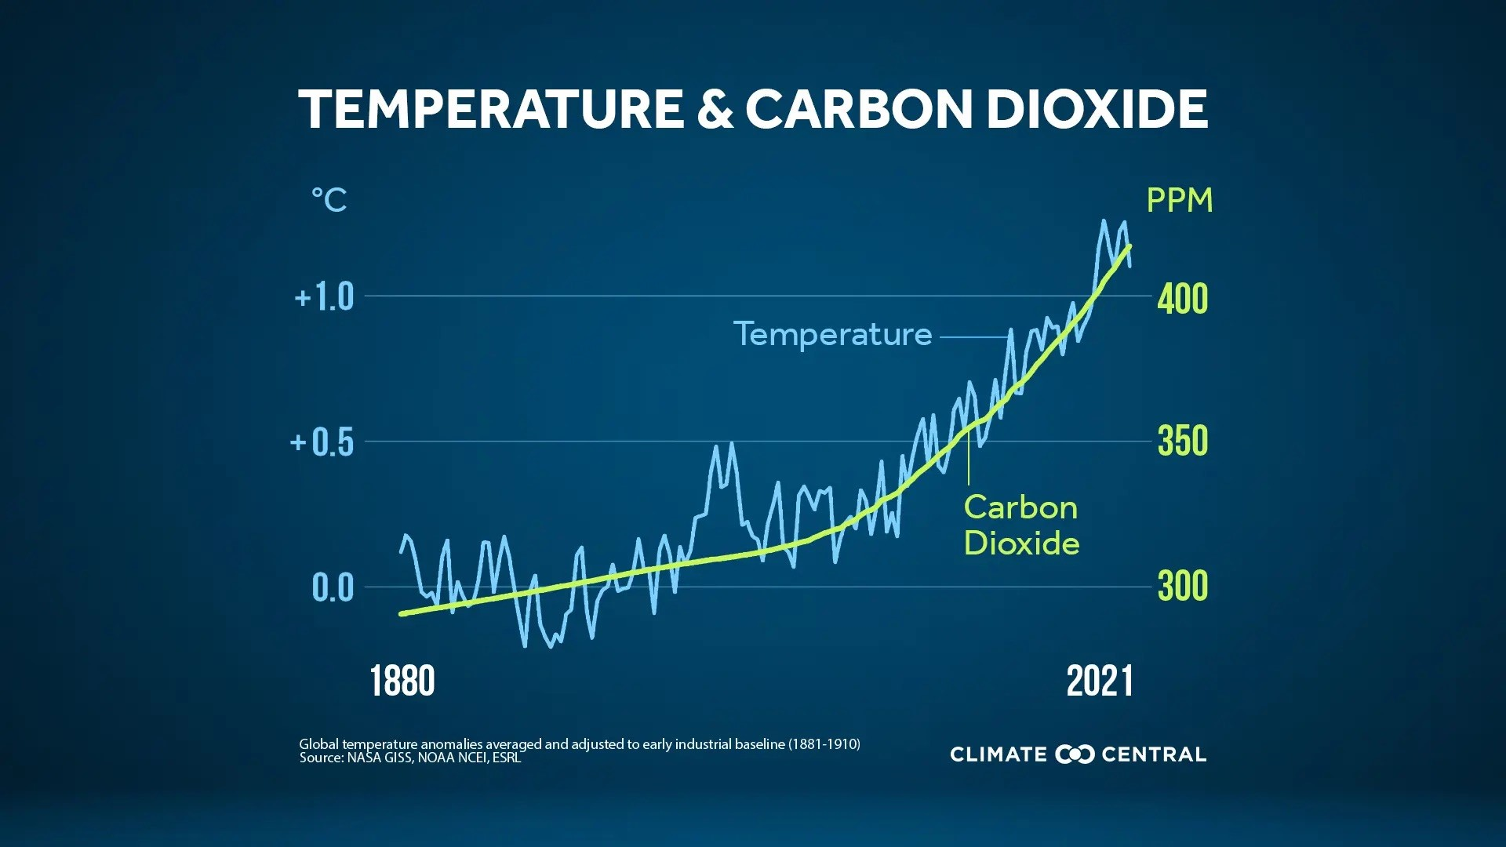
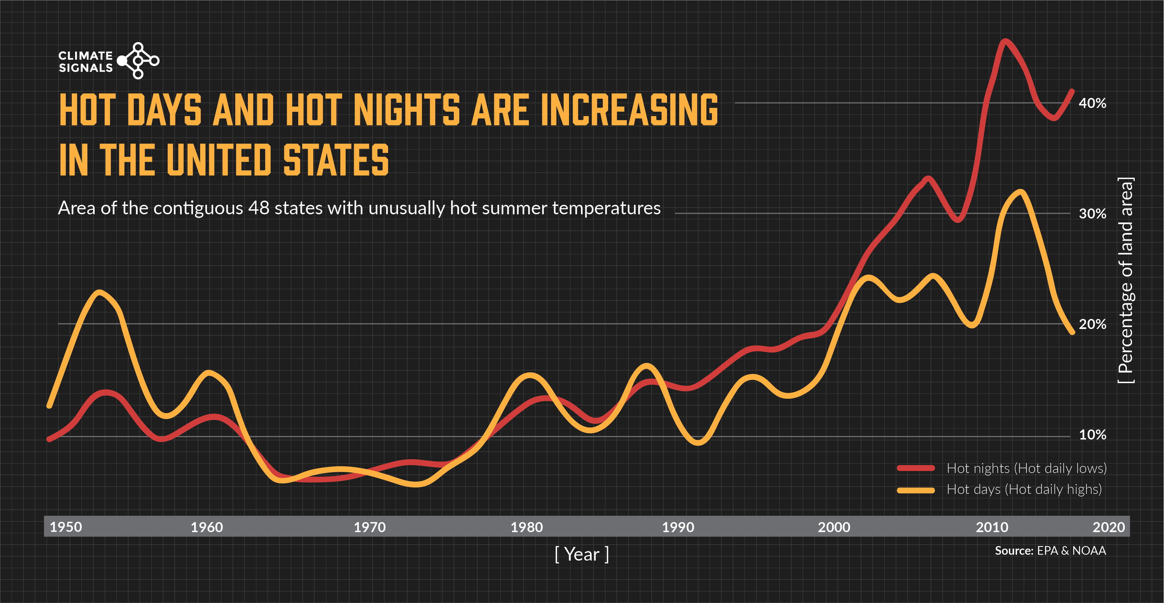

Slide 5
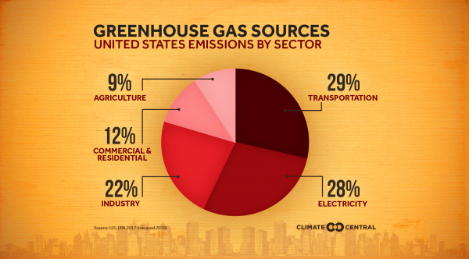

Slide 6
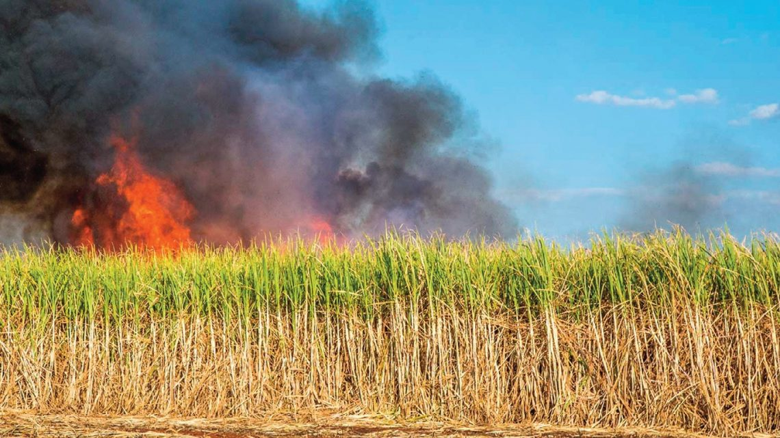
SUGARCANE BURNING BATTLE HEATING UP SHARE ON: S. FLORIDA TIMES — OCTOBER 25, 2022

Slide 7
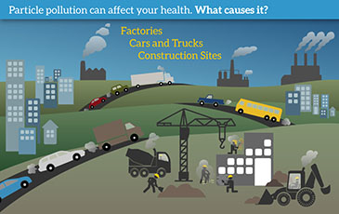

Slide 8
U.S. Health Care Sector- 5th in world
Health care sector emits 4.4% of global greenhouse gas emissions.
U.S. — hospitals, health systems, doctors’ offices, pharmaceutical companies, medical device companies, and others — is responsible for 8.5% of U.S. greenhouse gas emissions.

Slide 9
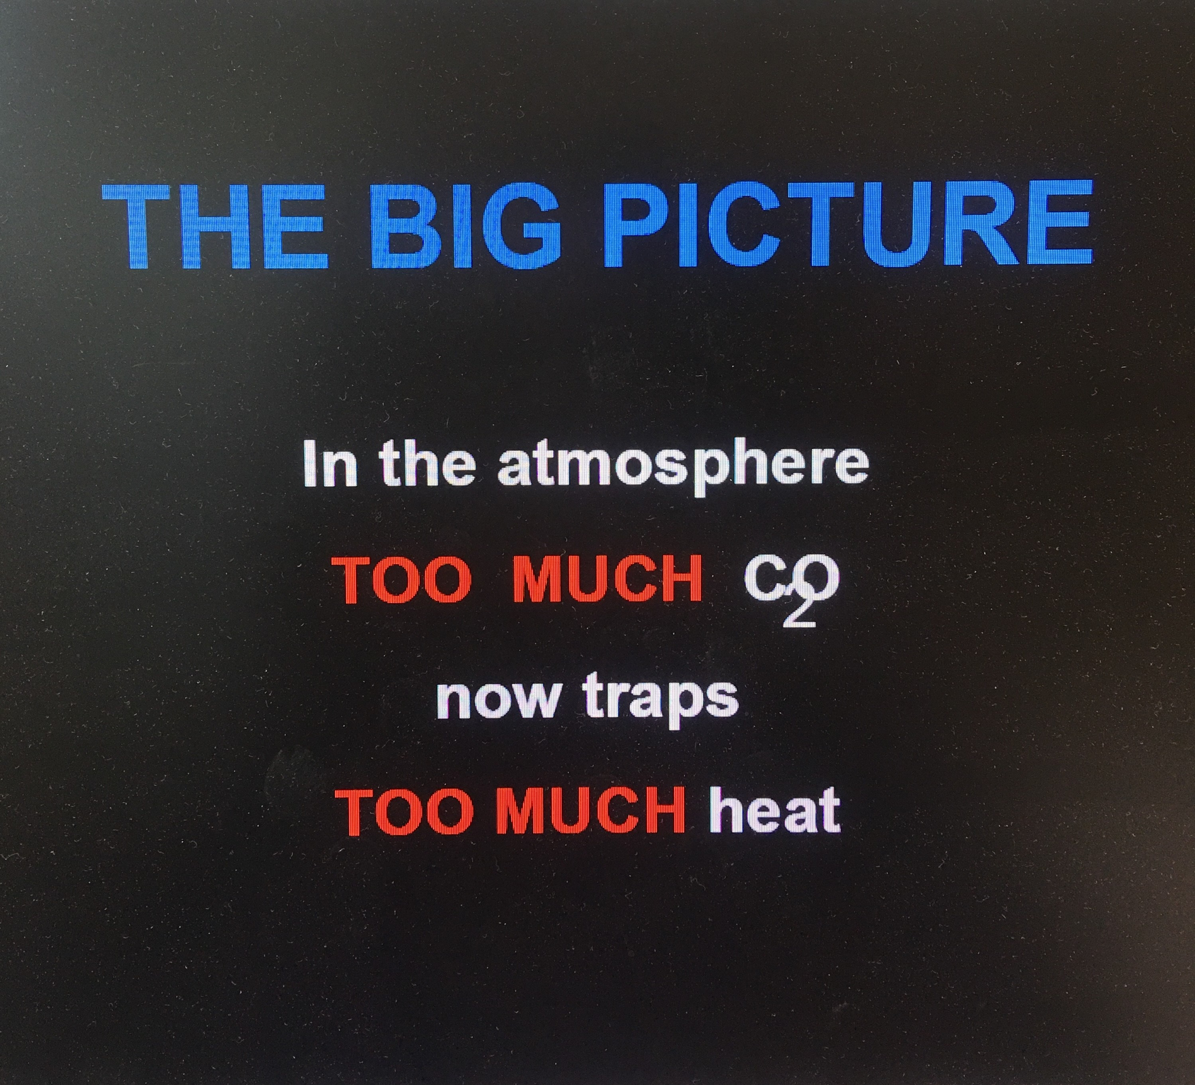

Slide 10
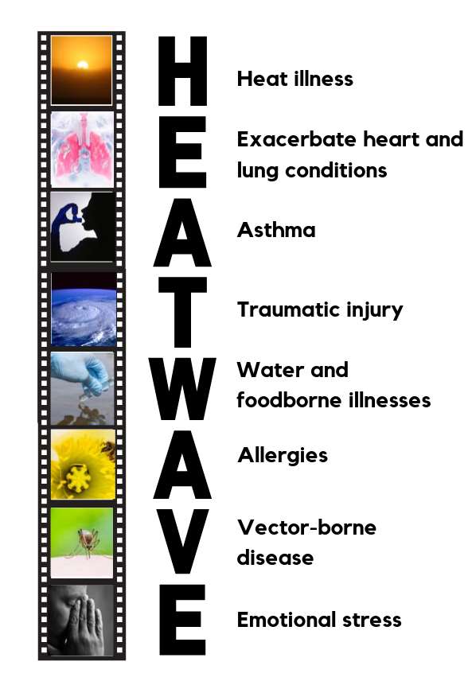
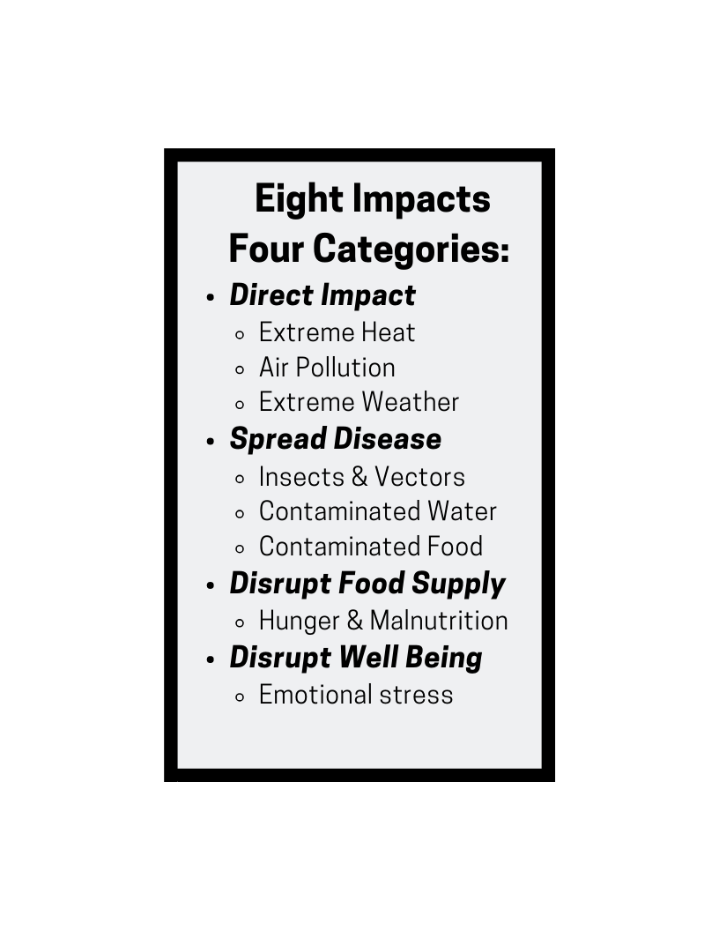
Climate Impacts Health
Notes:
This slide is also an extension of the first message, moving into the part of this talk that gives more specifics about health impacts. Depending on how long you have to talk, the doctor stories here illustrate the health impacts in a way that audiences find fascinating. But if you lack time, the most important is to get in the 5 messages, which can be found on the first text page of the Medical Alert! report. The 2nd message is that these health impacts will worsen if we do not address climate change.
The 3rd message is that we have a way to successfully address climate. Hope is not lost. We can do something about this!
The 4th message is that Clean Energy and Energy efficiency are the route to addressing climate change AND cleaning the air
The 5th and final message is that these solutions will BENEFIT our health. At this point we can quantify how much they will benefit our health and how much $$ they will SAVE!

Slide 11
Some People Face Greater Risk
All people are at risk. Some face greater risk:
Children
Student who play sports
Pregnant women
Elderly individuals
People with chronic illnesses and allergies
People with limited resources
People who work or play outdoors
Notes:
This is an extension of the first evidence based message !! Children and students playing outdoor sports are more exposed to the heat. Pregnant women and their pregnancies are at greater risk from heat and poor air quality, both of which lead to premature delivery. The elderly are at greater risk from heat. People with limited resources often live at the fenceline where they are exposed to danger from the fossil fuel industry and cannot get out of harms way when danger threatens.

Slide 12
Earth’s Warming
We are already at 1.01 degree Celcius (2 degrees Fahrenheit) rise since preindustrial time (1880)” https://www.ipcc.ch/sr15/chapter/chapter-1/
“2 degree Celcius warmer world still represents what scientists characterize as a profoundly disrupted climate with fiercer storms, higher seas, animal and plant extinctions, disappearing coral, melting ice and more people dying from heat, smog and infectious disease. Nature. Com 4/2022

Slide 13
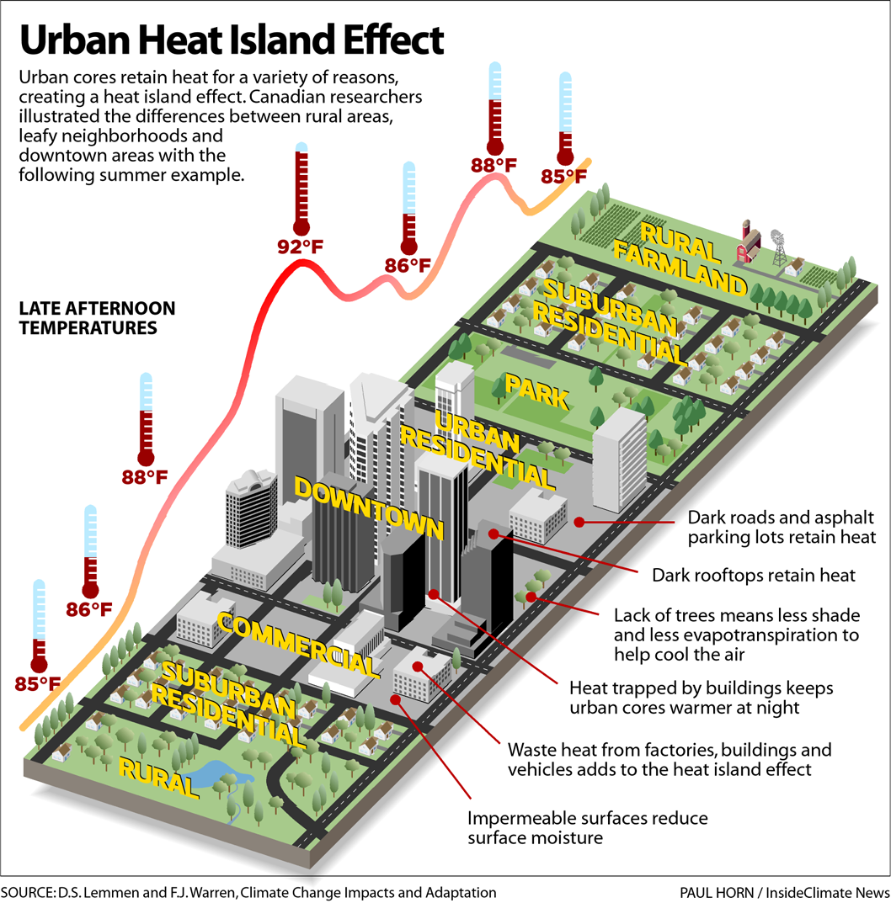

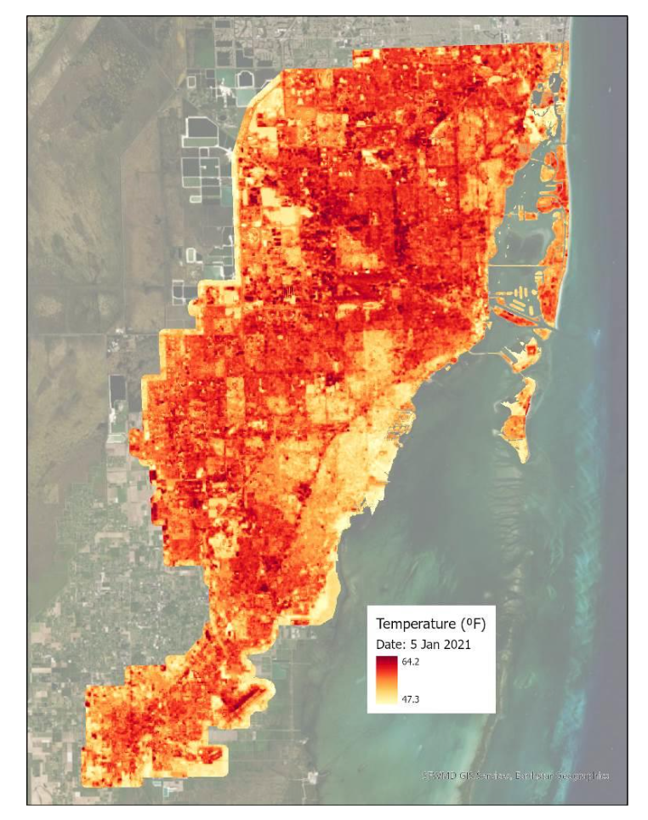
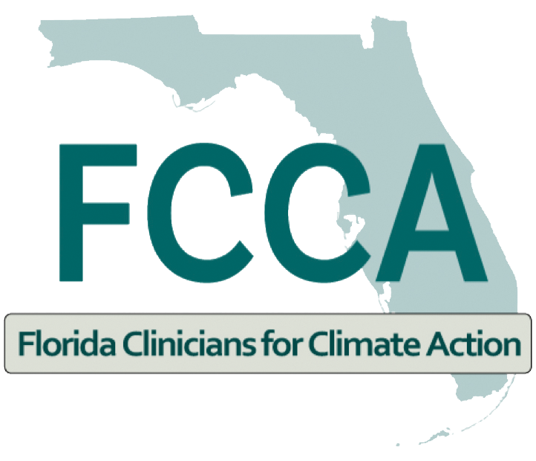

—
Notes:
Buildings, roads, and other infrastructure absorb and re-emit the sun’s heat more than natural landscapes (forests and water). Urban areas, because of the highly concentrated infrastructure and lack of greenery in urban environments, they become “islands” of higher temperatures relative to outlying areas.^{ii} Ambient air temperature can be 5-10 degrees hotter in an urban heat island over the more vegeated or rural areas.
Factors contributing to UHI: reduced natural landscape, urban materials (roofing, cement), spacing and alignment of buildings, Waste heat from vehicles, air-conditioning, industrial facilities)
Due to the urban heat island effect, cities are heating up at a rate twice that of the global average. “Severe heatwaves could affect 13.8% of the world population, or about 1.09 billion people, at least once every five years under 1.5°C of global warming-- a threshold that could be reached as soon as 2030. Under 2°C of global warming, 36.9% of the world population could be affected by severe heatwaves.”^{iii}
UHI’s impact on the economy is largely negative (increased energy consumption, particularly cooling, increased emission of GHGs and other pollutants, decreased water quality, human health and comfort impacts).^{i}

Slide 14
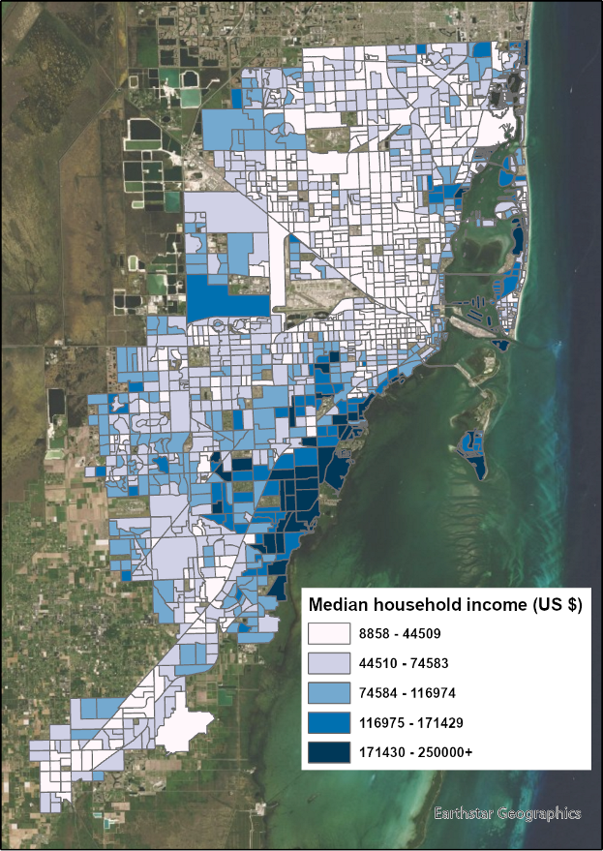
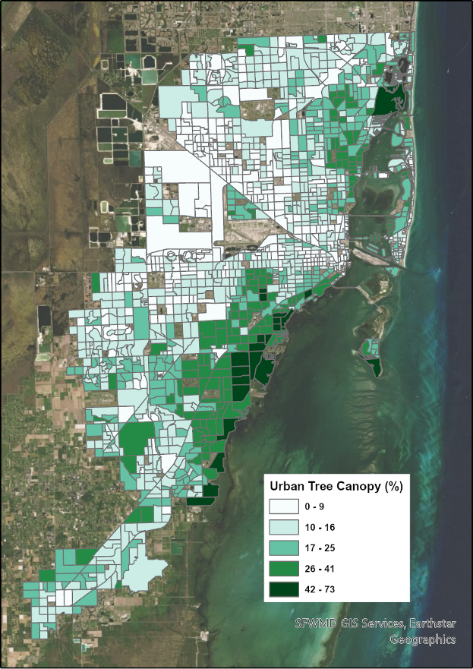
Notes:
The increase in apparent temperatures in our city are not only due to Climate Change but also to our urbanization to development patterns that have led to loss of tree canopy and vegetation and increase of impermeable surfaces.
Median household income and Urban Tree Canopy positive correlation
Equity and tree canopy
Usually urban heat islands are in poorer neighborhoods which have scarce tree canopy. In fact, through a 2016 Urban Tree Canopy Assessment, the County determined that lower-income areas, including predominantly African American and Hispanic neighborhoods, had significantly less tree canopy than their wealthier counterparts.
Benefits of Planting Trees
Reduces air-conditioning costs by providing shade
Improves a home's appearance, which can help to increase a property's real estate value
Provides a natural habitat for wildlife
Lessens flooding by absorbing excess rain water
Removes significant amounts of carbon dioxide from the air, which reduces the impact on climate change

Slide 15
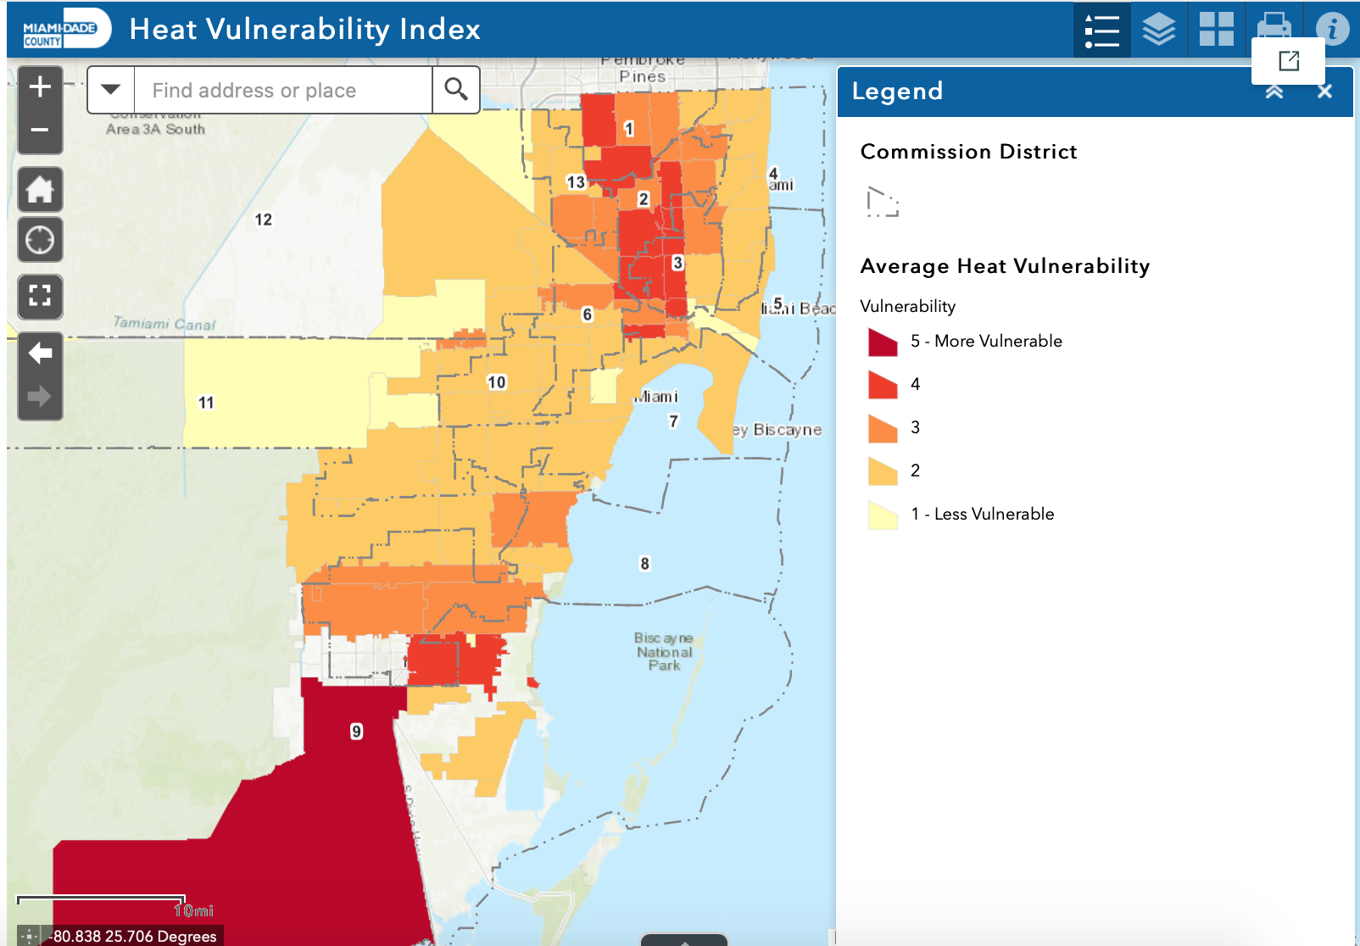
ArcGIS StoryMap: Vulnerability
Interact with the Heat Vulnerability Index web mapping application to identify vulnerable zip codes in Miami-Dade
Homestead, Florida City, Hialeah, Miami, Opa-Locka, and Miami Gardens
** Average of Heat Hospitalization and ER Visit Vulnerability as seen on previous slide

Slide 16
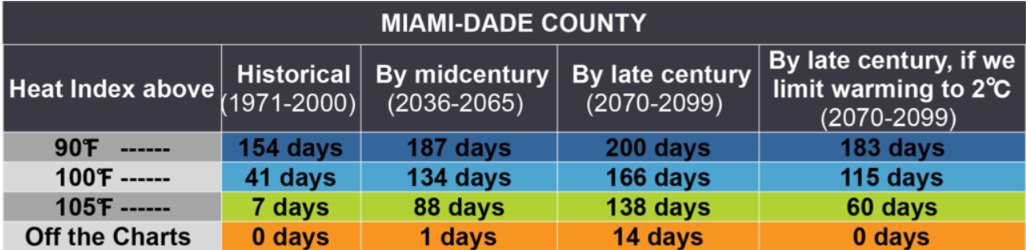
Notes:
And of course in South Florida we have very high average humidity, which makes it more difficult for our bodies to regulate the heat and therefore elevates the heat health related risks. Currently our humidity in the summer averages around 65-70% and so far we're seeing a slight avg increase in humidity over time. So This means that while historically Miami Dade County has experienced an average of 7 days or a week of days with a heat index at or above 105 degrees fahrenheit, by mid century that will likely increase to 88 days or essentially 3 months of days that reach a heat index of 105 or above.

Slide 17
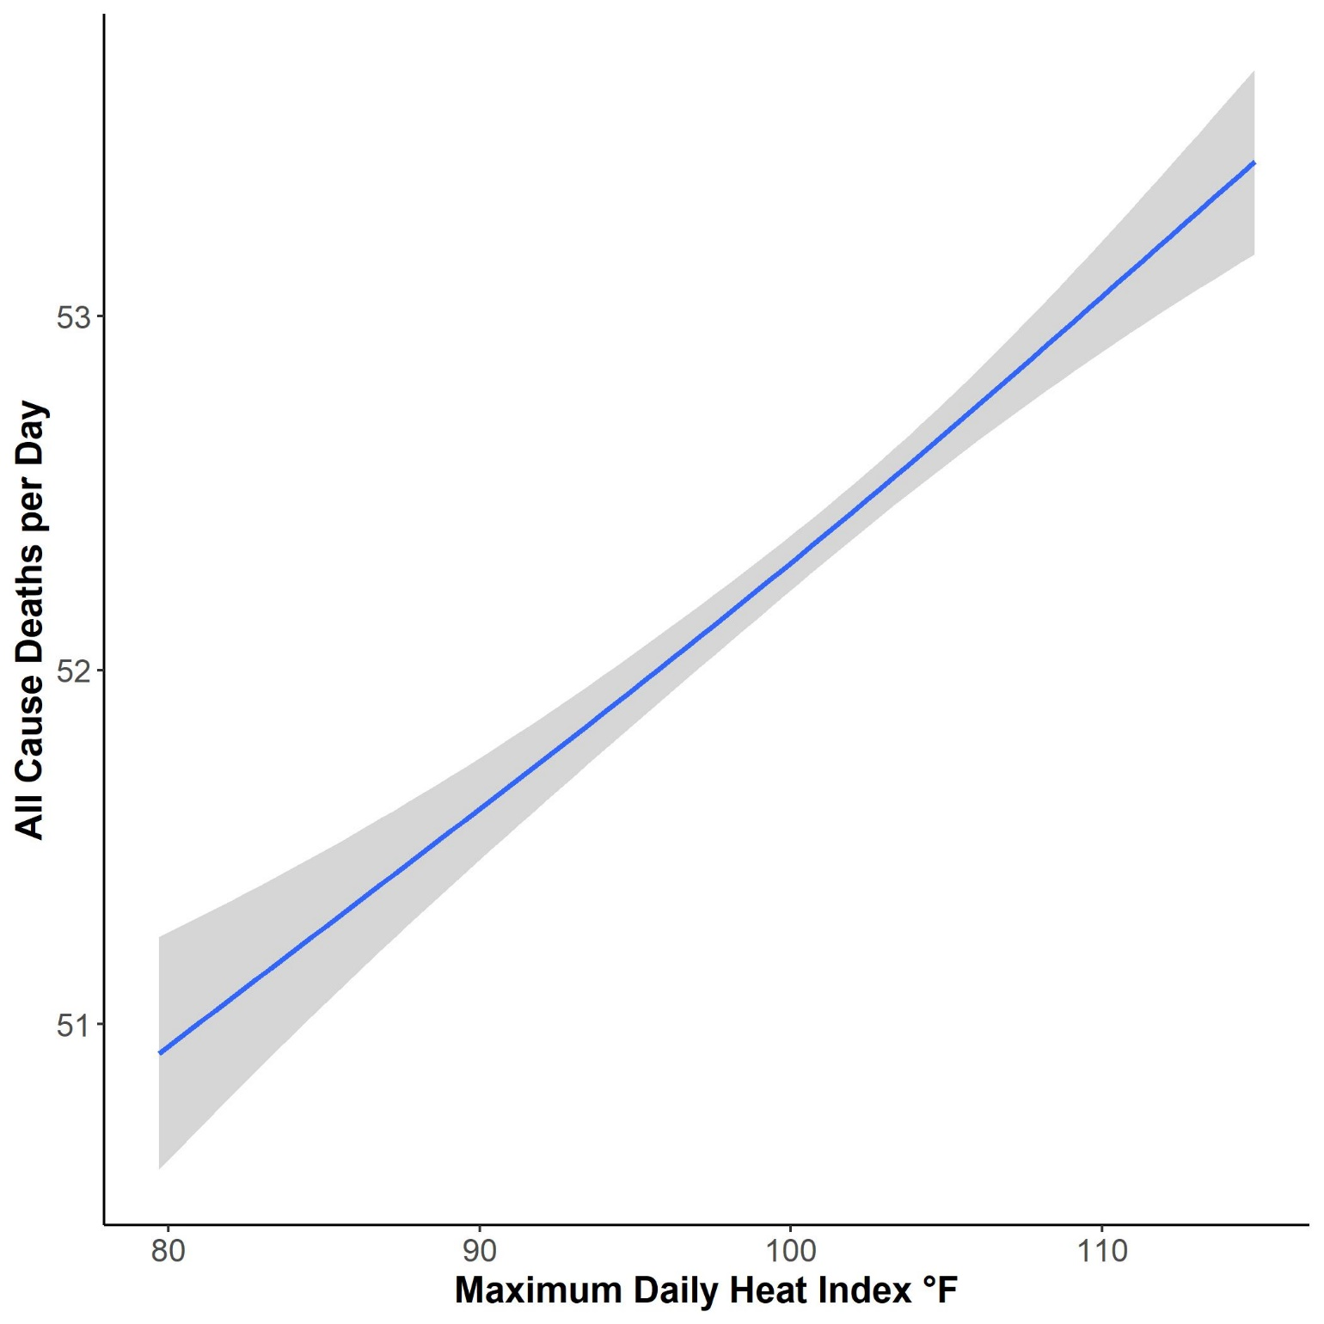

Slide 18
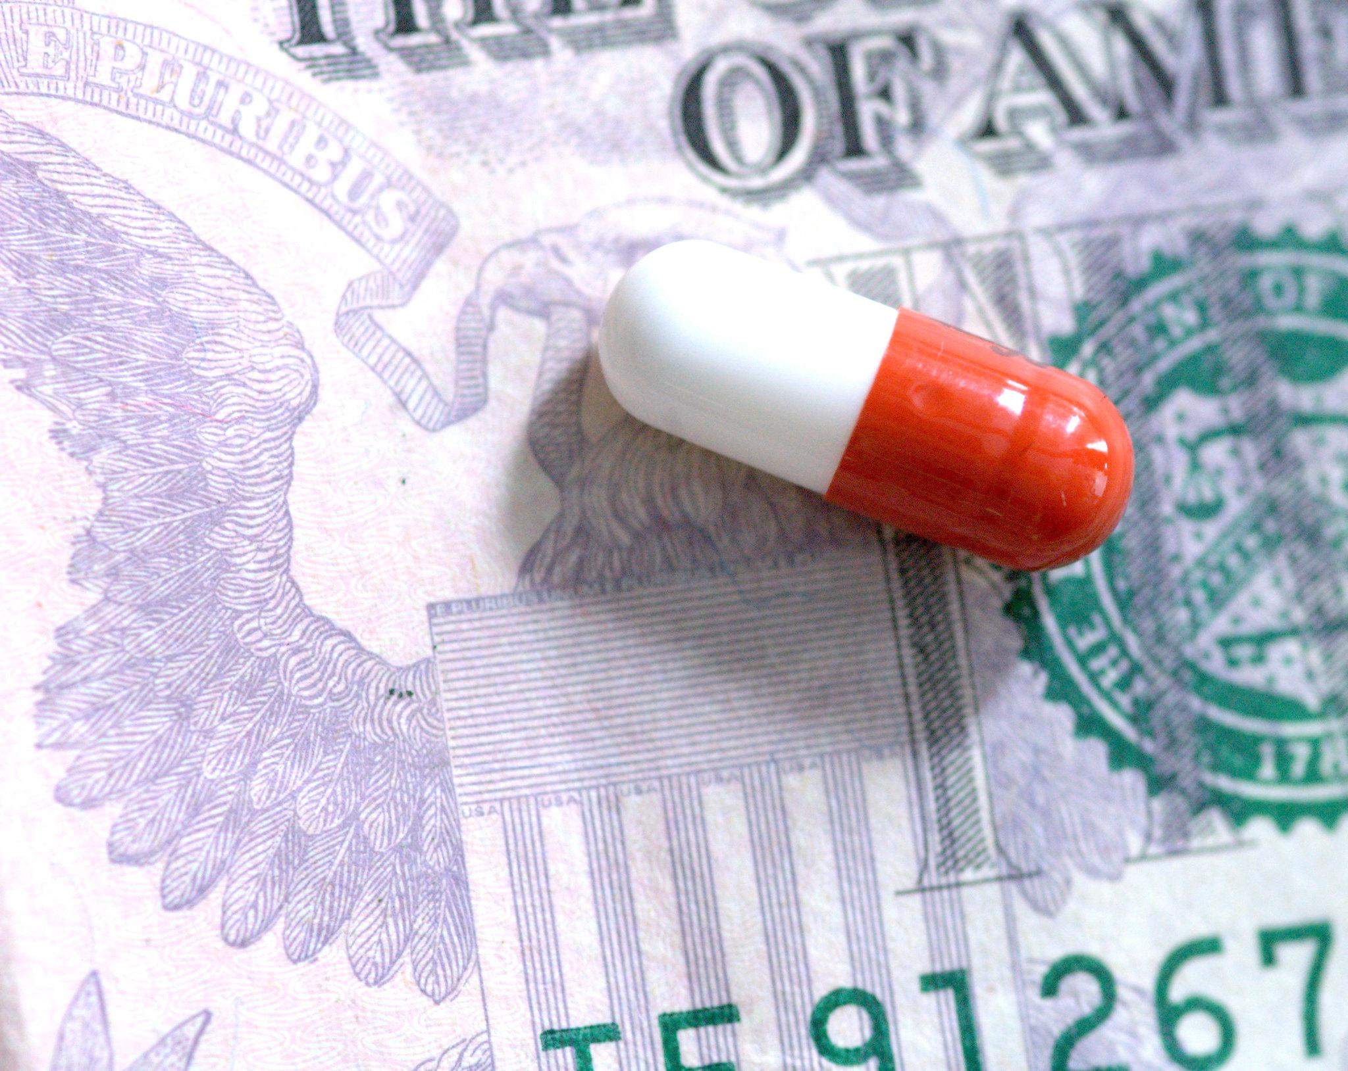
Heat Related Illness Costs
If no action is taken
Hospitalization
$5,017 to $17,047
Emergency Department
$3624 to $5800

Slide 19
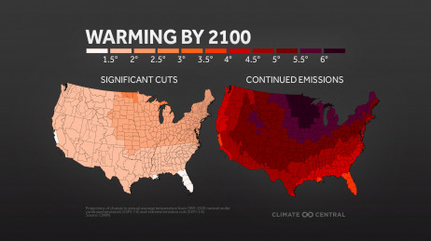
Act Now!

Slide 20

Climate & Heat Health Task Force
Goals reached:
Created workshops to gather info from different stakeholders, community priorities and opportunities
The Task Force will be made up of appointed members representing policy makers, scientific experts, and health care professionals as well as two citizen members who will ensure community voices are heard and lifted up in the formation of the heat plan.
Workshops available at:
https://miamifoundation.org/extremeheat/

Slide 21














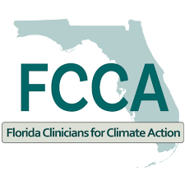






CCCollaboration is a critical asset
Notes:
Communicating extreme heat impacts across our community can save lives and help us build stronger connections between the County, residents, and a variety of community partners. Deepening engagement with existing partners and expanding our networks helps us collaboratively identify, educate, and advance solutions to protect us from extreme heat.

Slide 22
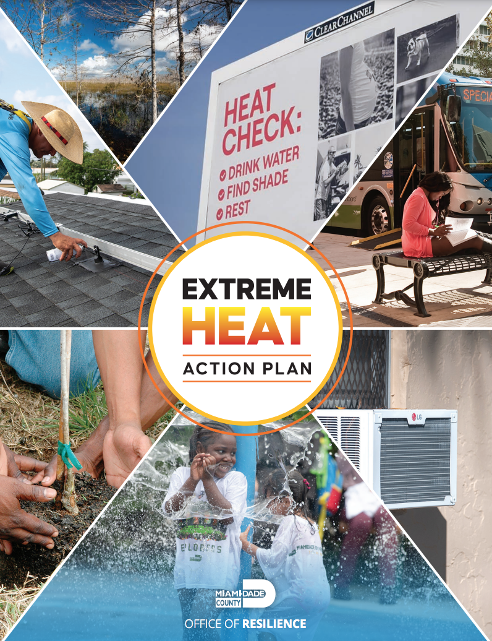



Extreme Heat Action Plan
Goal 1: Inform, Prepare and Protect People
Goal 2: Cool our Homes and Emergency Facilities
Goal 3: Cool our Neighborhoods

Slide 23
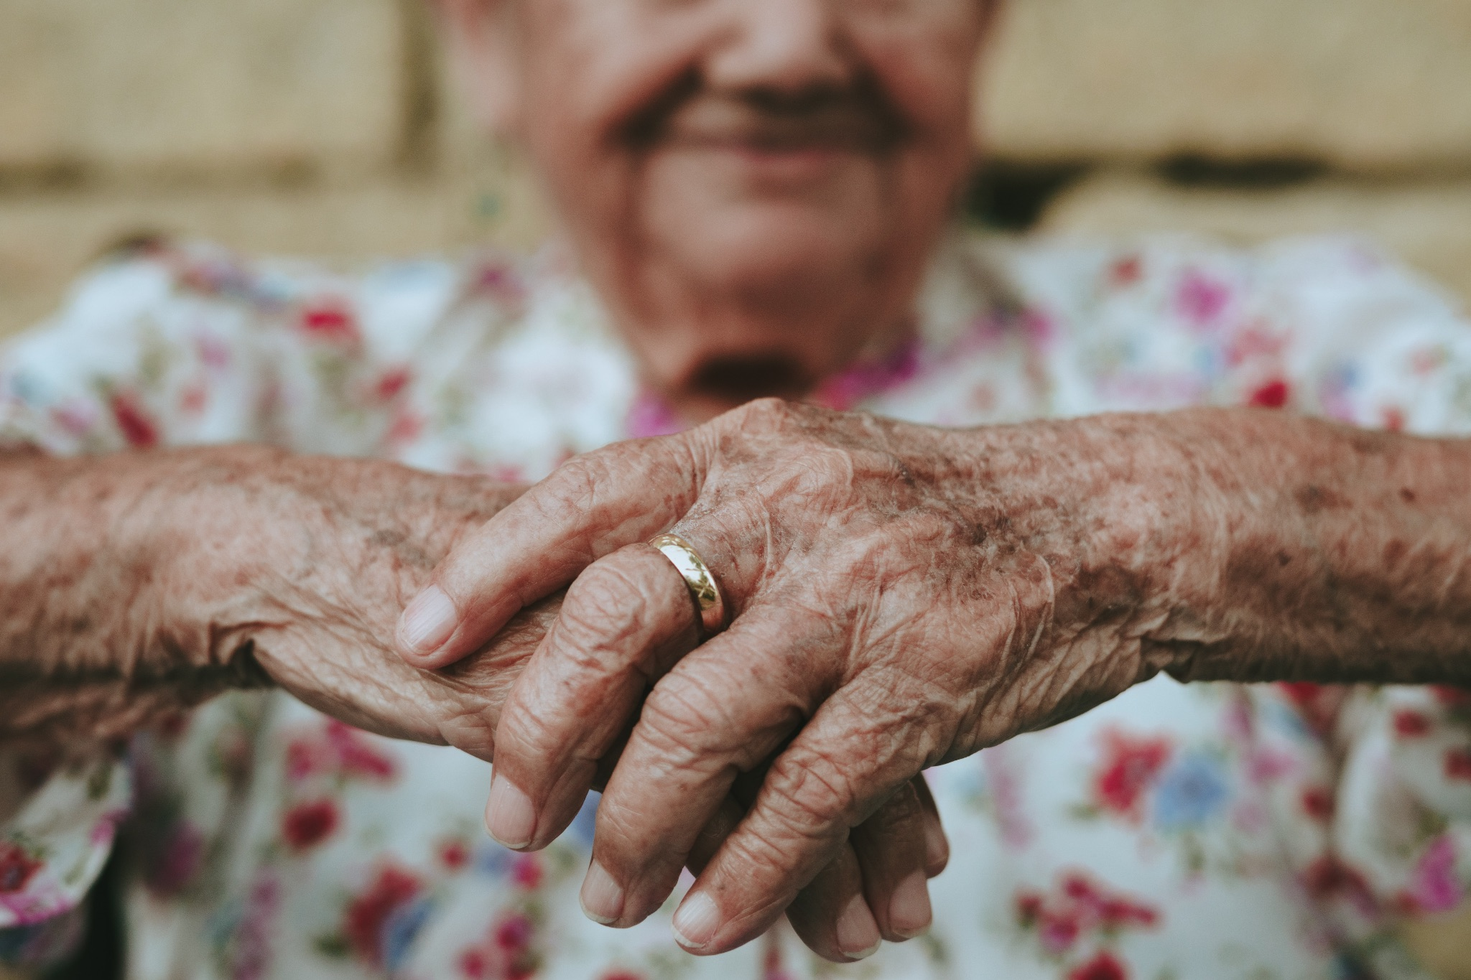



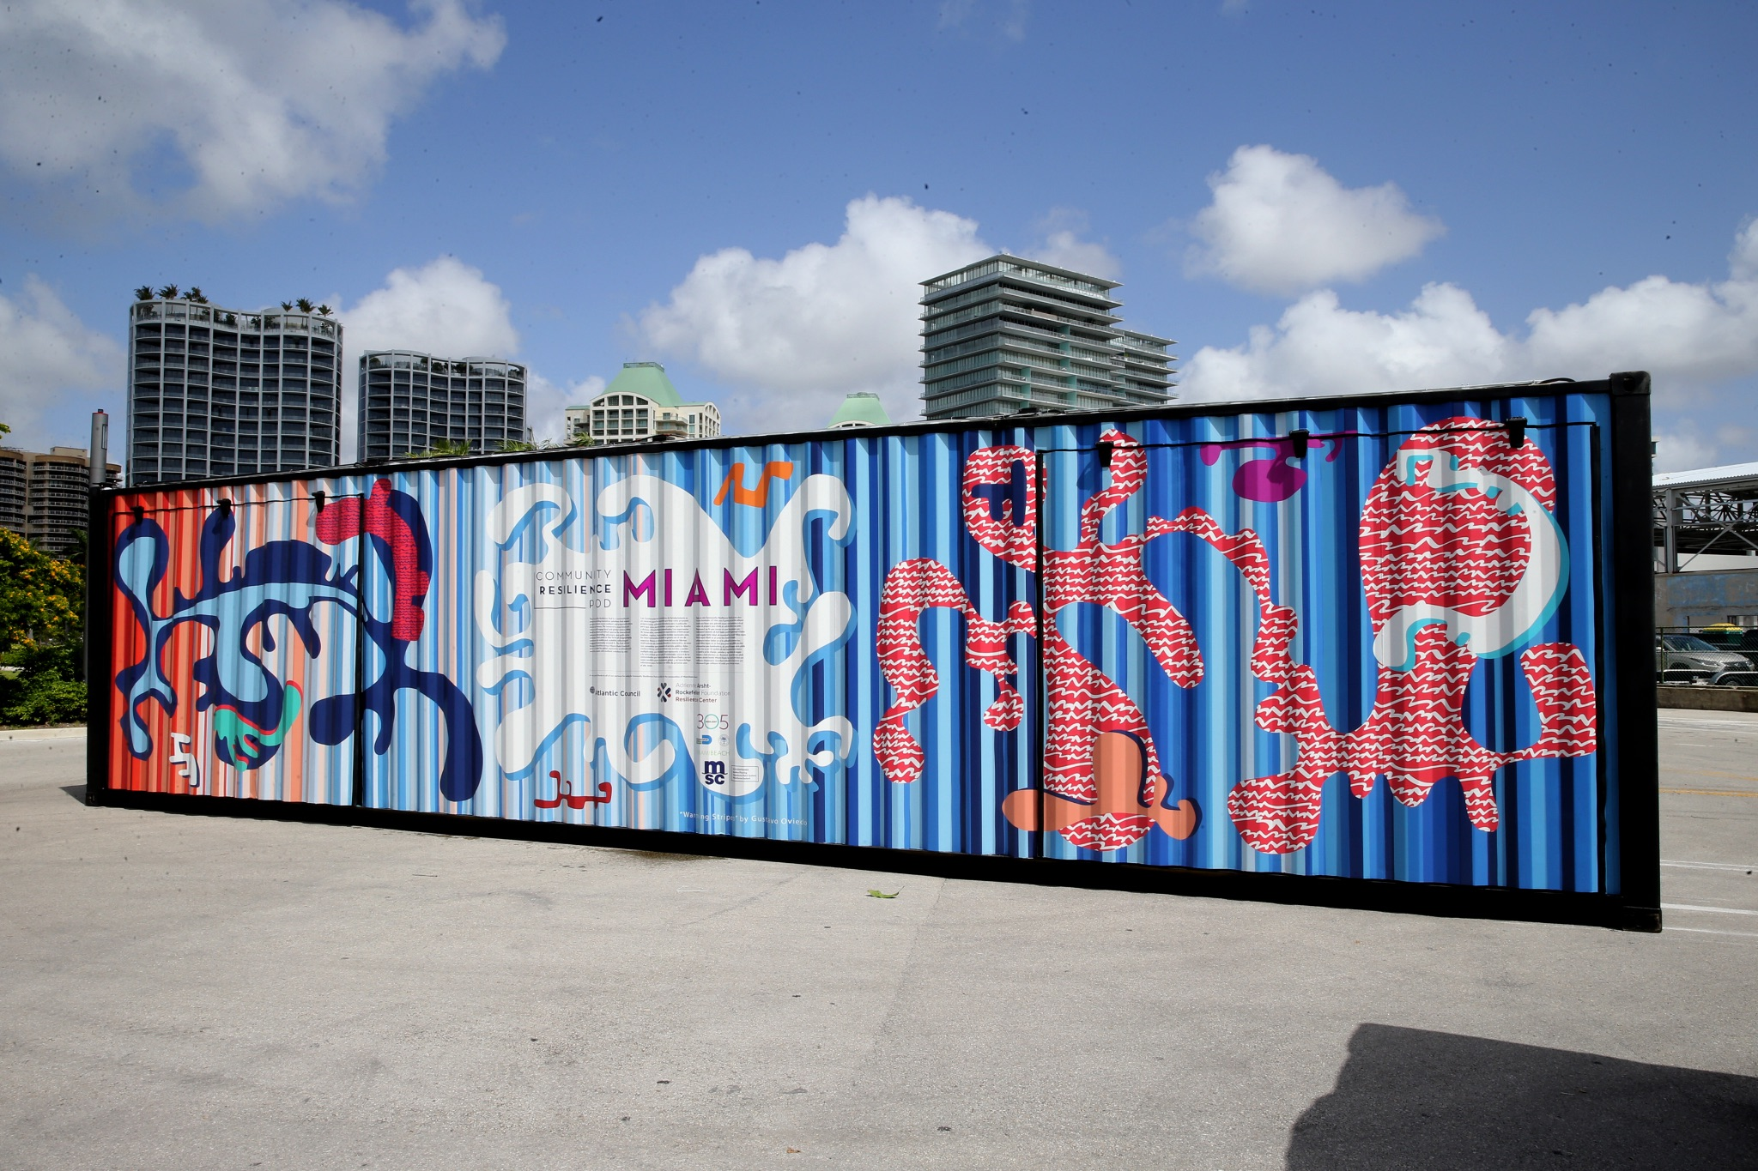
Goal 1: Inform, Prepare and Protect People
Foster healthy and resilient communities by bolstering outreach and education efforts, improving extreme heat warning systems and emergency protocols, protecting outdoor workers and building the capacity of healthcare practitioners to identify and respond to heat vulnerability and illness in their patients.
Build on the Success of the Heat Season Campaign
Enhance Messaging and Protocols
Engage and Support Employers of Outdoor Workers
Seek Worker Protections at all Levels of Government
Engage and Prepare Healthcare Practitioners
Leverage Urban Heat Research Group for Continued Learning
Notes:
https://www.miamidade.gov/parks/library/growing-green-bus-stops.pdf add slide with brochure here

Slide 24

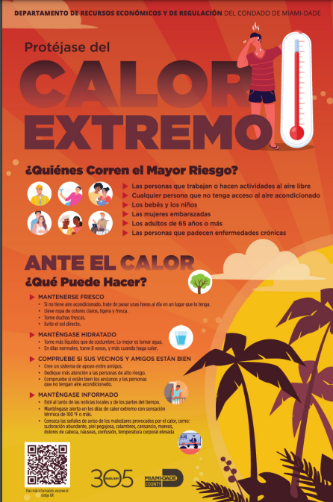
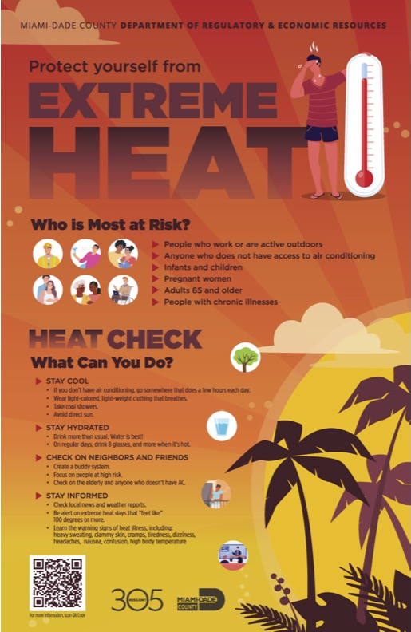

Protect yourself from Extreme Heat Posters
English – Spanish - Creole

Slide 25



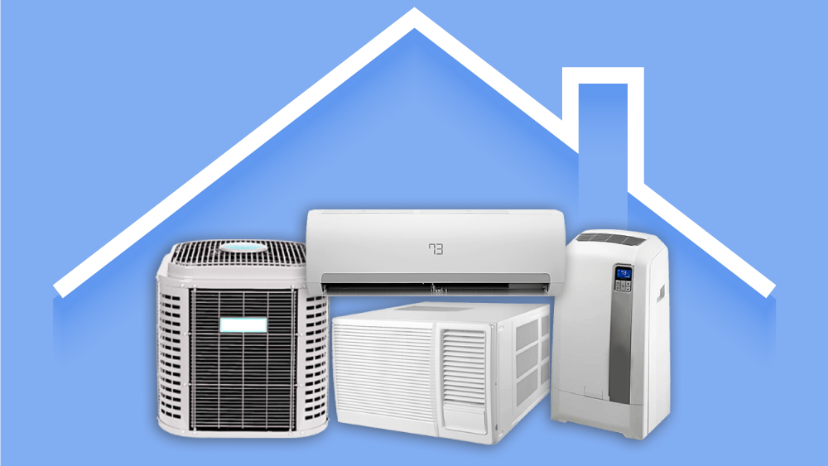
Goal 2: Cool our Homes and Emergency Facilities
Improve access to efficient and reliable cooling in homes and to a place to cool off in the event of a power outage.
7. Seek Increased Support for Efficiency and Cooling Upgrades
8. Advocate for Heat Safe and Affordable Housing Policies
9. Improve Coordination and Expand Outreach on Energy Efficiency
10. Invest in Energy Resilience at Evacuation Shelters
11. Ensure Compliance with Assisted Living/Nursing Home Generator Rule
12. Incorporate Extreme Heat in Countywide Resilience Hub Plan

Slide 26





Goal 3: Cool our Neighborhoods
Reduce the excessive heat burden in urban areas by expanding the tree canopy and vegetation, improving access to water features and shade structures, and cooling our surfaces.
13. Create a Bold Tree Plan
14. Cool our Commutes
15. Cool Our Schools
16. Expand Access to Water and Shade
17. Plant and Protect Trees on County Land
18. Pilot and Scale Cool Pavements
19. Ramp up Engagement and Citizen Science
Notes:
https://www.miamidade.gov/parks/library/growing-green-bus-stops.pdf

Slide 27
Please follow us on Instagram @flclinicians Please follow us on Facebook @Florida Clinicians for Climate Action
Thank You
www.floridaclincians.org

