Slide 1
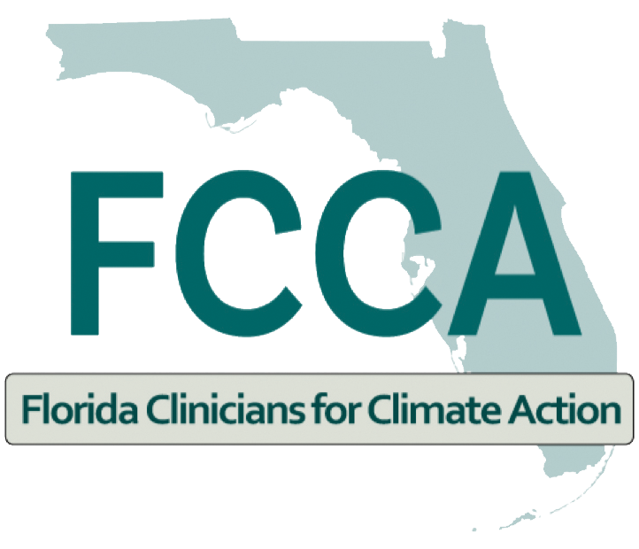
Heat Stress and Heat Illness Prevention CME Series
Climate Change and Transportation: Health Impacts and Solutions
by
Catherine Toms, MD, MPH
October 26, 2023
Notes:
Hi, thanks for joining me for this learning session: Climate Change and Transportation: Health Impacts and Solutions. I am Catherine Toms, a steering committee member for Florida Clinicians for Climate Action and I lead a new nonprofit organization, Green Cars for KIds.

Slide 2

Disclosure
I have no actual or potential conflict of interest in relation to this presentation.
Notes:
I have no actual or potential conflict of interest in relation to this presentation. In the first session of this climate and health series, we introduce you to climate change and its impacts our general patient population. If you would like to review, I refer you to that first session in this BHSF series, or you can scan the QR code on this slideto link to FCCA website with additional information and resources.

Slide 3
Learning Objectives
After participating in this session, attendees should be able to:
1. describe how the transportation sector contributes to carbon pollution
2. explain three ways diesel and gasoline-powered vehicles impact our health
3. list two health benefits of transportation electrification
4. identify three steps clinicians can take to reduce the impact of pollution from transportation

Slide 4
The Problem
Current transportation system is fossil fuel-based
poor air quality
driving global warming that fuels the climate crisis
Notes:
It is important to remember there is scientific consensus that the burning of fossil fuels (coal, gas and oil) releases GHGs into our atmosphere thereby rasing air and ocean temperatures globally. It’s the primary driver of the climate crisis. A literature search done by Cornell University in 2021 found that 99% of scientists agree that anthropogenic activity has warmed our atmosphere, oceans, and land. Our current transportation system is fossil fuels-based which is responsible for poor air quality in cities across the us and internationally. Because the burning of fossil fuels like gasoline, diesel, natural gas and coal is the primary driver of the increase in greenhouse gases fueling the climate crisis and extreme heat, we need to rapidly transition our economy from fossil fuel-bassed to clean 21st century renewable energy sourced. But how?

Slide 5
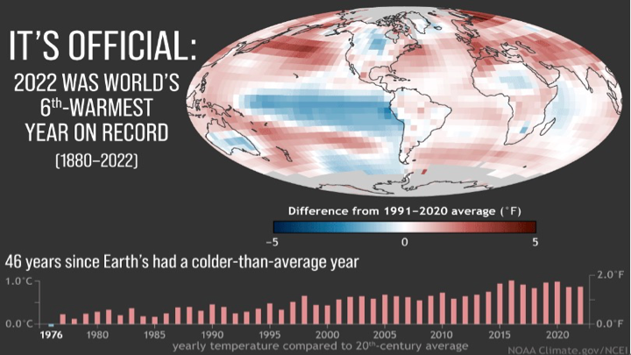
Notes:
What is the problem?: It’s getting hotter- globally and locally. We are seeing warmer, wetter weather as our atmosphere traps more CO₂ and other GHGs. This graph shows global temperatures compared to the 20th-century average each year from 2022 (right) back to 1976 (left)–the last year the world was cooler than average. 2022 was the 6th warmest year since modern record-keeping began in 1880.- with 2016 and 2020 tying for the hottest years on record. The past 8 years have been the warmest of the last 140 years.The month of July broke world tempature records and so far, 2023 is Miami’s hottest year ever. Each decade since the 1980s is hotter than the previous one, and meteorologists predict even hotter temperatures in the coming decades if we don’t do something about it.
https://www.miamiherald.com/news/local/environment/climate-change/article277020973.html#storylink=cpy
Source: NOAA Climate.gov image, based on data from NOAA NCEI. (NOAA Climate.gov, using NOAA NCEI data).

Slide 6
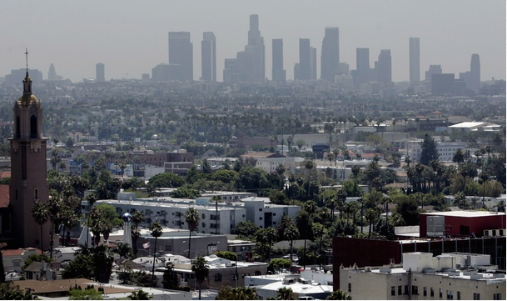
Notes:
So let’s look at Air Pollution: According to the Amer. Lung Assn.'s 2023 State of the Air Report, cities stretching from Fairbanks, Alaska to Augusta, Georgia are polluted with unacceptable levels ground level ozone and particle pollution- California’s cities are especially burdened. More than 1 in 3 Americans live in places with unhealthy levels of air pollution.—119.6 million people—are living in places with failing grades for unhealthy levels of particle pollution or ozone (only two of the primary air pollutants caused by the burning of fossil fuels). There are disparities- people of color are 3.7 x more likely than whites to live in a county with failing grades.
https://www.lung.org/research/sota/city-rankings/most-polluted-cities
https://www.lung.org/research/sota

Slide 7
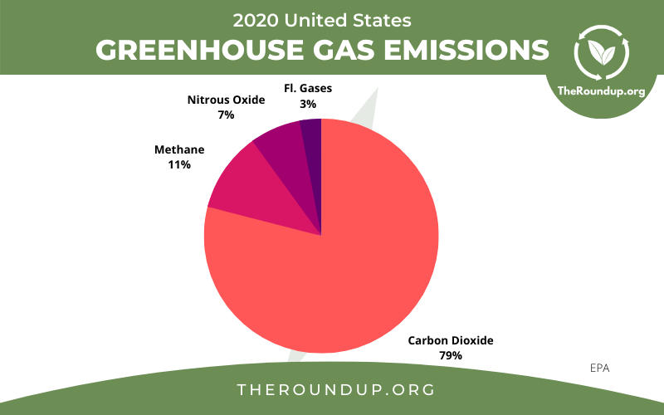
Notes:
What are the main GHG warming our atmosphere? Carbon Dioxide/ CO2 is the most common greenhouse gas. The EPA estimates that carbon dioxide accounts for around 79% of GHG emissions caused by human activity, and the combustion of fossil fuels like gasoline-powered car engines is the primary cause of anthropogenic atmospheric CO2. While it is not the most potent gas, the volume of CO2 means it does the most damage, currently accounting for 66% of the effects of climate change. So, how are we adding all this CO2 to the atmosphere?

Slide 8
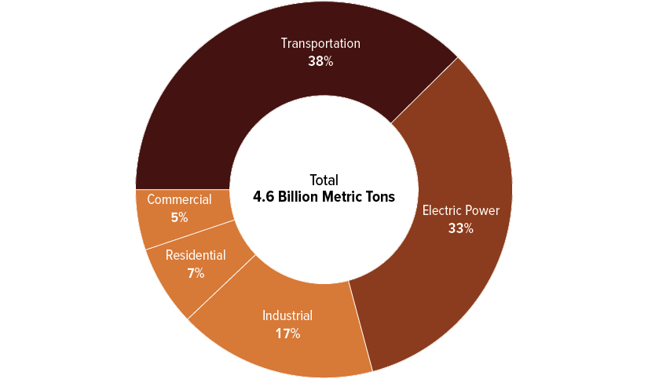
Shares of Energy-Related Emissions of Carbon Dioxide by Economic Sector, 2021
-Congressional Budget Office
www.cbo.gov/publication/58566.
Notes:
When you break down the total CO₂ emissions in the US by sector, transportation is the largest source of greenhouse gas (GHG) emissions in the U.S.(38%) and 81% of passenger-miles traveled are made with personal vehicles.

Slide 9
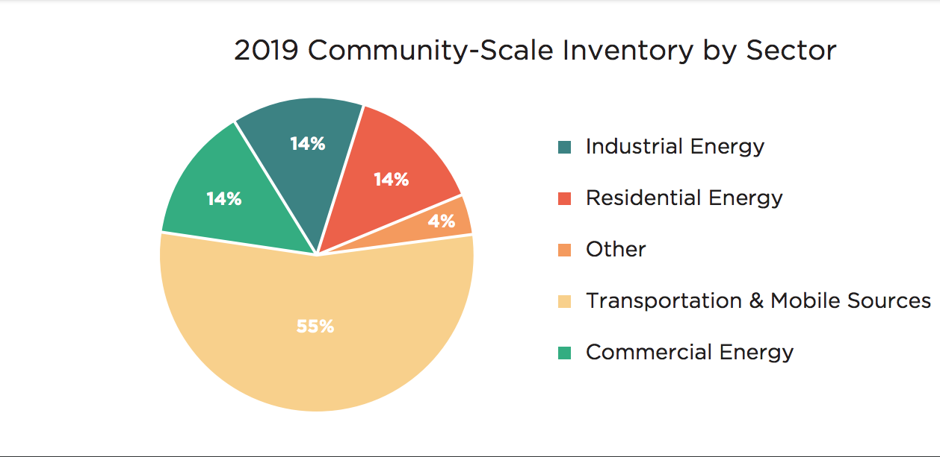
Miami-Dade County Community Scale Emissions
Source: Miami-Dade County’s 2019 Community-Scale greenhouse gas (GHG) emissions inventory
Notes:
The latest data from the US Energy and Information Agency show that 50% of Florida’s total GHG emissions come from transportation. The transportation sector accounted for 55% of MDC's Greenhouse Gas Emissions (GHG) according to the county's last emissions inventory.

Slide 10
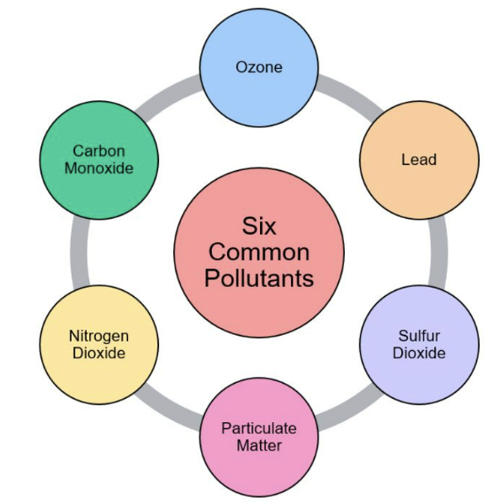
Criteria Air Pollutants
Image credit: My NASA Data
Notes:
A typical passenger vehicle emits about 4.6 metric tons of carbon dioxide per year which is equivalent to the carbon capture of 180 trees. This number can vary based on type of the vehicle's fuel, fuel economy, and the number of miles driven per year. Diesel creates more Co2 than regular gasoline. But CO2 isn’t the only pollutant. Studies have linked pollutants from vehicle exhaust to adverse impacts on almost every organ system in the body. Automobile exhaust can cause myocardial infarction and strokes, metabolic disorders, asthma attacks, preterm birth and lowbirth weight, worsening of COPD, impaired cognitive functioning, lung cancer, premature death. The EPA has identified six pollutants as “criteria” air pollutants. These are carbon monoxide, ground level ozone, lead, sulfur dioxide, particulate matter and nitrogen oxides (NO2).

Slide 11
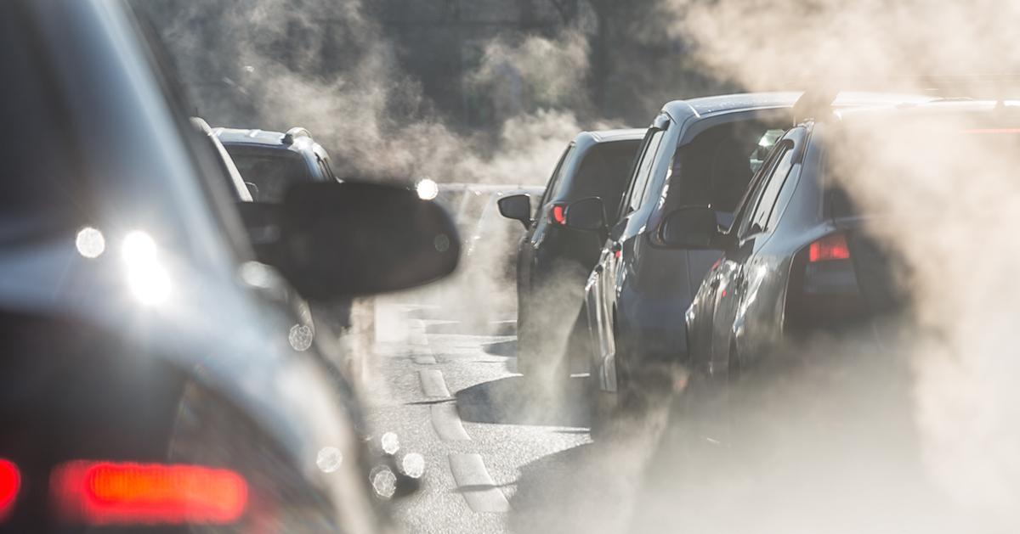
SOURCE: ISTOCK
Notes:
Carbon Monoxide(CO) is an odorless, colorless, and poisonous gas. 84% of CO is produced from anthropogenic sources via the incomplete combustion of fossil fuels-particularly from cars and trucks. Catalytic converters have helped reduce CO emissions. When inhaled, CO impairs normal respiratory function of cells. CO irreversibly binds to hemoglobin, resulting in cellular respiratory dysfunction, the cardiovascular, nervous, and respiratory systems are most impacted by Carbon monoxide. High concentrations of inhaled CO leads to dizziness, confusion, chest pain & shortness of breath, nausea & vomiting, unconciousness, and death. People with heart disease are particularly vulnerable to CO poisoning especially when exerciseing or under stress.

Slide 12
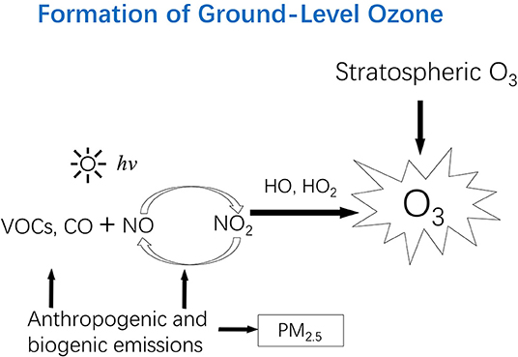
Citation: Zhang Junfeng (Jim), Wei Yongjie, Fang Zhangfu. Ozone Pollution: A Major Health Hazard Worldwide. Frontiers in Immunology DOI=10.3389/fimmu.2019.02518
Notes:
Ground-level ozone is a colorless and highly irritating gas that forms just above the earth's surface. It is called a "secondary" pollutant because it is produced when two primary pollutants react in sunlight and air. These two primary pollutants are nitrogen oxides (NOx) and volatile organic compounds (VOCs). Heat & sunlight catalize this reaction thus creating more ground-level ozone in the summer.
When Ozone(O3) is inhaled, it causes inflammation in lung eithelium and exacerbates asthma emphysema, bronchitis, & COPD). Exceeding the WHO’s ozone limit is also associated with substantial increases in hospital admissions for heart attack, heart failure and stroke, especially for older adults. Inhaled PM and ozone impact the CNS primarily by inducing systemic inflammation and damaging the blood-brain barrier and may accelerate cognitive decline during the initial stages of dementia development. The ozone precursers,VOCs, include benzene, 1,3-butadiene, and acetaldehyde — are known to have acute and chronic effects to the CNS, respiratory, CV, and reproductive systems and suppress hematopoiesis. The EPA has classified benzene and 1,3-butadiene as known human carcinogen for all routes of exposure and are linked to leucemia. Acetaldehyde is classified as a possible carcinogen especially to the upper respiratory tract.
========================
https://www.ucsusa.org/resources/cars-trucks-buses-and-air-pollution
https://www.epa.gov/sites/default/files/2016-09/documents/benzene.pdf

Slide 13
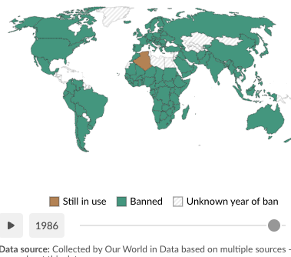
The US phase out of leaded gasoline for on-road vehicles sparked a global ban.
Algeria was the final country to do so in 2021.
Notes:
Lead is one of the six criteria air pollutants and is toxic to humans even in trace amounts. The removal of lead from gasoline has resulted in a 98% decrease of lead in our air since the beginning of its phase out in the 1970s with the Clean Air Act. Unleaded gasoline is not available for on-road vehicles but is still used for farm equipment, race cars, marine engines, and aviation fuel. Lead phase out of gasoline is a success story-and a prime example of the power of regulation to reduce our environmental impact. The Clean Air Act continues to protect public health by seting standards for other airpollutants (CO, Nox and other hydrocarbons) and tighter regulation should be supported by health professional individuals & organizations. Formaldehyde

Slide 14
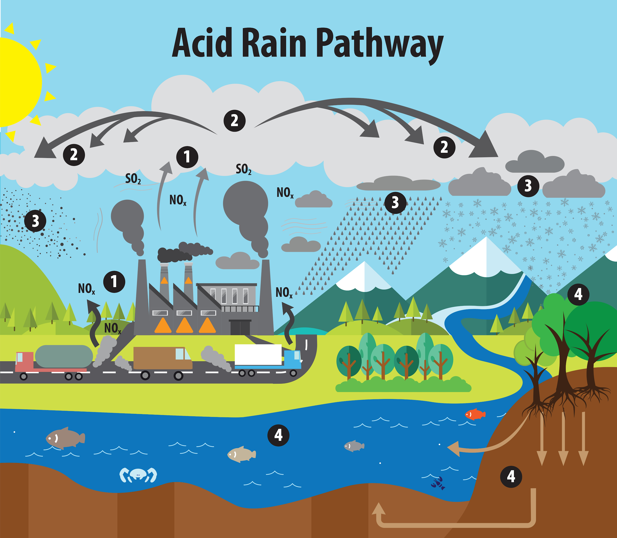
Source: EPA, https://www.epa.gov/acidrain/what-acid-rain
Notes:
Sulfur dixoide is also an element of smog from automobile, marine vessels, and aircraft exhaust. Sulfur dioxide is a colorless, poisonous gas with an odor that smells like rotten eggs/burnt matches. It causes irritation to the eyes, nose, and throat. It causes bronchial constriction, wheezing and coughing. Sulfur dioxide has been associated with increased ER admission for wheezing in children, and decreased lung function tests and increased methhemoglibin in adults who inhaled SO2 in the workplace. Together with NOx, So2 forms acid rain when combined with oxygen and water in our atmosphere. Acid rain is damaging to fish, wildlife, trees, and vegetation.

Slide 15
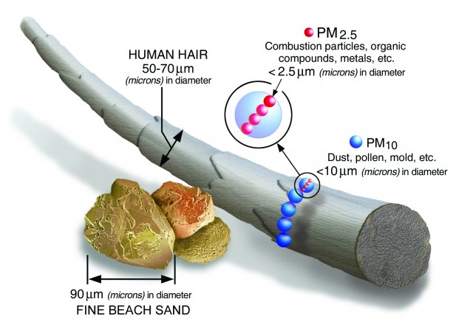
Impact of PM
premature death in people with preexisting CV and pulmonary disease
nonfatal myocardial infarctions
arrythmias
asthma exacerbation
decreased pulmonary function
increased respiratory symptoms.
Source: https://www.epa.gov/pm-pollution/particulate-matter-pm-basics
Notes:
Particulate matter (also called particle pollution) is a mixture of solid particles and liquid droplets found in the air. The larger particles, PM₁₀ are roughly one-tenth the diameter of a human hair. Particulate matter is responsible for almost 48,000 premature deaths in the United States every year. They pose a serious threat to human health, because they can penetrate deep into the lungs and cause endothelial damage. But the smallest type of particulate matter, PM2.5, has a diameter of less than 2.5 µg and is the most dangerous type because it can pass across the alveolar-capillary barrier into the blood stream The soot in vehicle exhaust and the haze we see in cities is PM2.5 also referred to as fine particulate matter. PM can be a primary pollutant or a secondary pollutant created from chemical reactions with hydrocarbons like methane, nitrogen oxides, and sulfur dioxides. Numerous scientific studies have linked particle pollution exposure to pulmonary and cardiovascular disease including:
premature death in people with preexisting CV and pulmonary disease
nonfatal myocardial infarctions
arrythmias
Asthma exacerbation
decreased pulmonary function
increased respiratory symptoms.
Patients with pre-existing CV and pulmonary illness, children(including increased infant mortality and increase hospital admission for childhood asthma), and older adults are the most vulnerable to particle pollution exposure. A study o68.5 million Medicare-enrolled adults found a 6-8% increase in risk of all-cause mortality for every 10µg/m3 increase in PM2.5. Research has shown that reducing particle pollution improves respiratory health in children and adults.

Slide 16
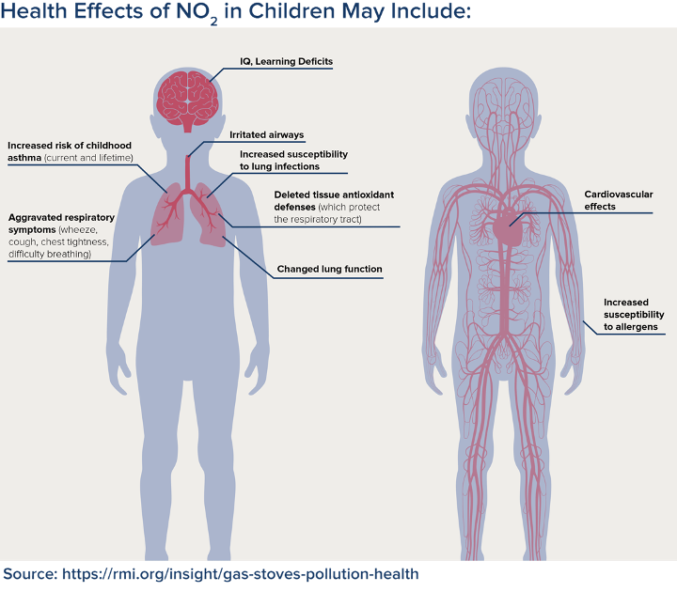
Notes:
Nitrogen oxides (Nitrogen dioxide and Nitrogen oxide (NO). are secondary pollutants forming ground level ozone and particulate matter. But they are also harmful as a primary pollutant. Transportation emits more than half of nitrogen oxides in our air and direct emissions from on-road vehicles alone accounted for about 33% of the nation’s total nitrogen oxides. NOx can cause lung irritation and weaken the body's defenses against respiratory infections such as pneumonia and influenza. NOx short term exposure is known to exacerbate asthma and has been associated with an increase in asthma-related hospital and ED admissions and is associated with an increased incidence of asthma.

Slide 17
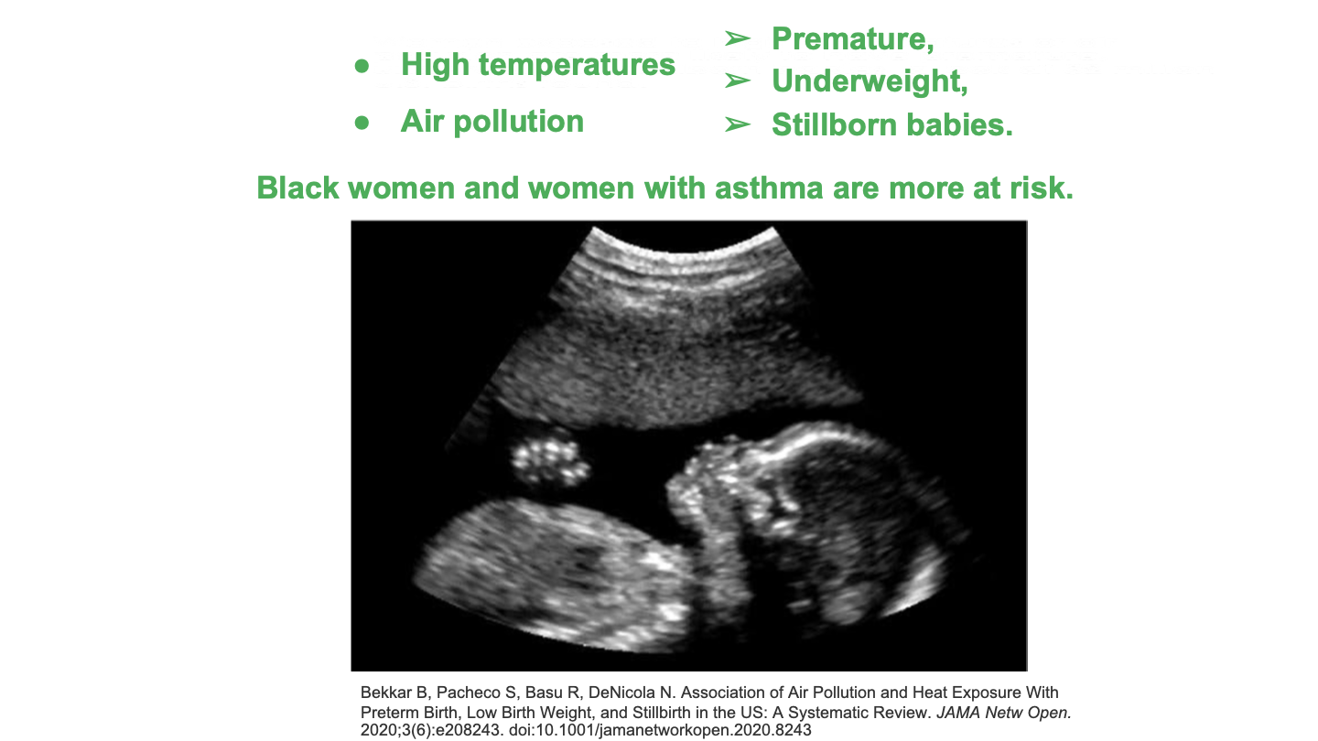
Notes:
A landmark study of over 32 million U.S. births published in 2020, found an association between prenatal exposure to high temperatures or air pollution and premature birth, LBW, and stillbirth. The results show that not all women are impacted equally: the associations were strongest among black women and women with asthma. Pre- and Postnatal exposures to air pollutants increase the risk of respiratory disease in children by impairing lung function at birth, impacting somatic growth and delaying development of the immune system. Children exposed before and after birth to higher levels of air pollution have increased incidence of acute respiratory illnesses and pneumonia, asthma and higher incidence of COPD later in life.
Bekkar B, Pacheco S, Basu R, DeNicola N. Association of Air Pollution and Heat Exposure With Preterm Birth, Low Birth Weight, and Stillbirth in the US: A Systematic Review. JAMA Netw Open. 2020;3(6):e208243. doi:10.1001/jamanetworkopen.2020.8243
SIv PD and Bush. A. Environmental Contributions to respirator disease in children. Kendia and Wilmott's Disorders of the respiratory tract in children. 2024

Slide 18
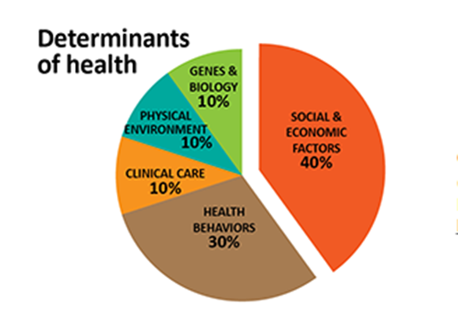
Climate Change, Health, and Equity
Tarlov AR. Public policy frameworks for improving population health. Ann N.Y Acad Sci 1999; 896: 281-93.
Notes:
So, while environmental pollution and climate change harms us all, it does not impact everyone equally. The harms fall disproportionately on black and brown communities first and worst. Why is this? Research tells us that the zip code where we live often has a greater effect on our health than our genetic code or the quality of clinical care we receive. Who has a better chance of good health: the person who lives in a clean, safe environment, or one who’s neighborhood is burdened with high rates of unemployment, violent crime, and exposure to environmental pollution? The evidence shows that 40% of our health and well-being is the result of positive or negative social and economic factors.

Slide 19
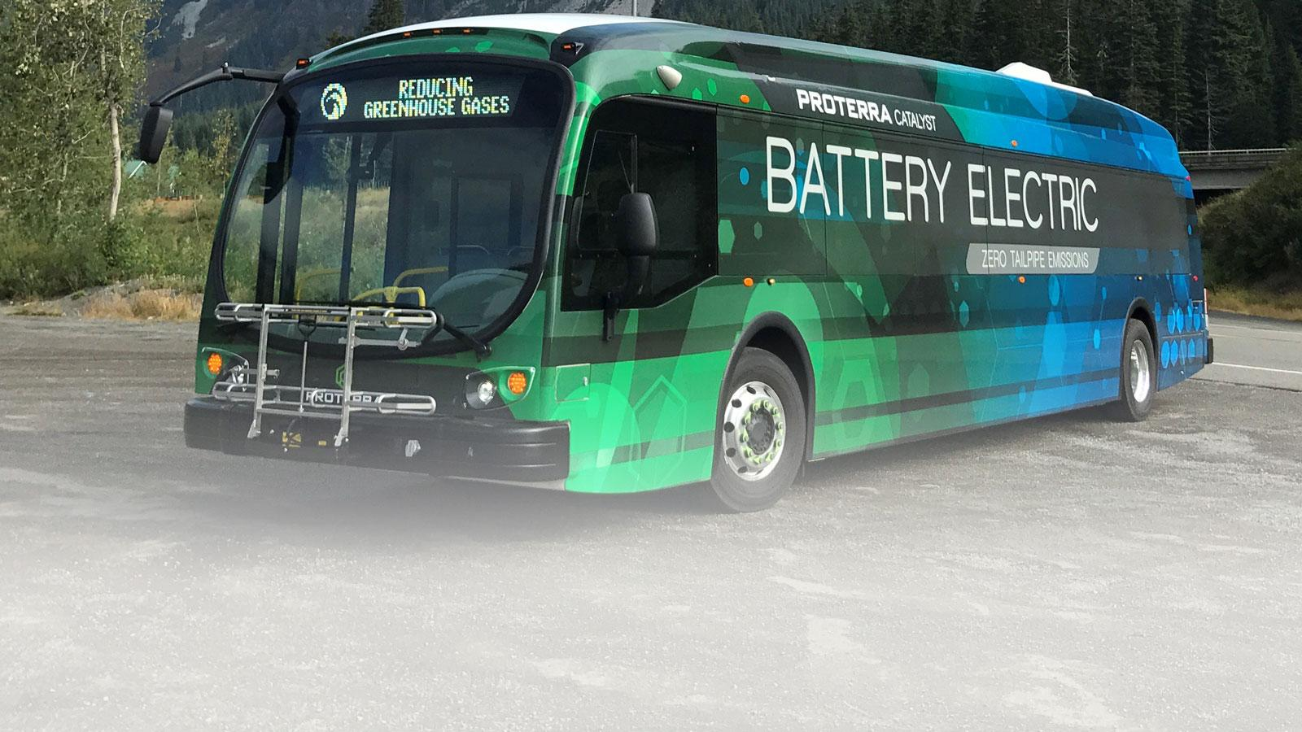
Notes:
These factors are known as Social Determinants of Health, but a growing body of health professionals are referring to them as social risk factors or social influencers of health. They include things like housing, income, access to healthcare and TRANSPORTATION.
Regardless of insurance, 4 percent of patients, including 3 million children, miss a healthcare visit each year due to unavailable transportation. -This includes 9 percent of children in families with an annual income of less than $50,000. There was a study done for Nicklaus Children’s Health System, which serves children in 6 counties in South Florida. The Study found that over 73,000 children in Miami-Dade County and 47,000 in Broward County faced barriers to healthcare due to a lack of transportation annually. So not only does the environmental pollution from transportation harm low income and communities of color more due to things like living in close proximity to roadways and urban heat islands, those same neighborhoods often have poor access to reliable transportation. So any plan to electrify transportation must be equitable and include these historically marginalized populations.
ref:
http://www.hpoe.org/Reports-HPOE/2017/sdoh-transportation-role-of-hospitals.pdf
https://www.nicklauschildrens.org/patient-resources/community-outreach/community-health-needs-assessment

Slide 20
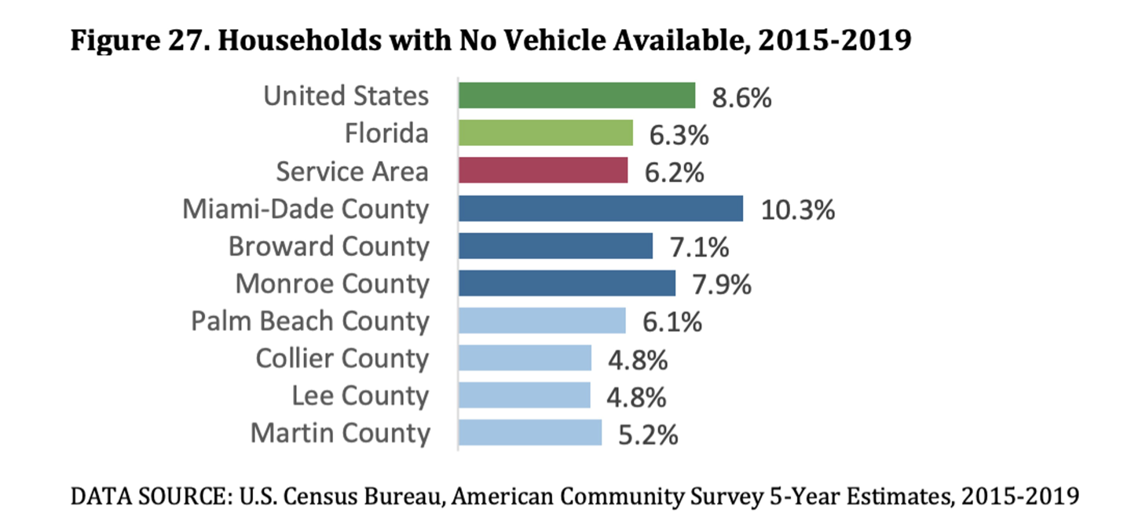
Worse Health Outcomes in Transportation-Disadvantaged Communities
Notes:
The 2022 Nicklaus Children’s HS Community Health Needs assessment cited inadequate transportation to access appointments as a barrier to healthcare in their service are area which includes MDC, Broward, PBC, and Monroe counties. 10.3% of Miami-Dade residents are without a vehicle. These families face substantial challenges in accessing employment, healthcare, and social services.

Slide 21

At-risk Groups
Older adults
Children, especially infants
People with pre-existing illnesses
People with mental illness
People with disabilities
Frontline & communities of color
People who work or play outdoors
Low income
Homeless
Pregnant People
Notes:
Back to the health impacts of fossil fuel-based transportion We are all at risk of health harms from extreme heat and air pollution; yet, patients with pre-existing illneses,especially cardiovascular and pulmonary diseases, the elderly, children, pregnant people, people living in close proximity to to busy roadways and power plants are especially vulnerable. Communities of color are at increased risk because they often live in UHIs, have a higher energy burden or live in substandard housing, often without air conditioning, and are burdened with long-standing social and economic inequalities.

Slide 22

Benefits of Transportation Electrification
$978 billion in public health benefits
89,300 fewer premature deaths
2.2 million fewer asthma attacks
10.7 million fewer lost workdays
American Lung Association. State of the Air 2023. April 2023. www.lung.org/sota
Notes:
The COVID-19 pandemic and the resulting disruption of societal norms including our tranvel patterns have given us a window into what a future with electrified transportation could yield. So, lessons from the pandemic inspire us to more urgently combat air pollution with multiple solutions, one of which is transportation electrification. Electric vehicles produce fewer emissions that contribute to climate change and smog than conventionally fueled vehicles.(US Department of Energy, Reducing Pollution with Electric Vehicles (2020)).
The American Lung Association’s State of the Air Report tells us that a transition to zero-emission passenger vehicles, including cars, SUVs and light pickup trucks, powered by clean, non-combustion electricity from 2020 to 2050 would result in up to:
$978 billion in public health benefits
89,300 fewer premature deaths
2.2 million fewer asthma attacks
10.7 million fewer lost workdays citation: American Lung Association. State of the Air 2023. April 2023. www.lung.org/sota

Slide 23
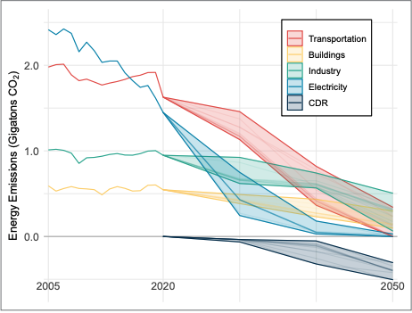
Source: https://www.whitehouse.gov/wp-content/uploads/2021/10/US-Long-Term-Strategy.pdf
Notes:
So if we can transition to electric vehicles with zero tailpipe emissions and couple that with clean 21st century electricity generated by the sun and wind, we can reduce our carbon pollution leading to cleaner air in the short term and slowing rising temperatures in the long-term. We already have the technology; we just need collective and political will to drastically reduce our carbon pollution. The United States has committed to the goal of a net-zero greenhouse gas (GHG) economy by 2050 as a party in the U.N. Framework Convention on Climate Change (UNFCCC). So we need to act quickly, but how do we get there and how can clinicians play a role? This graph from the White House’s long term net-zero strategy clearly shows that transportation electrification and other transportation-based solutions are high impact; what are local strategies?

Slide 24
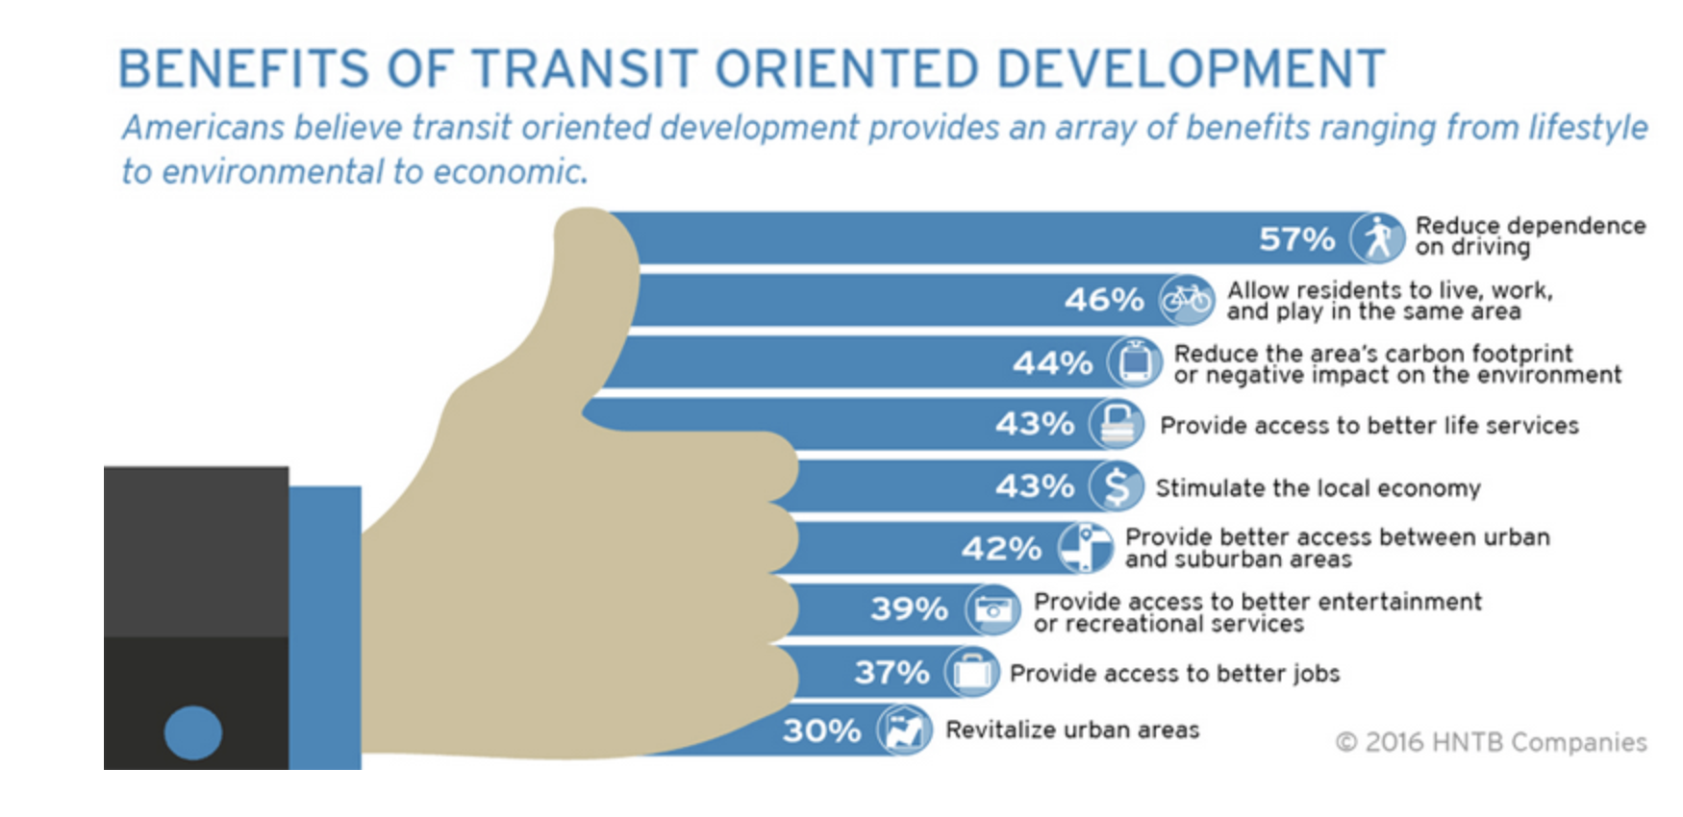

Notes:
We have differing transportation needs and a variety of choices. So a comprehensive plan includes…increasing public transit options rail, bus, trolly and building infrastructure that supports safe active transportation- primarily walking, and cycling- and micromobility(scooters, e-bikes) and facilitating the connection between the two. City planners call this Transit-Oriented Development.
https://pbgfl.com/DocumentCenter/View/8235/SFTOD---PBG-Station-Area---Project-Update----Oct-2018---morning-presentation?bidId=
https://www.c40.org/wp-content/uploads/2022/02/C40-Good-Practice-Guide-Transit-Oriented-Development.pdf

Slide 25

Source: https://thefifthestate.com.au/
Notes:
TOD is: • Development within ¼ to ½ mile of Station or along Transit Corridor (10-minute walk) • Mixed-Use with Higher Density & Intensity than Surrounding Area • Pedestrian & Bike-Friendly • Controlled Parking • Streetscapes & Site Design focused on Pedestrian Flow
https://thefifthestate.com.au/urbanism/planning/transit-oriented-development-set-to-take-off/

Slide 26
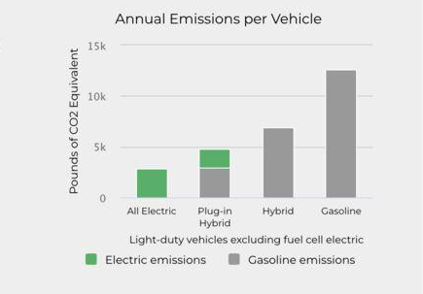
Based on assumptions with 2021 data from EIA https://afdc.energy.gov/vehicles/electric_emissions.html
Notes:
How can you make a difference as an individual? You could pledge that your next car will be electric (there are financial incentives available through the IRA that provide a federal rebate up to $7500 for the purchase of a new electric vehicle or plug-in hybrid and up to $4000 for a used electric model). If you have to make long trips by car or aren’t comfortable going all-electric, a plug-in hybrid is a good option.There are a variety of transportation choices for different needs. So a comprehensive plan includes increasing alternatives available to the public such as telecommunication (zoom, virtual conferences) and telehealth, more public transit options (trams, subway, electric buses, bike and scooter sharing services) and building infrastructure that supports safe active transportation- primarily walking, and cycling- and facilitating the connection between the two.

Slide 27
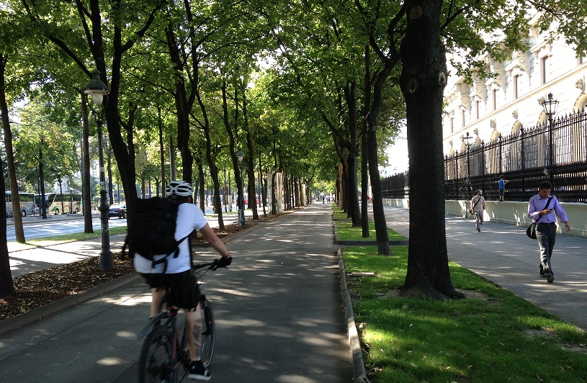
Active Transport = A Trifecta Solution
Good for the community
Good for your wallet
Good for your health
An Equitable Solution: Mobility variety to fit a diverse population
Notes:
Active transoportation is just one of the climate & health soulutions that I call, “ trifecta solutions: “ 1. they are good for the community because they reduce GHG emissions and air pollution, 2. good for your wallet because they cost less than high-carbon producing alternatives, & 3. they improve your health and the health of your family.

Slide 28

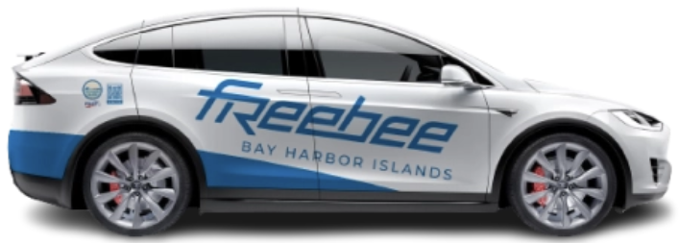
Source: ridefreebee.com
Notes:
Another aspect of good city planning is including first-last mile personal vehicle options for residents who have difficulty walking ¼ -½ mile to public transportation- think the elderly, pregnant women, young children, or those with physical disabilites. A great example of a zero-emissions ride service that empowers all residents to utilize public transit is the Florida-based company, Freebee. Freebee partners with municipalities and private institutions to provide first-last mile transportation free of charge to residents using an all-electric fleet.

Slide 29

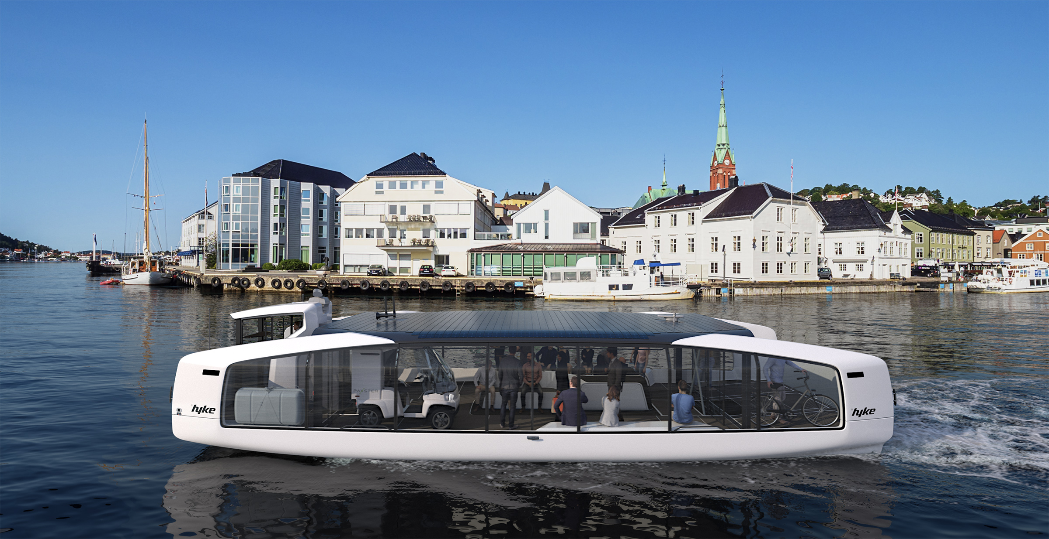
Source: https://hyke.no/
Notes:
Ports are a significant sources of air and ghg pollution due to land- and water-side diesel equipment operations. Federal, and local funding for port electrification has fast tracked electrification of ports across the US. Just two examples are here in the state of Florida, Jaxport in Jacksonville and PortMiami. battery- and solar-powered ferry can autonomously navigate and dock at passenger stations, where it wirelessly recharges.cleaner, quieter and more enjoyable boating

Slide 30
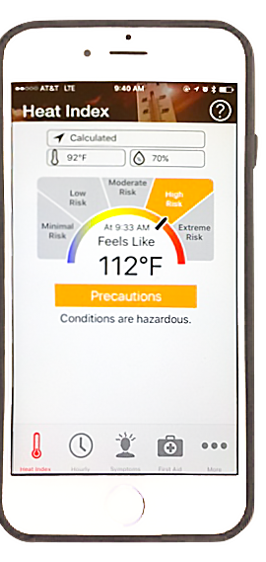
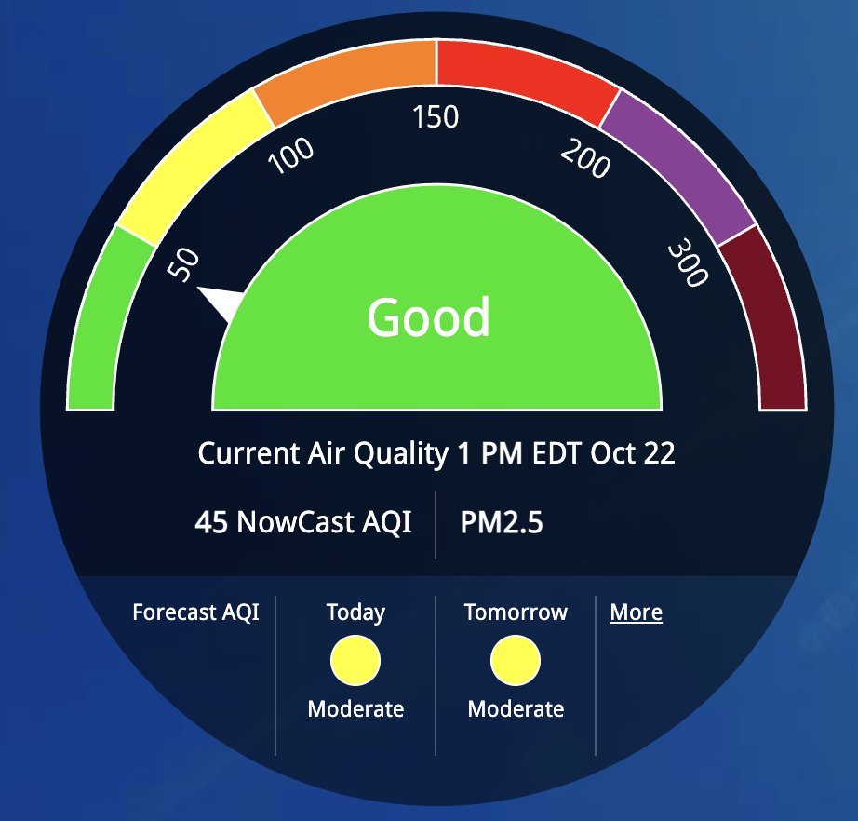


TOOLS FOR PATIENTS
OSHA-NIOSH Heat Safety Tool
Airnow.gov
Notes:
So what can clinicials do to reduce the burden of carbon pollution on their patients and on the public at large? 1. Identify your patients who are at higher risk for health impacts from heat and air pollution, advise them of things they can do to reduce their exposure and share tools like the two here that can help patients monitor local air quality and a dangerously high heat index. OSHA-NIOSH Heat Safety Tool- gives the heat index- “feels-like” temp at your location, predicts HI during the day and provides HRI prevention and First Aid information
Air now provides current air quality information in locations across the US as well as health information and other resources.

Slide 31
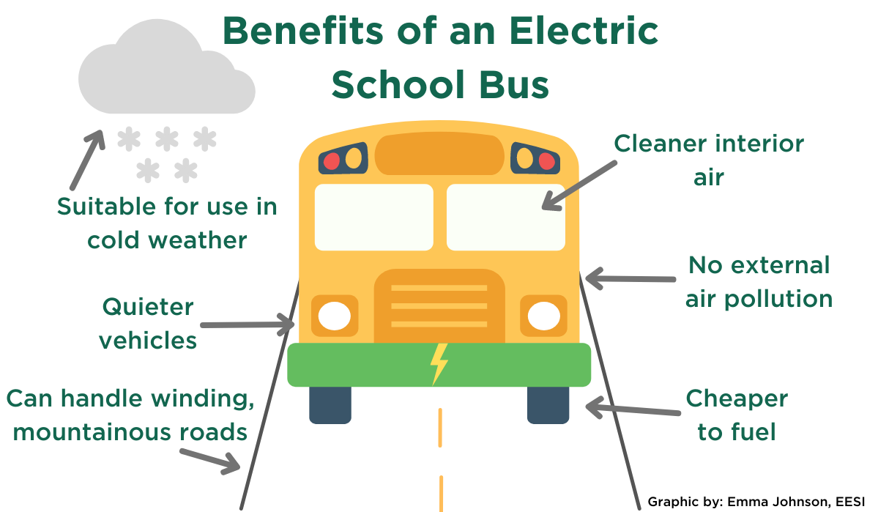

Source: electric.co
Notes:
Support equitable transportation electrification: in your own hospital or health system at the local, state, and national level: For example a group of clinicians at Jackson Memorial Hosiptal formed a sustainability committee and a transportation electrification subcommittee- they work with hospital administrators and county officials to install charging infrastructure at their facility, offer incentives for carpooling like preferred parking and reduced or free on-site charging, public transit monthly ticket discounts /reimbursements, even adding secure e-bike and connventional bike racks on hospital campuses. Offer to provide expert testimony at city council meetings about the health benefits of reducing fossil fuel-powered transportation or volunteer to sit on your local trasportation planning board/council or local school board and support city fleet electrification or school bus electrification. Federal funding for electric school buses across the US is available through grants from the IRA and IIJA. Email or call your school superintendent to offer to support their application for funding.

Slide 32



Green Cars for Kids
…driving children to better health
and a brighter future with electric vehicles
Notes:
Green Cars for Kids is a South Florida-based new nonprofit organization that provides free transportation to essential healthcare for under-resourced kids and expectant mothers using an all-electric fleet. Green Cars for Kids is a climate, health, and equity solution that aims to improve perinatal and pediatric health by increasing access to care, reducing air pollution, and decreasing greenhouse gas emissions that impact frontline communities most. The launch of the program is planned for early 2023 in collaboration with Miami-based Freebee ride service, March of Dimes, local clinics, and community-based organizations.

Slide 33


Notes:
So, I’ll leave you with inspiration from Jonathan Foley
Founder & Executive Director, Project Drawdown: "We don't HAVE to reimagine everything, we GET to. These challenges are also opportunities to build something great. ”
" -I cheer you on!! Thank you https://drawdown.org/ https://drawdown.org/sectors/buildings

Slide 34
Key Takeaways and a Call to Action
The transportation sector contributes the most to GHG emissions (38%) in the US and
causes poor air quality
drives global warming that fuels the climate crisis
Diesel and gasoline-powered vehicles impact our health by emitting CO₂ and air pollution, especially 6 criteria air pollutants:
Ozone
Lead
Sulfur dioxide
Carbon dioxide
Particulate matter
Nitrogen oxides (NO & NO₂)
Health Benefits of transportation electrification;
$978 billion in public health benefits
89,300 fewer premature deaths
2.2 million fewer asthma attacks
10.7 million fewer lost workdays
Clinicians can help reduce the health impacts of transportation pollution by
Driving electric, carpooling, active transportation commutes
Identify at-risk patients & provide tools and information about how they can reduce exposure
Advocate at their workplace, locally, regionally, federally for clean air and transportation electrification

Slide 35
Resources
American Lung Association. (2023). Health impact of pollution: State of the Air. Health Impact of Pollution | State of the Air | American Lung Association. https://www.lung.org/research/sota/health-risks
Bekkar B, Pacheco S, Basu R, DeNicola N. Association of Air Pollution and Heat Exposure With Preterm Birth, Low Birth Weight, and Stillbirth in the US: A Systematic Review. JAMA Netw Open. 2020;3(6):e208243. doi:10.1001/jamanetworkopen.2020.8243
Centers for Disease Control and Prevention. (2022, November 21). Air Pollutants. Centers for Disease Control and Prevention. https://www.cdc.gov/air/pollutants.htm
Hayhoe, K., D.J. Wuebbles, D.R. Easterling, D.W. Fahey, S. Doherty, J. Kossin, W. Sweet, R. Vose & M. Wehner. (2018). Our changing climate. In: Impacts, risks, and adaptation in the United States: Fourth national climate assessment, volume II [Reidmiller, D.R., C.W. Avery, D.R. Easterling, K.E. Kunkel, K.L.M. Lewis, T.K. Maycock, and B.C. Stewart (eds.)]. U.S. Global Change Research Program, Washington, DC, p. 76. doi: 10.7930/NCA4.2018.CH2
Professional Research Consultants, Inc. (2018, December). Community Health Needs Assessment &amp; Implementation Plan. Community Health Needs Assessment &amp; Implementation Plan | Nicklaus Children’s Hospital. https://www.nicklauschildrens.org/patient-resources/community-outreach/community-health-needs-assessment
SIv PD and Bush. A. Environmental Contributions to respirator disease in children. Kendia and Wilmott's Disorders of the respiratory tract in children. 2024
United States Environmental Protection Acency. (2023, August 28). Greenhouse gas emissions from a typical passenger vehicle. EPA. https://www.epa.gov/greenvehicles/greenhouse-gas-emissions-typical-passenger-vehicle
U.S. Department of Energy, Energy Efficiency and Renewable Energy. (n.d.). Emissions from electric vehicles. Alternative Fuels Data Center: Emissions from Electric Vehicles. Date accessed Oct. 9, 2023.https://afdc.energy.gov/vehicles/electric_emissions.html
US Department of Energy, Reducing Pollution with Electric Vehicles (2020).
U.S. Energy Information Administration (EIA). (2022, December 29). U.S. Energy Information Administration - EIA - independent statistics and analysis. Gasoline and the environment - leaded gasoline - . https://www.eia.gov/energyexplained/gasoline/gasoline-and-the-environment-leaded-gasoline.php

