Slide 1
Heat Stress and Illness Prevention Lecture Series Malaria in Florida
September 27, 2023
Amy Y. Vittor, MD PHD
Infectious Diseases and Global Medicine
University of Florida

Slide 2
Objectives
Be able to describe the historical and current epidemiology of malaria in the state of Florida.
Formulate diagnostic and treatment plan for patients suspected to have malaria.
Relate the most important environmental and social factors contributing to the emergence and re-emergence of malaria.
Define who is at risk of acquiring malaria, and formulate a prevention plan for such patients.

Slide 3
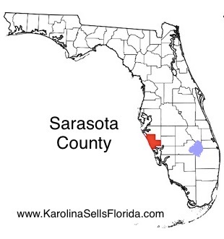
First autochtonous cases in FL in 20 years
Mid May: 1st case of vivax malaria
Early June: 2nd case
Late June: 3rd and 4th cases
Late June: 5th and 6th cases
July: 7th case
All cases were within a 4-mile radius
In April, a case of imported vivax malaria was reported in the same radius
Early June: 3 Anopheles crucians specimen tested positive for Plasmodium vivax (midgut, but not salivary glands)
Aerial and ground spraying with larvicides, insect repellant and bednets to homeless people in Manatee and Sarasota counties
Blackburn, D. et al. MMWR Sept 8, 2023, 72(36): 973-978
Florida Arbovirus Surveillance
https://www.floridahealth.gov/diseases-and-conditions/mosquito-borne-diseases/_documents/2023-w36-arbovirus-surveillance-report.pdf

Slide 4
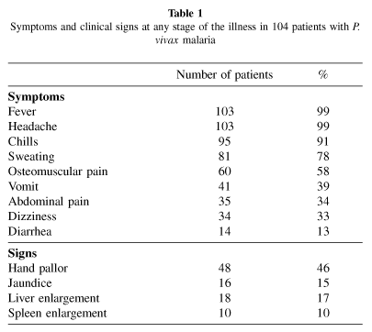
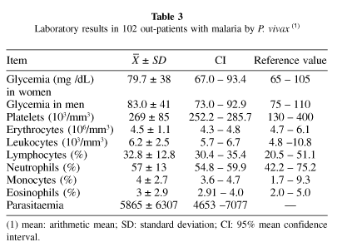
Clinical features of vivax malaria
Echeverri, M. et al. Rev Inst de Med Trop Sao Paulo 2003 45:29-34
Notes:
A descriptive study was carried out in 104 patients with Plasmodium vivax malaria, from the region of Turbo (Antioquia, Colombia). Clinical features and levels of hemoglobin, glycemia, serum bilirubin, alanine-aminotransferase (ALT), aspartate-aminotransferase (AST), creatinine and complete blood cell profile were established. 65% of the studied individuals were men and their mean age was 23. Of all individuals 59% had lived in the region for > 1 year and 91% were resident in the rural area. 42% were farmers and 35% had a history of malaria. The mean parasitaemia was 5865 parasites/mm³. The evolution of the disease was short (average of 4.0 days). Fever, headache and chills were observed simultaneously in 91% of the cases while the most frequent signs were palmar pallor (46%), jaundice (15%), hepatomegaly (17%), and spleen enlargement (12%). Anemia was found in 39% of the women and in 51% of the men, 8% of individuals had thrombocytopaenia and 41% had hypoglycemia.

Slide 5
Malaria clinical syndromes
Incubation period: 7 – 30 days
Uncomplicated:
- F/C/sweats/HA/N/V/malaise/ myalgia
Complicated:
Severe anemia (→ “blackwater fever”)
Coagulopathy
ARDS
AKI
Metabolic impairment (acidosis, hypoglycemia)
Cerebral malaria (cognitive impairment, seizures, coma)
RBC knobs lead to adherence to endothelium of venular walls
Sequestration leads to micro-infarcts and hemorrhage
10% have persistent neurological sequelae

Slide 6
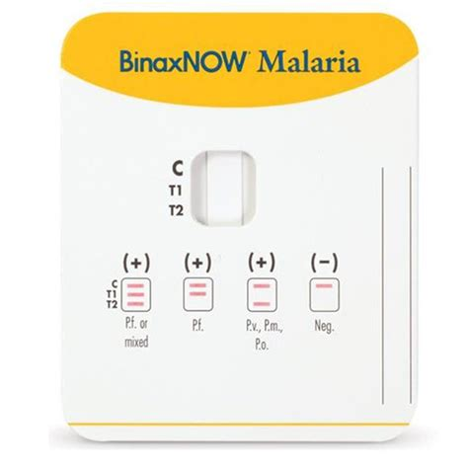
Diagnosis
Rapid diagnostic tests (RDTs) : BinaxNOW Malaria (Abbott)
Sensitivity 94% (P. falcip), 84% (non-P.falcip)
Confirm with microscopy : sensitivity may be low if inexperienced lab, low parasitemia. If initially negative but high clinical suspicion, repeat q12-24h x 3
Repeat blood smears if severe malaria to ensure that parasitemia is declining with treatment
Notify DOH!
CDC malaria hotline : 1-855-856-4713 (toll free); (after hours): 1-770-488-7100
Farcas, G.A., et al. Am J Trop Med Hyg 2003 69(6):589-92
CDC.gov/parasites/malaria/index.html

Slide 7
Treatment of vivax malaria
If the infecting species is initially unknown, treat presumptively for falciparum malaria
Severe malaria (any species): IV artesunate OR Artemether-lumefantrine OR atovaquone-proguanil OR quinine OR mefloquine
Uncomplicated malaria – depends on Plasmodium species and acquisition in area with or without chloroquine resistance
In vivax malaria acquired in a region with an unknown chloroquine resistance, preferred options are artemether-lumefantrine and atovaquone-proguanil.
If acquired in an area without chloroquine resistance, chloroquine or hydroxychloroquine is the treatment of choice.
If vivax or ovale malaria : screen for G6PD – if not deficient, primaquine or tafenoquine
CDC.gov/parasites/malaria/index.html
Notes:
Primaquine contraindicated also in pregnant women, infants, lactating women
Tafenoquine for age>16yr (single dose)

Slide 8
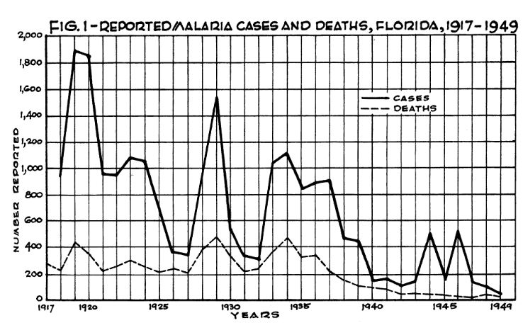
History of malaria in Florida
1800s through 1940s: malaria was one of top 3 killers in Florida
Mainly rural disease, with peaks in July – December
Extensive drainage projects commenced, even before understanding that malaria was transmitted by mosquitoes (1897)
1945: DDT residual spraying
1951: malaria declared eliminated from US
1990: single local case in Bay County, FL. An. quadrimaculatus collected, ? Positive.
1996: 2 probable local cases in Palm Beach County.
2003: July – August, 8 vivax malaria cases in Palm Beach County. An. quadrimaculatus and An. crucians collected, none positive.
Hanson, H. et al. Am J Pub Health 1935, 25(2): 156-161
Lieux, DB. Florida Entomologist 1951, 34(4): 131-135
Malecki, J.M. et al. MMWR 2004, 52(38): 908-11

Slide 9
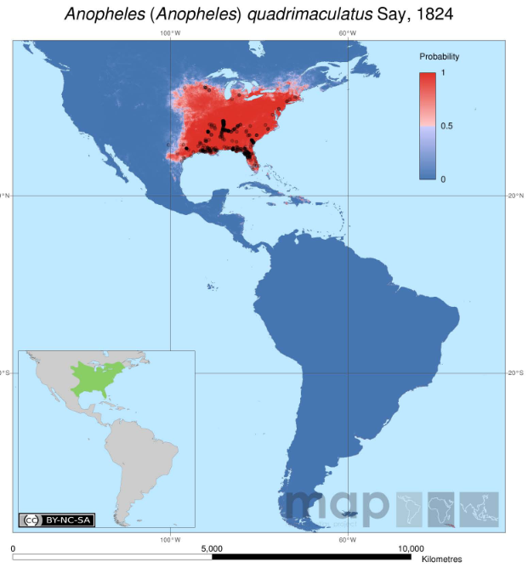
Malaria competent mosquitoes in Florida
An. quadrimaculatus (ponds, lakes)
An. crucians (salt marsh)
An. atropos
An. walker
An. punctipennis

Slide 10
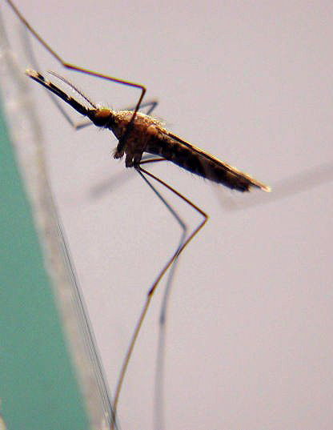
Anopheles crucians
Salt-marsh Anopheles
Breeds in brackish water near coast or acid water ecosystems like cypress swamps
Usually most abundant in winter
1945: South Carolina – 3.3% An. crucians positive for sporozoites, higher than An. quadrimaculatus (0.175%)
Hu, GY et al. J Med Entomol 1993, 30(5): 883-7
Sabrosky, CW. Science 1946, 104(2698): 247-8

Slide 11
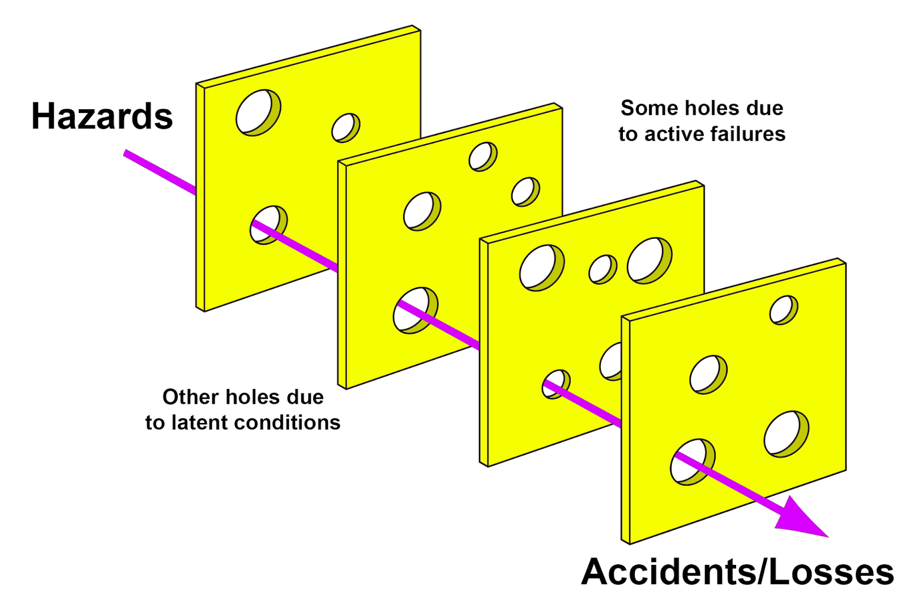
Pathogen
Climate
Landscape
Pathogen Introduction
Susceptibles
Outbreak

Slide 12
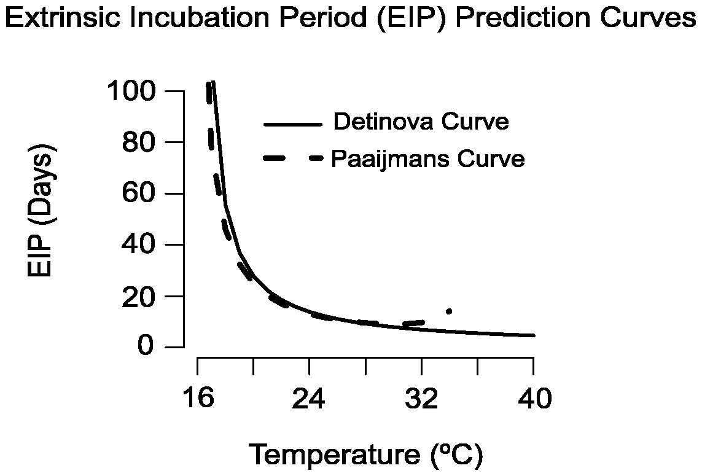
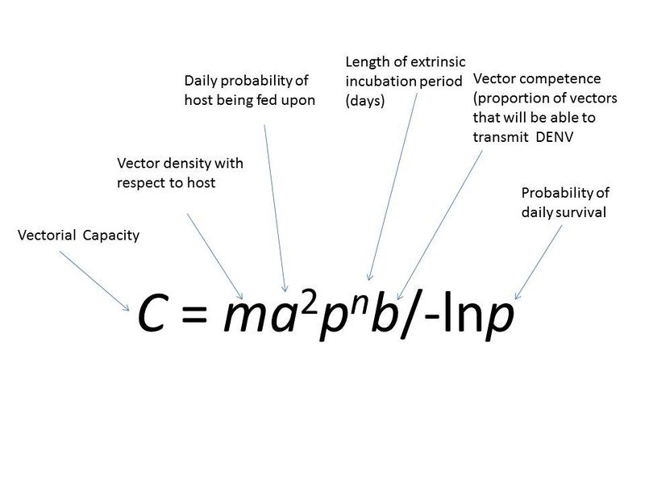
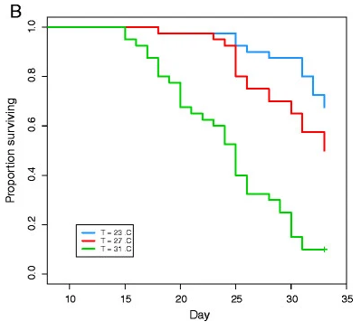
Vectorial Capacity
Christiansen-Jucht, C. et al. Parasites & Vectors 2014, 7: 489
Paaijmans, KP et al. PNAS 2009, 106(33): 13844
Notes:
Transmission potential, ross macdonald
Changes in the extrinsic incubation period of malaria parasites and in the basic reproductive number as a consequence of temperature fluctuation. (A) Duration of the extrinsic incubation period (days, right hand bar) of Plasmodium falciparum parasites across a range of mean temperatures (12–28°C) and diurnal temperature ranges (0–16°C). (B) The relative change in R₀ (%, right hand bar) across a range of mean temperatures (18–28°C) and diurnal temperature ranges (0–16°C), comparing R₀ estimates derived from the length of EIP shown in Fig. 1A with estimates as predicted by the iconic equation of Detinova (12). Models are run with 12:12 day:night cycle.
Kaplan-Meier plots of An. gambiae larval (A) and adult (B) survival at different environmental temperatures. The 23°C temperature (blue) was set as the baseline against which survival at other temperature was compared; 27°C (red); 31°C (green); 35°C (yellow).

Slide 13
Rainfall in Sarasota/Manatee counties
Raw data obtained from https://climatecenter.fsu.edu/products-services/data/precipitation/bradenton

Slide 14
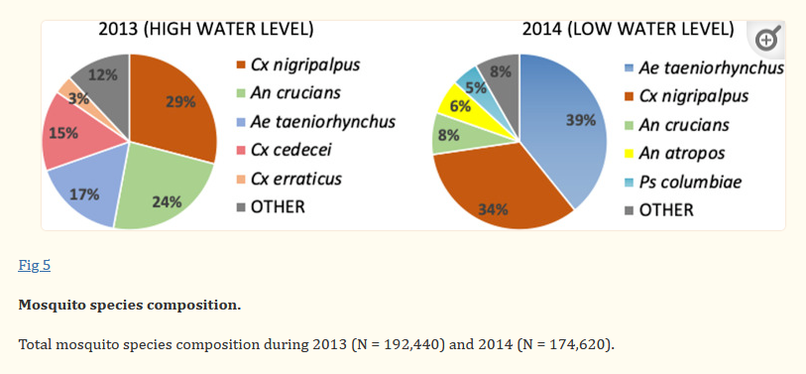
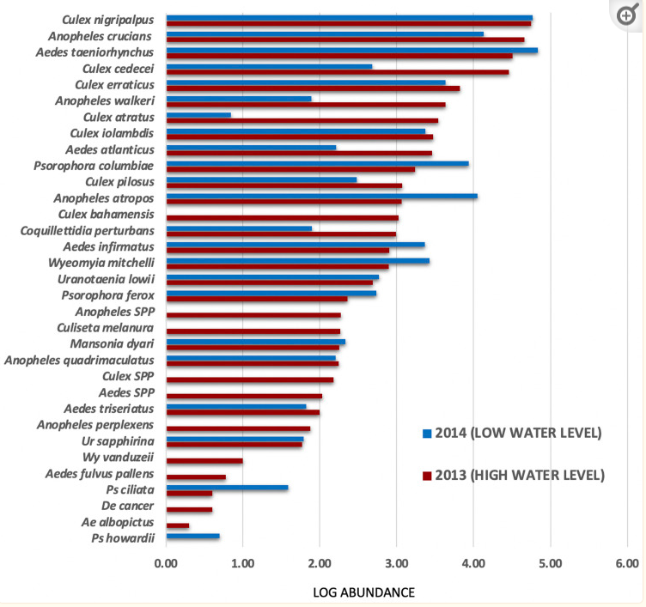
Fish, D. et al. PLoS One 2021 16(11): e0259419

Slide 15
Pathogen
Climate
Landscape
Pathogen Introduction
Susceptibles
Outbreak

Slide 16
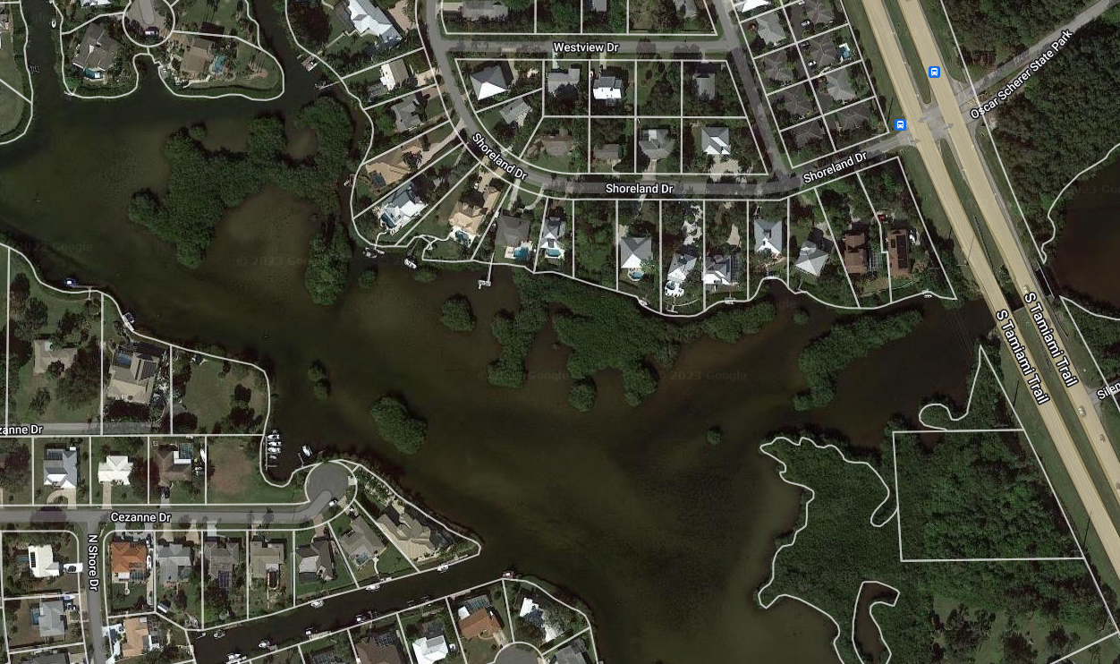
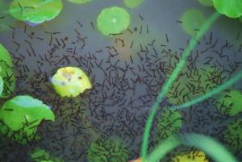
Housing development and mosquitoes
Apple Maps
https://news.wgcu.org/section/environment/2023-07-20/eighth-malaria-case-confirmed-in-sarasota-equals-largest-u-s-outbreak-of-the-disease-in-decades

Slide 17
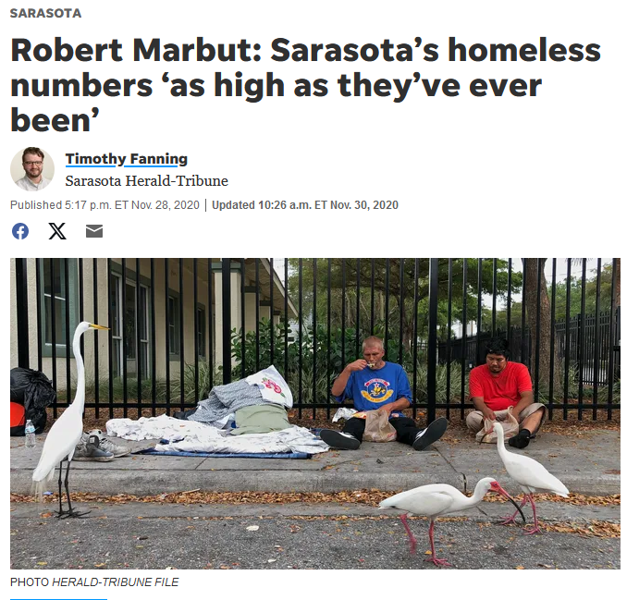
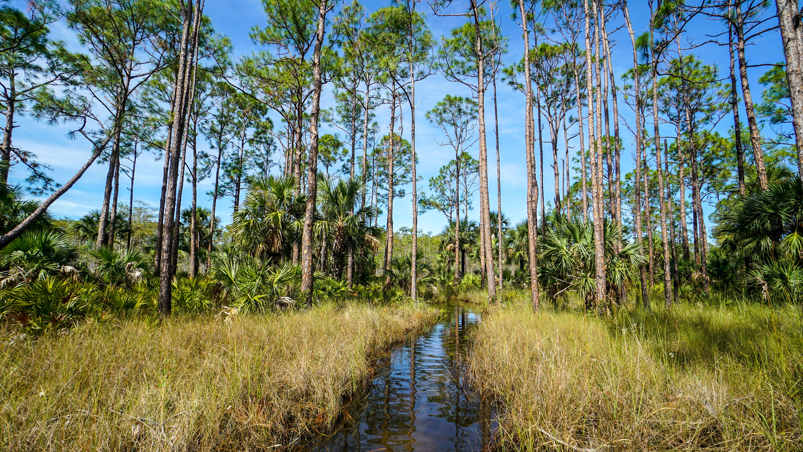
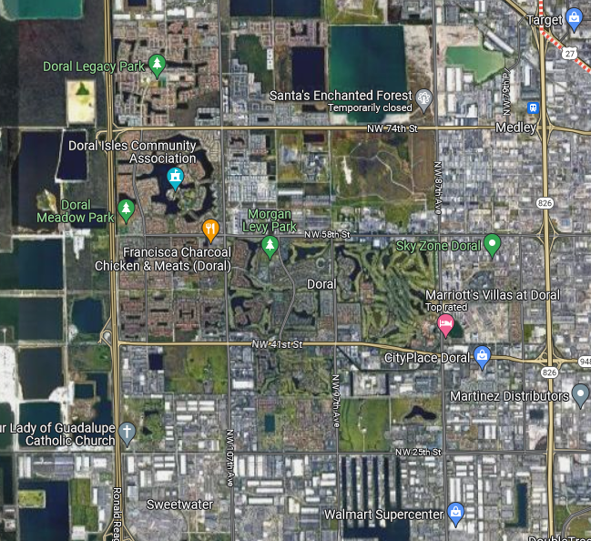
Vectorial Capacity
Vector ecology – An. crucians occupies natural marsh habitat as well as urban marshes
Coatsworth, H. et al. Lancet Reg Health Am 2022 (11): 100231
Fish, D. et al. PLoS One 2021 16(11): e0259419
Notes:
Transmission potential, ross macdonald
Changes in the extrinsic incubation period of malaria parasites and in the basic reproductive number as a consequence of temperature fluctuation. (A) Duration of the extrinsic incubation period (days, right hand bar) of Plasmodium falciparum parasites across a range of mean temperatures (12–28°C) and diurnal temperature ranges (0–16°C). (B) The relative change in R₀ (%, right hand bar) across a range of mean temperatures (18–28°C) and diurnal temperature ranges (0–16°C), comparing R₀ estimates derived from the length of EIP shown in Fig. 1A with estimates as predicted by the iconic equation of Detinova (12). Models are run with 12:12 day:night cycle.

Slide 18
Pathogen
Climate
Landscape
Pathogen Introduction
Susceptibles
Outbreak

Slide 19
Pathogen introduction
Florida Department of Health Arbovirus Surveillance Reports, 2013 - 2023

Slide 20
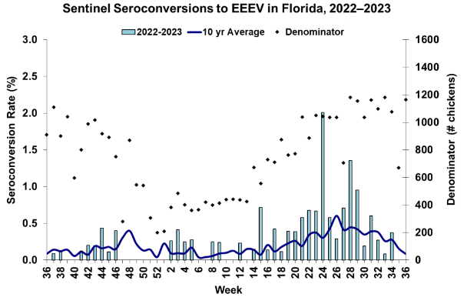
Other vector-borne disease threats in Florida
An. crucians also found infected with:
Saint Louis encephalitis virus
Eastern equine encephalitis virus
Tensaw virus
Everglades virus
EEEV circulation higher than usual, 2 human cases
4 human WNV cases
September 2023: 14 local cases of dengue in Miami-Dade County (DENV-3), 3 cases in Broward County, 1 case in Polk and Hardee counties
Anderson, J.F. et al. Am J Trop Med Hyg. 2022 106(2): 610-622
Florida Arbovirus Surveillance
https://www.floridahealth.gov/diseases-and-conditions/mosquito-borne-diseases/_documents/2023-w36-arbovirus-surveillance-report.pdf

Slide 21
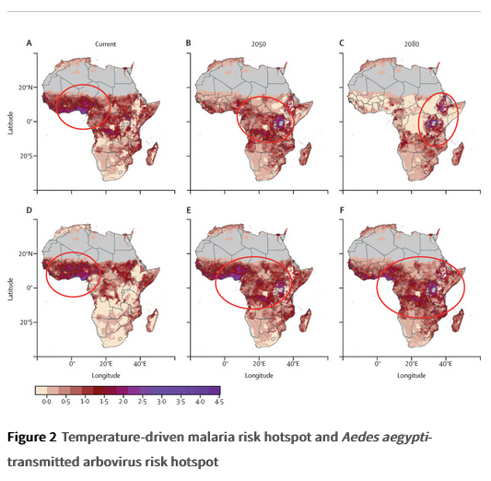
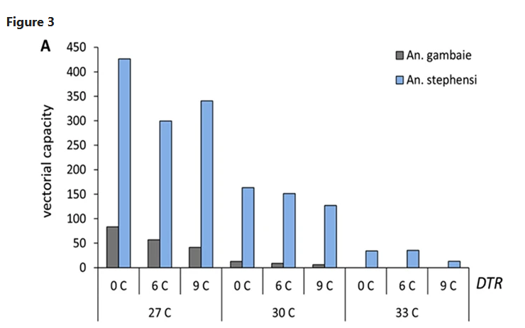
What’s happening around the world (malaria)?
Mordecai, EA et al. Lancet Planet Health 2020, 4(9): E416-23
Murdock, CC et al. Sci Rep 2016, 6(1): 27771
Notes:
Malaria risk hotspot (red circles; top row A–C) shifts to high elevations in east Africa while Aedes aegypti-transmitted arbovirus risk hotspot (red circles; bottom row D–F) expands throughout sub-Saharan Africa, from current (left column A and D) to 2050 (middle column B and E) to 2080 (right column C and F). Colour scale represents the number of months per year predicted to have highly suitable temperatures for disease transmission (relative R₀>0·5), multiplied by population density (log₁₀ population density), for a scaled index of person-months of high risk for transmission. Temperature suitability for transmission is based on the upper 50th percentile of relative R₀ from temperature-dependent R₀ models (appendix pp 4–8).¹⁵
, ¹⁶
All climate projections are based on the business as usual climate scenario Representative Concentration Pathway 8·5, using the HadGEM2-ES General Circulation Model. The red circles (risk hotspots) show the areas where the most people are at the highest risk. An aridity mask (grey) excludes regions that are too dry for malaria transmission.³⁹
This figure shows one possible scenario of temperature-driven risk, rather than making a specific prediction about future disease burden, which will depend on moisture availability, human population growth and mobility, and other factors. R₀=basic reproduction number.

Slide 22
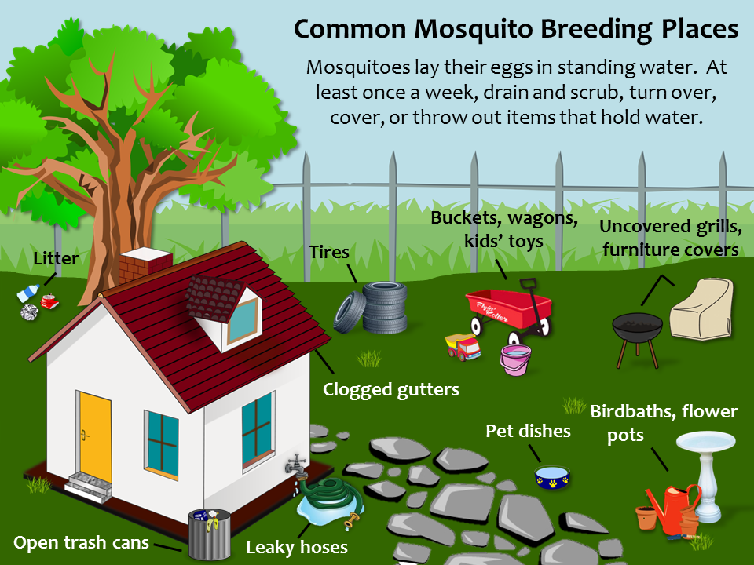
What can we do to prevent vector-borne diseases?
Reduce mosquito breeding sites:
Remove litter, buckets, tires, anything that can hold water around the house
Clean rain gutters
Install/repair window screens
Maintain swimming pools
!
!
!
!

Slide 23
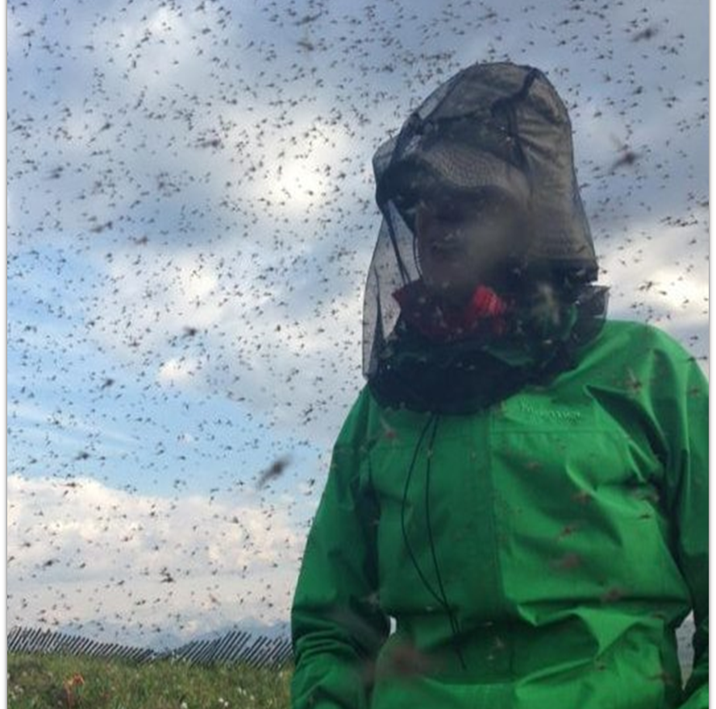
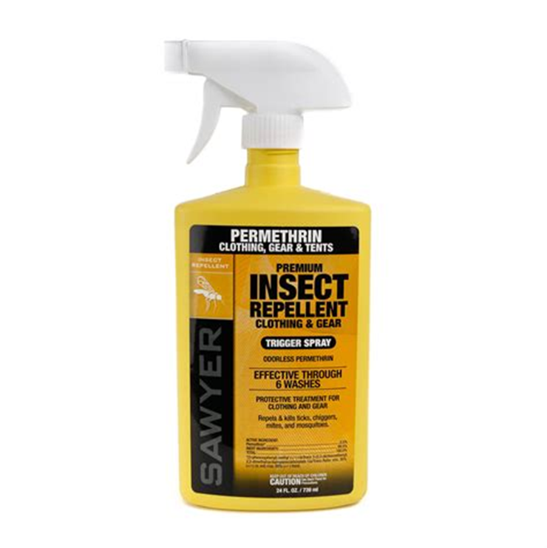
What can we do to prevent vector-borne diseases?
Clothes:
Long sleeves, long pants, closed shoes
Consider impregnating clothing with permethrin (mosquitoes, ticks)
!
!

Slide 24
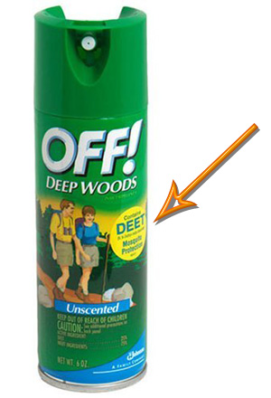
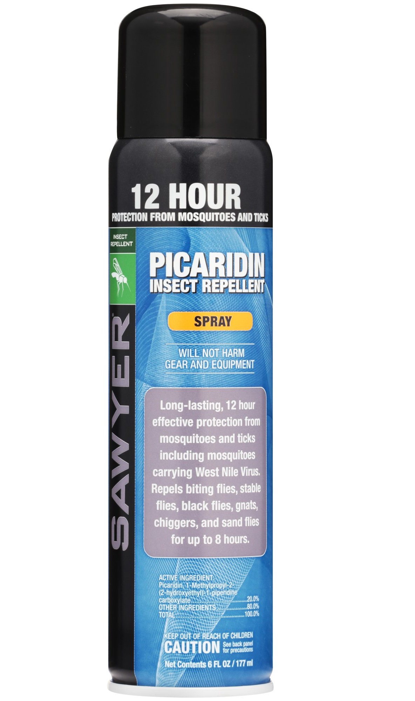
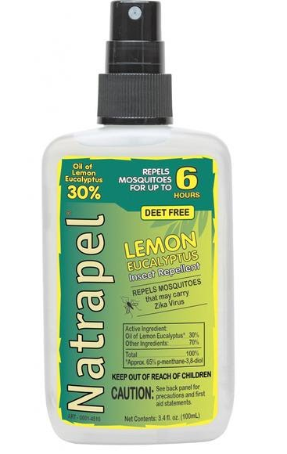
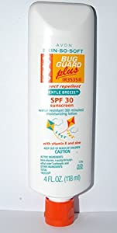
What can we do to prevent vector-borne diseases?
DEET (up to 30%)
Picaridin
Oil of lemon eucalyptus
Para-menthane-diol
2-undecanone/IR3535
Notes:
DEET : mosquitoes, ticks, flies
5% → protection for 2 hrs
30% → protection for 6 hrs
Safe for people >2 months, but if less than 2 years old, a treated netting over strollers is preferred
Toxicity: skin irritation, lethargy, seizures* at high concentrations (>50%)
Can degrade certain fabrics and plastics
Picaridin : mosquitoes, ticks
5 – 20% → up to 12 hrs protection
No serious toxicity, does not damage clothing, odorless
Not recommended for kids < 2yrs
Oil of lemon eucalyptus : Mosquitoes only
40% → 6 hrs
Toxicities: minor skin irritation
IR3535:
7.5% → ½ hour

Slide 25
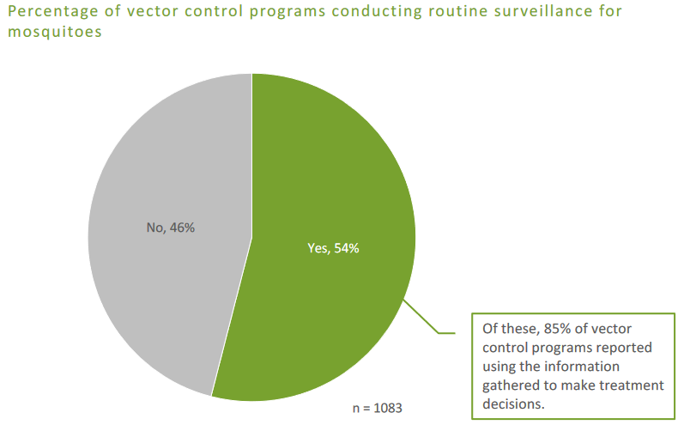
Community solutions
Support public health and mosquito control infrastructure
2017 national survey evaluating preparedness of mosquito control agencies for outbreaks in the USA: 8% of 1083 mosquito control organizations were “fully capable”
46% of organizations did not perform standardized mosquito surveillance
18 states had no vector control programs meeting all core competencies
Physicians notifying their county DOH of suspected and confirmed malaria cases triggers investigation, case finding, and vector control efforts.
National Assoc County and City Health Officials. Mosquito control capabilities in the U.S. 2017.
Dye-Braumuller, KC et al. Curr Trop Med Rep 2021, 8: 43-51

Slide 26
Community solutions
Consider vulnerable populations:
Homeless population
Children
Elderly
People with cardiovascular disease, hypertension, diabetes
Pregnant women
Outdoor laborers

Slide 27
Health research and policy in an ecological context
Residential development: Suburban development accompanied by forest fragmentation is driving tick-borne disease expansion in the United States. → Is this happening in Florida with respect to malaria?
Wetlands restoration: What is the impact of this on mosquito breeding and disease?

Slide 28
