Slide 1
Key message
Build resilience AND disrupt power

Slide 2
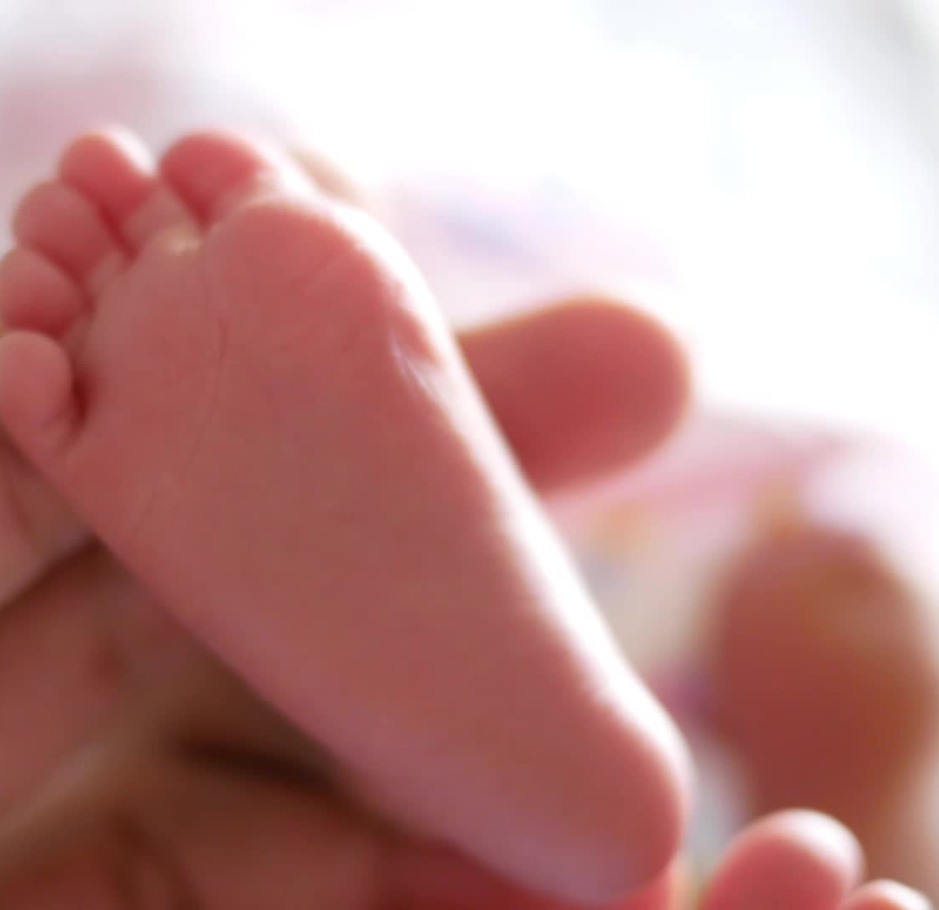
Climate change is worsening maternal and newborn health & inequities
The Intergovernmental Panel on Climate Change report “Climate Change 2022, Impacts, Adaptation and Vulnerability” made more than 30 references to pregnancy health highlighting, with high confidence, how pregnant women and children are particularly impacted.
Notes:
This is a key resource -
The world authority on climate science the IPCC is building an ever-increasing body of epidemiology and science on how the climate crisis is hurting public health and slowing our ability to improve health outcomes everywhere.
Increasingly making argument that climate harms leading to unjust inequities in who gets to have a healthy pregnancy and who gets a healthy baby.
Between countries, widening gaps between carbon rich industrialized countries and poor low carbon countries.
But also within countries, here in the US – important to understand that injustice and marginalization is creating vulnerability to climate harms everywhere. NEXT SLIDE

Slide 3
NEW National Climate Assessment 5
“Women disproportionately experience the burden of climate change because of unique mental, sexual, and reproductive health needs that intersect with existing social, racial, and economic disparities.”
Several sections mentioned the vulnerability of pregnant people, with the report citing studies that have found links between poor pregnancy outcomes like miscarriages and low birth weight and extreme heat, air pollution and disaster-associated stressors.
It goes on to state that these factors are contributing to the maternal mortality crisis, which disproportionately impacts people of color, who are also more likely to live in communities where they face even more exposure to heat and pollution.
The assessment also explained how women’s societal roles and socioeconomic status further impact their health. Women often have more caregiving responsibilities and less access to health care, both of which make it harder to recover after climate-related disasters both financially and health-wise.

Slide 4
Key question
Who are the intersectional, multisectoral “climate care workers” we need and are they resourced?
Are they as powerful as they need to be?
Notes:
NOT JUST clinical – multisectoral. FLORIDA – begun to explore how it’s doulas who can connect the electricity subsidies, subsidized food,
Get the impression willing to support new programming to manage heat or hurricanes, but also NEED COMMUNITY ADVOCATES in a POSITION WHERE THEY CAN CHALLENGE the cause of the crisis.

Slide 5

Extreme Heat – Driving Inequities.
Exposure – STUDY 109 urban areas, redlined neighborhoods = hotter!
Exposure at work + who gets to ask for cooler work?
Exposure at home + who gets AC, who can afford to run it??
Vulnerability – pregnancy known (to some extent) but marginalized!
Notes:
I am going to show you a few out of many studies that suggest exposure to unusually high temps → preterm birth, still birth.
Pregnancy health vulnerability is increasingly known but often forgotten.
Human Rights Watch reviewed 105 official heat safety web pages, climate action plans, heat plans, heat advisories, disaster plans, and sustainability initiatives for 18 large US cities, including the 15 most populous, with a total of 32 million people. As of August 2020, only two of these documents, from Chicago and Philadelphia, explicitly addressed the danger heat poses during pregnancy. Since the review was conducted, Human Rights Watch has seen that New York City has also included this group in a list of vulnerable populations. Concerns about the dangers of heat for pets were found 37 times.

Slide 6
Adverse birth outcomes and heat in the US
Extreme heat is driving unjust racial inequities in who gets to have a healthy pregnancy and a healthy newborn in the US.
JAMA review study - association with extreme heat and PTB, still birth and greater effect on Black pregnant people.
“Three studies examining large numbers of preterm births in California noted an increased risk of preterm birth for each 5.6 °C-increase in temperature, as did another study covering 12 clinical sites across the US for 2.8 °C increase.”
“[I]ncreased risk of still birth 10.4% per 5.6 °C in mean (& another study] reported an increase of 6% per 1.0 °C in the week before delivery during the warm season.”
Newer studies: Minnesota, Texas for example also found bigger effect Black PP than white PP.
Notes:
Lots of studies Europe, China Austrialia and US
Look at US because disprop are from hre, but also because tell us something very important.
See JAMA review looked a number of studies, foud impact on PTB and SB – here see some granularity on that, BUT ALSO when disag, found bigger effect on PTB and SB on Black than white pp.

Slide 7
New overview study on stillbirth
Recent review STUDY on still birth “There is limited pregnancy-specific guidance within heatwave planning, and no evidence-based interventions have been established to prevent poor pregnancy outcomes. We highlight priority research questions to move forward in the field and specifically note the urgent need for evidence-based interventions that are sustainable.”
Notes:
NOTE – intervention studies are needed!

Slide 8
Key message
Dangerous and miserable heat for one pregnant person is no more than an inconvenience for another
Notes:
This seems obvious but is missing in a lot of policy.

Slide 9
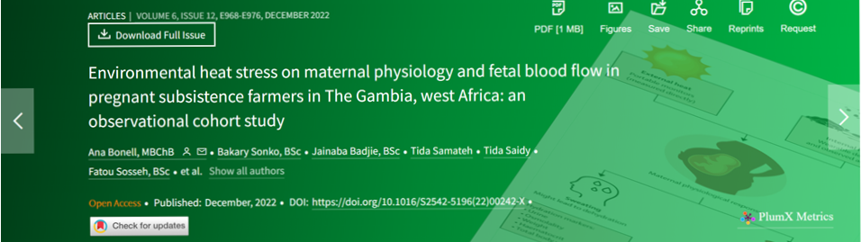
Heat & fetal distress study, The Gambia
An accompanying study also looked at intersection of heat with gender and poverty in The Gambia.
Discussion on biological mechanisms that may be involved.
Notes:
We have lots of epidemiology but why is there so little medical/biological science on heat and pregnancy? Lots of science on heat for athletes and soldiers.
“Can’t put pregnant people in a heat chamber”
The total and adjusted direct effects of maternal heat stress exposure were significantly associated with fetal strain.

Slide 10
Maternal hypertension and complications
Study from South Africa found exposure to high temps linked with maternal hypertension.
New US study “may be links” between heat and severe maternal morbidity
Gestational diabetes: A recent survey of studies warned that there may be a connection between hot summer weather and increased rates of gestational diabetes, a common but serious pregnancy condition.
Hospitalizations A 2019 study by health economists “prenatal exposure to extreme heat increases the risk of maternal hospitalization during pregnancy, and that this effect is greater for Black than for white mothers,” and that “(a)t childbirth, heat-exposed mothers are more likely to have hypertension and have longer hospital stays.”
A 2021 study in New York state “immediate and prolonged effect of extreme heat exposure on pregnancy complications (including threatened/spontaneous abortion, renal diseases, infectious diseases, diabetes, and hypertension)… stronger in African Americans and counties with lower socioeconomic position.”

Slide 11
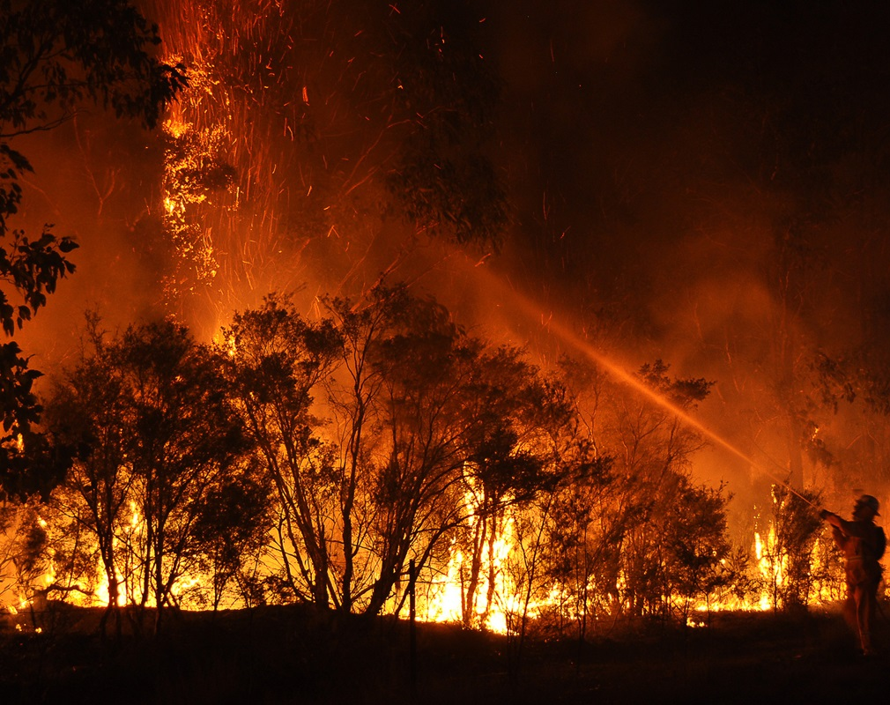
Wildfire exposures in Oregon
Same/worse toxic constituents as air pollution … & stress.
Fewer studies but a recent review on birth outcomes, and other impacts for birthing people.
Partner Nurturely and HRW – interviewed birth workers in Oregon:
Asthma, depression and other mental health concerns.
Smoke days/big fires obstruct healthcare, ANC
Huge differences in exposure and capacity to respond depending on income, whether authorized immigrants/not, housing and work.
Harms to healthcare workers.
Birth workers WANT to advocate and build resilience

Slide 12
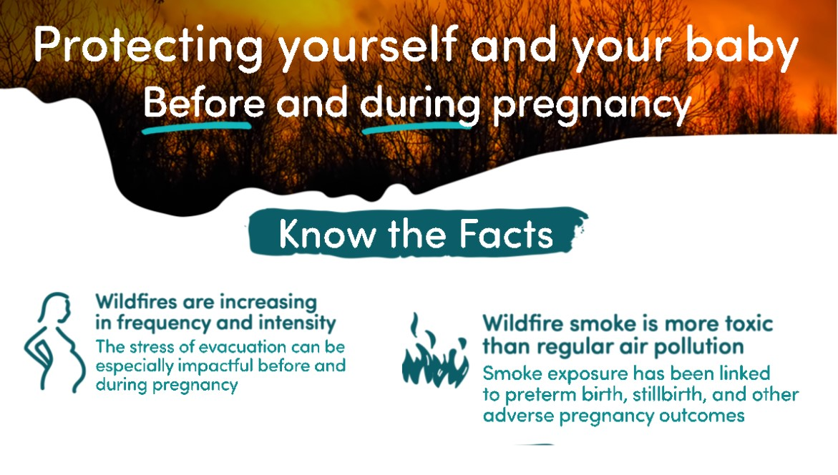

Slide 13
A key learning: the “stay indoors” problem.
The climate crisis is here, so we need to address harms already here.
Even if we cut all carbon tomorrow, it’s going to get worse. We need to learn and prepare for the future.
However, we should not ONLY focus on adaptation. What is the MNH community doing to contributing to turning off fossil fuels?

Slide 14
Preterm birth and stillbirth should be climate indications (but they’re NOT!)
Useful STUDY looked at the many ways climate change contributes to preterm birth including heat, nutrition, climate displacement and others.
Recommended: Given the potential risk posed to pregnancy health by preterm birth, we advocate for prematurity/pregnancy health to be considered as a critical factor in the assessment of climate change interventions.
(One startling finding: “Open hostility and refusal to integrate climate “refugee” populations significantly increase preterm birth by 58% among secondary refugees versus a 12% increase among primary refugees.”)
Notes:
This is a super interesting study, framing in the outcome, PTB, as opposed to specific climate impact.
e.g. deaths in heat waves, but stillbirths and deaths of babies born preterm are not included.
Pregnancy health marginalized.
Within the Climate justice movement in the US maternal health hugely marginalized, policy circles far behind other harms. Seeing increasing interest from researchers others interested in climate financing, but not hearing from pregnant people impacted, community health workers working with them, or midwives, these voices are notably missing from both the fight for resilience and to cut GHGs. WHAT CAN THE MNH community do about this?

Slide 15
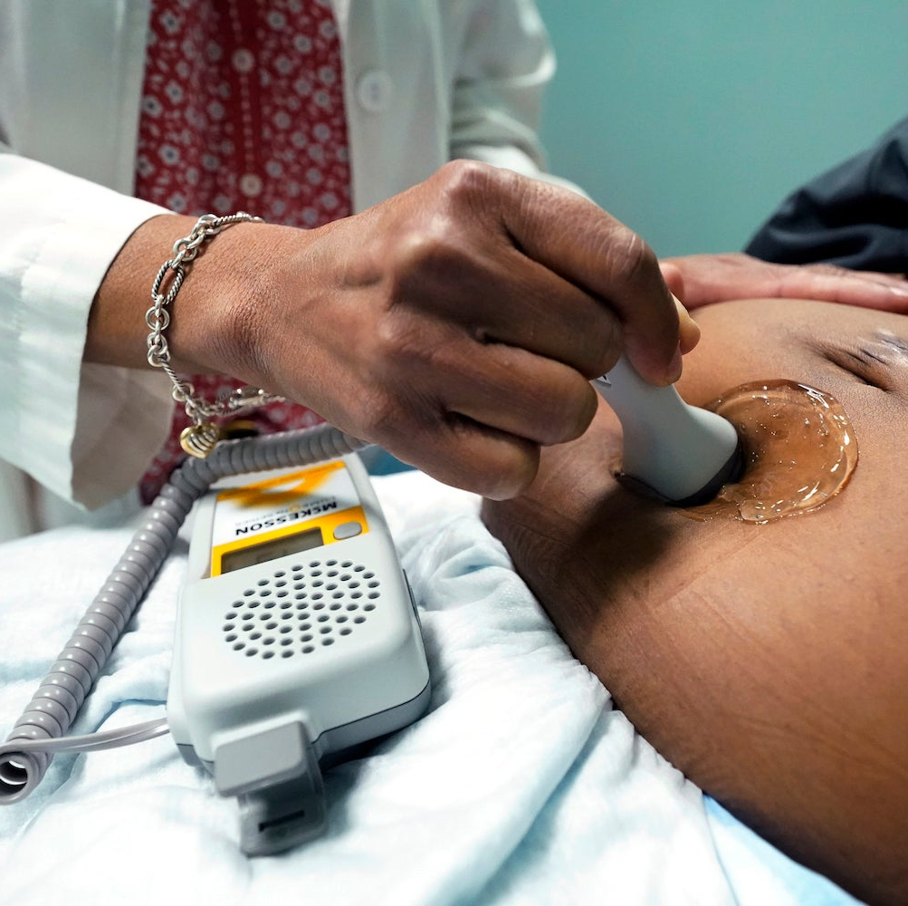
Pregnancy in disaster
Studies show links with preterm birth, for example, a study in Florida
In the short term, disasters are associated with physical trauma, adverse environmental exposures, and unstable housing. In the longer term, disasters may lead to relocation, changes in family functioning, and negative economic effects. These aspects of disaster exposure, in turn, lead to lack of access to health care, increased stress and negative mental health outcomes, and negative behavioral changes, including smoking and substance use, poor nutrition, physical overexertion and limited activity, and reduction in breastfeeding. All of these factors interact with social determinants of health to worsen effects on the most vulnerable women, infants, and communities. Few interventions after disasters have been tested.
In 2021:
HHS Maternal-Child Health Emergency Planning Toolkit (phe.gov)

Slide 16
The 2023 state of the climate report: Entering uncharted territory
The effects of global warming are progressively more severe, and possibilities such as a worldwide societal breakdown are feasible and dangerously underexplored.
By the end of this century, an estimated 3 to 6 billion individuals—approximately one-third to one-half of the global population—might find themselves confined beyond the livable region, encountering severe heat, limited food availability, and elevated mortality rates because of the effects of climate change.
Big problems need big solutions. Therefore, we must shift our perspective on the climate emergency from being just an isolated environmental issue to a systemic, existential threat.

Slide 17
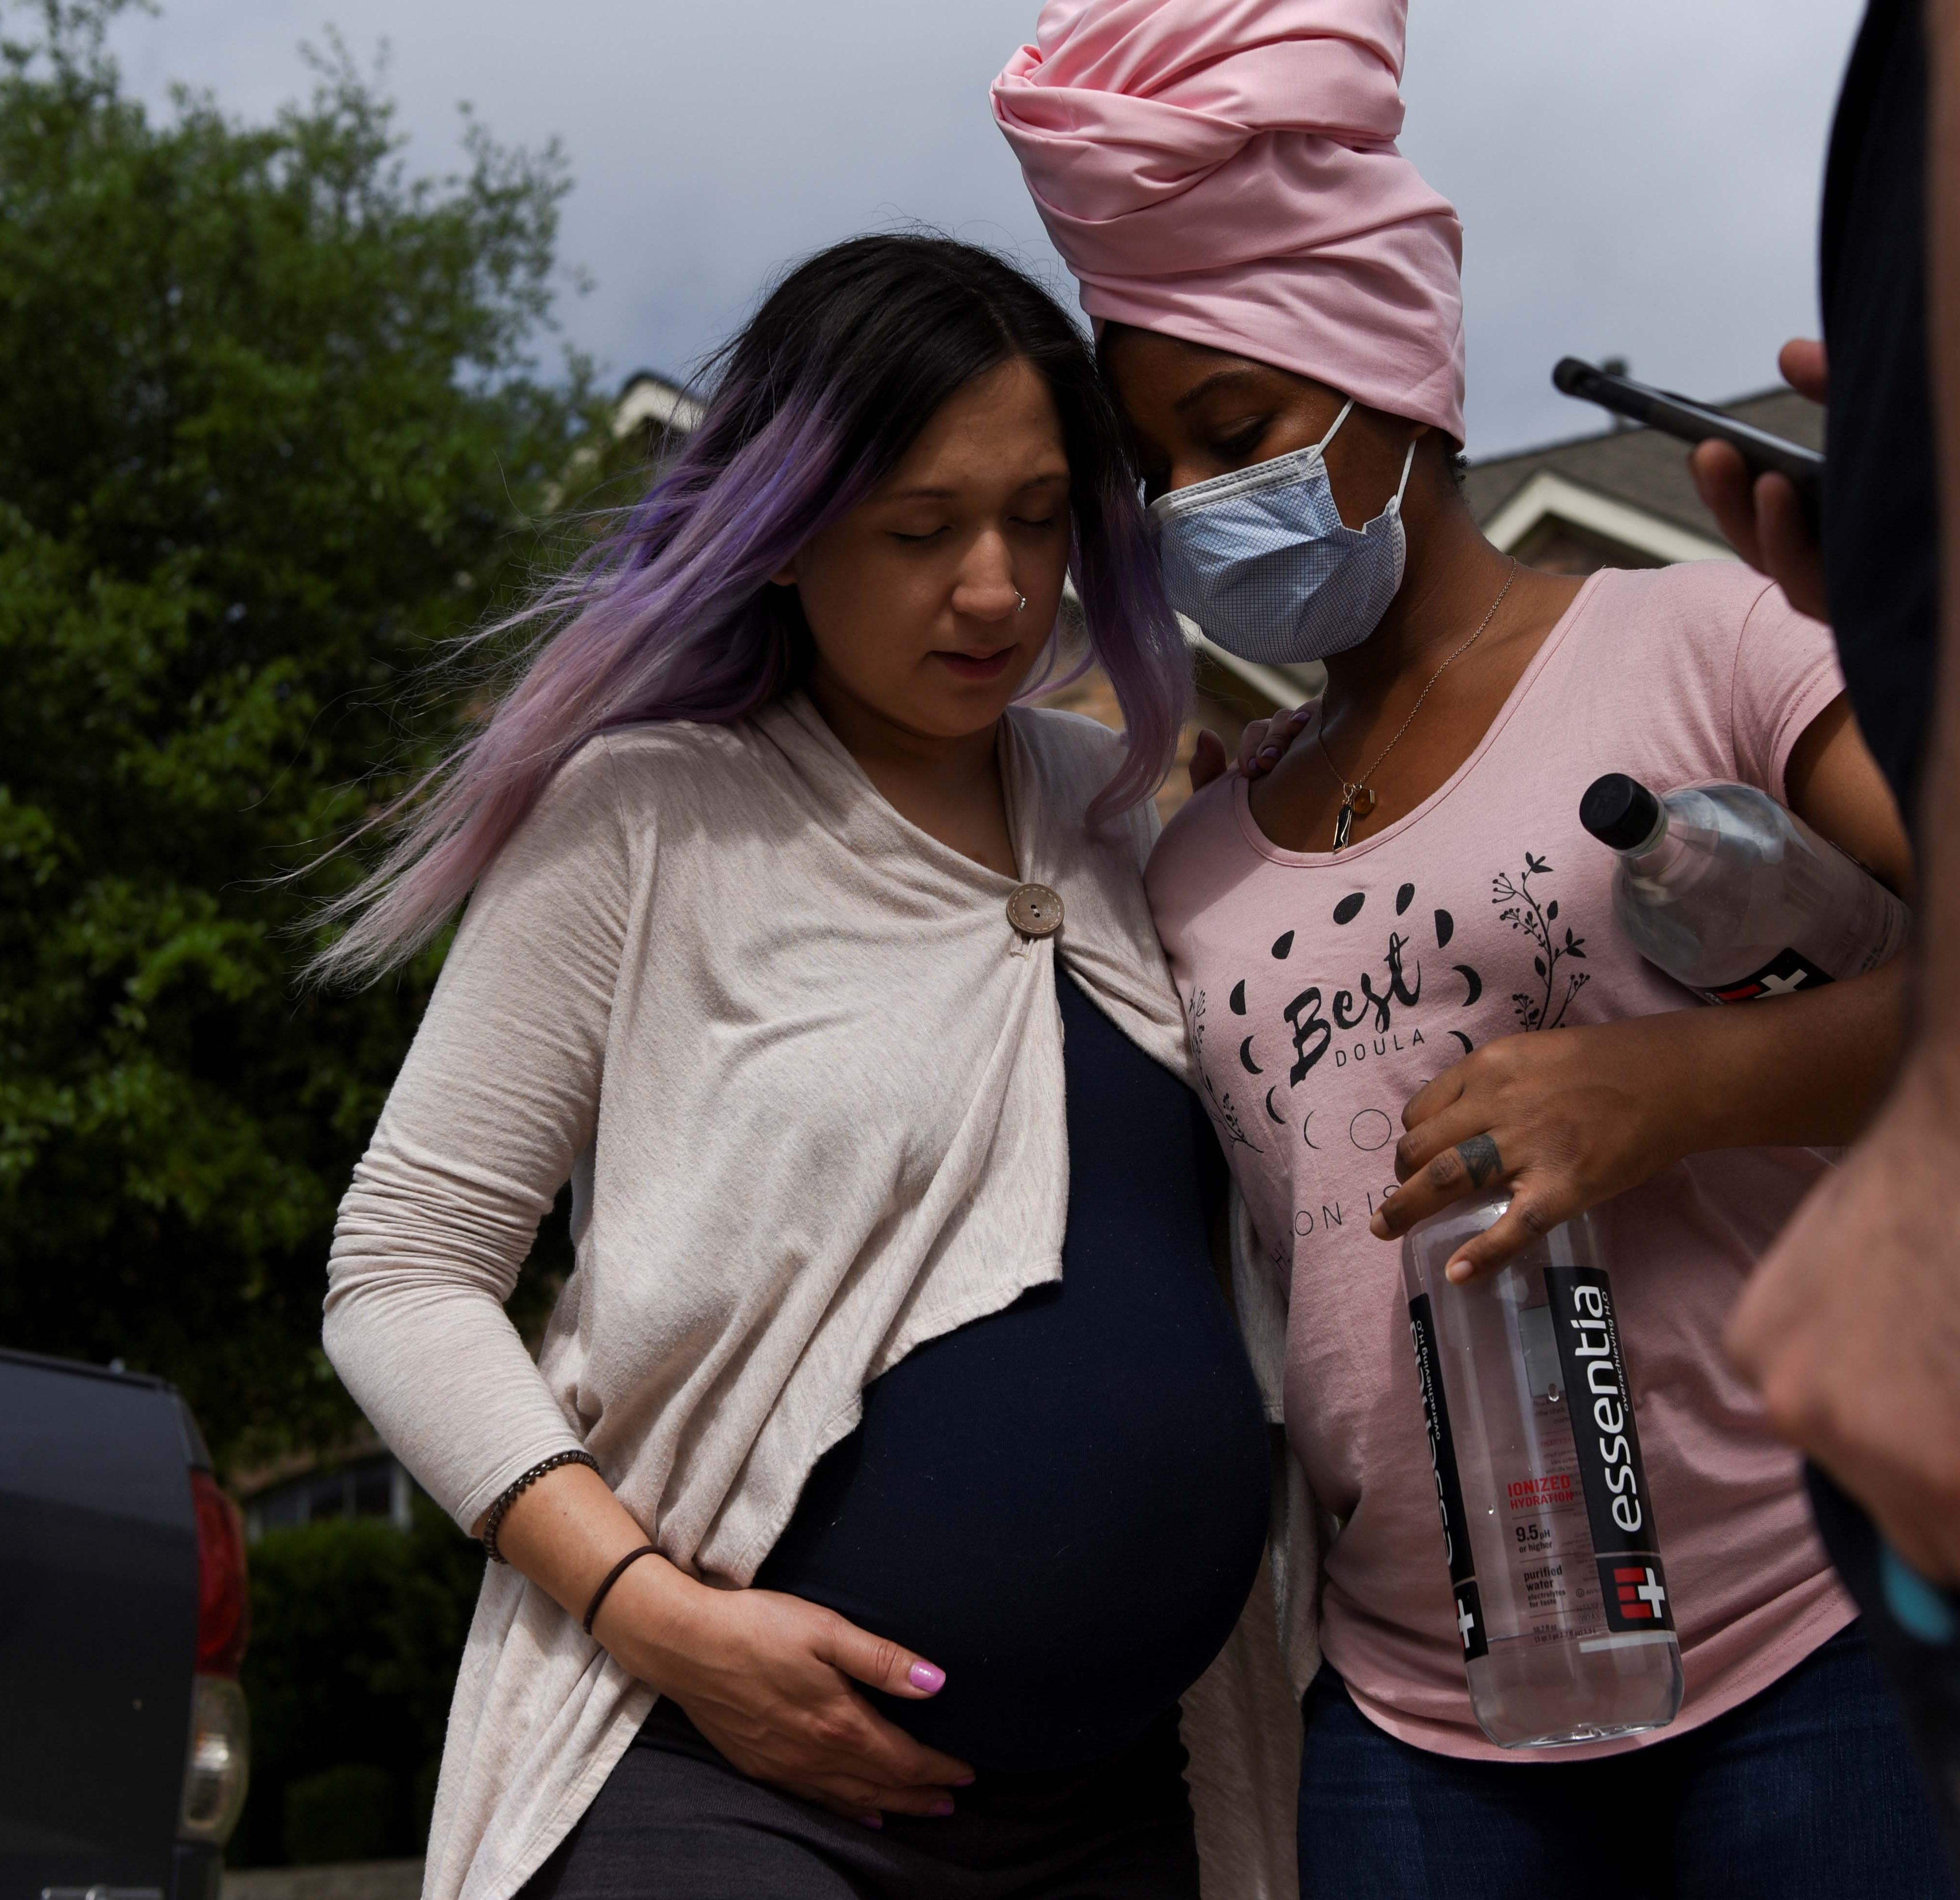
What’s our part in the big shift?
Resilience depends on “connectors” care workers that are marginalized and massively underpaid, for example community health workers. How can they be more powerful?
How can community midwives, perinatal community health workers have more power to build resilience AND fight fossil fuel and hi-carbon states?
What is THEIR vision of a more sustainable and healthier world?
How can we provide platforms, resources to the most affected communities so they are part of a more sustainable future?
How can we make the right to healthy environment part of sexual and reproductive health and rights?

