Slide 1


Heat Stress and Heat Illness Prevention CME Series Session 2 Climate and Exertional Heat Illness
October 18, 2022

Slide 2
Adult ER Interventions/Treatment Options
Eugene S Fu, MD
Associate Professor of Clinical Anesthesiology
Miller School of Medicine, University of Miami
Miami, FL
October 18, 2022

Slide 3
Disclosure
I have no actual or potential conflict of interest in relation to this presentation.

Slide 4
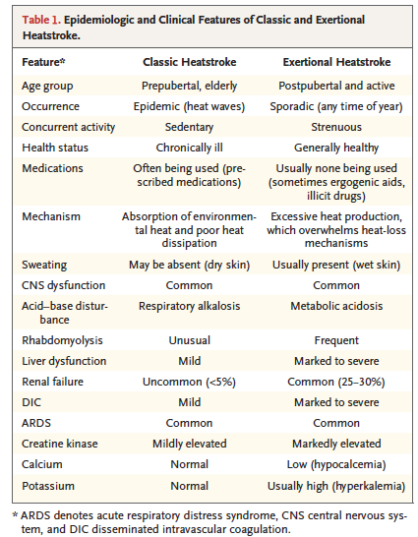
Epstein et al, NEJM 2019;380:2449-59

Slide 5
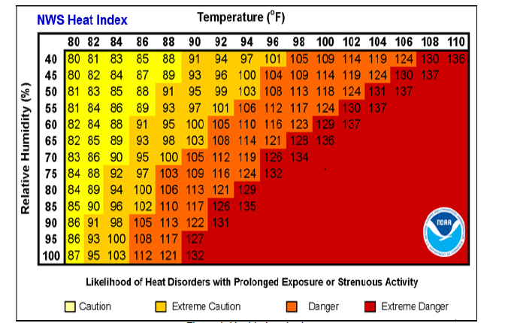
Heat Index
https://www.weather.gov/ama/heatindex

Slide 6
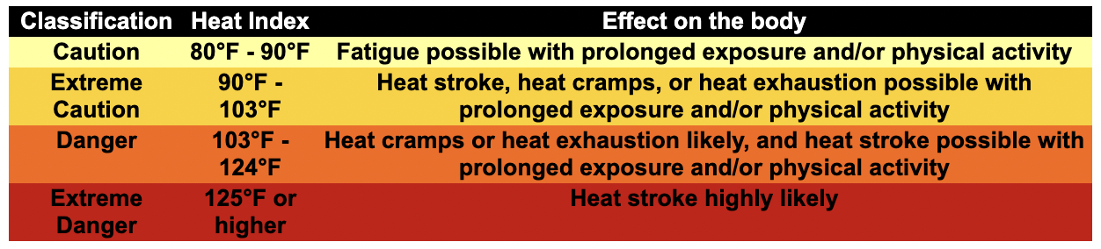
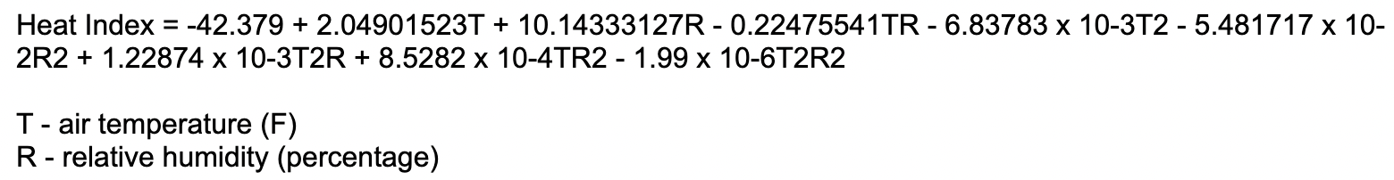
Heat Index
https://www.weather.gov/ama/heatindex

Slide 7
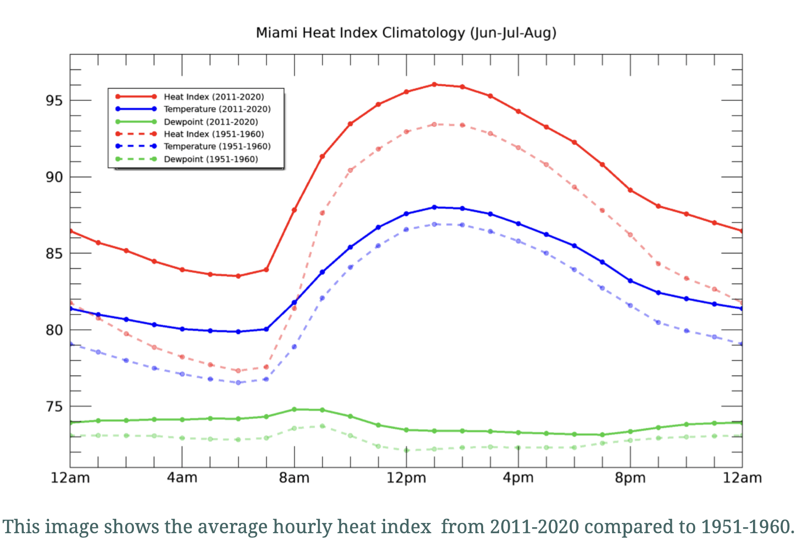
https://storymaps.arcgis.com/stories/6f1e91cf8a8e4d5d9bd67525575c042e

Slide 8
Heat Exhaustion
Mild-to-moderate illness due to water or salt
depletion that results from exposure to high
environmental heat or strenuous physical
exercise; signs and symptoms include intense
thirst, weakness, discomfort, anxiety, dizziness,
fainting, and headache; core temperature
may be normal, below normal, or
slightly elevated (>37°C but <40°C)
Bouchama et al, NEJM;2022:346:1978-1988

Slide 9
Heat Stroke
Severe illness characterized by a core temperature
>40°C and central nervous system
abnormalities such as delirium, convulsions,
or coma resulting from exposure to environmental
heat (classic heat stroke) or strenuous
physical exercise (exertional heat stroke)
Bouchama et al, NEJM;2022:346:1978-1988

Slide 10
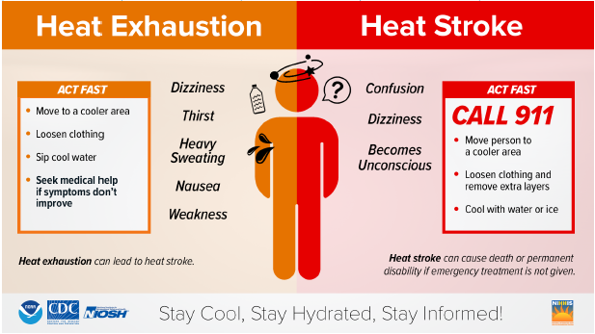
https://www.weather.gov/safety/heat-illness

Slide 11
https://www.miamidade.gov/global/economy/environment/heat.page
Heat-Related Illness (HRI)
Heat Exhaustion
Heat Stroke

Slide 12
General HRI Care
Initial Assessment/Care
1. Assess and monitor oral/axillary/infrared temperature.
Remove the patient from the hot environment to a cool environment.
2. Apply passive/active cooling techniques as necessary, but do not allow the patient to begin shivering.
Passive External Cooling Techniques
Removal from environment causing illness
Remove articles of clothing
Active Cooling Techniques
Provide a cool environment with fans, misting or air conditioning
Apply cold packs to back of neck, axilla, and groin
Moisten patient with cool saline or place wet towels around the neck and head
Miami-Dade Fire Rescue Medical Operations Manual

Slide 13
General (HRI) Care (cont.)
3. Care should be directed at supporting vital signs. Follow the appropriate protocol.
Support life-threatening problems associated with airway, breathing, and circulation.
Administer oxygen, to maintain SPO2 ≥ 94%.
Perform Airway Management and support respirations as necessary with a BVM or advanced airway.
4. Assess past medical history and nature of illness (NOI):
Medications
Exposure to increased temperatures, humidity
Extremes of age
Extreme exertion
Time, length of exposure
Poor oral intake
Fatigue, muscle cramping
Miami-Dade Fire Rescue Medical Operations Manual

Slide 14
General (HRI) Care (cont.)
5. Assess Signs and Symptoms:
Altered mental status
Unconsciousness
Hot, dry, or sweaty skin
Pale, clammy skin
Hypotension, shock
Seizures
Nausea
Weakness, dizziness, syncope
Rapid, shallow respirations
6. Follow most appropriate heat illness protocol according to presentation upon initial assessment.
Miami-Dade Fire Rescue Medical Operations Manual

Slide 15
Heat Exhaustion
Signs and symptoms include pallor, profuse sweating, hypotension, tachycardia, headache, weakness, fatigue and thirst.
Follow general protocols for Heat-Related Illness/Hyperthermia:
1. If patient does not present with nausea/vomiting and maintains a patent airway, provide oral hydration of fluids when available.
Preferably fluids of a balanced oral electrolyte solution.
2. Do not perform massage of the muscle cramps as it may aggravate the area and increase pain.
Miami-Dade Fire Rescue Medical Operations Manual

Slide 16
Heat Exhaustion (cont.)
3. Consider application of active cooling techniques gently until comfortable.
4. Establish vascular access via IV/IO of Normal Saline.
5. If patient’s systolic B/P < 90 mmHg administer a fluid bolus up to 1000 mL of NS. Monitor B/P and lung sounds often.
If the patient develops signs and symptoms of fluid overload respiratory distress (dyspnea, crackles, rhonchi, decreasing SpO2), slow the administration rate of the IV to KVO.
6. Monitor cardiac rhythm continuously and perform a 12-Lead ECG.
Miami-Dade Fire Rescue Medical Operations Manual

Slide 17
Heat Stroke
Signs and symptoms include altered mental status, hallucinations, or confusion, increased body temperature, minimal or no sweating, collapse, shortness of breath, shock, nausea and vomiting.
Follow general protocols for Heat-Related Illness/Hyperthermia:
1. Application of active cooling techniques rapidly.
Moisten or wet patient by dripping a NS solution bag until cooling efforts reaches 102℉ or apply wet towels around neck and head.
Continue moistening and provide fanning during transport.
Wrap the patient with wet sheets if there is good ambient airflow present.
Miami-Dade Fire Rescue Medical Operations Manual

Slide 18
Heat Stroke (cont.)
2. Do NOT administer anything by mouth.
3. Establish vascular access via IV/IO of Normal Saline.
4. Administer a fluid bolus up to 1000 mL of NS. Monitor B/P and lung sounds often.
If the patient develops signs and symptoms of fluid overload respiratory distress (dyspnea, crackles, rhonchi, decreasing SpO2), slow the administration rate of IV to KVO.
5. Monitor cardiac rhythm continuously and perform a 12-Lead ECG.
6. If seizures develop, administer Midazolam (Versed) 5 mg slow IV/IO/IN. This may be repeated once to a total dose of 10 mg.
Miami-Dade Fire Rescue Medical Operations Manual

Slide 19
Heat Stroke-Emergency Department
In the management of exertional heat stroke, transport to the emergency department after cooling to core body temperature to < 39.0℃.
Monitor rectal/bladder temperature and cool to core temperature <38.0℃.
Continue anticonvulsants as needed.
Airway management-mechanical ventilation. Maintain MAP > 65 mm Hg or >75 mm Hg in elderly patients or patients with hypertension or cardiac history.
Epstein et al, NEJM 2019;380:2449-59

Slide 20
Heat Stroke- ICU
1. Monitor rectal, bladder, or blood temperature to maintain core temperature to <38℃.
2. Respiratory-ARDS management, mechanical ventilation.
3. Cardiac- Invasive hemodynamic and TEE monitoring, inotropic or vasopressor support, arrythmia management.
4. Neurologic-Seizures, encephalopathy, brain edema. Mannitol, hypertonic saline, ICP monitoring.
5. Renal-AKI, rhabdomyolysis. Maintain urine output > 50 ml/hr, diuretics, dialysis.
6. Hepatic-Liver function and encephalopathy. N-acetylcysteine and lactulose.
7. Coagulopathy-DIC, bleeding and thrombosis, FFP, cryoprecipitate, factor VII, PCC to achieve target INR of 1.5. AT-III, TM, ?Heparin, ?Argatroban,
Epstein et al, NEJM 2019;380:2449-59.

Slide 21
Epstein et al, NEJM 2019;380:2449-59

Slide 22
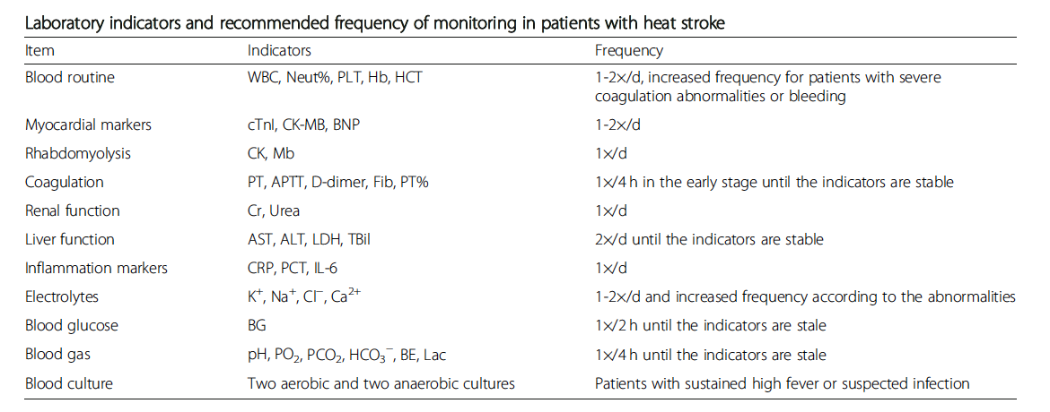
Liu et al, Military Medical Research 2020;7:1

Slide 23
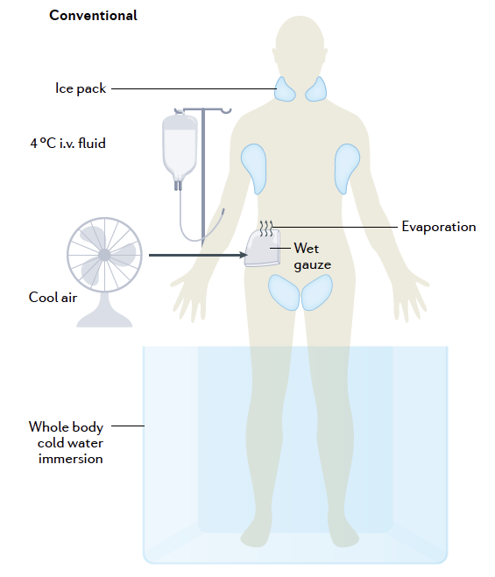
Bouchama et al, Nat Rev Dis Primers;2022:8:8

Slide 24
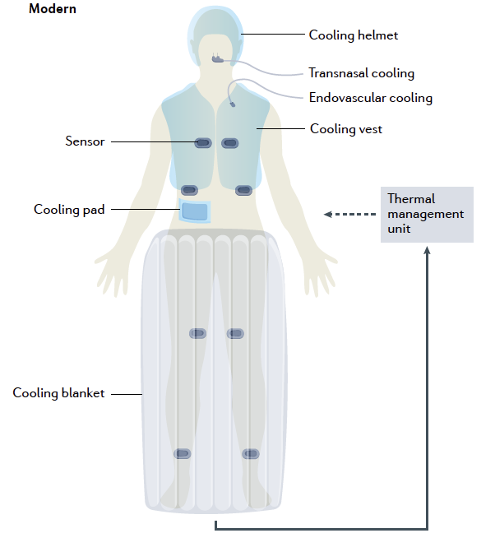
Bouchama et al, Nat Rev Dis Primers;2022:8:8

Slide 25
Conclusion
Exertional Heatstroke can occur in young healthier patients and mortality approaches 25% when ICU care is needed,
Projections indicate that future temperatures will exceed thresholds that threaten life sustainability.
Experts are sounding the alarm for the need to develop public health approaches to develop breakthroughs in understanding gene-environmental interactions.
A precision based public health approach in combination with biomarker discovery would be beneficial for targeted prevention and better protection of the population during heatwaves.
Bouchama et al, Nat Rev Dis Primers;2022:8:8

Slide 26
Acknowledgements
Florida Clinicians for Climate Action (FCCA)
Urban Heat Research Group (UHRG)
Miami Dade County-Chief Heat Officer

