Slide 1
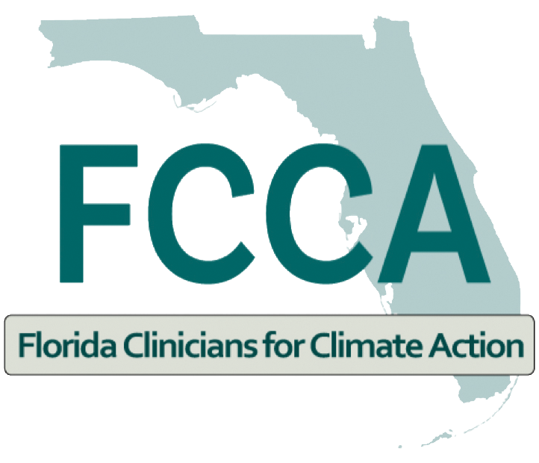

Heat Stress and Heat Illness Prevention CME Series Session 1 Climate, Heat, and Health
September 13, 2022

Slide 2
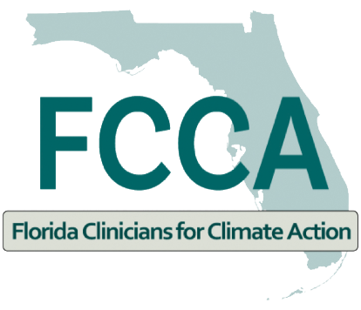
Miami-Dade County Specific Heat Data
Jane Gilbert, Chief Heat Officer
Miami-Dade County
Miami, FL
September 13, 2022

Slide 3
Disclosure
I have no actual or potential conflict of interest in relation to this presentation.

Slide 4
Miami-Dade County Specific Heat Data
….and how and why it’s getting more dangerous.

Slide 5


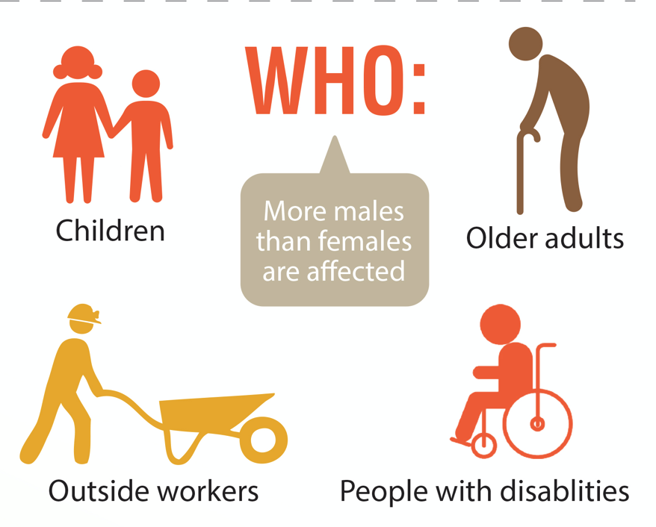

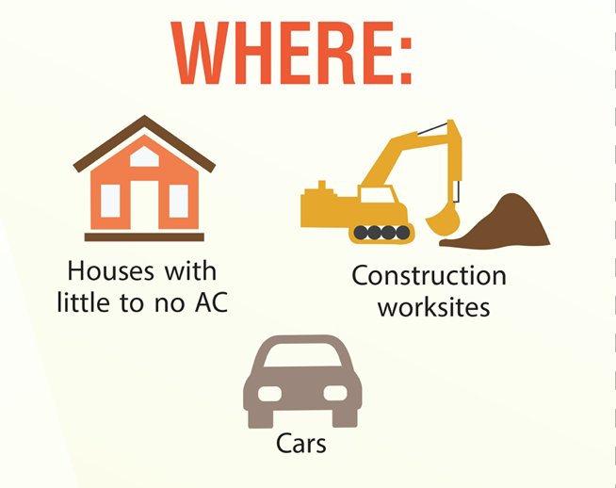
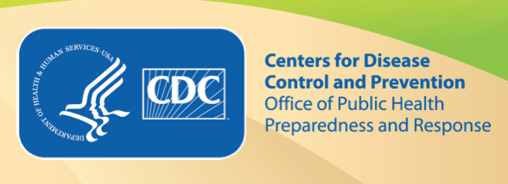
Extreme Heat
Heat is the leading weather-related killer in the United States
High heat and humidity can lead to heat-related illness, including heat cramps, heat exhaustion and heat stroke
High risk groups experience a disproportionate amount of health impacts
Most HRIs and deaths are preventable
Pregnant Women
Notes:
A large portion of public health impacts stem from individuals failing to recognizing the danger associated with extreme heat events or making poor decisions during these events. According to the CDC, most deaths from these events are preventable.
Image credits: CDC, Office of Public Health Preparedness and Response
Vaidyanathan, A., Saha, S., Vicedo-Cabrera, A. M., Gasparrini, A., Abdurehman, N., Jordan, R., ... & Elixhauser, A. (2019). Assessment of extreme heat and hospitalizations to inform early warning systems. Proceedings of the National Academy of Sciences, 116(12), 5420-5427.
]

Slide 6
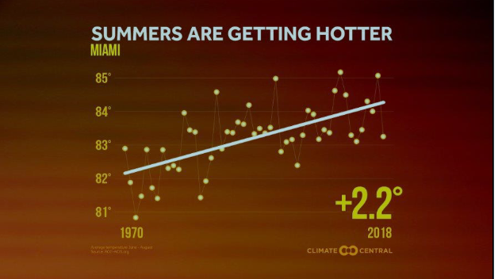
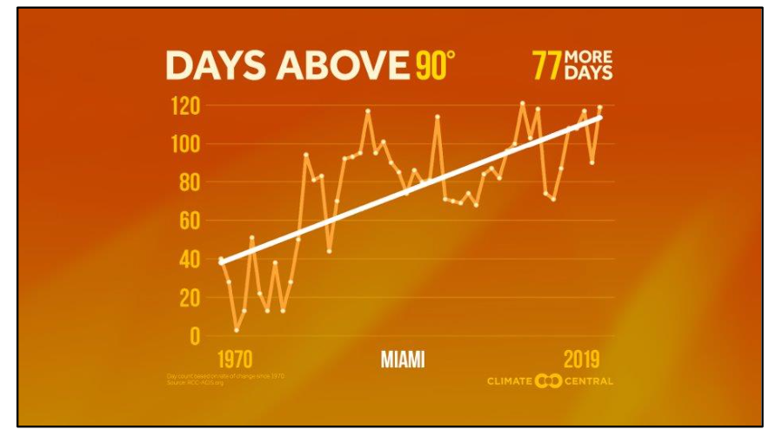
Currently in Miami
S
The number of dangerously high heat days are INCREASING due to climate change
Source: Climate Central
Notes:
Southeast Florida is known for its tropical climate and warmer temperatures. Since 1970, Miami-Dade County has had an average increase of days above 90°F from 84 to now 133 days per year. Since 1985 our average minimum temperatures have risen a little over 2 degrees farhenheit since 1985.

Slide 7
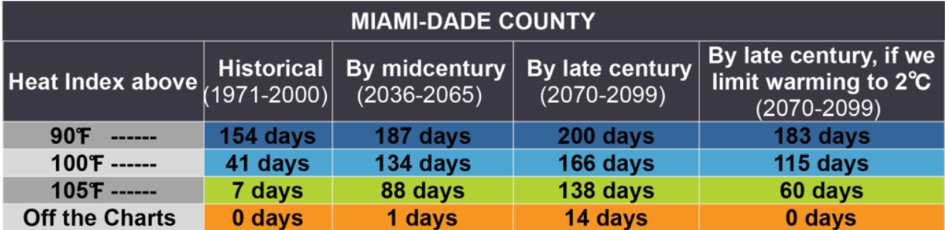
Source: Union of Concerned Scientists
Notes:
And of course in South Florida we have very high average humidity, which makes it more difficult for our bodies to regulate the heat and therefore elevates the heat health related risks. Currently our humidity in the summer averages around 65-70% and so far we're seeing a slight avg increase in humidity over time. So This means that while historically Miami Dade County has experienced an average of 7 days or a week of days with a heat index at or above 105 degrees fahrenheit, by mid century that will likely increase to 88 days or essentially 3 months of days that reach a heat index of 105 or above.

Slide 8
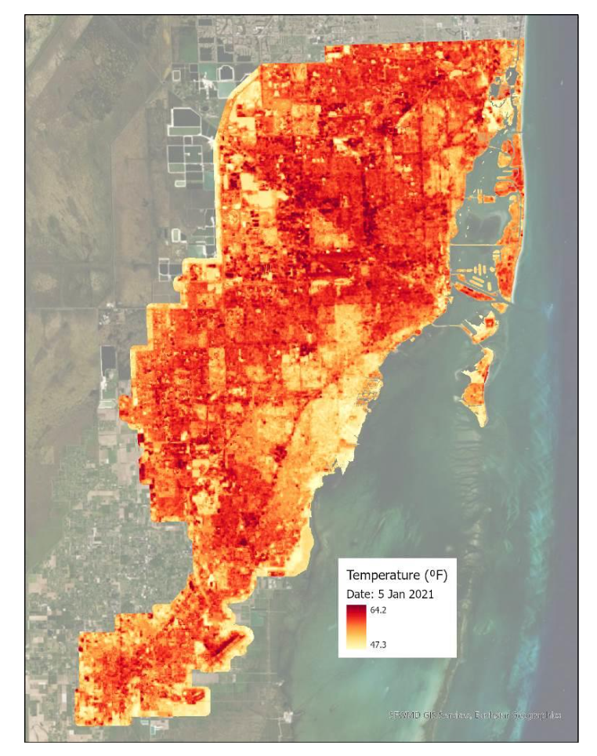
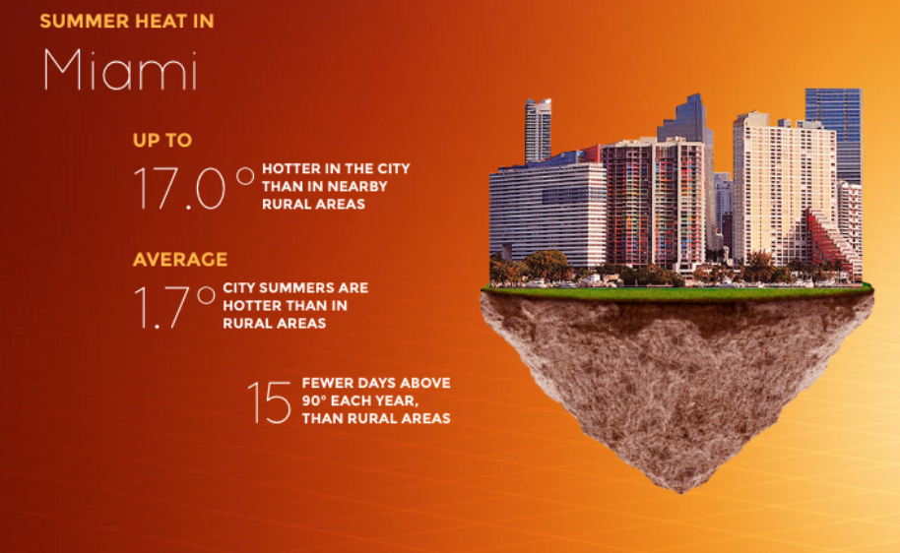
Background: Currently in Miami
Heat risks are also elevated in urban environments due to Urban Heat Island Effect
Notes:
The prevalence of concrete, asphalt, and other heat- absorbing surfaces throughout the region compounds the impacts of heat through the Urban Heat Island Effect. In the summer, land surface temperatures can be up to 17 degrees hotter in the city than rural areas.
There are also temperature inequities throughout the city due to the historic practice of redlining. Redlining, was the discriminatory practice of denying services, amenities, funding, and housing on the basis of race or ethnicity. Typically, neighborhoods that were redlined, still today do not have many heat mitigation features like trees, parks, or well-maintained housing and an excess of impervious surfaces.
Courtesy of Heat Tool Kit, https://statesatrisk.org/florida/all

Slide 9
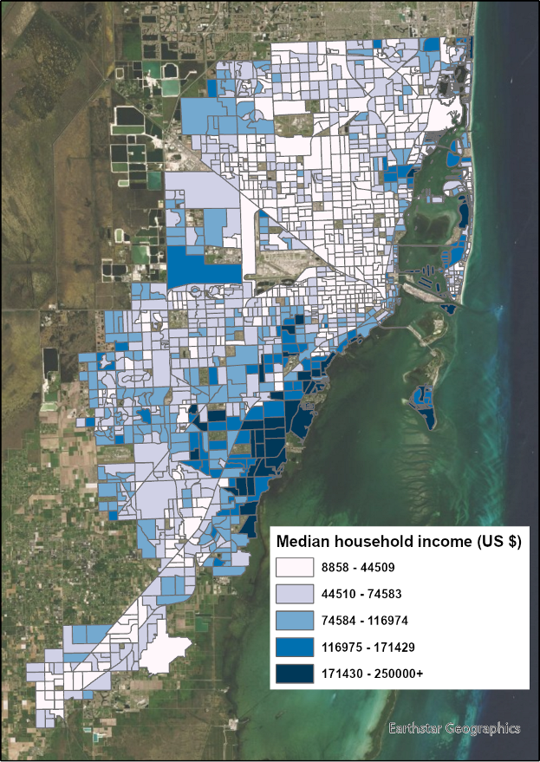
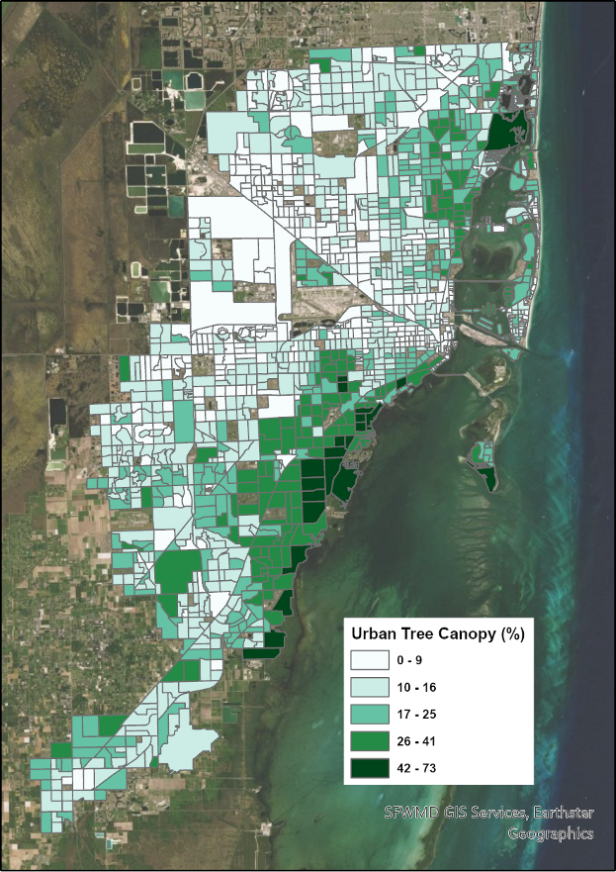
Source: Miami-Dade County Urban Tree Canopy Assessment
Notes:
Median household income and Urban Tree Canopy positive correlation

Slide 10
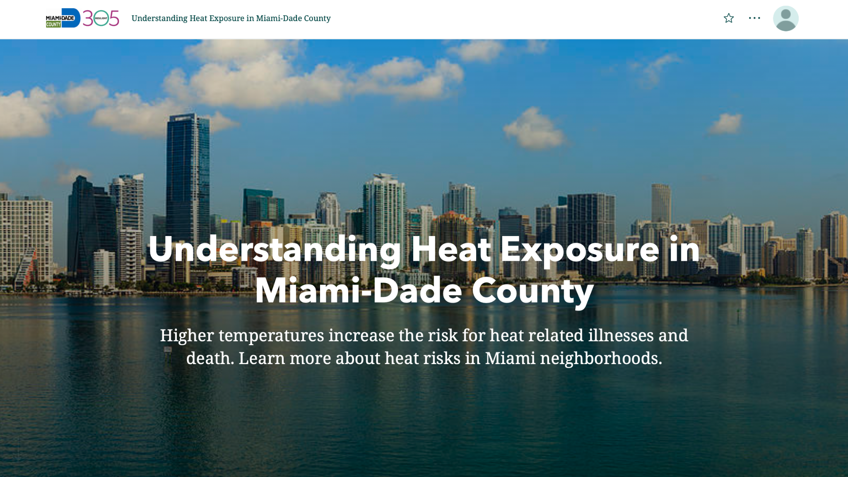
ArcGIS StoryMap on Heat Exposure
www.miamidade.gov/heat
Notes:
Public facing communication on heat exposure and vulnerability in Miami-Dade
Understand:
Climate Change
Temperature differences throughout the county
Heat and Health
Vulnerability
Resilience

Slide 11
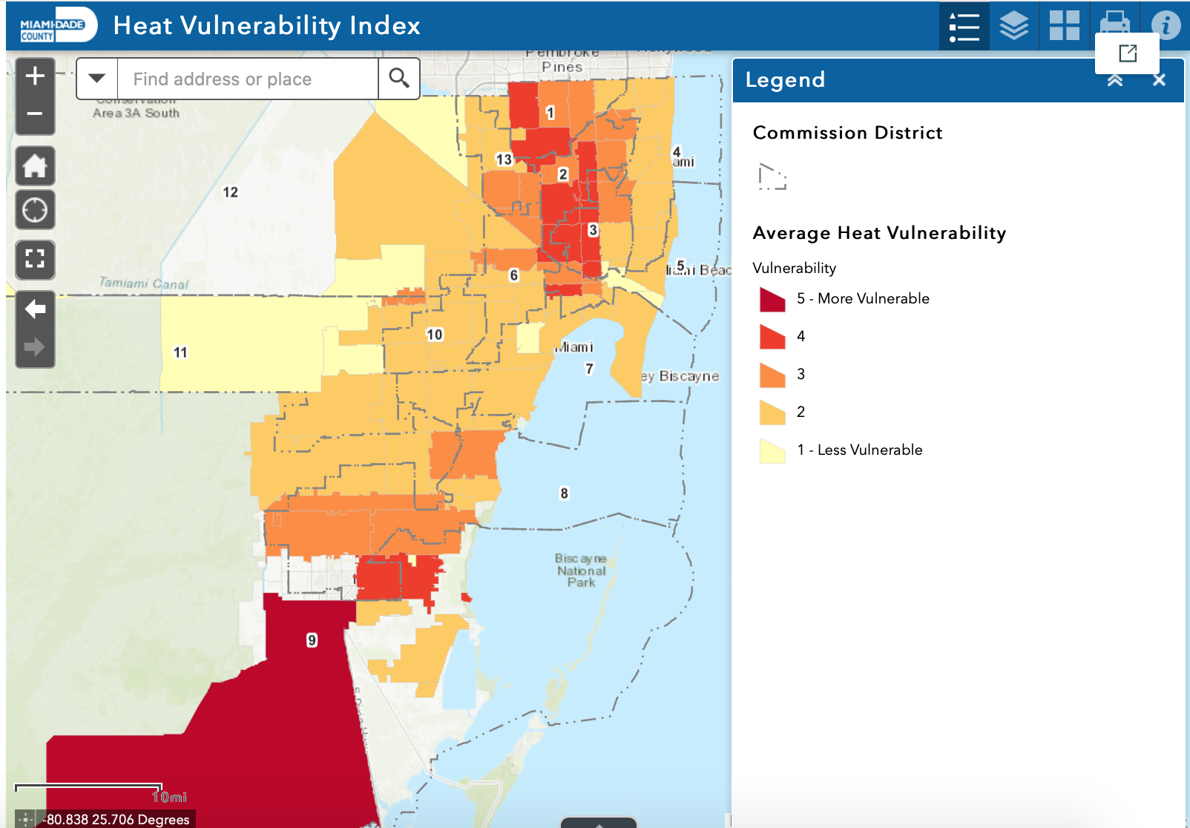
Miami-Dade Extreme Heat Vulnerability Index Map
Interact with the Heat Vulnerability Index web mapping application to identify vulnerable zip codes in Miami-Dade
Homestead, Florida City, Hialeah, Miami, Opa-Locka, and Miami Gardens
** Average of Heat Hospitalization and ER Visit Vulnerability as seen on previous slide
Source: Miami-Dade County Extrene Heat Vulnerability Mapping Report (Uejio and Ahn 2022)

Slide 12
Heat Vulnerability Study - Populations at Risk in Miami-Dade
Category | Description of Data | Provider
Health Outcome | Heat Related Illness Emergency Department | FDOH
 | Heat Related Illness Hospitalizations | FDOH
Exposure | Land Surface Temperature | NASA
 | % Impervious Surface | NLCD (2019)
Sensitivity | % Older Adults (age > 65) | US Census
 | % Living Alone | US Census
 | Children 0-5 | US Census
 | % Living in Poverty | US Census
 | Household Income | US Census
 | % Limited Language Proficiency | US Census
 | % African American | US Census
 | % Hispanic | US Census
 | % Indigenous | US Census
 | % Mobile Homes | US Census
 | % High School Education | US Census
 | % Outdoor Workers (Agr, Forestry, Fish, Mining, Construction) | US Census
 | % Female Head of Housing | US Census
Hospitalizations
% Living in Poverty
% Mobile Homes
Emergency Department Visits
Daytime surface temperature
% Outdoor Workers
% Age less than 18
Miami-Dade Extreme Heat Vulnerability Mapping Report (Uejio and Ahn, 2022)

Slide 13
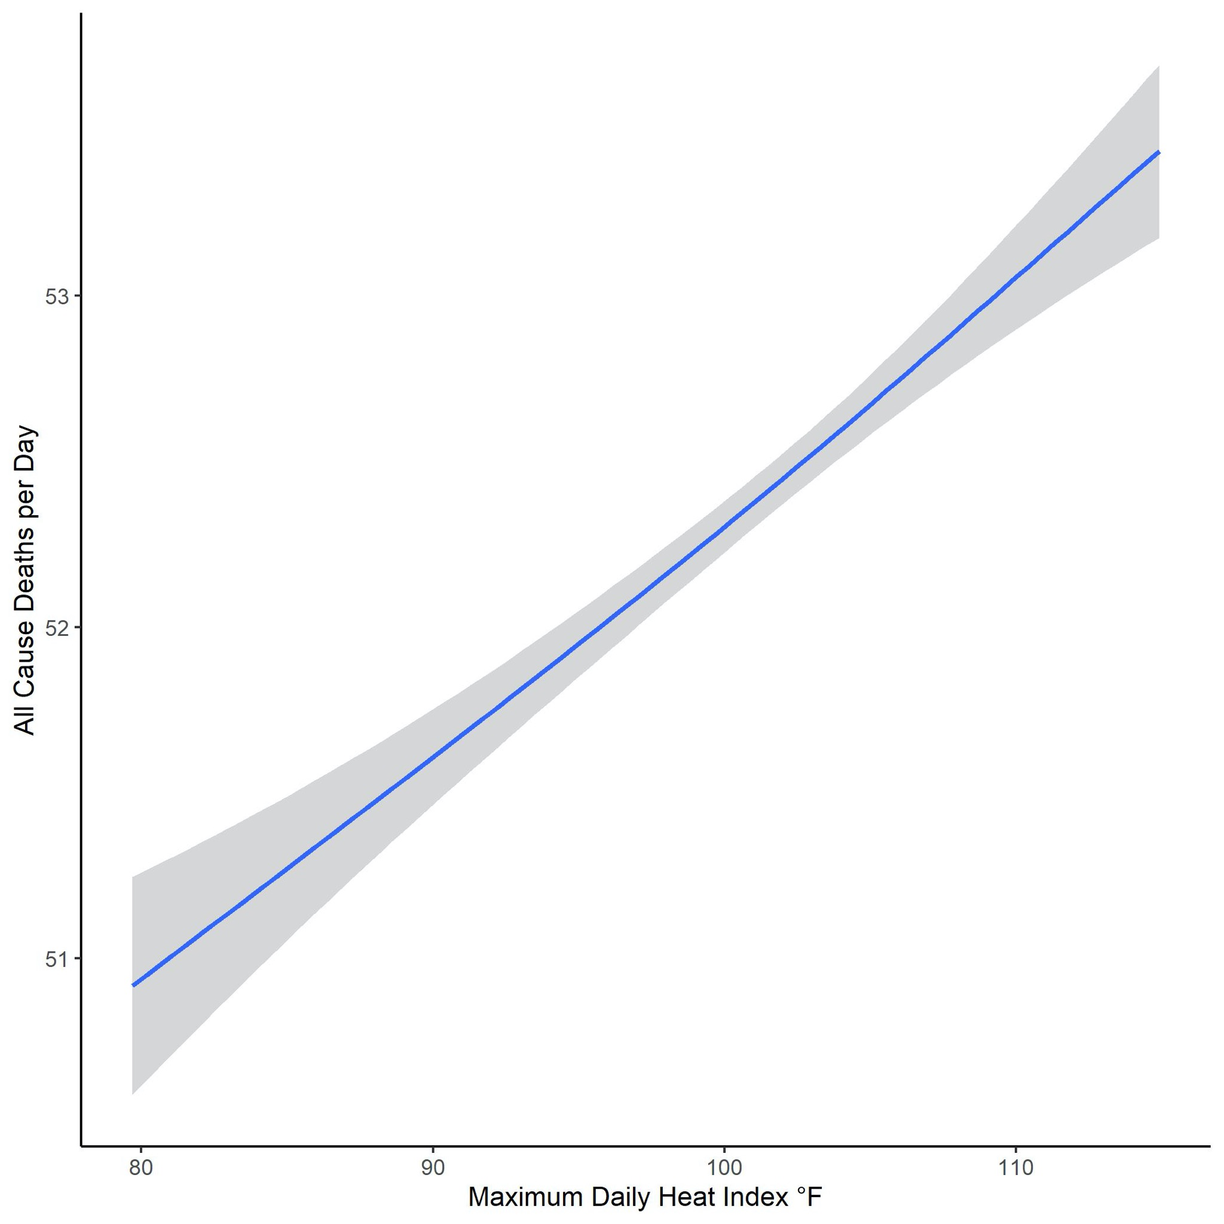
Heat Index and Mortality
The majority of heat related deaths occur below heat advisory thresholds
A 10 degree increase in the heat index results in one more death per day
Heat attributable death was 34 deaths per year (2015-2019)
National Weather Service Heat Advisory & Warning
Miami-Dade Extreme Heat and Mortality Report (Uejio and Ahn, 2022)

