Slide 1
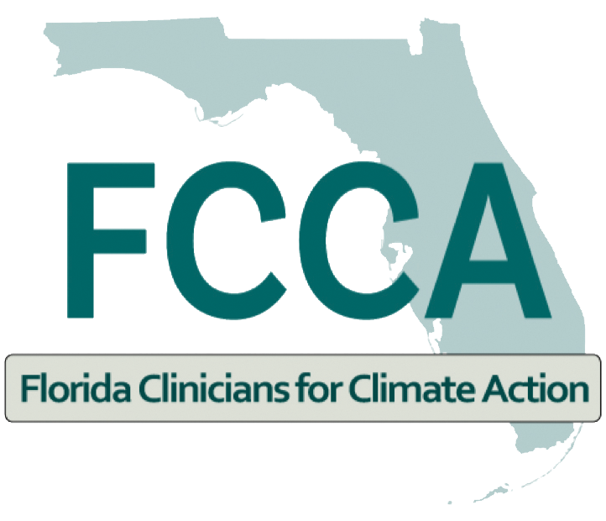

Impacts of Ambient Air Pollution on the Body
Jevon Harrison, M.B.B.S.
Florida State Medical Association Representative
Florida Clinicians For Climate Action
Miami, FL
December 13, 2022.

Slide 2
Disclosure
I have no actual or potential conflict of interest in relation to this presentation.

Slide 3
Ambient air pollution
Air pollution in outdoor environments
Occurs when air pollutants reach high concentrations
Air quality index (AQI):
Ground level ozone
Particulate matter (PM); of aerodynamic diameters 10 microns or less [PM₁₀] + [PM_{2.5}]
Carbon monoxide
Sulfur dioxide
Nitrogen dioxide
AirNow.gov
aqicn.org
Notes:
https://www.uptodate.com/contents/overview-of-occupational-and-environmental-health?search=ambient%20air%20pollution&source=search_result&selectedTitle=1~150&usage_type=default&display_rank=1#H543488597
The AQI scale runs from 0 to 500, with a value of 100 or less corresponding to the national air quality standard (AQI of 0 to 50 is consistent with good air quality; AQI of 51 to 100 is consistent with moderate air quality). An AQI of greater than 100 is considered unhealthy for sensitive groups (ie, those with baseline lung disease), and a value greater than 300 signifies hazardous conditions.

Slide 4
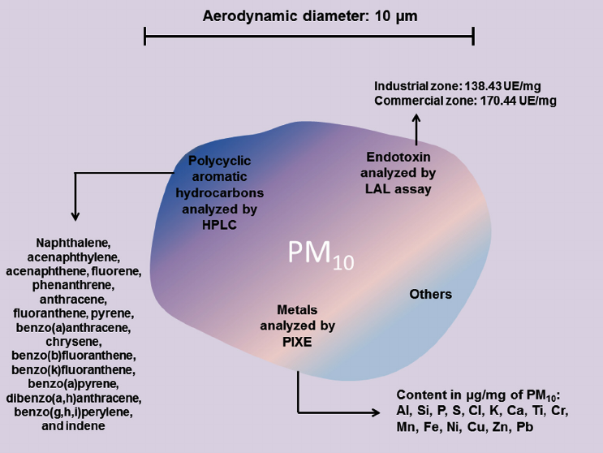
The anatomy of Particulate Matter
Smaller than 10 micrometers has greatest effect
Surface of particles contain Fe, Cu, Mn, Zn + polycyclic aromatic carbons and lipopolysaccharides
PM_{2.5} is small enough to pass the nose hairs
Large surface area to carry toxic substances
Free radicals (OH mainly), metals, organic components
Figure 1 adapted from https://www.researchgate.net/figure/The-composition-of-particulate-matter-with-aerodynamic-diameter-of-10-m-m-PM-10-PM-10_fig2_280535817

Slide 5
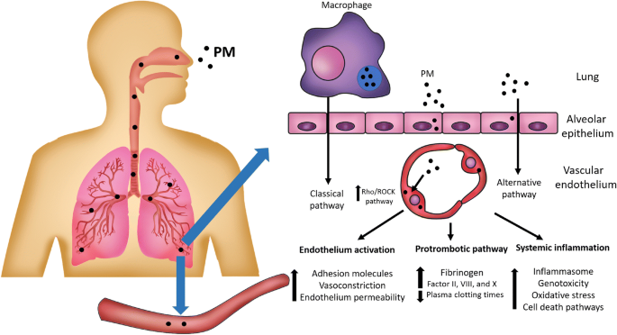
How it enters the body
Figure 2 adapted from https://link.springer.com/article/10.1007/s11356-020-10574-w

Slide 6
Particulate matter 2.5 (PM_{2.5})
Comes from:
Dust storms, volcanoes, forest fires
Transportation, fuel burning, cigarette smoke and industrial processes
Enters the circulation through diffusion
Affects:
Immune system
Respiratory system
Cardiovascular system
Neurological system
The fetus
https://www.health.ny.gov/environmental/indoors/air/pmq_a.htm#:~:text=What%20is%20Particulate%20Matter%202.5,unit%20of%20measurement%20for%20distance.
Notes:
https://www.health.ny.gov/environmental/indoors/air/pmq_a.htm#:~:text=What%20is%20Particulate%20Matter%202.5,unit%20of%20measurement%20for%20distance.

Slide 7
What does this do to the body?

Slide 8
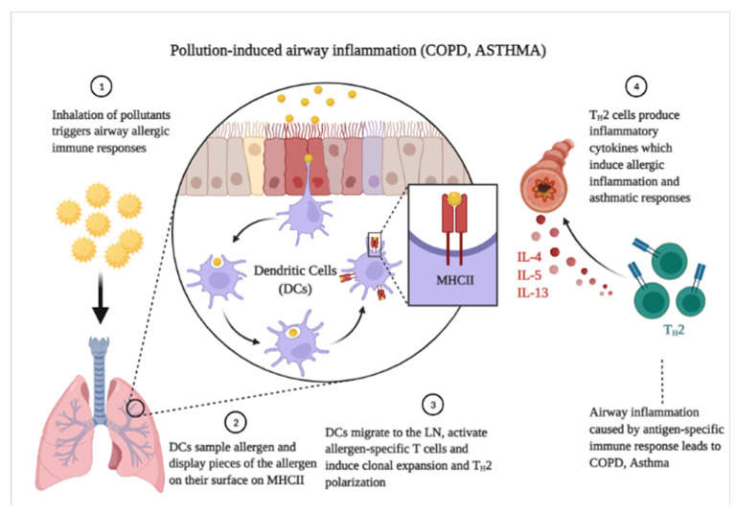
Figure 3 adapted from https://www.ncbi.nlm.nih.gov/pmc/articles/PMC9223652/figure/ijerph-19-07511-f002/
Notes:
Figure 2 adapted from https://www.ncbi.nlm.nih.gov/pmc/articles/PMC9223652/figure/ijerph-19-07511-f002/

Slide 9
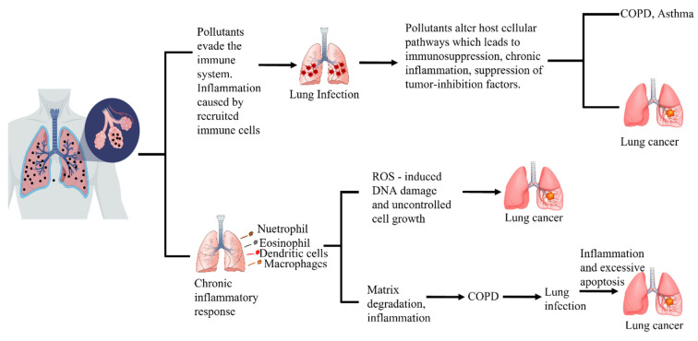
Figure 4 adapted from https://www.ncbi.nlm.nih.gov/core/lw/2.0/html/tileshop_pmc/tileshop_pmc_inline.html?title=Click%20on%20image%20to%20zoom&p=PMC3&id=9223652_ijerph-19-07511-g004.jpg
Notes:
Figure 4 adapted from https://www.ncbi.nlm.nih.gov/core/lw/2.0/html/tileshop_pmc/tileshop_pmc_inline.html?title=Click%20on%20image%20to%20zoom&p=PMC3&id=9223652_ijerph-19-07511-g004.jpg

Slide 10
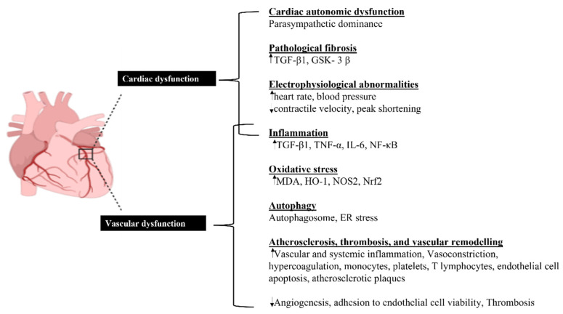
Figure 5 adapted from https://www.ncbi.nlm.nih.gov/pmc/articles/PMC9223652/figure/ijerph-19-07511-f003/
Notes:
Figure 3 adapted from https://www.ncbi.nlm.nih.gov/pmc/articles/PMC9223652/figure/ijerph-19-07511-f003/

Slide 11
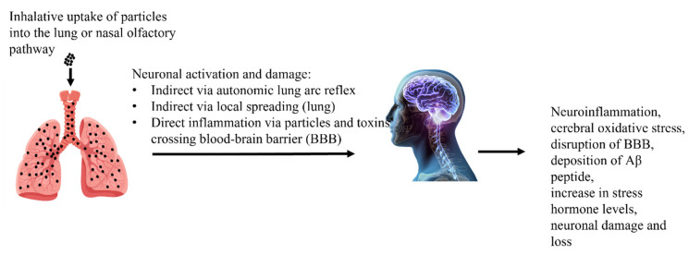
Neurodegenerative
Figure 6 adapted from https://www.ncbi.nlm.nih.gov/core/lw/2.0/html/tileshop_pmc/tileshop_pmc_inline.html?title=Click%20on%20image%20to%20zoom&p=PMC3&id=9223652_ijerph-19-07511-g005.jpg
Notes:
Figure 5 adapted from https://www.ncbi.nlm.nih.gov/core/lw/2.0/html/tileshop_pmc/tileshop_pmc_inline.html?title=Click%20on%20image%20to%20zoom&p=PMC3&id=9223652_ijerph-19-07511-g005.jpg
Olfactory problems
Auditory impairments
Depression symptoms

Slide 12
The main effects
Activates the nervous and neuroendocrine system
INFLAMMATION!!!!
Many inflammatory-related cytokine genes become activated [especially in the MITOCHONDRIA]
Neutrophil, eosinophil, T cell and mastocyte count increases
Increase in Calcium concentration→ Activation of inflammatory cascade
Free Radical formation → Peroxidation of lipids on cell membrane surfaces → apoptosis and necrosis
Xing YF, Xu YH, Shi MH, Lian YX. The impact of PM2.5 on the human respiratory system. J Thorac Dis. 2016 Jan;8(1):E69-74. doi: 10.3978/j.issn.2072-1439.2016.01.19. PMID: 26904255; PMCID: PMC4740125.
Notes:
https://www.ncbi.nlm.nih.gov/pmc/articles/PMC4740125/

Slide 13
The Respiratory System
Damages bronchial mucociliary system → less bacterial clearance
Inflammatory cytokine net disruption → Inhibition of gap junctional intercellular communication→ increasing epithelial barrier permeability death of lung epithelial cells and fibroblasts
Disruption of surfactant → Inhibits alveolar macrophage phagocytosis
Imbalanced intracellular calcium homeostasis → activation of the inflammatory cascade
Increases TNF-alpha expression → increase in free radical formation
Xing YF, Xu YH, Shi MH, Lian YX. The impact of PM2.5 on the human respiratory system. J Thorac Dis. 2016 Jan;8(1):E69-74. doi: 10.3978/j.issn.2072-1439.2016.01.19. PMID: 26904255; PMCID: PMC4740125.
Notes:
https://www.ncbi.nlm.nih.gov/pmc/articles/PMC4740125/

Slide 14
The Respiratory System
Decreases viability of alveolar macrophages
Irritates and corrodes the alveolar wall
Can lead to lung cancer
Pulmonary edema and pneumonitis
Exacerbates
asthma
bronchitis and emphysema → COPD

Slide 15
Cardiovascular system
Systemic inflammation + induction of sympathetic nervous system →Cardiac remodeling occurs due to inflammatory activation
Impairs autonomic nervous system → decline in heart variability (ARRYTHMIAS)
Constriction + reduced vasodilation → hypertension → Angina
Increased risk of myocardial infarction

Slide 16
Pregnancy and the fetus
Fetus
Mother
Bronchopulmonary dysplasia
Cardiovascular diseases
Preterm birth
Increased risk of leukemia
Pre-eclampsia
Hypertensive complications

Slide 17
Chronic exposure
Imaging of Lung lymph nodes and mesenteric lymph nodes done
Lymph node drainage is impaired
Uptake by macrophages via CD 68⁺ and 169⁻ noted over time
There is also a decrease in memory T cells
Occurs at marginal zone of lymph nodes
impaired phagocytosis
impaired proliferation
impaired cytokine production IFN-α, TNF-α and IL-6
Ural et al. (2022). Inhaled particulate accumulation with age impairs immune function and architecture in human lung lymph nodes. Nature Medicine. https://doi.org/10.1038/s41591-022-02073-x
Notes:
https://www.nature.com/articles/s41591-022-02073-x

Slide 18
Insulin resistance + adipose inflammation→ hepatic endoplasmic reticulum stress →type 2 Diabetes Mellitus
Hepatitis (Halogenated hydrocarbons)
Worsens respiratory viral illness
Hinders recovery

Slide 19
Carcinogenesis
Alters telomere length
Alters DNA for:
Damage and repair
Inflammation
Oxidative stress response
Methylation
GI: Colorectal, gastric
GU: Bladder
Lung cancer
Heme: Leukemia in children
Notes:
altered telomere length, expression of genes involved in DNA damage and repair, inflammation, immunological and oxidative stress response, and epigenetic effects such as DNA methylation

Slide 20
Who is affected?

Slide 21
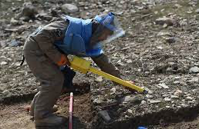


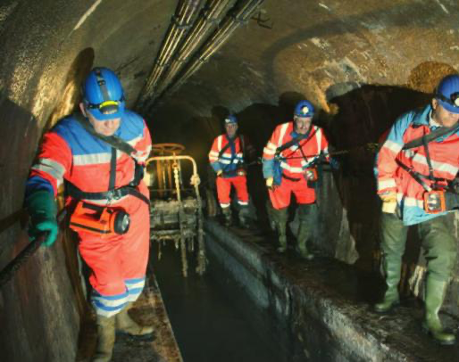
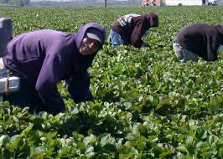
Notes:
Figure 7 adapted from https://www.google.com/search?q=types+of+field+workers&rlz=1C5CHFA_enUS1023US1023&sxsrf=ALiCzsaMUQ5Byylvsf5y5UkYCEoY7GII8w:1670966455346&source=lnms&tbm=isch&sa=X&ved=2ahUKEwjTmoKQw_f7AhVDmYQIHWd4AQgQ_AUoAXoECAIQAw&biw=712&bih=673&dpr=2
Figure 8 adapted from https://www.workerscontrol.net/authors/sewer-syndicalism-worker-self-management-public-services
Figure 9 adapted from https://afghanistan.asia-news.com/en_GB/articles/cnmi_st/features/2019/04/29/feature-02
Figure 10 adapted from https://mcc.gse.harvard.edu/reports/children-mean-raise
Figure 11 adapted fromhttps://www.timeshighereducation.com/hub/p/aging-society-how-will-elderly-population-survive

Slide 22
Who is affected?
EVERYONE
Field workers:
Agricultural workers, sewer employees, land miners
Elderly with:
Cardiovascular disease, cerebrovascular, neurodegenerative, bronchitis, emphysema and asthma

Slide 23
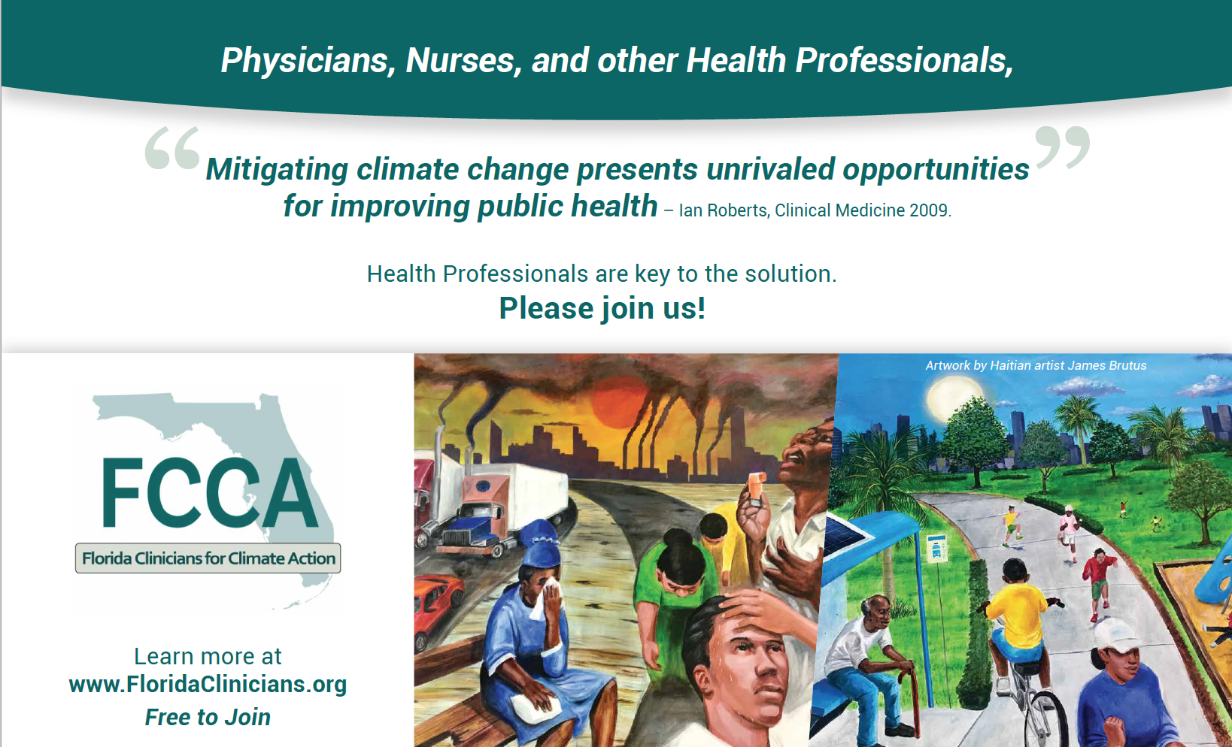

Notes:
Join a Group:
Florida Clinicians for Climate Action (FCCA) is a coalition of health professionals and health organizations concerned about the impacts of climate change on Florida residents, especially those in vulnerable populations.
Why should you join?
FCCA can help you learn more about climate & health, and point you to advocacy opportunities
We provide regular climate & health training opportunities.
We can work with you on writing letters to the editor, or on Op-Eds.
We can point you to opportunities to take action.
For example, recently, we added our voice to the coalition fighting against the sugarcane burning practices that are disproportionately harming communities of color in South Florida.
We also spoke out in favor of stronger efficiency standards to help low-income families save money on their electric bill.
FCCA is also engaging in lawmaker education - setting up meetings with our lawmakers to help them understand how climate affects our health.
Our Mission:
Engage - health professionals and health organizations in a climate discussion. Recruit health professionals to learn about climate change and understand the health impacts.
Educate - health professionals, their patients and policymakers about the health effects of climate change and the health benefits of climate solutions.
Advocate - for policies that support a healthy sustainable future. Advocate for solutions that incorporate economic and social justice, and that pay close attention to vulnerable communities.

Slide 24
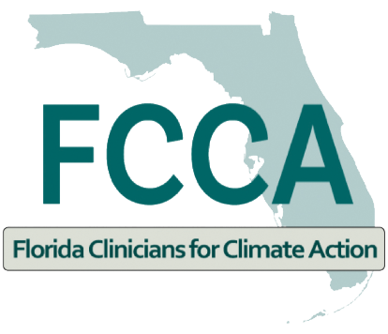
Please follow us on Instagram @flclinicians Please follow us on Facebook @Florida Clinicians for Climate Action Follow me on IG and Tik Tok : @drcherylholder
Thank You
www.floridaclincians.org

