Slide 1
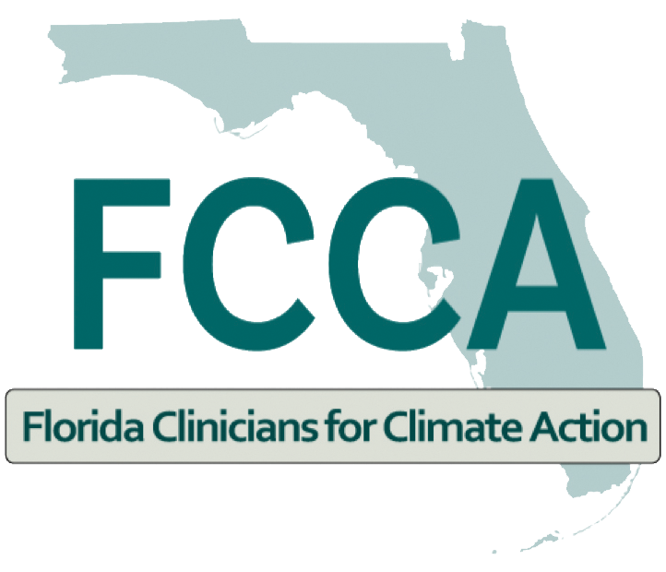

Heat Stress and Heat Illness Prevention CME Series Session 4 The Health Impacts of Heat and Ambient Air Pollution
December 13, 2022

Slide 2
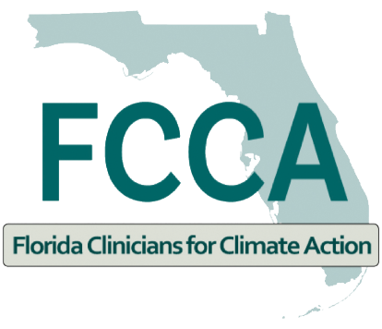
The Health Impacts of Heat and Ambient Air Pollution
Cheryl L. Holder, M.D.
Associate Professor
Assoc. Dean of Diversity, Equity, Inclusivity and Comm. Initiatives
FIU/Herbert Wertheim College of Medicine
Co-Chair. Florida Clinician for Climate Action
Co-Chair. Miami Dade Heat, Health Task Force

Slide 3
Disclosure
I have no actual or potential conflict of interest in relation to this presentation.

Slide 4
Learning Objectives
Summarize the relationship between increasing temperatures and ambient pollution levels
Discuss characteristics of patients who are most vulnerable to the effects of increased levels of ambient air pollution
Analyze evidence of a relationship between patient symptoms, heat and ambient air pollution
Identify behaviors which may increase patient exposure to ambient air pollution
Recommend appropriate patient interventions that are associated with decreased exposure to ambient air pollution

Slide 5
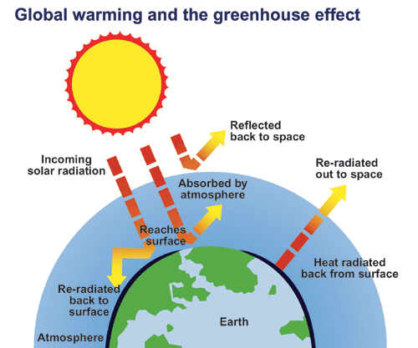
Greenhouse Effect

Slide 6
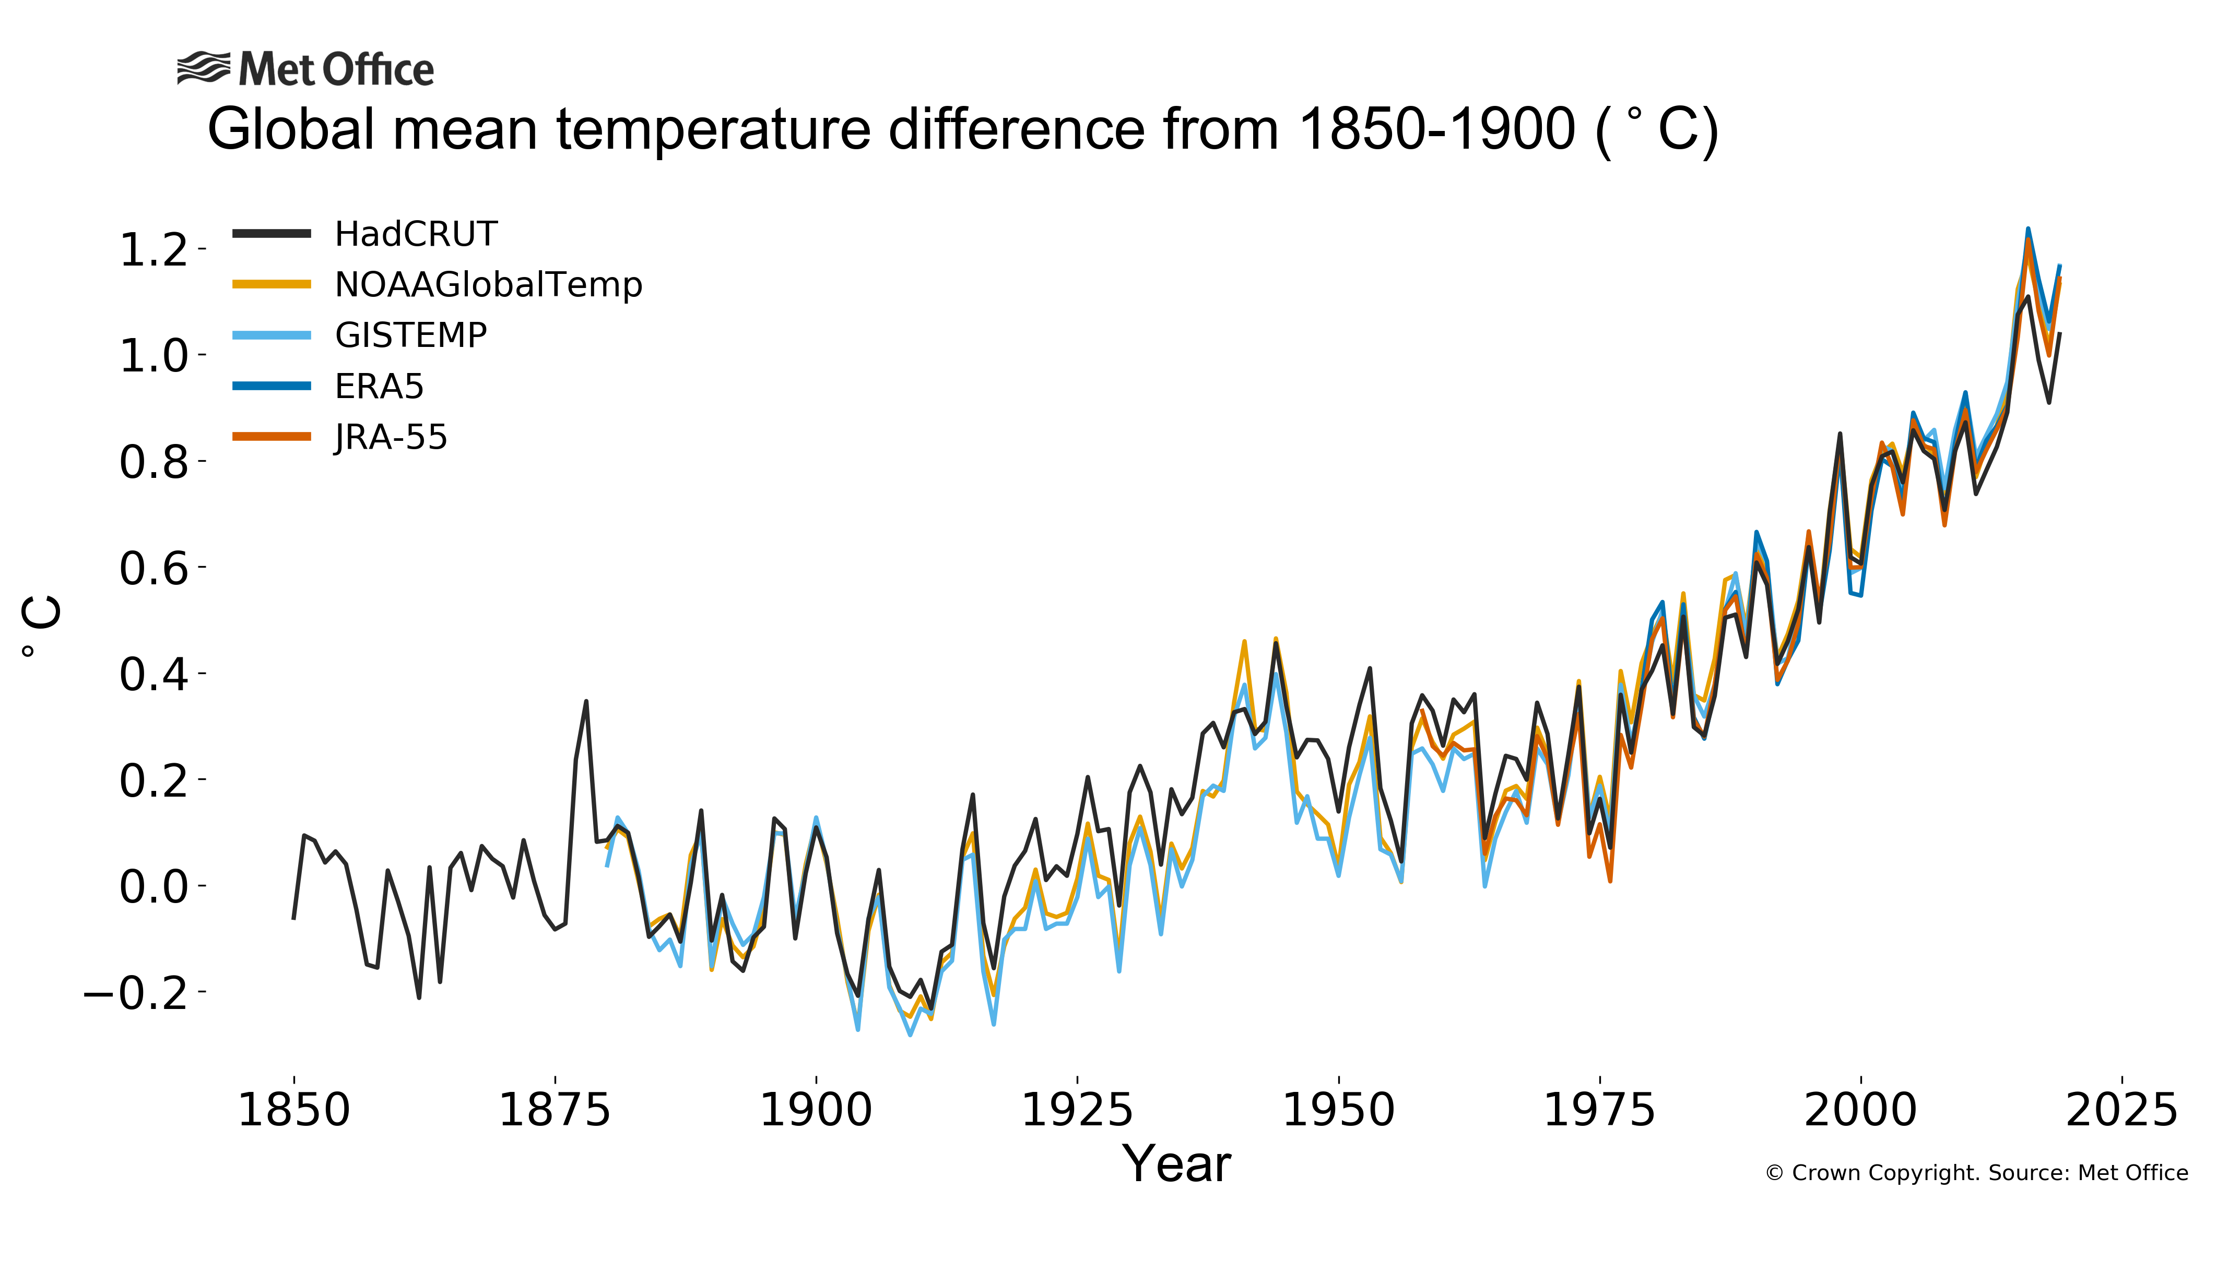
Disclosure

Slide 7
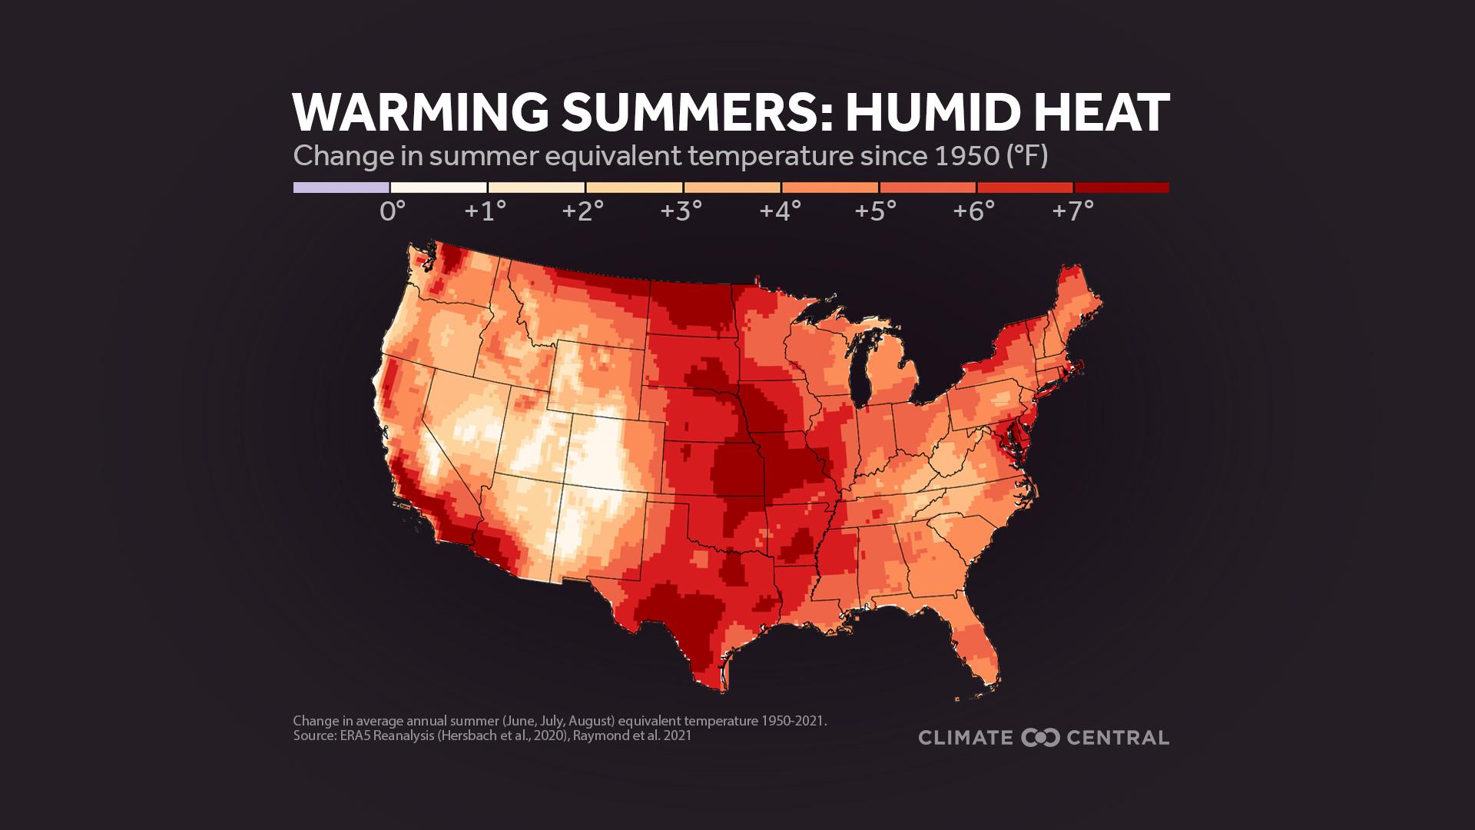
Heading

Slide 8
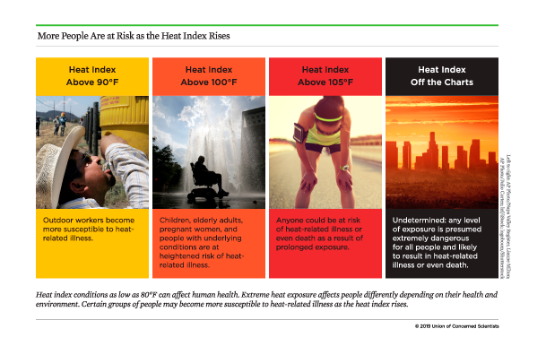
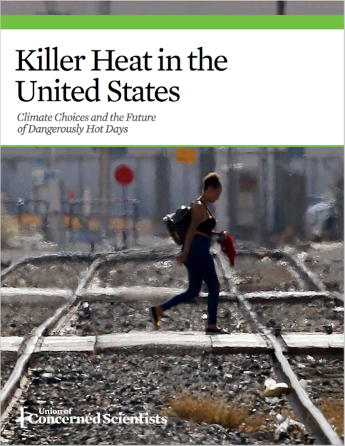
Killer Heat
In Florida, there is an historical average of 25 days per year with a heat index “Feels like” temperature above 100 degrees Fahrenheit.
This would increase to 105 days per year on average by midcentury (2036 – 2065) and 141 by the century’s end.
Notes:
By the end of the century, an estimated 17.6 million people would be exposed to a heat index above 100 degrees Fahrenheit for the equivalent of two months or more per year. By limiting warming to 2 degrees Celsius, about 570,000 of those residents would avoid such days of extreme conditions.
Historically, there has been an average of four days per year with a heat index above 105 degrees Fahrenheit. This would increase to 63 days per year on average by midcentury and 111 by the century’s end. Limiting warming to 2 degrees Celsius above pre-industrial levels would cap the frequency of such days at an average of 41 per year.
By the end of the century, an estimated 17.6 million people would be exposed to a heat index above 105 degrees Fahrenheit for the equivalent of a month or more per year. By limiting warming to 2 degrees Celsius, roughly 5.1 million of those residents would avoid such days of extreme conditions.
Historically, the state as a whole has experienced zero “off-the-charts” heat days in an average year. This would increase to two days per year on average by midcentury and 15 by the end of the century. Limiting warming to 2 degrees Celsius would cap the frequency of such days at an average of zero per year.
By the end of the century, an estimated 13 million people would endure “off-the-charts” heat days for the equivalent of a week or more per year. Historically, fewer than 2,000 people nationwide have experienced such conditions in an average year. By limiting warming to 2 degrees Celsius, all residents would avoid such days of extreme conditions.

Slide 9
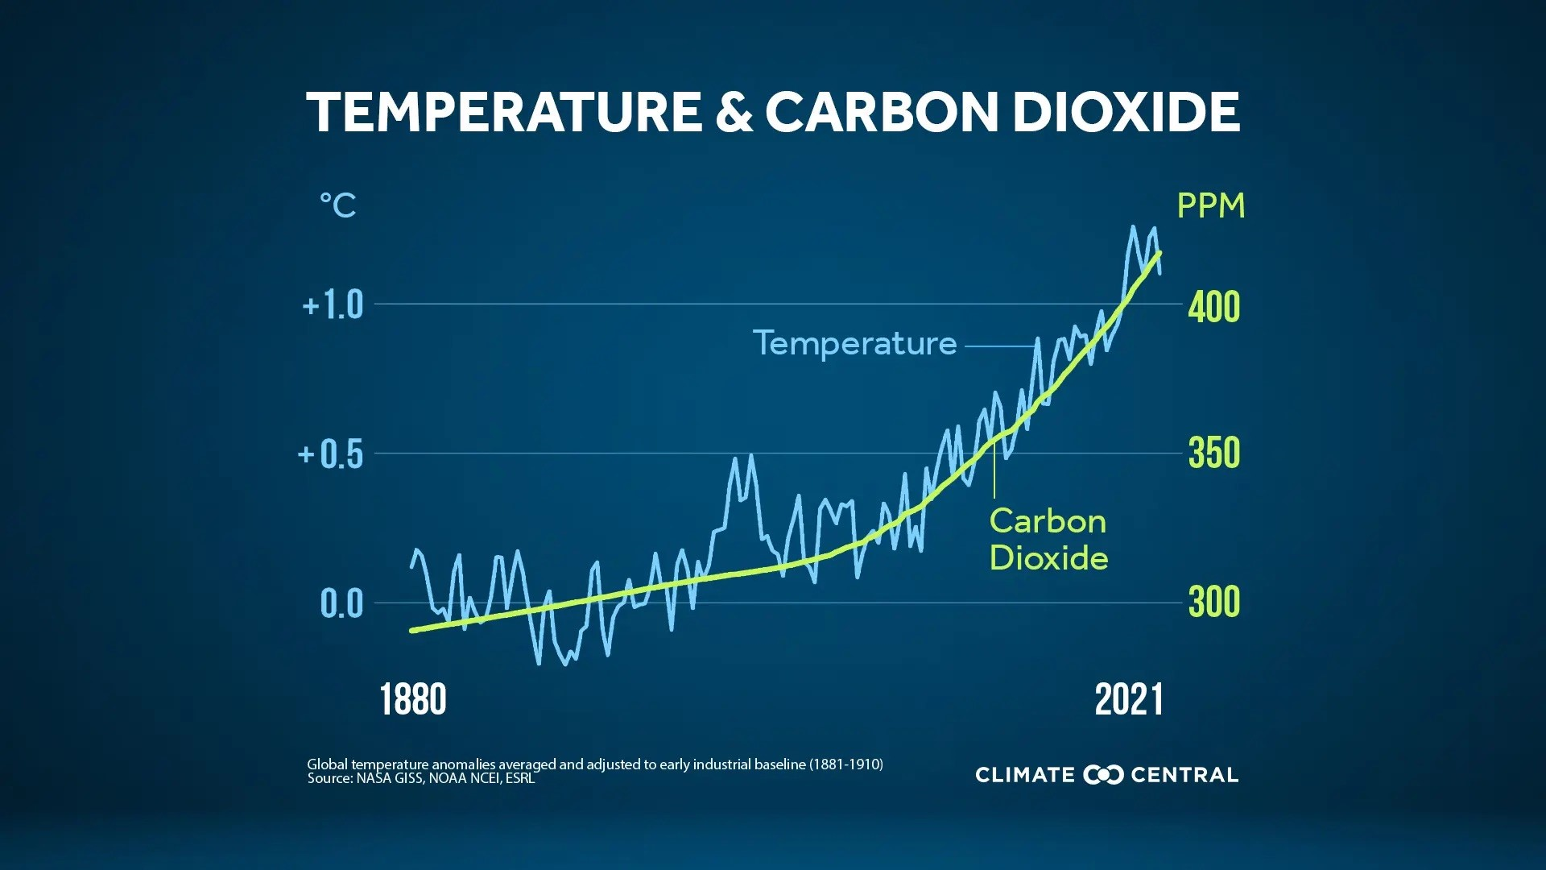
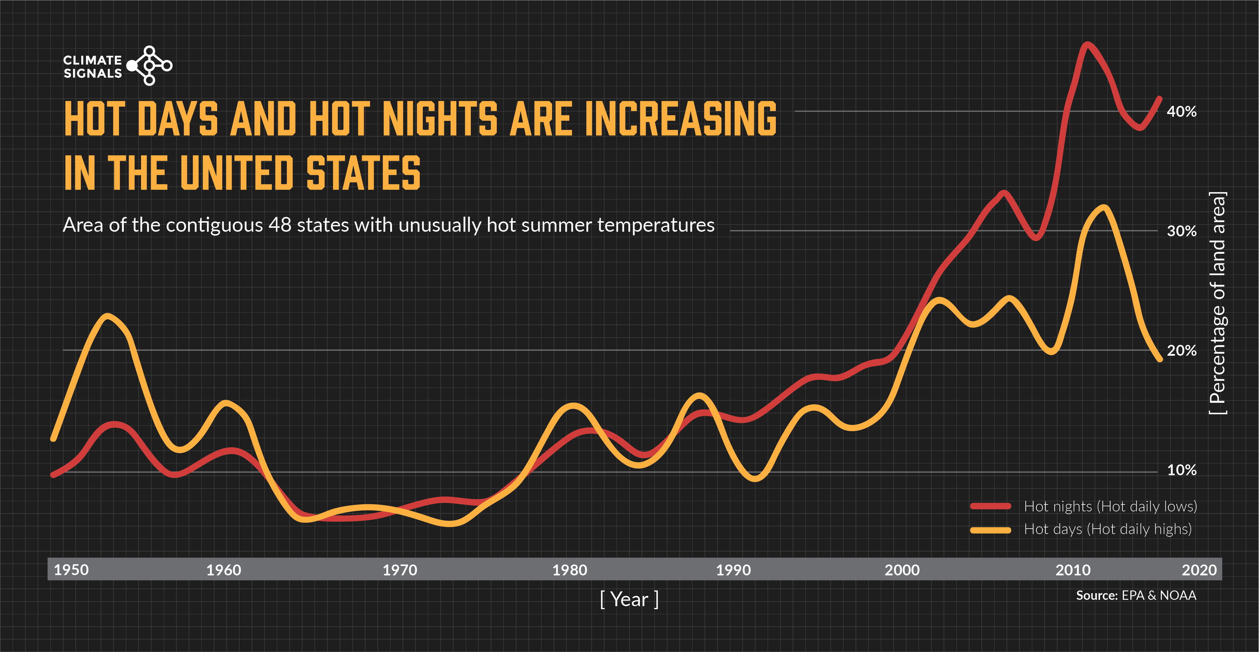

Slide 10
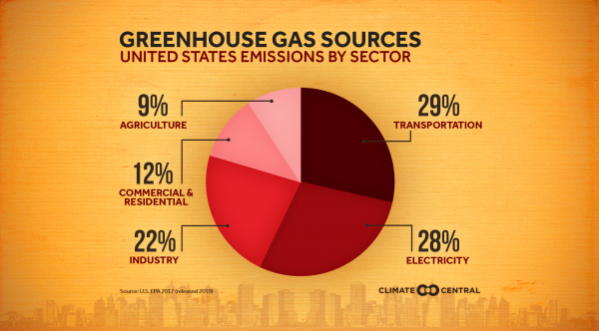

Slide 11
U.S. Health Care Sector- 5th in world
Health care sector emits 4.4% of global greenhouse gas emissions.
U.S. — hospitals, health systems, doctors’ offices, pharmaceutical companies, medical device companies, and others — is responsible for 8.5% of U.S. greenhouse gas emissions.

Slide 12
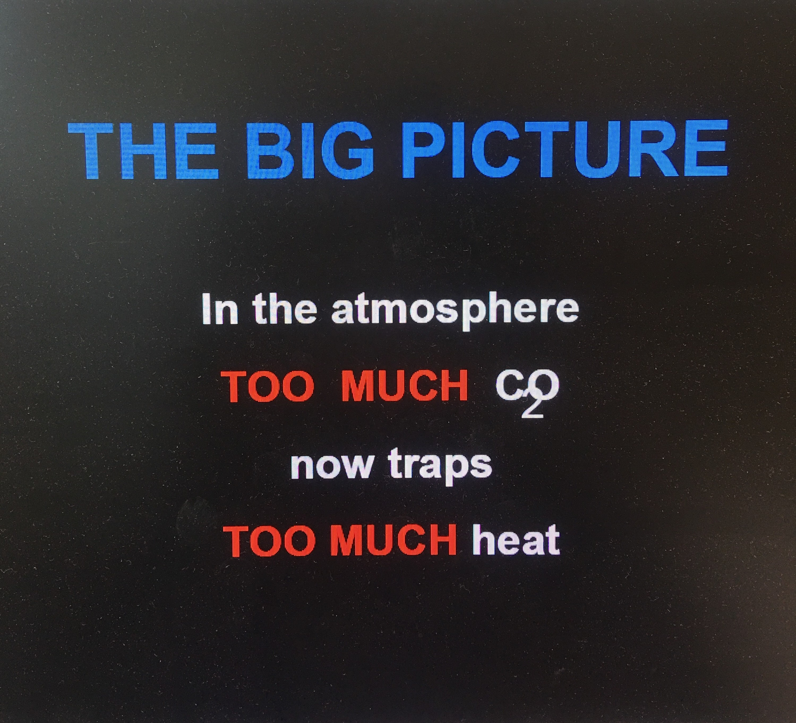

Slide 13
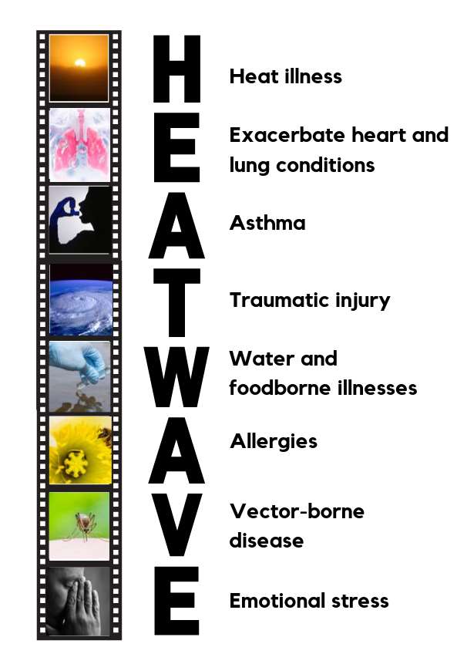
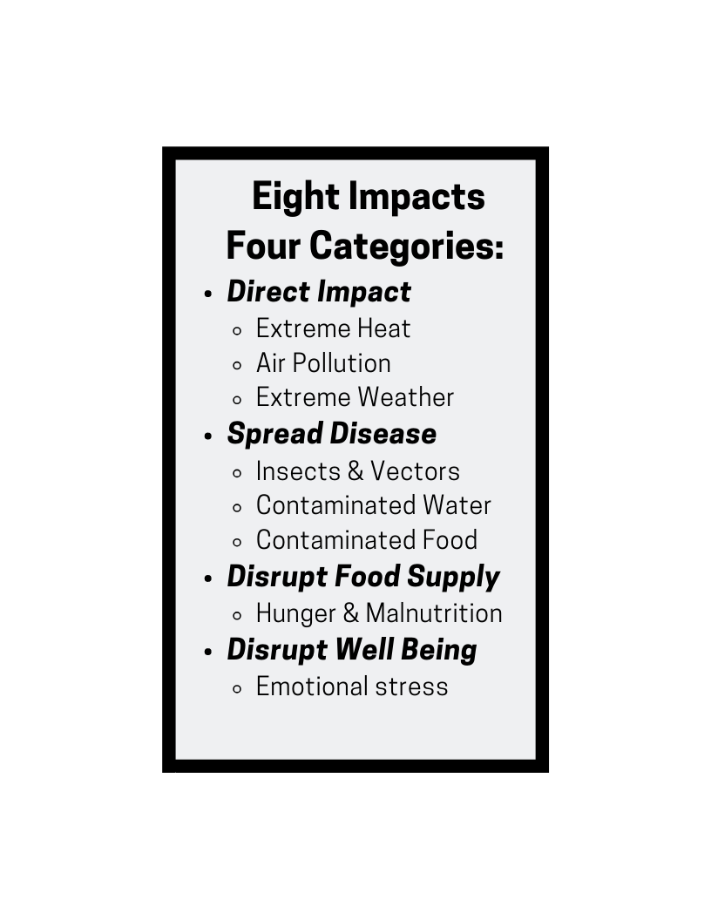
Climate Impacts Health
Notes:
This slide is also an extension of the first message, moving into the part of this talk that gives more specifics about health impacts. Depending on how long you have to talk, the doctor stories here illustrate the health impacts in a way that audiences find fascinating. But if you lack time, the most important is to get in the 5 messages, which can be found on the first text page of the Medical Alert! report. The 2nd message is that these health impacts will worsen if we do not address climate change.
The 3rd message is that we have a way to successfully address climate. Hope is not lost. We can do something about this!
The 4th message is that Clean Energy and Energy efficiency are the route to addressing climate change AND cleaning the air
The 5th and final message is that these solutions will BENEFIT our health. At this point we can quantify how much they will benefit our health and how much $$ they will SAVE!

Slide 14
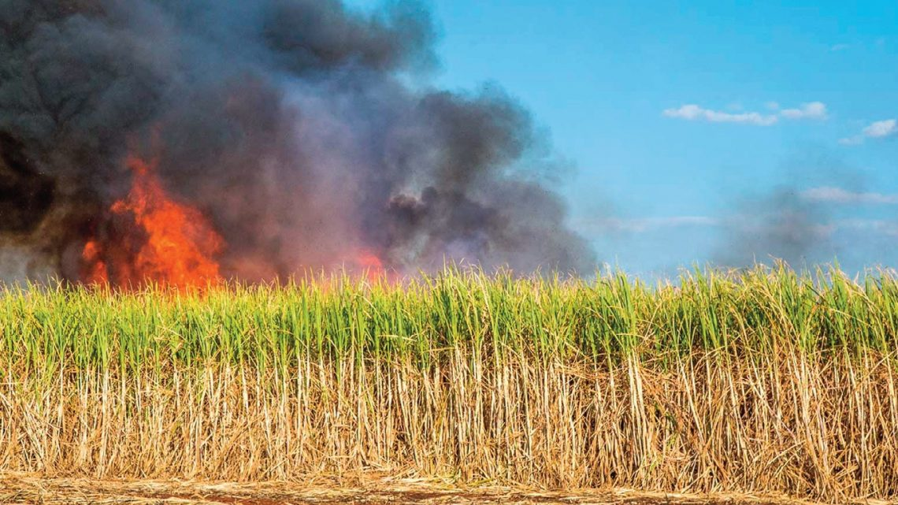
Case 1.
C.C- “I can’t breathe so good”
A 9 year old boy with constant cough that interferes with his sleep visits the pediatrician with his mother. His symptoms have caused tiredness and school absences. The family moved to Belle Glades, Florida this October and noted large plumes of smoke for several hours a day. His mother also notes mold in the some of the rooms. The cough began after their move. He has no known allergy or previous similar complaint. Examination reveals a mildly inflamed throat and mild wheezing.
SouthFl Times

Slide 15
SUGARCANE BURNING BATTLE HEATING UP SHARE ON: S. FLORIDA TIMES — OCTOBER 25, 2022

Slide 16
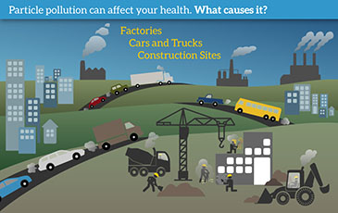

Slide 17
Ambient Air Pollution- Outdoor air pollution
Six major types: carbon monoxide, lead, nitrogen oxides, ground-level ozone, particle pollution (often referred to as particulate matter), and sulfur oxides. GAS, COAL and OIL contributes MOST.
5th highest risk factor for death ( after hypertension, smoking, high glucose and high cholesterol) –Health Effects Institute, State of Global Air 2019.
Contributes worldwide to nearly 9.5 million deaths yearly (8.7 million- particulate pollution and 800K-ozone)
BMJ 2022;379:e069487
http://dx.doi.org/10.1136/bmj-2021-069487

Slide 18
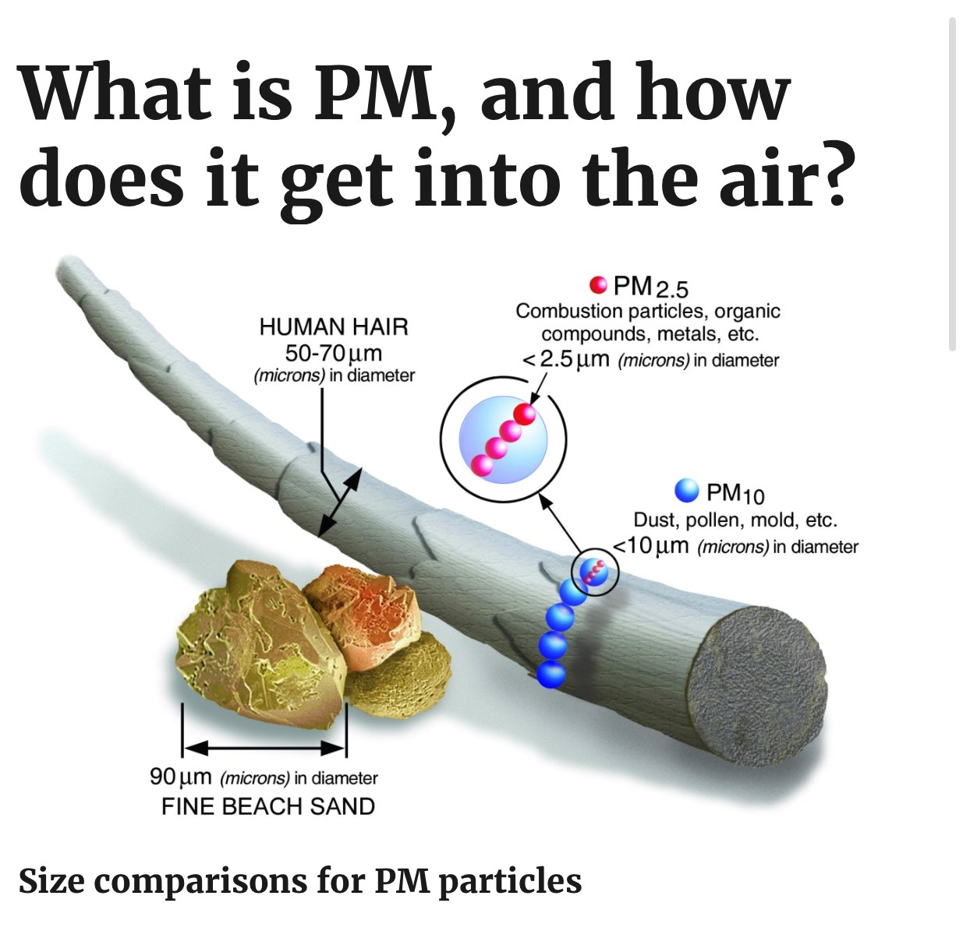
Particulate Matter PM 2.5 and PM 10
PM10 : inhalable particles, with diameters that are generally 10 micrometers and smaller; and
PM2.5 : fine inhalable particles, with diameters that are generally 2.5 micrometers and smaller.

Slide 19
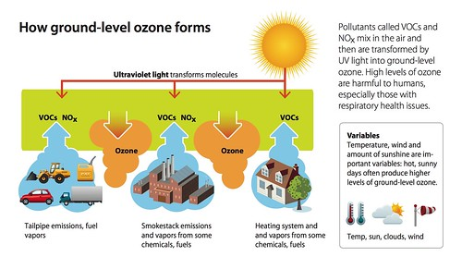
Ground Level Ozone

Slide 20
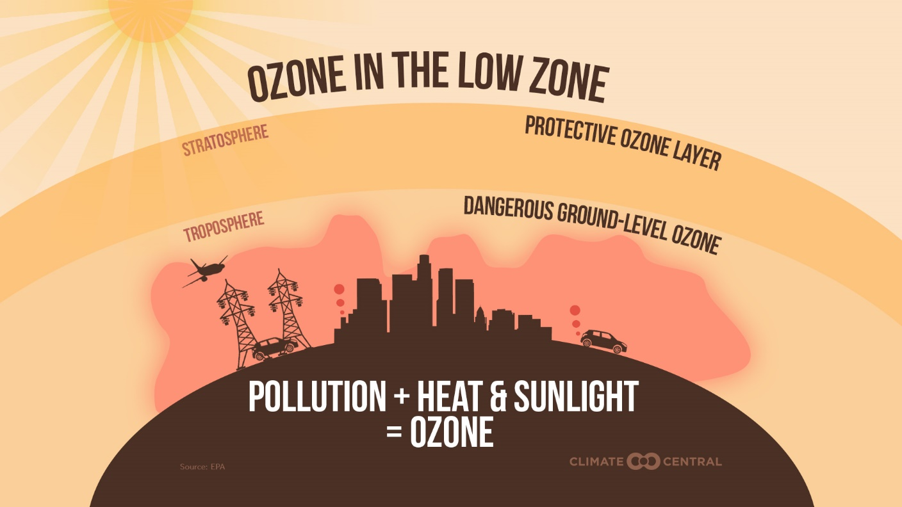
Ground level Ozone
Gasses emitted from factories, cars, farms and nature mix with air.

Slide 21
Heat and Ambient Pollution
Heat INCREASES ozone formation.
Warming planet increases drought which results in increased wild fires and dust storms –INCREASE Particulate Matter
Warming planet also slows wind speed resulting in more stagnant air days ( air mass stuck in same location for several days) – INCREASE exposure to PM and Ozone.

Slide 22
PM2.5 and PM 10 microgram Impact
Inhaled PM2.5 (particulate matter that is 2.5 µm) and ultrafine PM (0.1 µm) cause oxidative injury and acute inflammation in the respiratory tract.
PM2.5 transmigrates across the alveolar-capillary membrane – Causing widespread oxidative stress, inflammation, endothelial cell dysfunction, and coagulation activation, resulting in accelerating the atherosclerotic process in nearly every organ system.
BMJ 2022;379:e069487

Slide 23
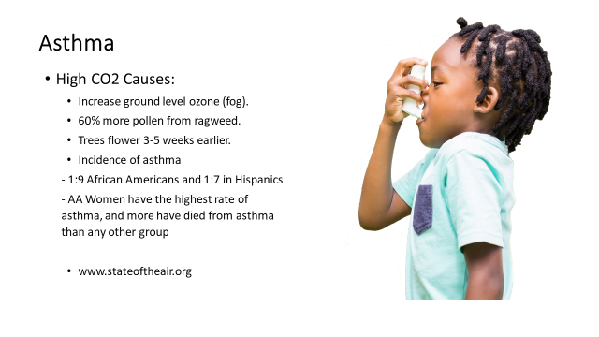
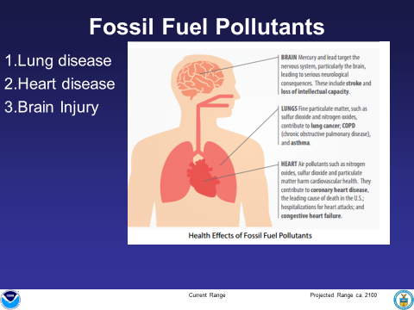
Air Pollution Health Impacts

Slide 24
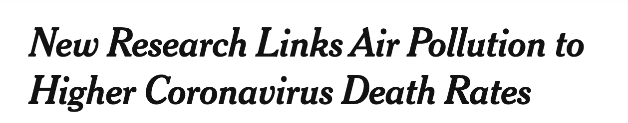

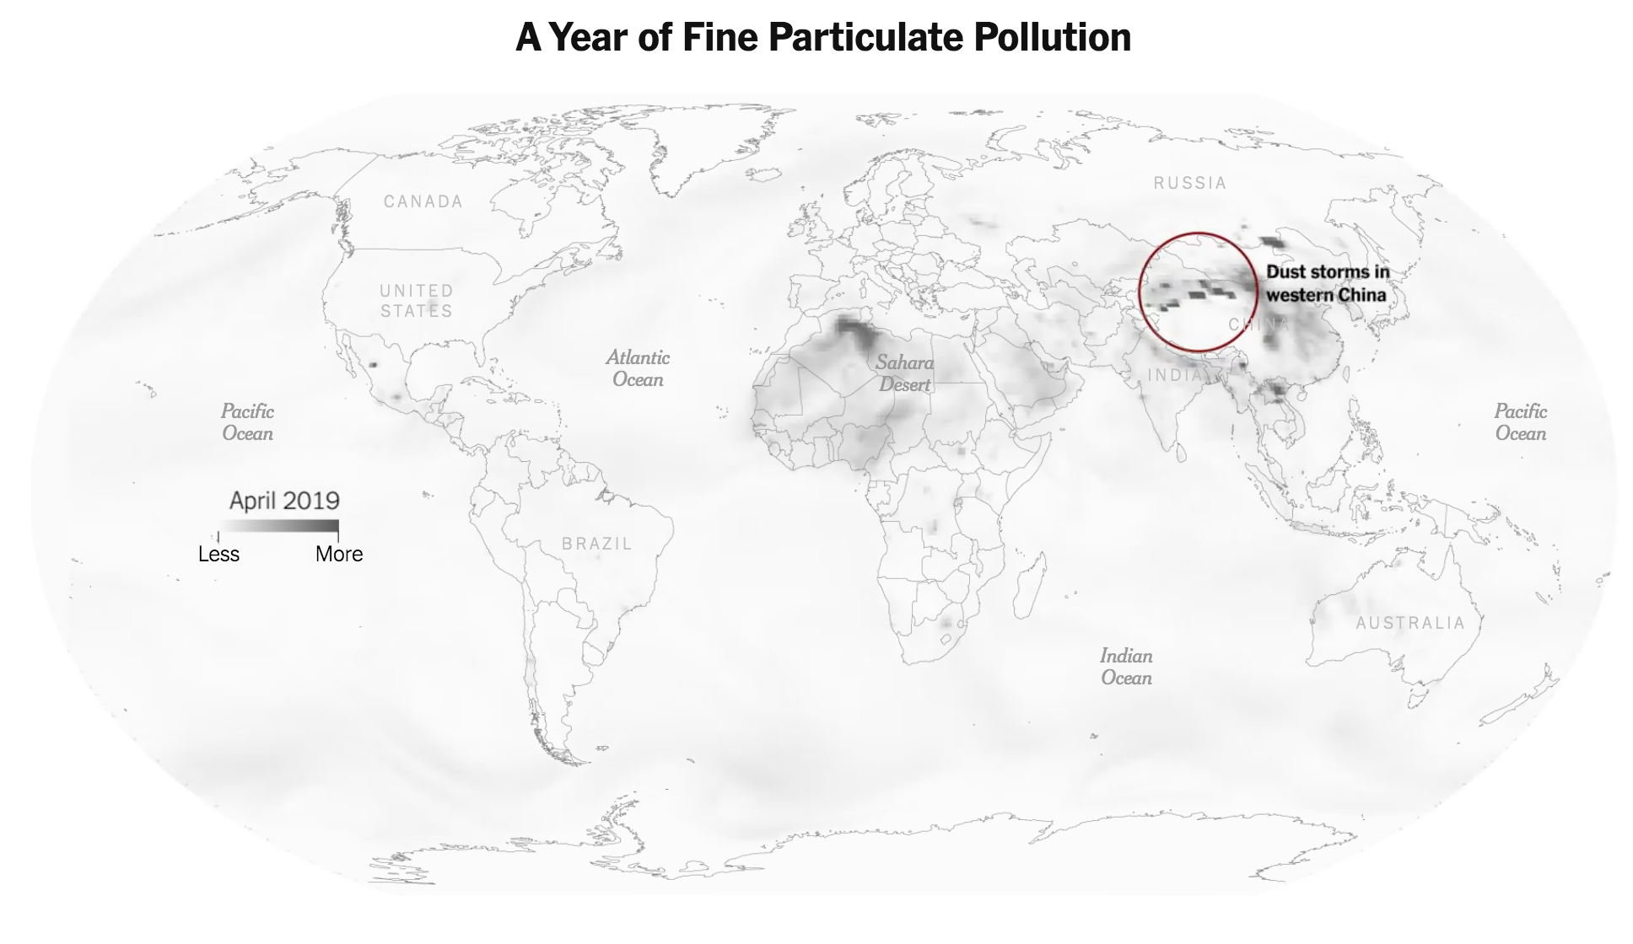
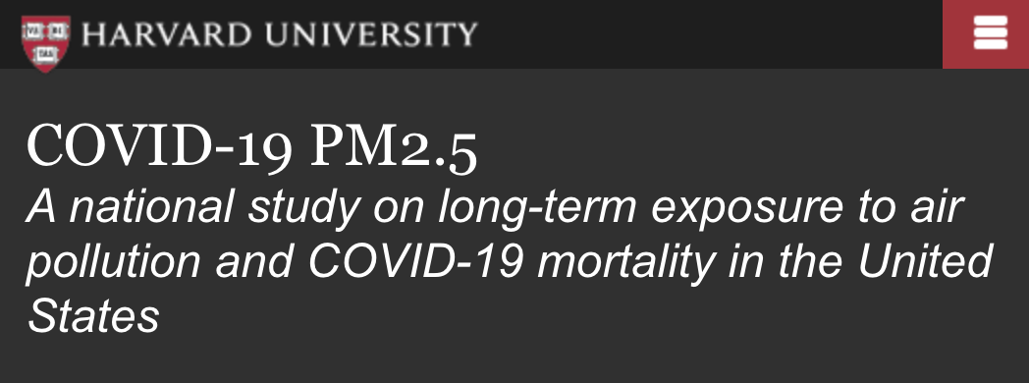
Notes:
A new study by Harvard University draws a direct link between Covid mortality rates and air pollution.
The study found that an increase of only 1 μg/m3 in PM2.5 is associated with an 8% increase in the COVID-19 death rate (95% confidence interval [CI]: 2%, 15%).
The results were statistically significant and robust to secondary and sensitivity analyses.
Conclusions: A small increase in long-term exposure to PM2.5 leads to a large increase in COVID-19 death rate, with the magnitude of increase 20 times that observed for PM2.5 and all-cause mortality. The study results underscore the importance of continuing to enforce existing air pollution regulations to protect human health both during and after the COVID-19 crisis. The data and code are publicly available.
The study can be found here: https://projects.iq.harvard.edu/covid-pm
Lead authors: Xiao Wu and Rachel C. Nethery
Corresponding and senior author: Francesca Dominici, PhD
The New York Times picked up on this story and released an interesting visualization tool.
That story is here:
https://www.nytimes.com/interactive/2019/12/02/climate/air-pollution-compare-ar-ul.html
This allows you to compare your city’s pollution with some of the worlds’ most polluted cities, like New Delhi
Fine Particulate Pollution
Does air pollution increase the risk of getting coronavirus? According to Dr. Aaron Bernstein, Director of Harvard’s Center for Climate Health and Global Environment “Air pollution is strongly associated with people’s risk of getting pneumonia and other respiratory infections and with getting sicker when they do get pneumonia. [As we know, some people who get COVID 19 may develop a serious pneumonia.] [He cited] A study done on SARS, a virus closely related to COVID-19, [and] found that people who breathed dirtier air were about twice as likely to die from the infection.” Over 26 million Americans suffer from asthma.
By the way, you may have heard that President Trump, the EPA Administrator Andrew Wheeler, and the National Highway Traffic and Safety Administration rolled back the clean air standards (Corporate Average Fuel Economy (CAFE) and greenhouse gas emissions standards ) which means more air pollution in our communities further endangering people’s health. The newly signed (March 30, 2020) Safer Affordable Fuel-Efficient (SAFE) Vehicles Rule for Model Years 2021-2026 Passenger Cars and Light Trucks will increase carbon dioxide emissions standards the nation's automakers must meet by only 1.5% a year through model year 2026. Under the Obama policy it was a 5% annual carbon dioxide emission standard increase aimed to reduce emissions from the transportation sector. Putting more polluting cars on America’s roads hurts all of us and threatens the health of our most vulnerable communities., especially children, the elderly, communities of color, low-income communities and those already suffering from pollution and climate change impacts.nPu existing Corporate Average
The rollback also codifies the Trump administration’s attack on the Clean Air Act and the authority of states to adopt stronger tailpipe pollution limits than those set by the federal government, a move that will take away states’ rights to protect the health of their own residents from health-harming pollution.
https://www.lung.org/clean-air/outdoors/what-makes-air-unhealthy/particle-pollution
https://www.epa.gov/pm-pollution/health-and-environmental-effects-particulate-matter-pm
https://www.psr.org/wp-content/uploads/2018/05/air-pollution-effects-respiratory.pdf
https://www.hsph.harvard.edu/c-change/news/coronavirus-climate-change-and-the-environment/
Source: U.S. Dept. of Health and Human Services Office of Minority Health: https://minorityhealth.hhs.gov/omh/browse.aspx?lvl=4&lvlid=15

Slide 25
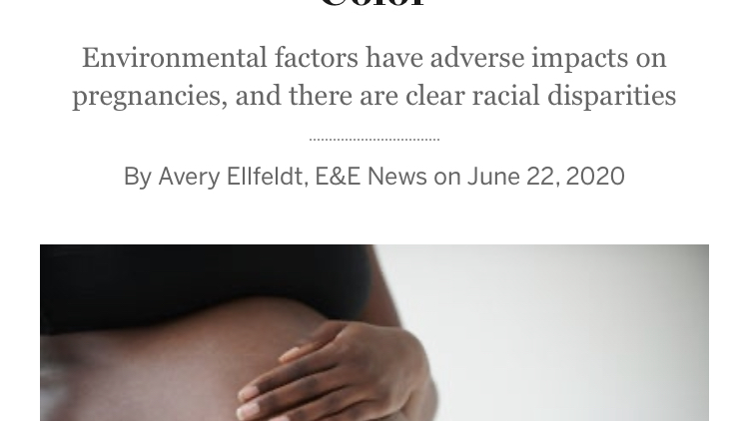

Slide 26
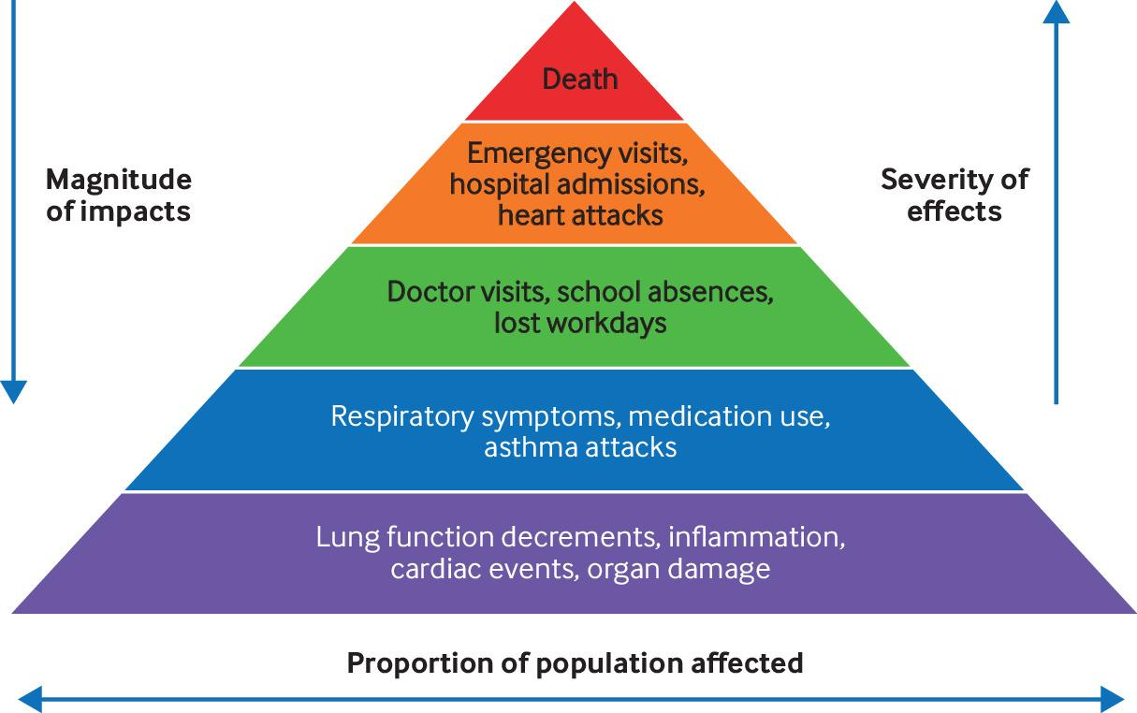

A pyramid of the effects of air pollution describing the contribution of fine particle and ozone related exposures to population wide health impacts.
C Sorensen et al. BMJ 2022;379:bmj-2021-069487
©2022 by British Medical Journal Publishing Group
Notes:
A pyramid of the effects of air pollution describing the contribution of fine particle and ozone related exposures to population wide health impacts. Adapted from the US Environmental Protection Agency.35

Slide 27
Some People Face Greater Risk
All people are at risk. Some face greater risk:
Children
Student who play sports
Pregnant women
Elderly individuals
People with chronic illnesses and allergies
People with limited resources
People who work or play outdoors
Notes:
This is an extension of the first evidence based message !! Children and students playing outdoor sports are more exposed to the heat. Pregnant women and their pregnancies are at greater risk from heat and poor air quality, both of which lead to premature delivery. The elderly are at greater risk from heat. People with limited resources often live at the fenceline where they are exposed to danger from the fossil fuel industry and cannot get out of harms way when danger threatens.

Slide 28
“NO Safe Level of Air Pollution Identified!” Cecilia Sorensen, M.D. BMJ 2022;379:e069487

Slide 29
Interventions to minimize patients’ health risks from ambient air pollution exposure
Category | Intervention | Recommended by | Grade
Health Status | Assess and screen for vulnerability and educate on steps to minimize health risks from exposure to air pollution Health status | American Thoracic Society, European Society of Cardiology (ESC) Prevention Guidelines | Low
Physical | Recommend a well fitted, certified respirator (eg, N95) for use in high exposure areas. | No consensus recommendations on use, however some experts recommend this temporary use based on studies showing blood pressure reduction and biomarker improvements. | Moderate
Technological
Pharmacological

Slide 30
Interventions to minimize patients’ health risks from ambient air pollution exposure
Category | Intervention | Recommended by | Grade
Behavioral | Advise avoiding combustion of all types of biomass within living spaces to improve indoor air quality. Identify and provide details of relevant government schemes Advise reducing or avoiding strenuous outdoor activity during days with poor air quality (without jeopardizing efforts to get regular exercise) Advise avoiding travel during peak transit hours. Advise performing outdoor activities during cooler parts of day to limit exposure to ozone. Advise staying indoors when outdoor air quality is poor | American Lung Association,51 World Health Organization British Lung Foundation,50 US EPA,53 American Lung Association,51 American Thoracic Society40 | High Moderate Low
Technological
Pharmacological

Slide 31
Interventions to minimize patients’ health risks from ambient air pollution exposure
Category | Intervention | Recommended by | Grade
Technological | Advise using air quality alerts to limit exposure Advise staying indoors with sealing of the building/room and with HEPA filtration systems in place. | US EPA and American Lung Assoc. US EPA | Low Moderate

Slide 32
Interventions to minimize patients’ health risks from ambient air pollution exposure
Category | Intervention | Recommended by | Grade
Pharmacological | Create “action plans” for vulnerable patients Encourage those with respiratory disease always to carry rescue inhalers Consider increased use of preventive inhaled Some experts medications in anticipation of exposure to poor air quality, as appropriate, and with careful consideration of risks and benefits Actively manage conditions which increase vulnerability Consider use of oral antioxidant | British Lung Association British Lung Some Experts Some experts Some experts | Moderate Low Very Low Very low

Slide 33
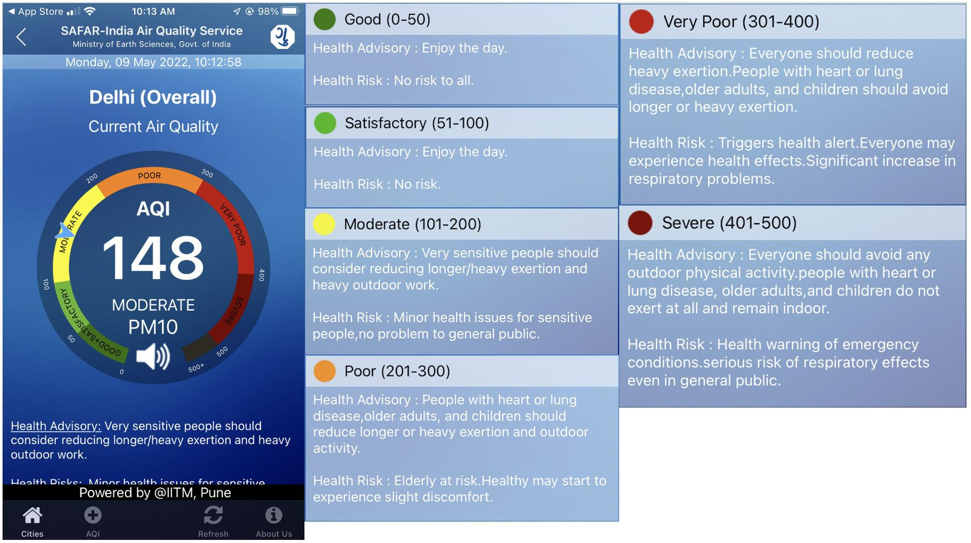
Image of System of Air Quality and Weather Forecasting and Research for Delhi, India (SAFAR-Air).
C Sorensen et al. BMJ 2022;379:bmj-2021-069487
©2022 by British Medical Journal Publishing Group
Notes:
Image of System of Air Quality and Weather Forecasting and Research for Delhi, India (SAFAR-Air). This is a composite index, coupled with health advisories. Colours on the dial correspond to air quality index levels of health concern. 0-50=good, 51-100=satisfactory, 101-200=moderate, 201-300=poor, 301-400=very poor, and 401-500=severe

Slide 34
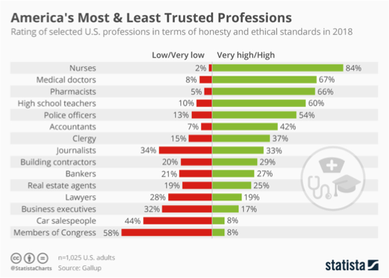
Health Professionals are the best messengers!!
Notes:
People trust nurses and other health care workers more
Not everyone knows a climate scientist but everyone knows a nurse, physician or health care worker
Health is the most convincing reason for people to be engaged/active on the problem of climate change (glaciers don’t cut it)
Nurses, Physicians, etc. have the most authority on health
“Simple Messages repeated often by a variety of trusted messengers” – Edward Maibach

Slide 35

Health Sector
22 million health sector workers
3.8 million nurses
1 million doctors
Over 300K pharmacists

Slide 36
Earth’s Warming
We are already at 1.01 degree (2 degrees Fahrenheit) rise since preindustrial time (1880)” https://www.ipcc.ch/sr15/chapter/chapter-1/
“2 degree warmer world still represents what scientists characterize as a profoundly disrupted climate with fiercer storms, higher seas, animal and plant extinctions, disappearing coral, melting ice and more people dying from heat, smog and infectious disease. Nature. Com 4/2022

Slide 37
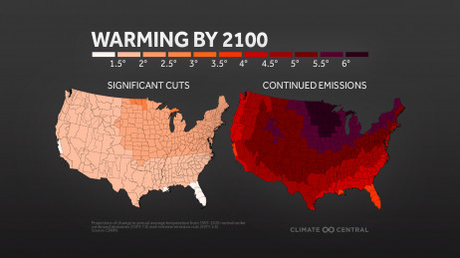
Act Now!

Slide 38
Please follow us on Instagram @flclinicians Please follow us on Facebook @Florida Clinicians for Climate Action
Thank You
www.floridaclincians.org

